Slide 1
The Kansas Electro Rally & Electrathon America
“Integrating the core”
“Developing career skills”

Slide 2
History-Kansas Electro-Rally
Green Cities Act(1996-97)(10yr grant)
Public Utilities Grants
Green Energy related educational programs
Renewable Energy
Kansas Electro Rally-1996-97
Hays High 1997-Present

Slide 3
Kansas Electro Rally-Post Grant
Grass Roots Organization
Current Board of director Post-secondary, Secondary and Public Utilities
Adopted Electrathon American Rules
Spring Championship Racing Series
Fall Racing Series

Slide 4
Why The Kansas Electro Rally?
Project & Research-Based Course of Study
Student Leadership
Financial Responsibility
Avenue to Test & Compete
Community Connections & Relations
Build to Set Specifications-Electrathon American Handbook/Rules

Slide 5
Indirect Projects
Wind Tunnel
Alternative Energy Projects
Screen Printing-Fund Raising
Marketing

Slide 6
Exploring Alternative Energy
Lead Acid Based Power Source
Standard Class
Novice
Solar Energy
Experimental Class
Novice
Gas/Battery/Solar
Experimental Class
Novice

Slide 7
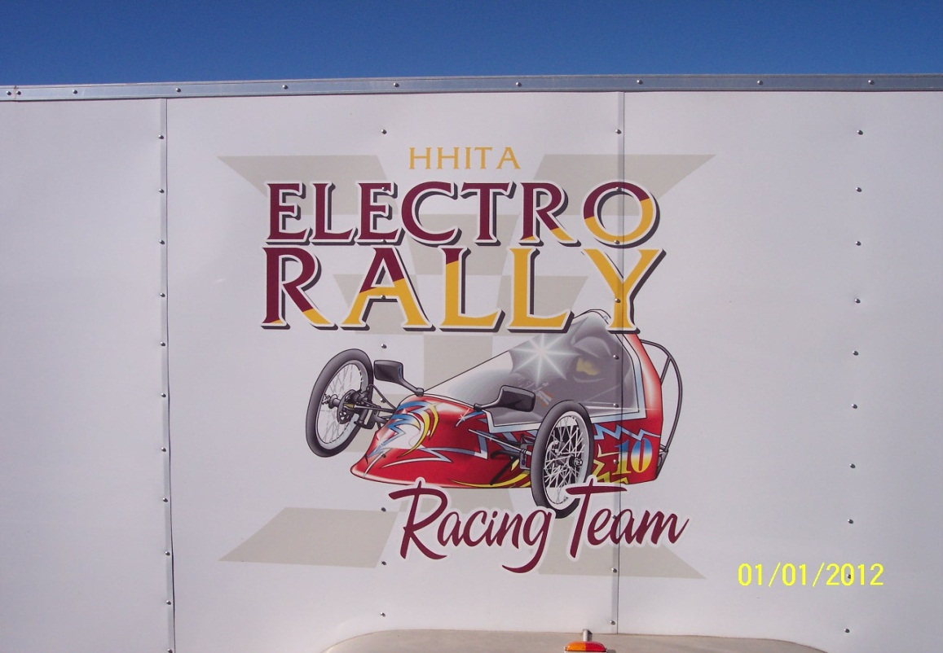
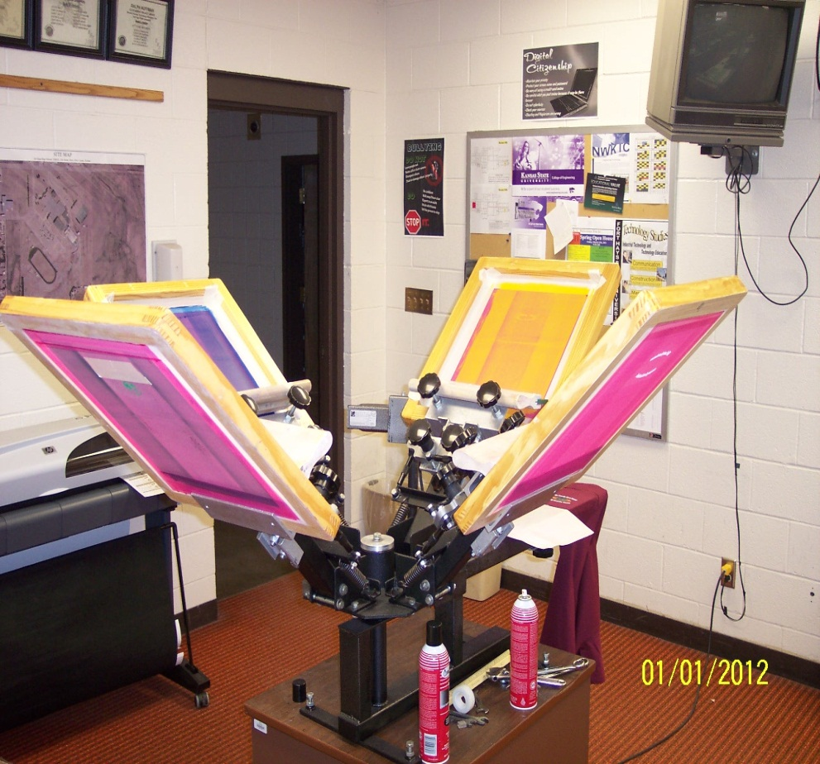
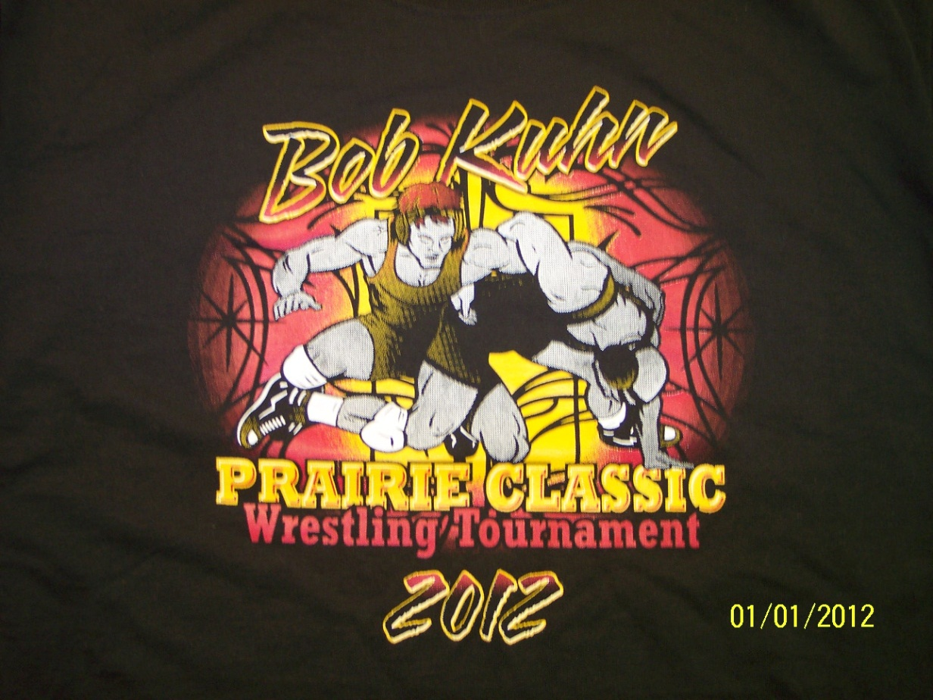

Slide 8
Why Project Based Learning?
Flexibility to Integrate Core Curriculum
Individualized & Group Assessment
Challenge Students Skills & Knowledge
Students Take Ownership in Projects
Encourages Self-Learning
Individual & Group Responsibility
Decision Making Skills
Increased World Experiences

Slide 9
Why ?-Continued
Challenge Students
Critical Thinking (Think outside box)
Evaluate systems through cause and effect
Modify and testing (multiple years of data)
Leads to more advanced projects (Electric Conversion Project S-10 Truck)
Culminating Project
Design & Project Development
Research & Design Element
Alternative Energy in Motion
Material & Processes
Outside Resources
Develop Professional Contacts
Budgeting & Finance
Professional Development
Communication Skills

Slide 10
Integrating Core Areas
-Kansas Electro Rally Report (Writing)
-Sponsorship Letters (Writing)
-Engineering(Math/Science/Technology)
- Frame Design/Body Design
- Gear Ratios (Speed/Performance)
- Chemical Engineering(Battery)
- Electrical Engineering
- Design & Fabrication (AutoCAD)

Slide 11
Diversified Course of Study
Core Courses Integration
Math
Science (Physics)
Communication
Technical Communication (CAD, Drafting)
Research & Design
Human & Technical Resources ( Professional Contacts)
Product Development
Testing
Financing & Budgeting
Materials & Processes
Alterative Energy Sources
Woods, Metals, Plastics

Slide 12
Critical Thinking Skills
Design Features
Power Source
Gear Ratios
Steering
Brake System
Safety
Specifications & Regulations
-Building to Technical Drawings Specifications
-Design Building to Electrathon America Regulations
-Safety
Racing
Learning, exploring and researching on a competitive stage
Prepares students for a larger more competitive environment
Provides for self-assessment

Slide 13
Student Ownership
Students making decisions
Design
Construction
Research
All Inclusive Project Based Activities
Core Curriculum
Application
Fund Raising
Competition
Assessment
Responsibility
Budgeting
Management & Organization
Assessment

Slide 14
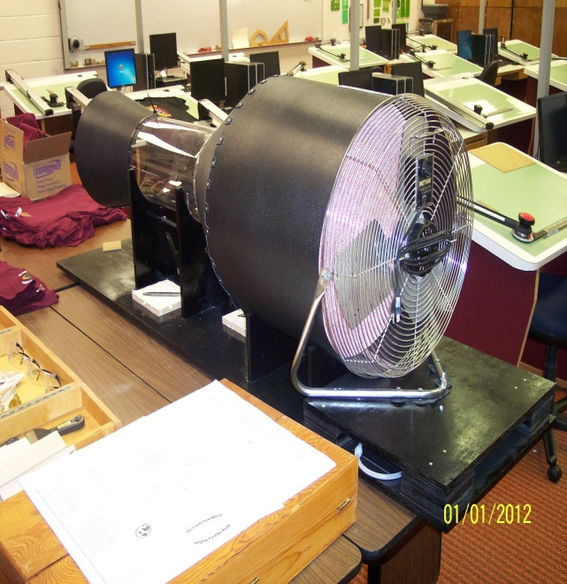
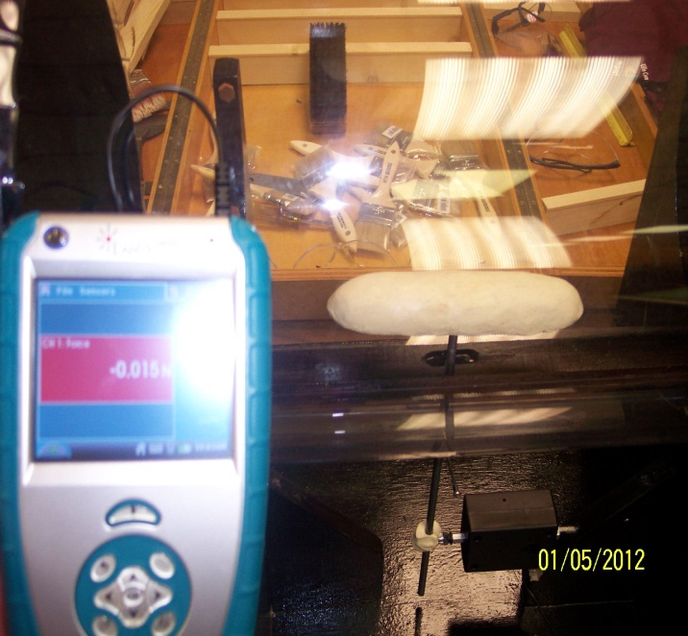
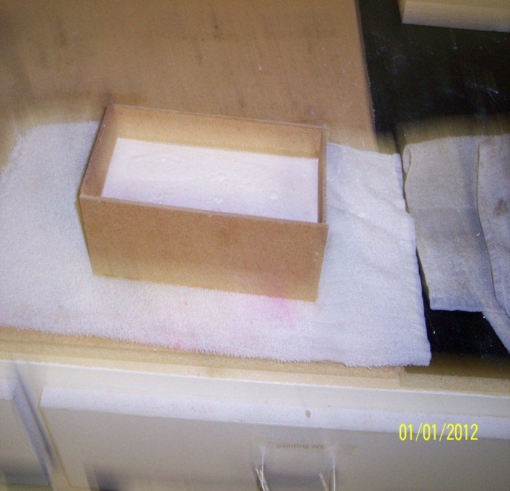
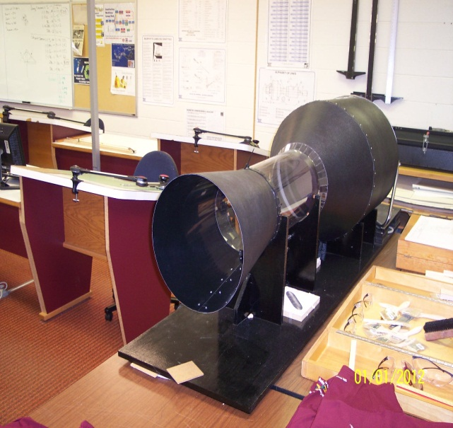
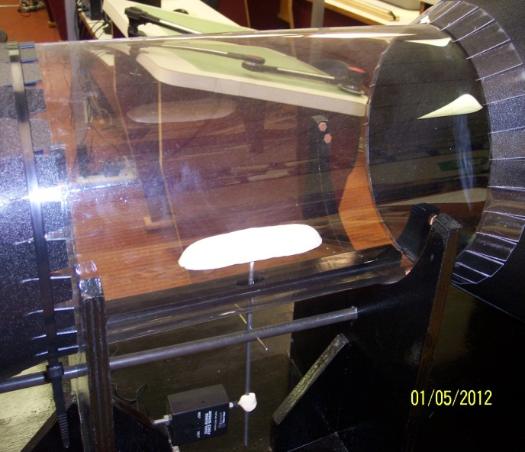

Slide 15
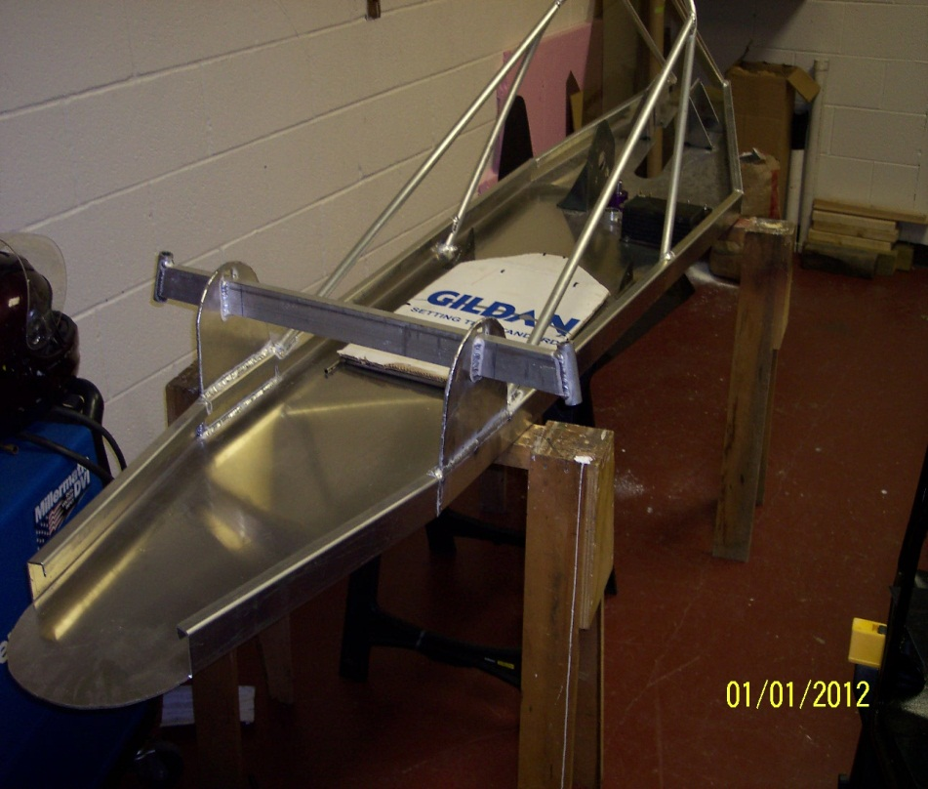
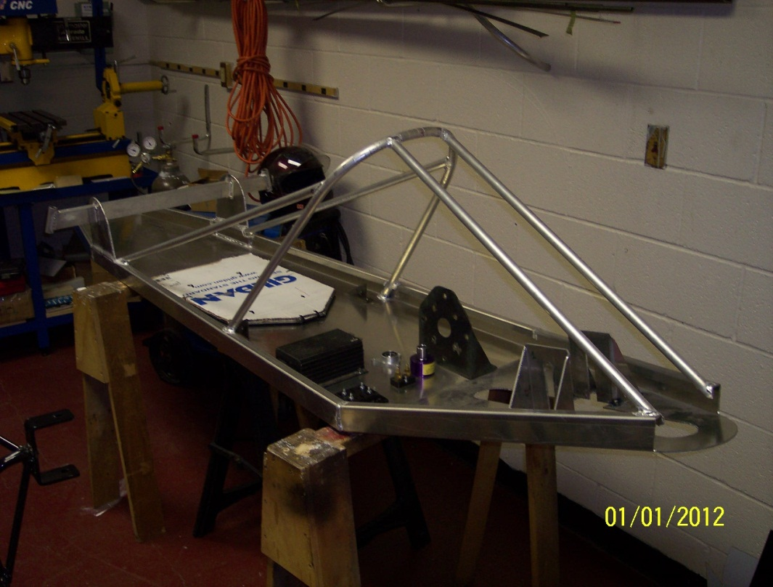
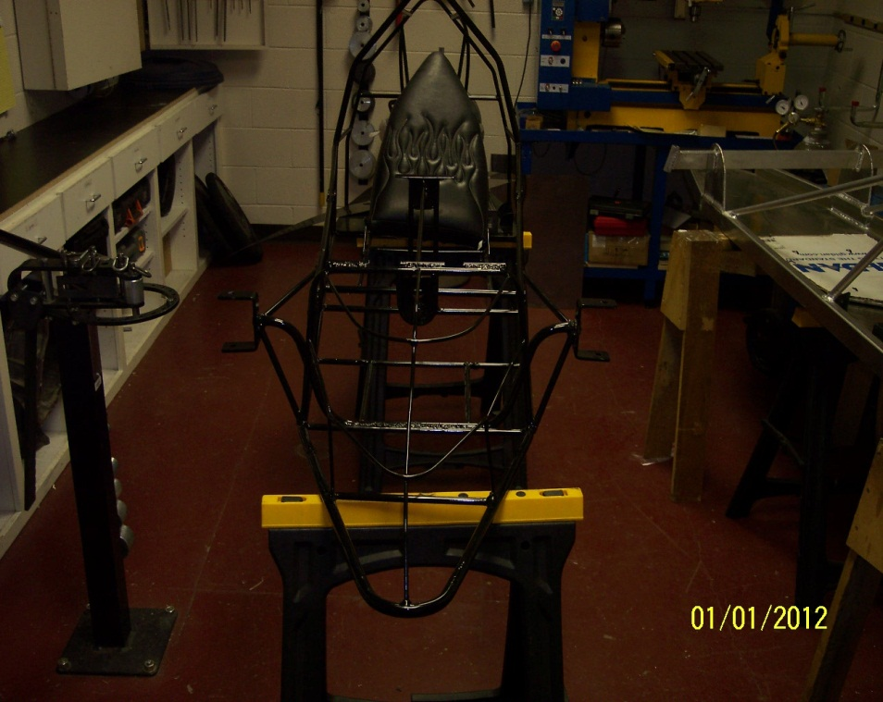
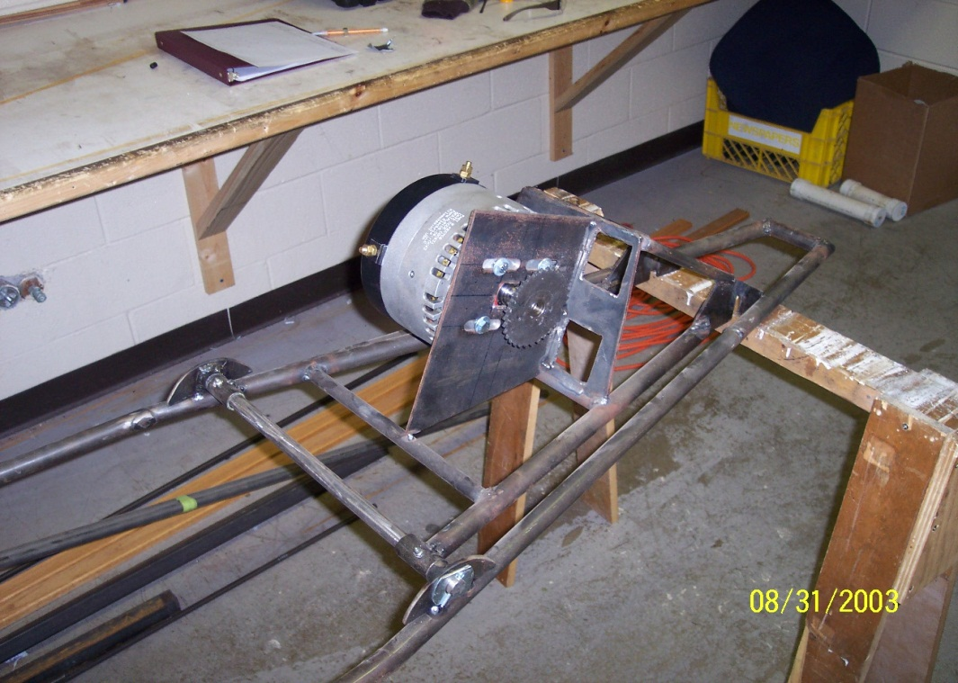

Slide 16
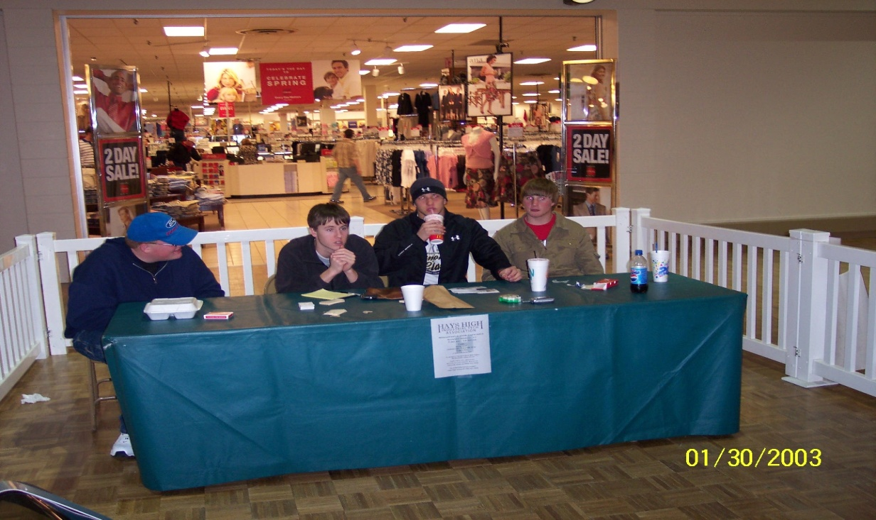
Community Relations
Community perceptions and relationships
Recruitment

Slide 17
Corporate Sponsors

Slide 18
Student Leadership Opportunities
Hays High Industrial Technology Association
Management
Organization
Fund Raising
Sponsorships
T-Shirt Sales
Wood Fest
Breakfast
Public Relations
Community Relations
Letters
Publications (School & Local Newspapers, websites)
Radio & TV ( Channel 13)

Slide 19
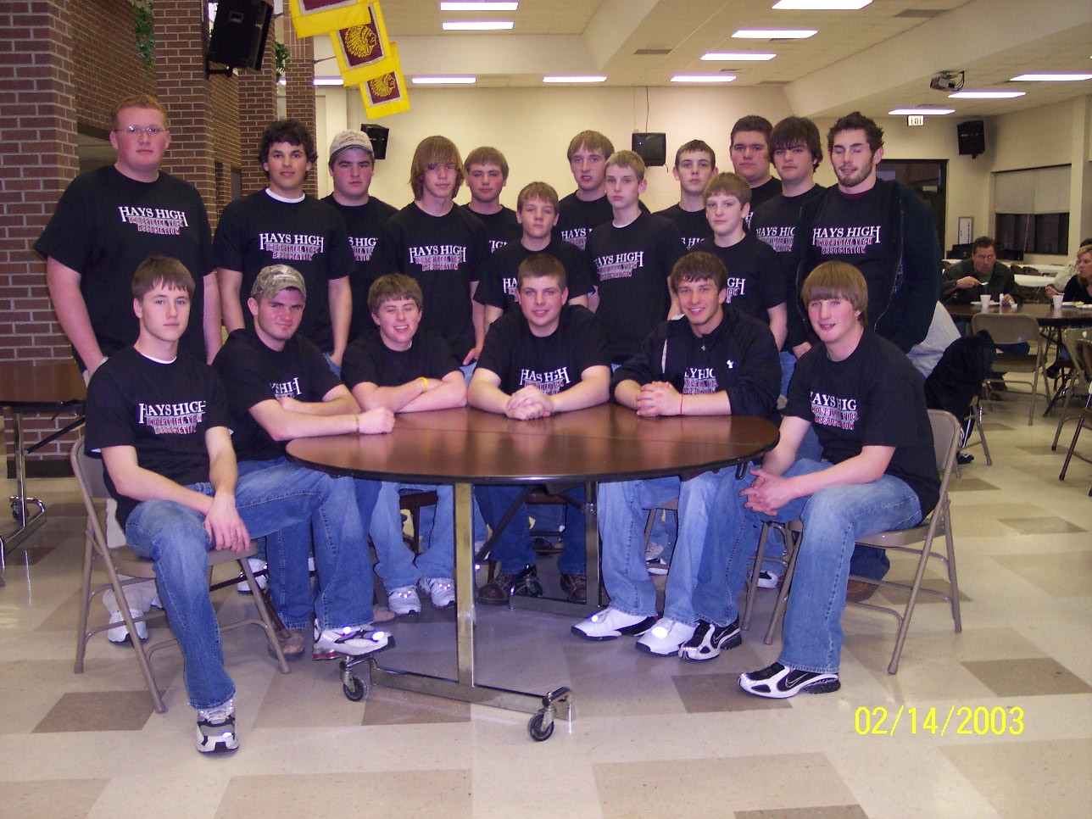
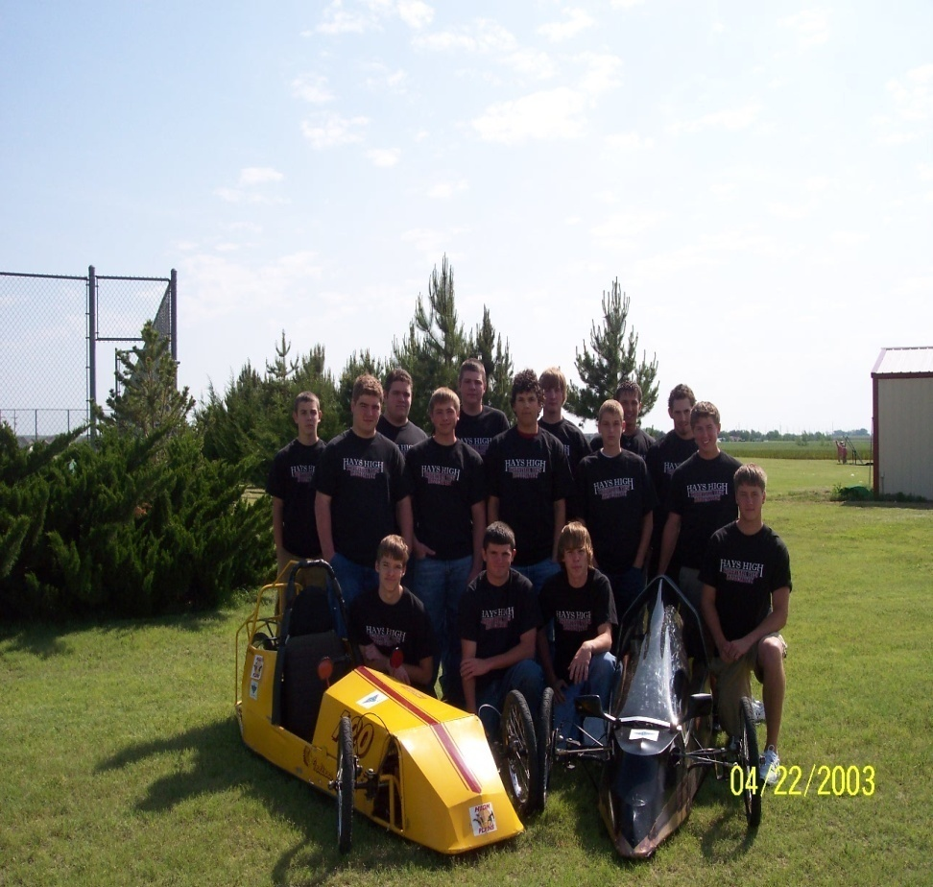
Student Leadership Opportunities
HHITA
Kansas Electro Rally

Slide 20
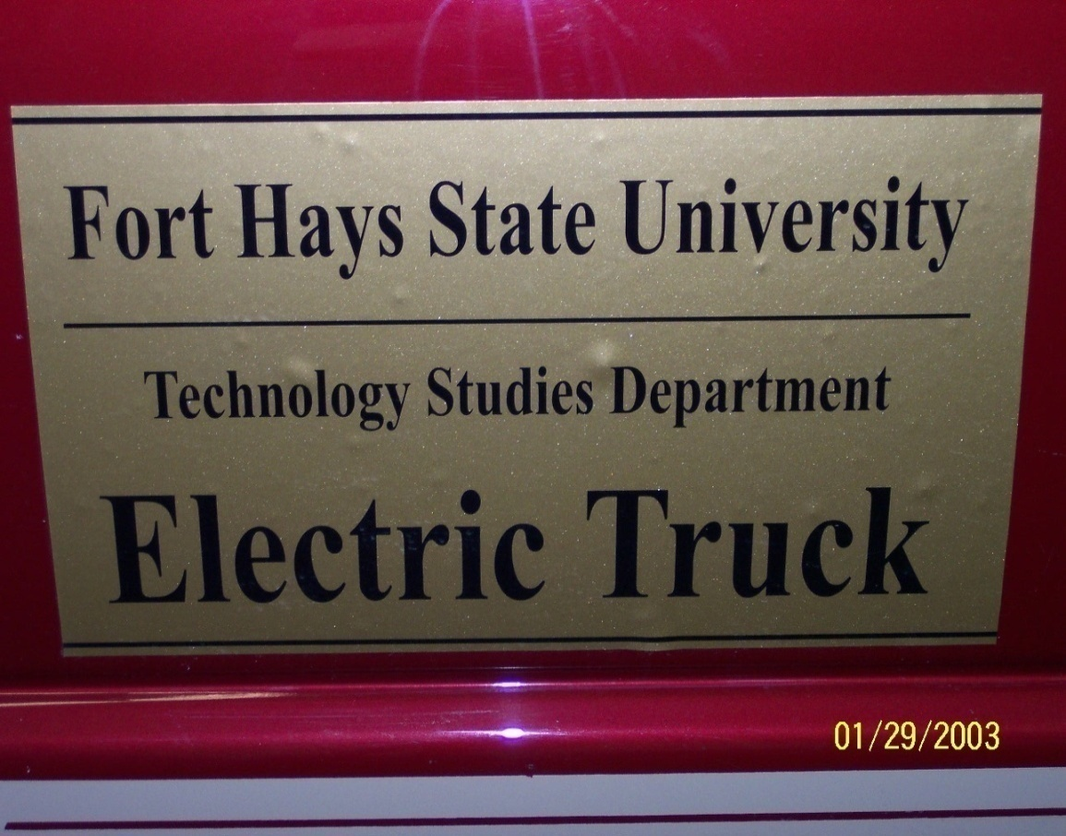
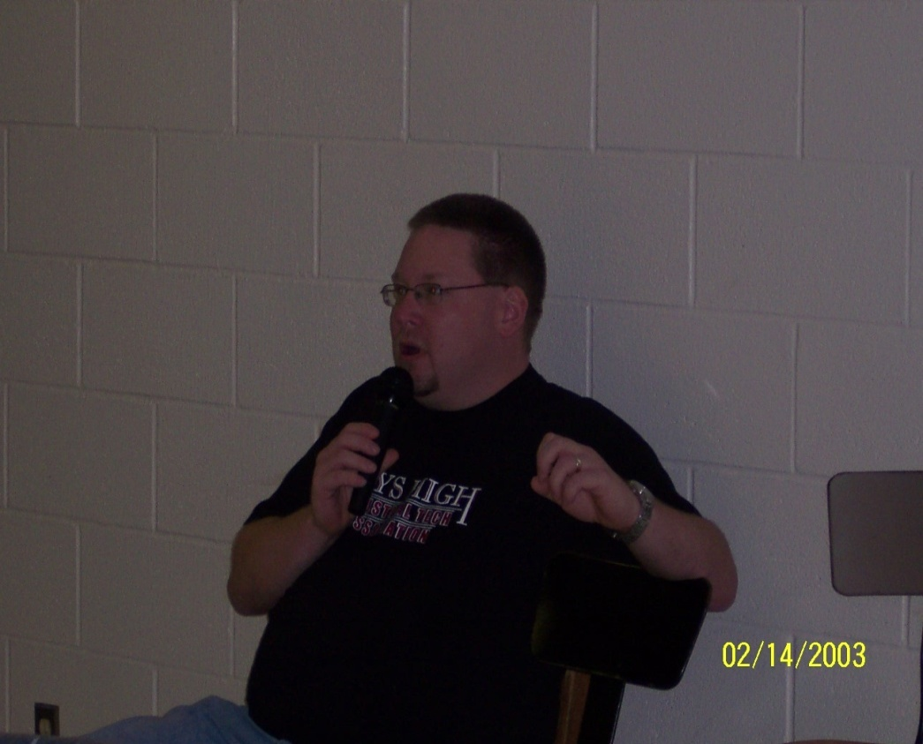
Department Collaboration
Metals Program
Woods Program
Channel 13-Radio & TV
Fort Hays State University
Core Areas

Slide 21
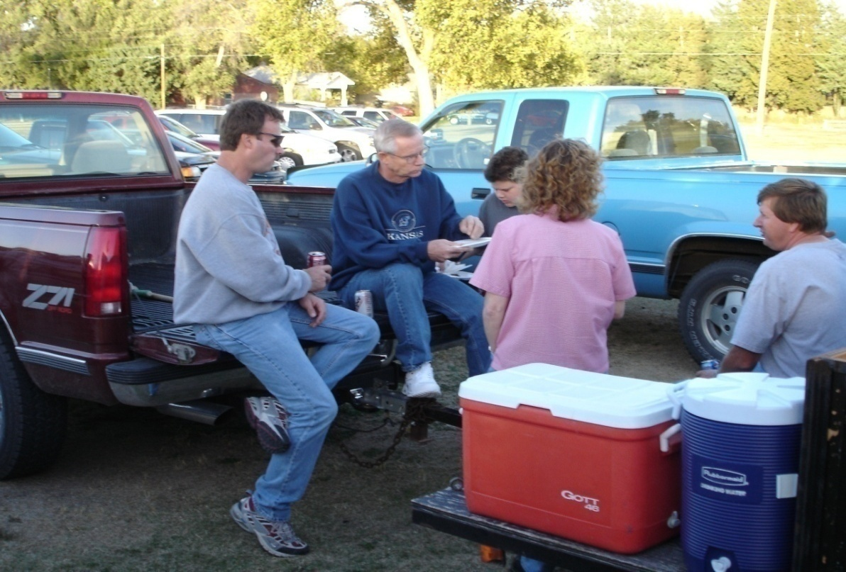
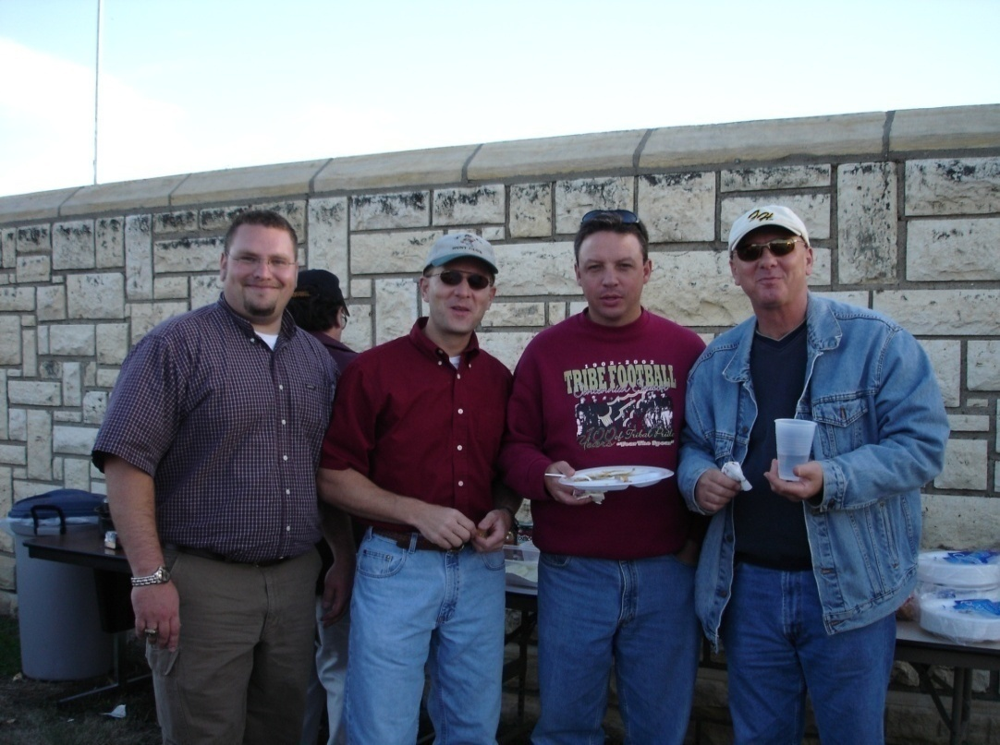
Promote Technical Education
-School Activities and Events -Community Events
-Social events

Slide 22
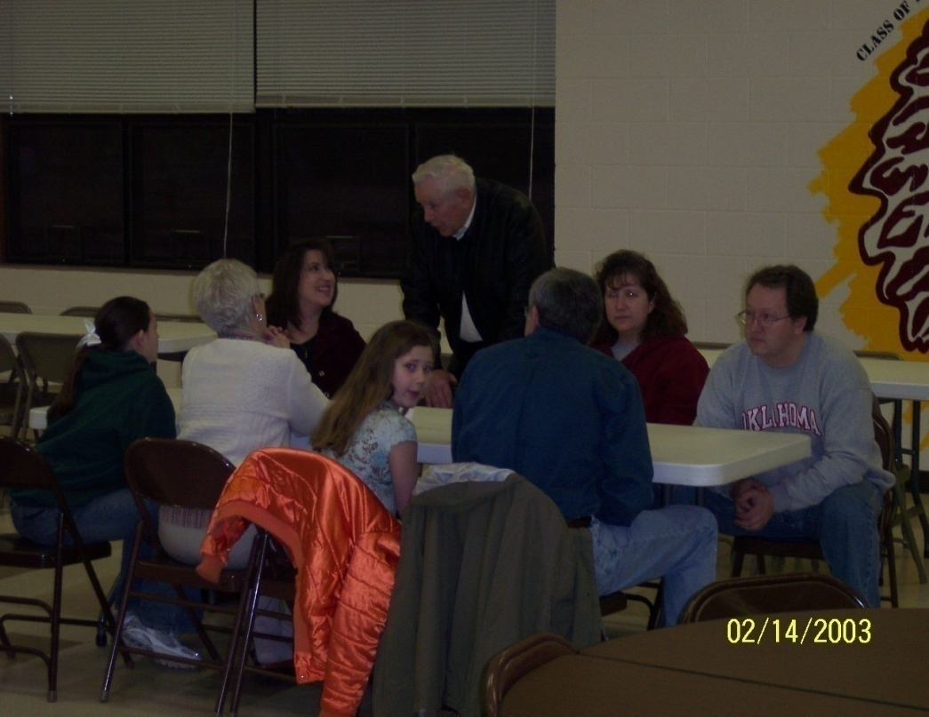
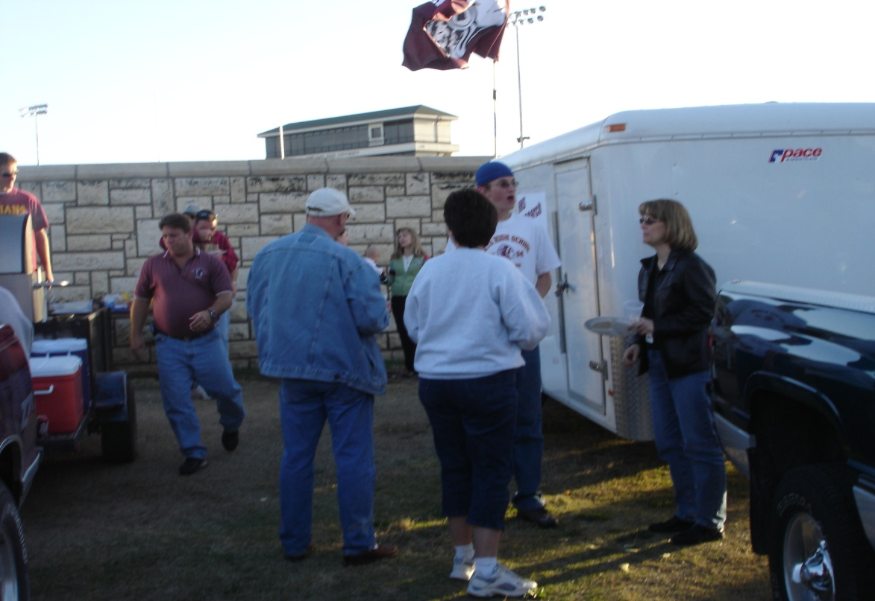

Slide 23
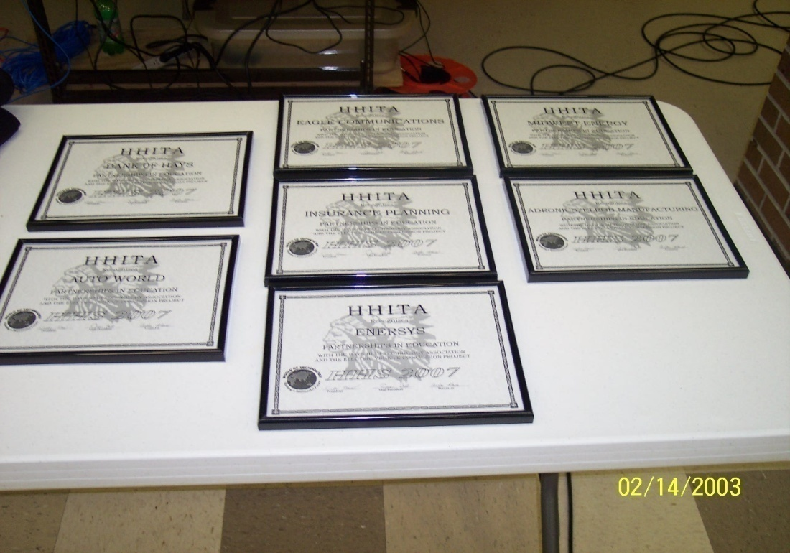
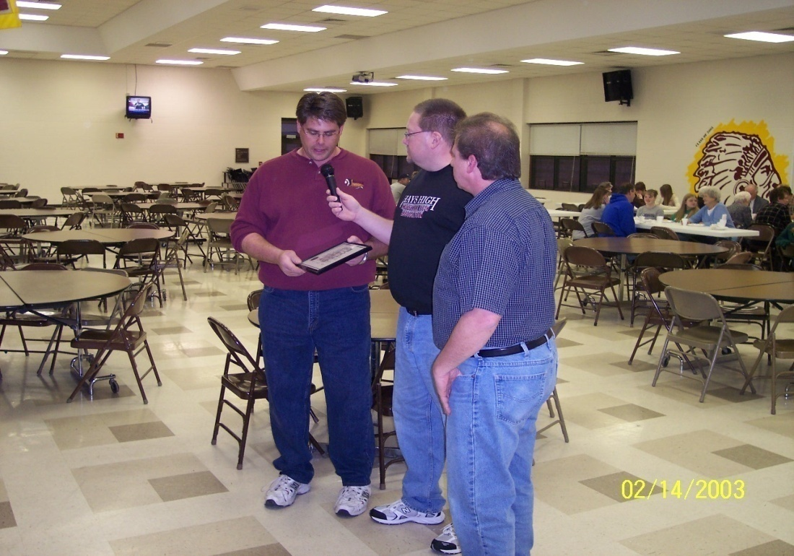
Community Connections
Technical Support
Marketing & Finance
Local Business & Industry
Fund Raising/Sponsors

Slide 24
Community Connections
Technical
Electrical
Motors
Structural
Electronic Components
Finance
Financial Support
Materials
Equipment
Industry
Welding & Machining
Materials & Processes
Public Relations
Local Business Displays
Radio & TV for fund raisers
Competitive Events

Slide 25
Competition Objectives
Drive an electrically powered vehicle as far as possible on a closed looped course using limited electric energy
Provide a forum where skill, ingenuity may be displayed, compared and tested.
Develop public awareness of alternative energy sources
Provide an affordable sport defined by specific rules in which individuals may participate competitively and safely.

Slide 26
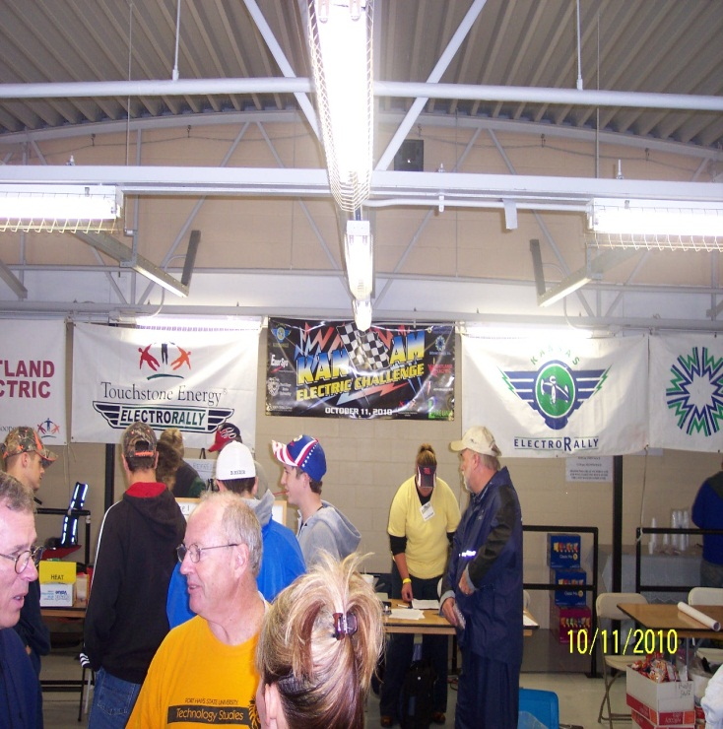
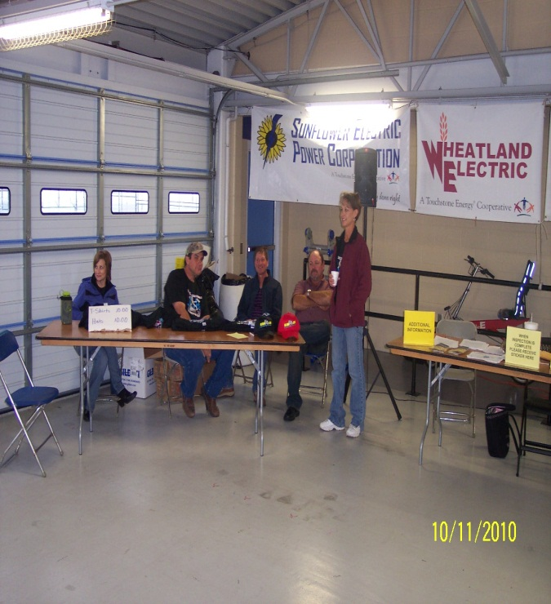
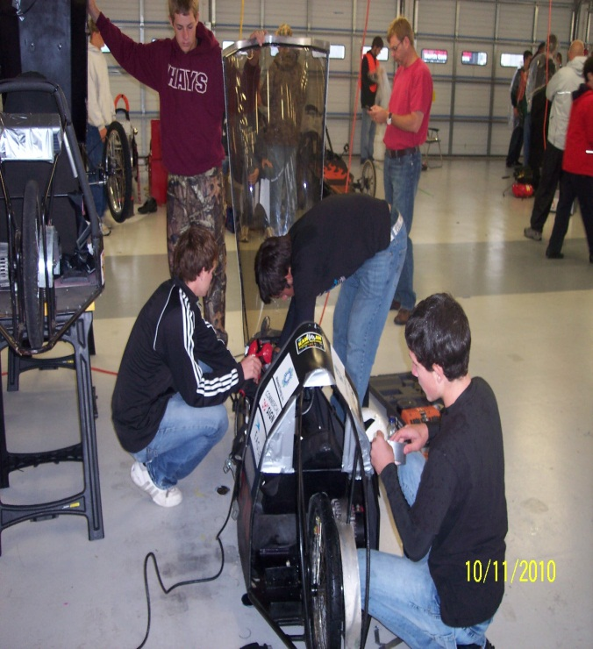
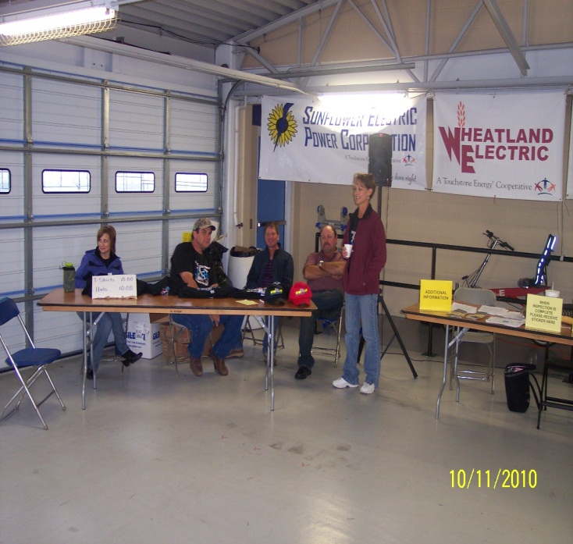
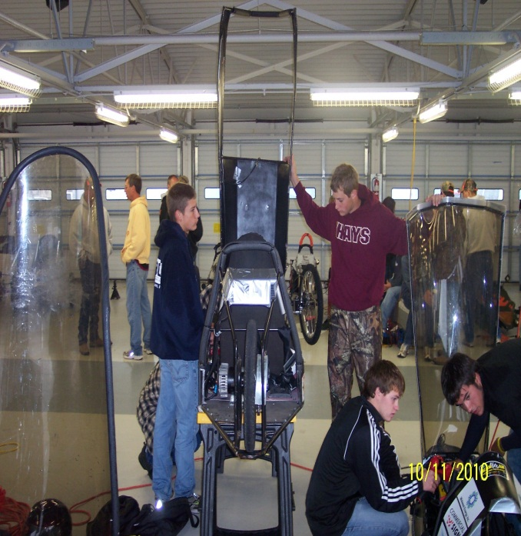

Slide 27
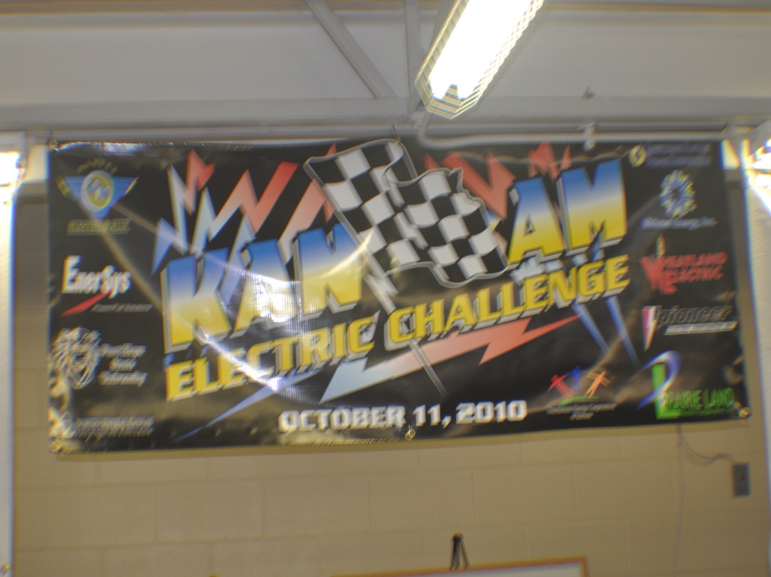

Slide 28
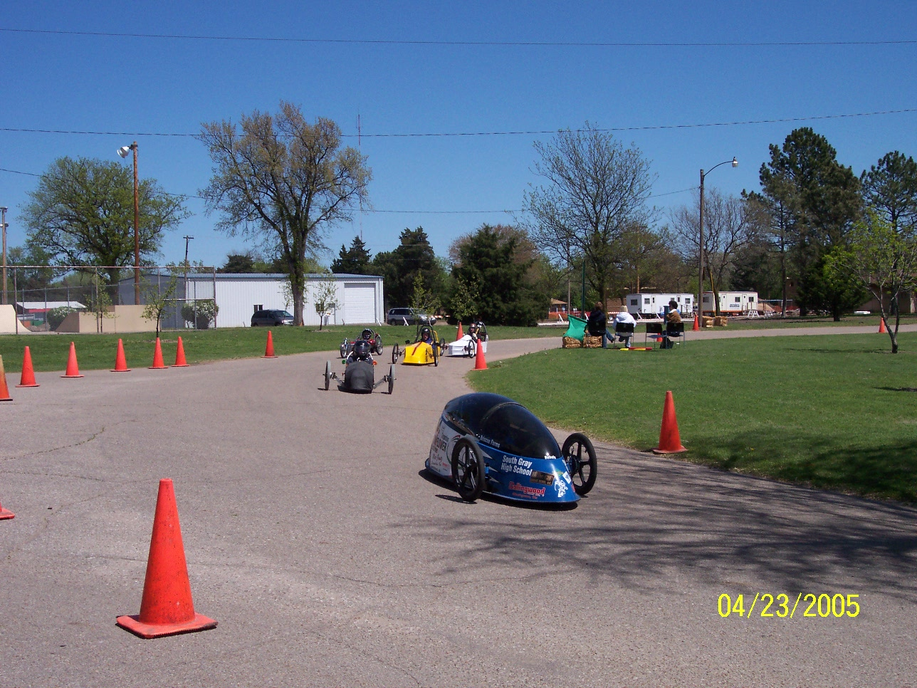

Slide 29
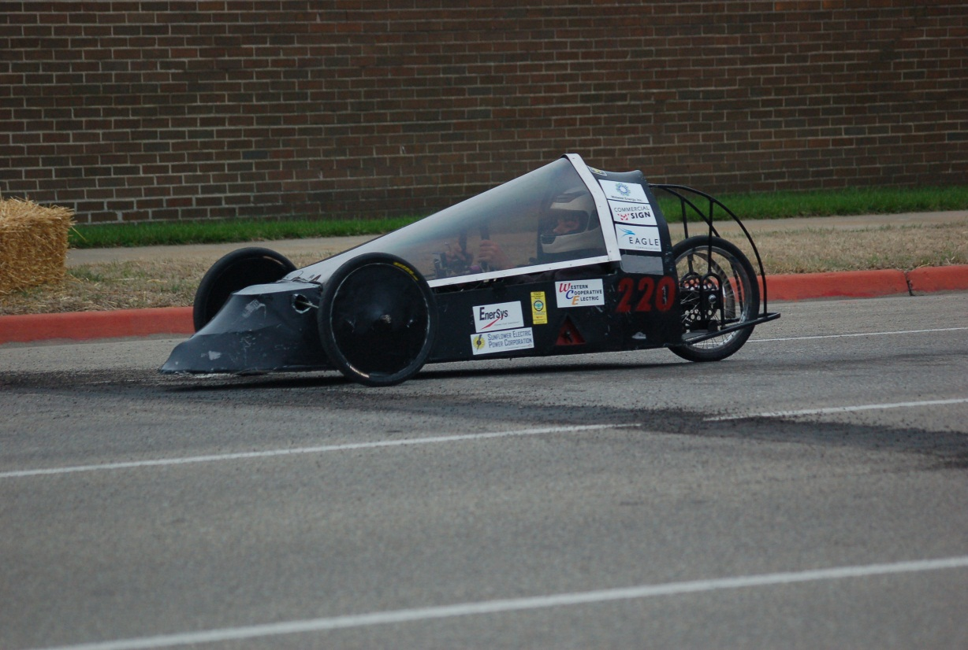
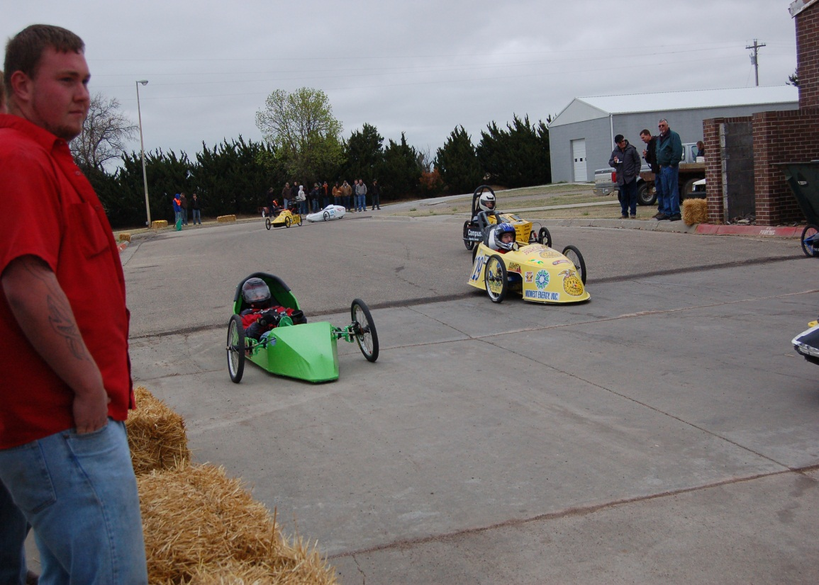
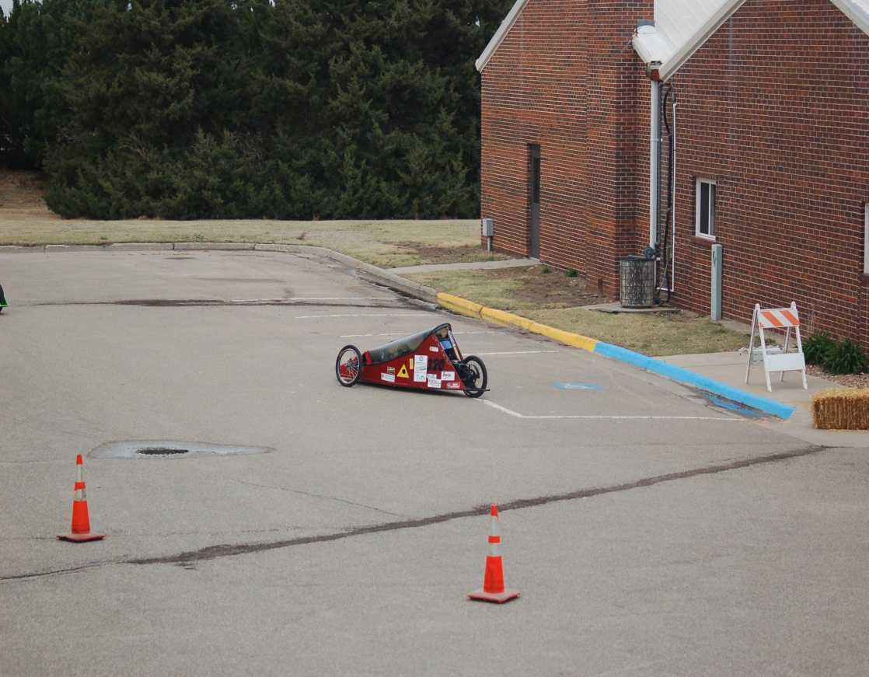
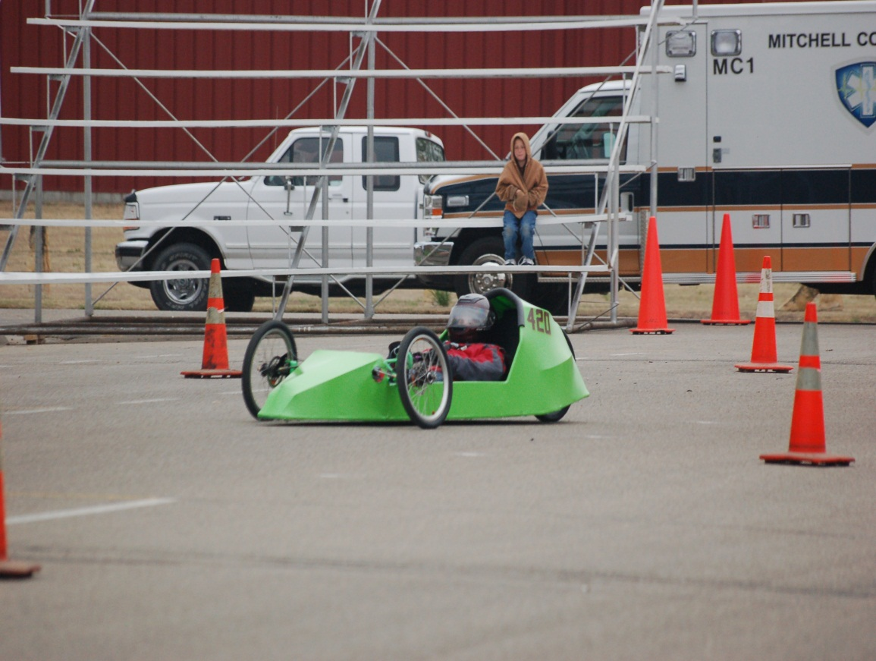

Slide 30
Vehicles Defined
Single Passenger
Lightweight(Driver 180)
Aerodynamic
3 or 4 pneumatic tires
Design to meet safety regulations and specifications
Standard sealed lead acid battery pack
Power pack limited to 67 pounds

Slide 31
Safety
Safety is the priority
Vehicle design
Vehicle Inspections
Course Safety
Local Event Organizers must stay within Electrathon America rules and guideline
Sanctioned events must meet vehicle design rules

Slide 32
Membership/Contacts
Includes vehicle registration & number
Handbook
Voting Rights
Kansas Electro Rally
cellis@usd466.com ( Chuck Ellis )
Kansas Electro Rally President
cdinkel&@usd489.com (Chris Dinkel)

