Slide 1
Accounting Pilot & Bridge Project

Slide 2
APBP: Introduction
Training Team
Glenda Eichman
Manhattan High School - Manhattan, KS
Joe Navickas
Deerfield High School – Deerfield, IL
Janie Patterson
Hutchinson High School - Hutchinson, KS
Sean Crevier
Vernon Hills High School – Vernon Hills, IL
Allison Nord
Comstock High School - Kalamazoo, MI

Slide 3
APBP: How it Began
Market demand for accounting majors
High School student/parents looking for college credit courses
Need for bridge between high schools and colleges
Popularity of AP courses in high schools makes it a desirable form for handling the problem
Profession wants access to top students at high school level

Slide 4
APBP: Implementation
www.accountingpilot.com
Name of course, course description, no prerequisite
Talk to your administrators, counselors, gifted facilitators, AP coordinator, students, parents
Get approved for weighted grade

Slide 5
APBP: Materials Access
Textbook website
www.mhhe.com/ainsworth6e
Wikispaces
Trainees invited to the project wiki
All training materials available
Distributed at training
Training notebook and USB drive if trainee desires that form

Slide 6
APBP: Exams
All students take the comprehensive exam as final in the course
This also acts as a review for those intending to take the qualifying exam
Teacher grades the comprehensive
KSU grades the qualifying and reports the score to you

Slide 7
APBP: Qualifying Exam
You determine test date
3 hours for test
Notify KSU (Dr. Deines) of date, send check for $86 from each student, and request test
Provide a strict test administration atmosphere

Slide 8
APBP: Data
Teachers transfer module and comprehensive exam scores to KSU as requested

Slide 9
APBP: Project Wiki
www.wikispaces.com/accountingpilot
Growth of project demanded centralized communication
Provides trainees
Training files
Module exams
Q&A
Teaching ideas / strategies
Project updates

Slide 10
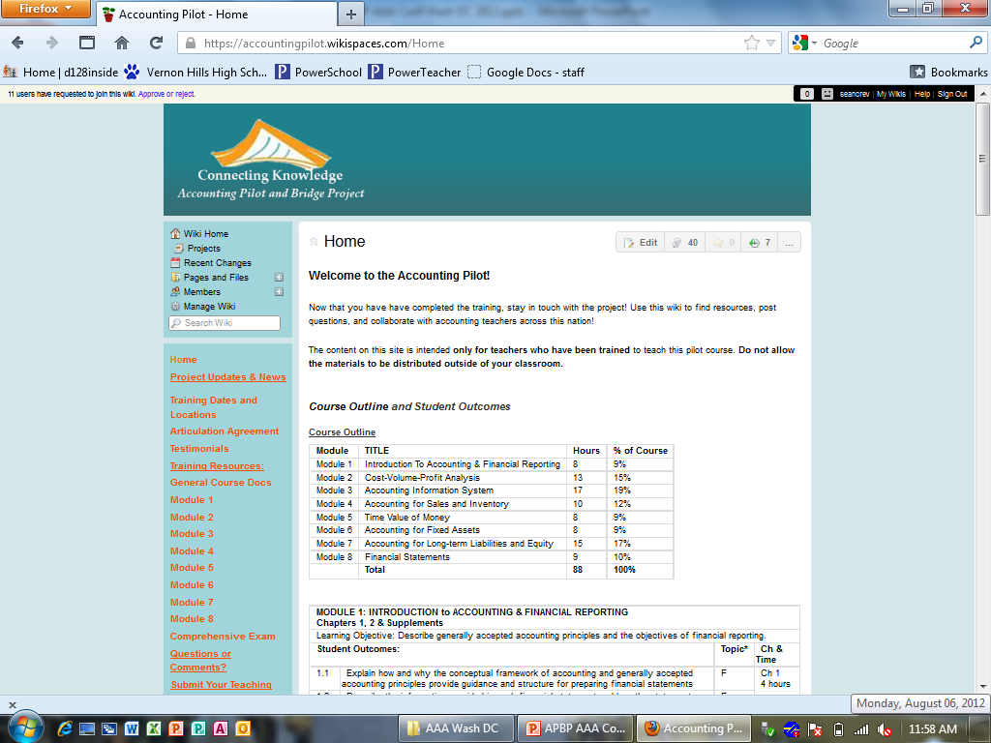
APBP: Wiki Site

Slide 11
APBP: Trainee FAQ’s
What Kansas colleges accept the credit?
Kansas State University
Wichita State University
Pittsburg State University
Emporia State University
Sterling College

Slide 12
APBP: Training
Upcoming Training Opportunities
NBEA – April 14-16, Atlanta, GA
Wichita – June 4-6

Slide 13
Need more info?
Glenda Eichman, Manhattan HS geichman1@gmail.com
Janie Patterson, Hutchinson HS pattersonj@usd308.com

