Slide 1
Notes:
Thank everyone for the opportunity to be here
Introduce YE staff, Ben
Thank Patrick Goebel and Jenny Stephens

Slide 2
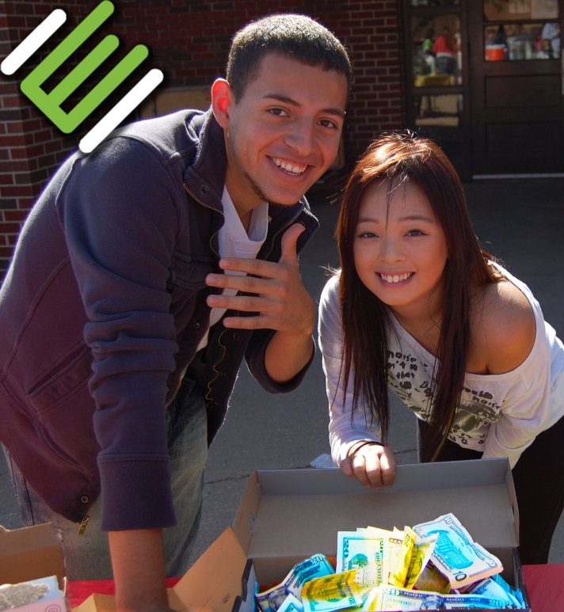
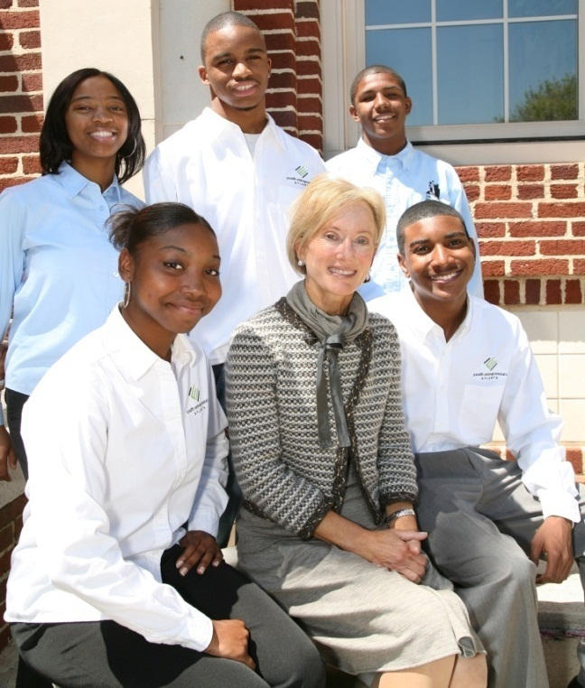
Our Mission
To provide students with business and entrepreneurial education and experiences that help them prosper and become contributing members of society.
We do this by:
Stimulating economic thinking skills
Encouraging creative, intelligent risk taking
Providing Practical business experiences
Instilling independence & personal responsibility
Notes:
Preparing students for success in school, work and life.
**Whether our alumni go on to some form of higher education, start their own company or work for someone else, it’s important that they always think like an owner.
Earl Goebel, saw trend Wichita’s outskirts would grow and created a comparative advantage. The values highlighted that Star Lumber attributes its success to parallel many of the values that are so important in our curriculum. (MBM Principles bookmark)
Ripple Effect
YE wants to grow entrepreneurs and entrepreneurial minded individuals who are the future business leaders and responsible citizens of Wichita, the state of Kansas and someday the entire Midwest region. In fact conversations have been started with places like Omaha and Oklahoma City.

Slide 3
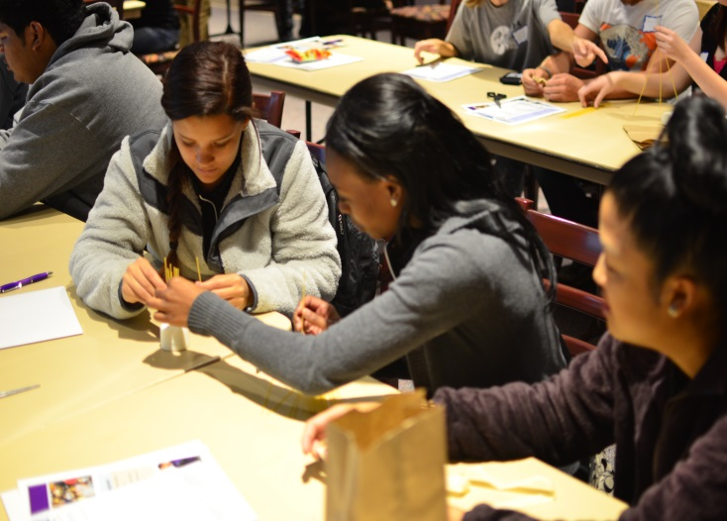
Goals
We teach free-enterprise fundamentals through hands-on experiences.
To give students the tools they need to start a business
To help students be entrepreneurial, even if they work for someone else
To encourage higher education (college, trade school, etc.).

Slide 4
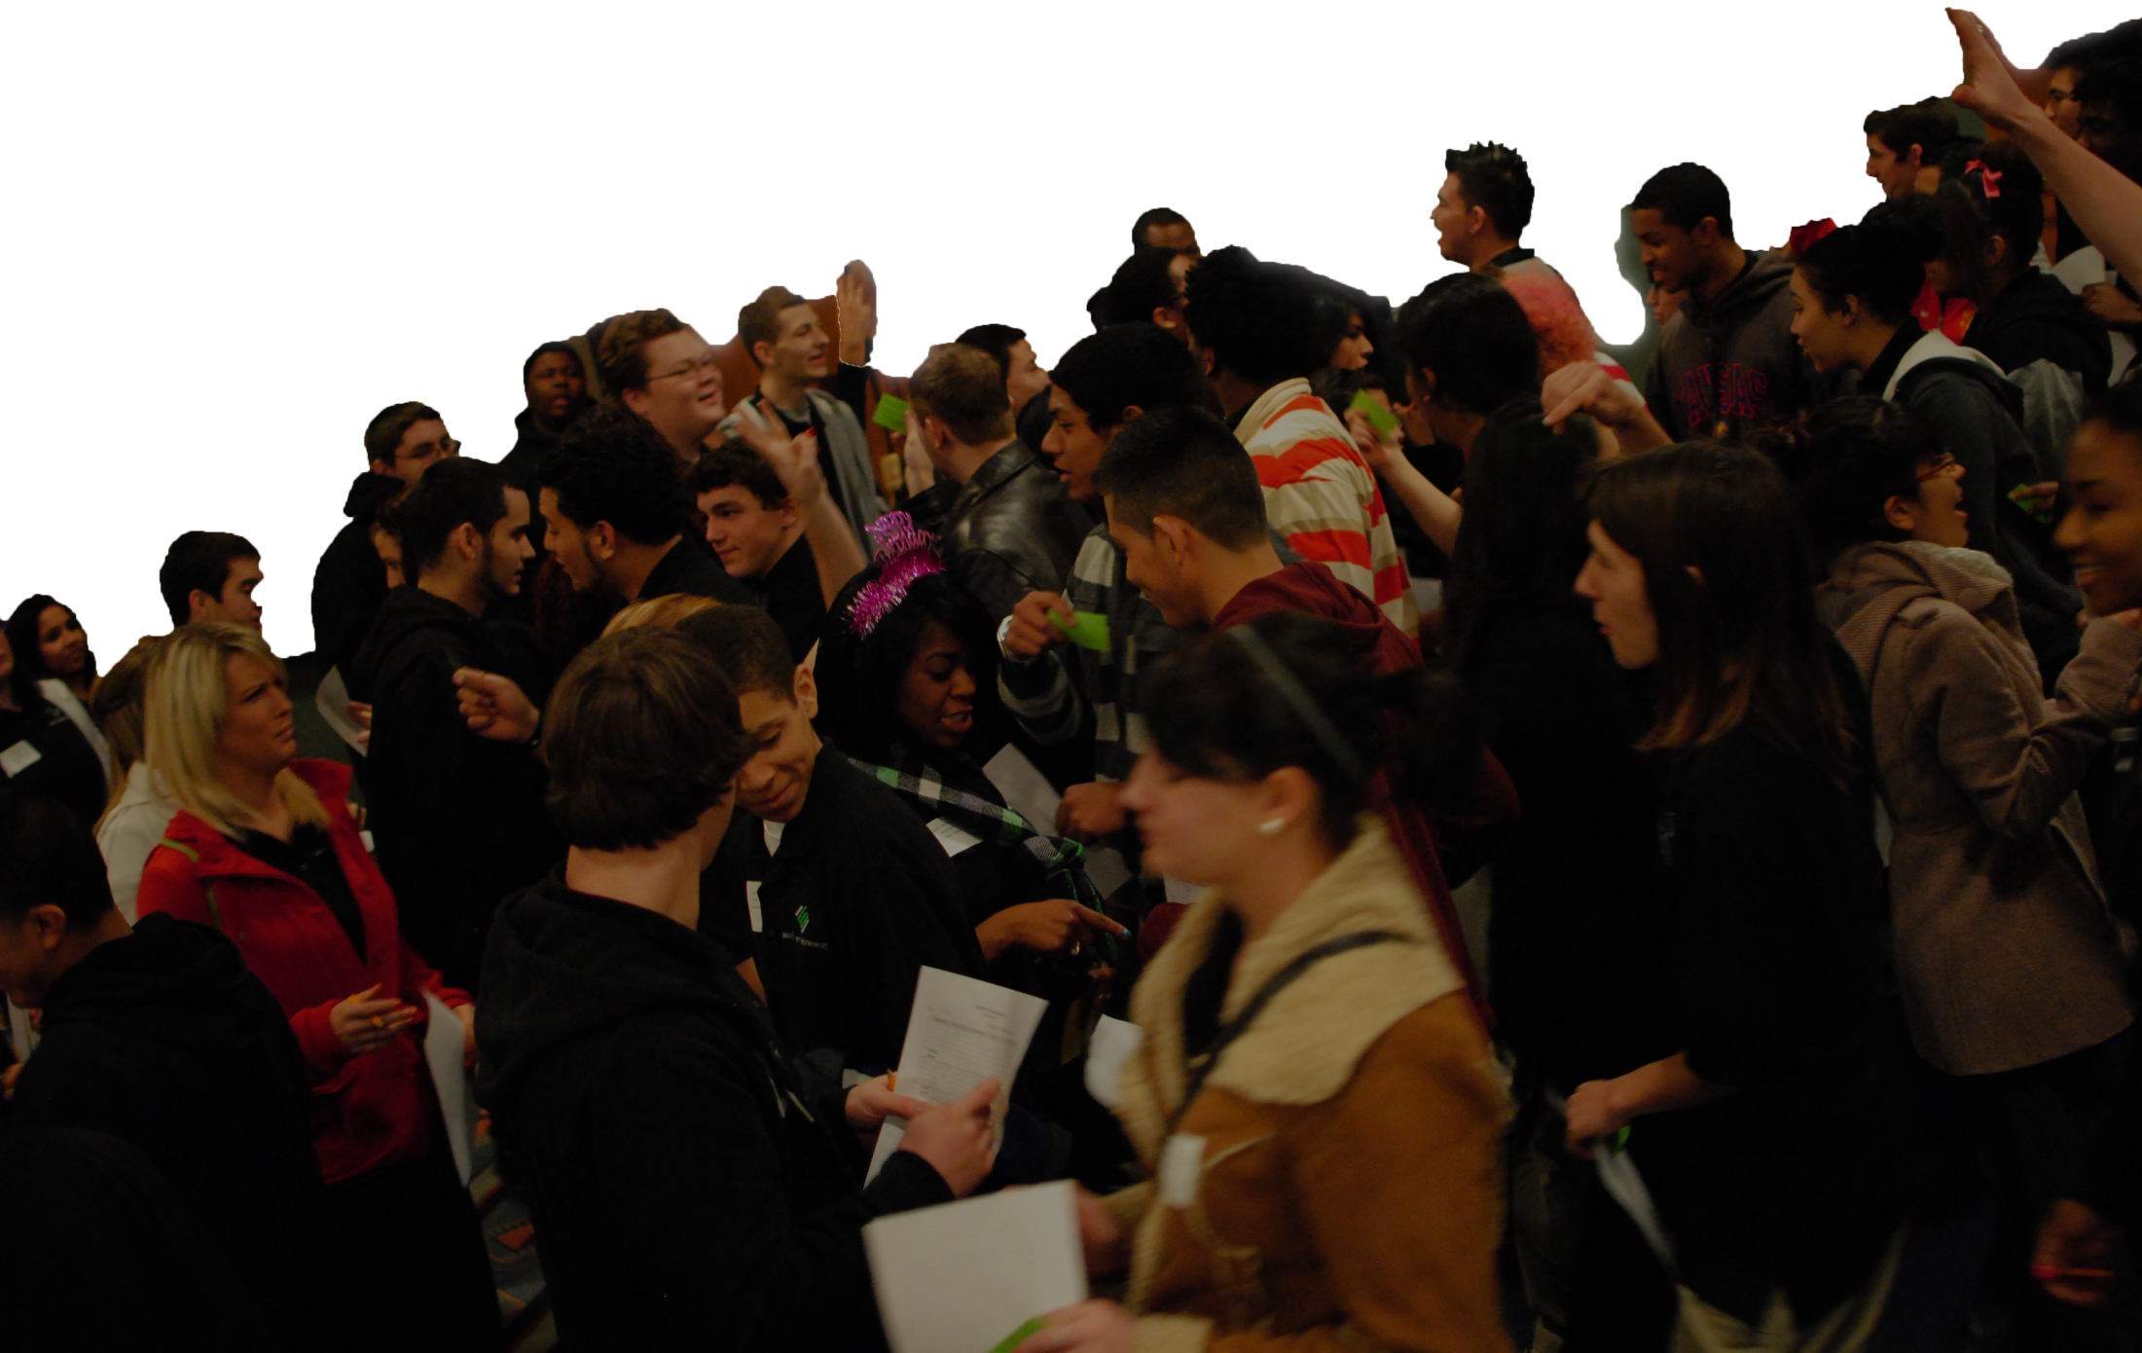
Who We Serve
21 School Districts
35 Schools
52 Classes
1,043 Students
650+ Alumni Participating in YE Academy
12,000+ Total Alumni
Notes:
YE reaches more than 1,000 students as part of the curriculum of 35 high schools, including 17 in the greater Wichita area, 8 in the Kansas City Metro, 4 in Topeka & 6 in Central & Southwest Kansas. In the Wichita area, we serve 567 students. 65% eco dis

Slide 5
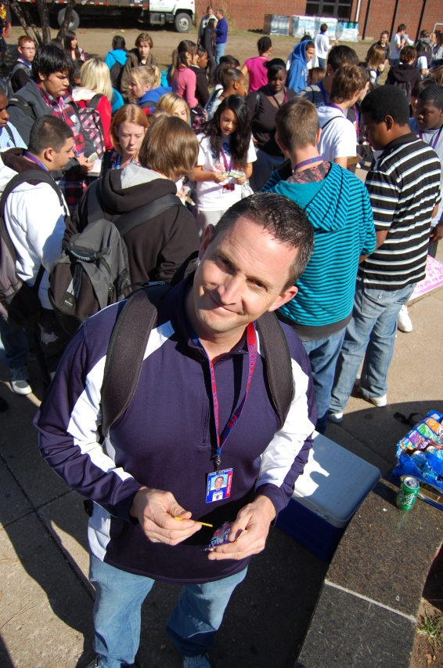
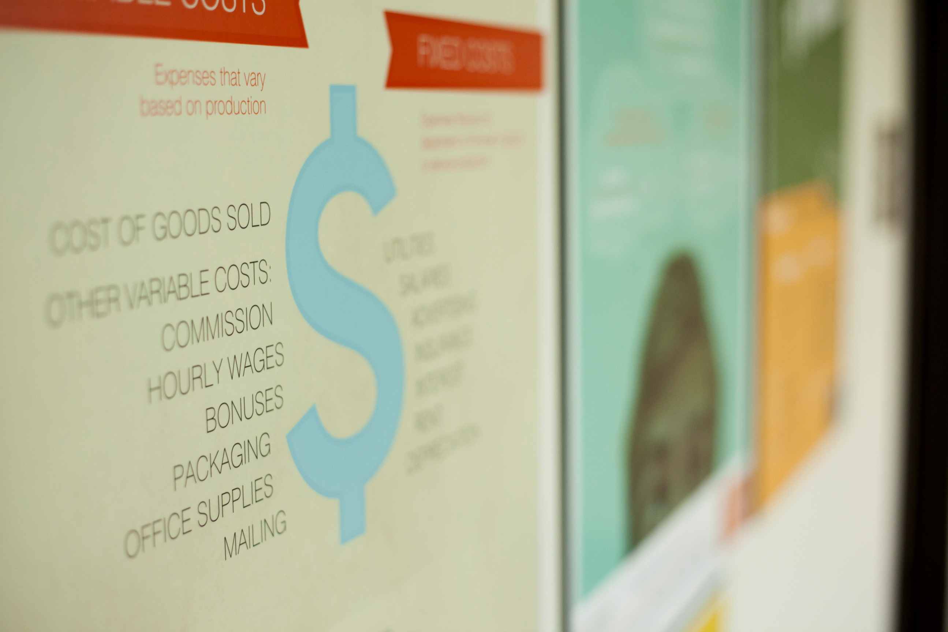
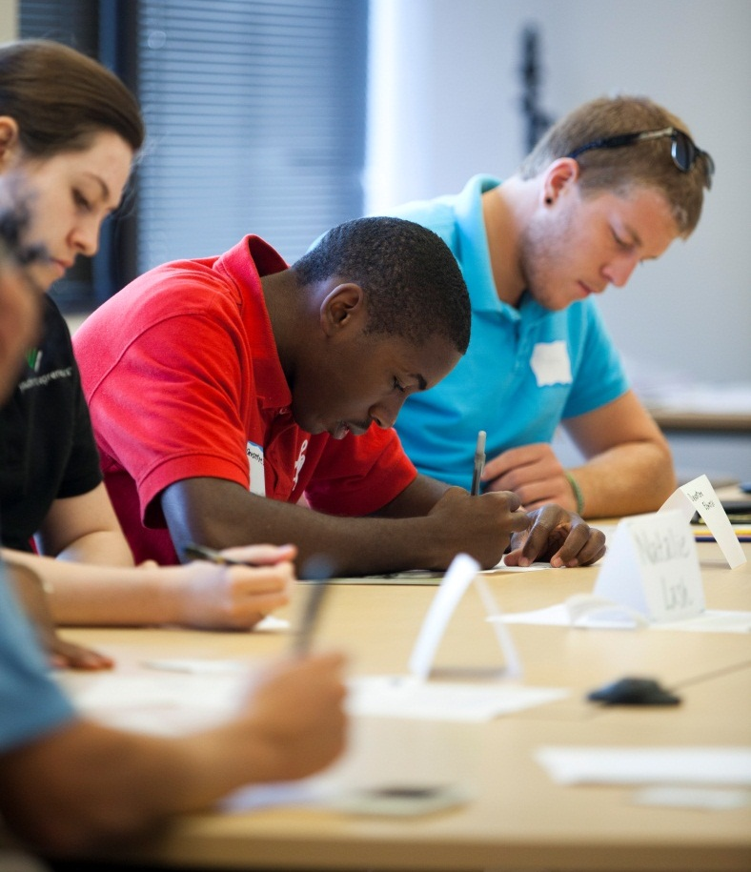
YE Programming
Notes:
goal – create entrepreneurial mindset by understanding markets and the entrepreneurial process
Through entrepreneurship, the principles used to effectively manage oneself, resources, and business and other people.
Two-semester, taught by a instructor at both public & private high schools
Class Content (Only if there is time)
MBM
Economics – (scarcity, opportunity cost, sunk cost, and comparative advantage),
Financials – costs, pricing and viability
Marketing & Communications
Legal
Soft skills such as presentation skills, business etiquette and risk taking
Tie to core concepts of math, reading, public speaking and depending on the student’s business idea, can tap into science, social studies, the arts and more
Market Day and Business Plan - passion or skill with a recognized need in their community. Solving problems for profit. Bust Entitlement – either side of scale. BPC
Tier II and YE Academy

Slide 6
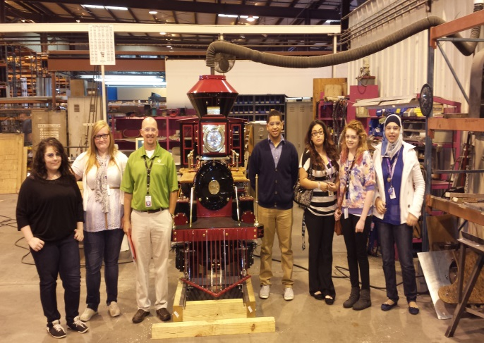
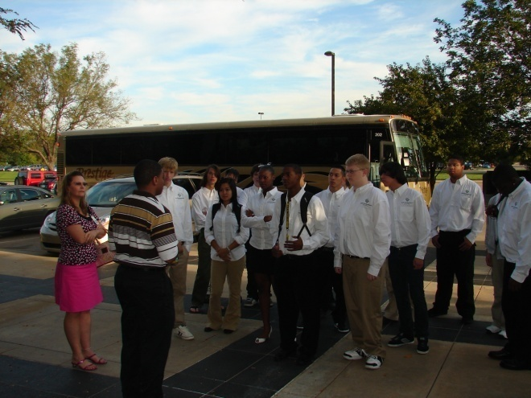
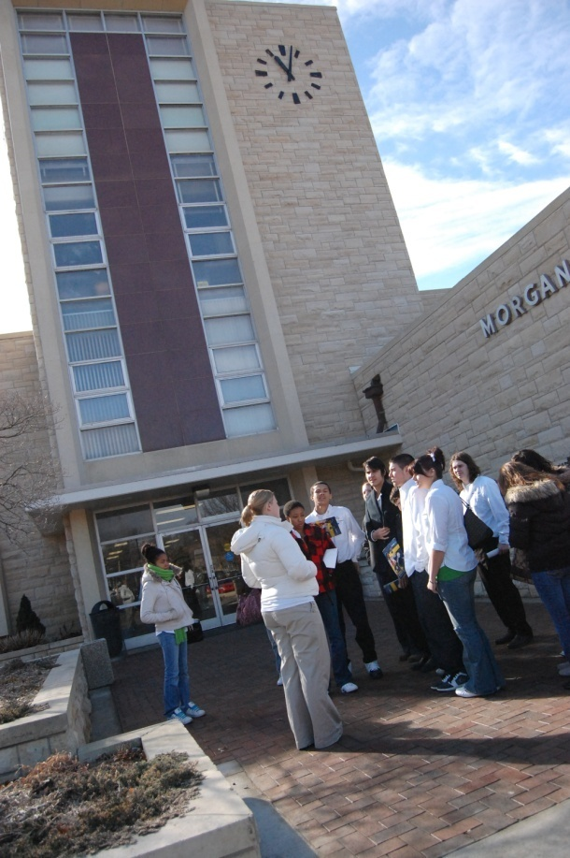
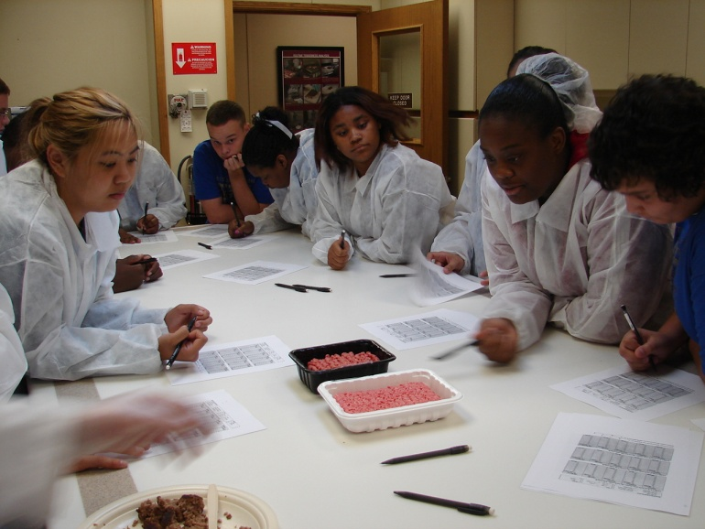
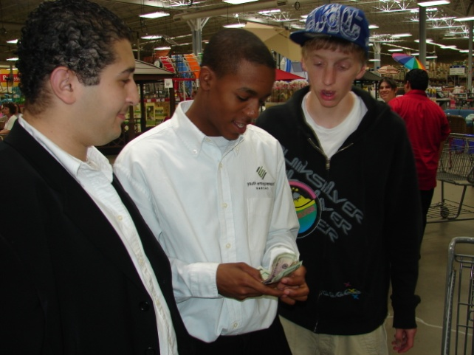
Wholesale Field Trips rips

Slide 7
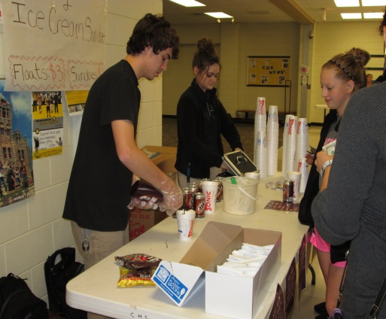
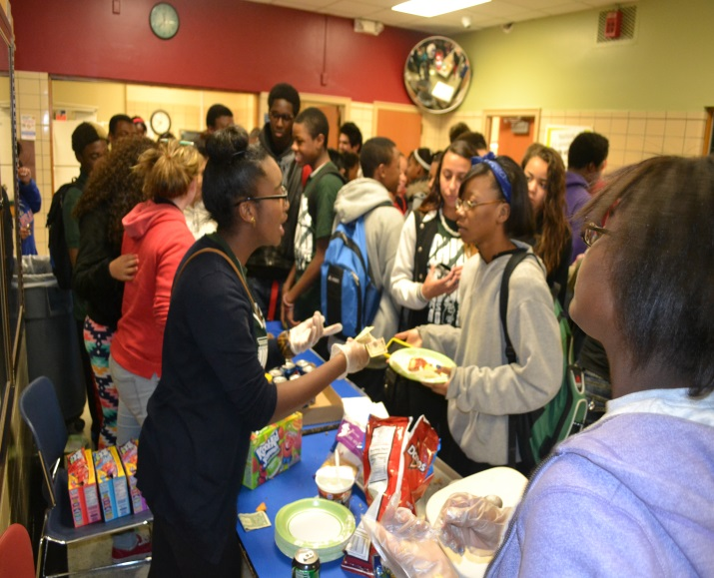
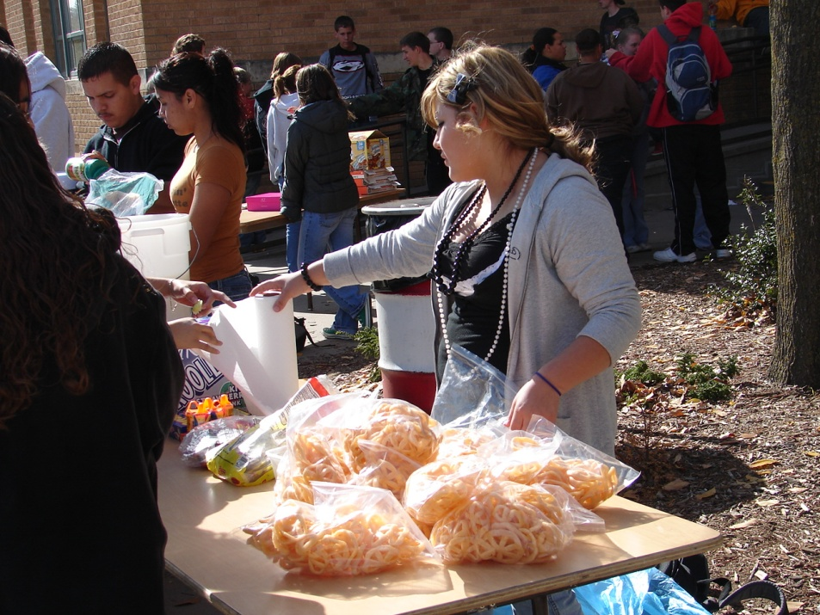
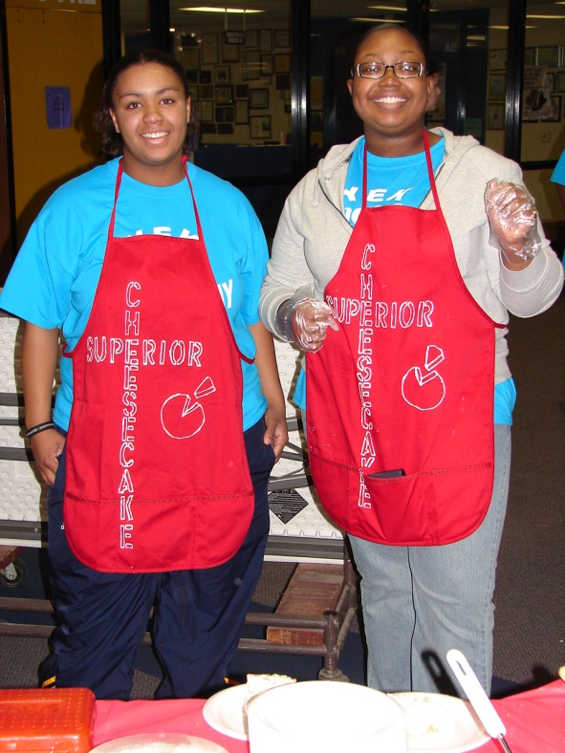
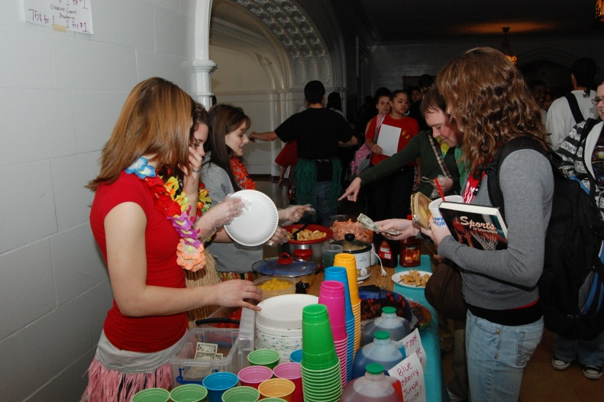
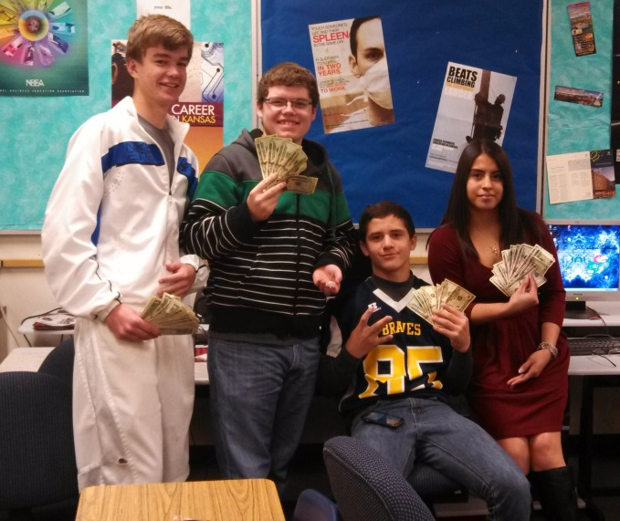
Market Day

Slide 8
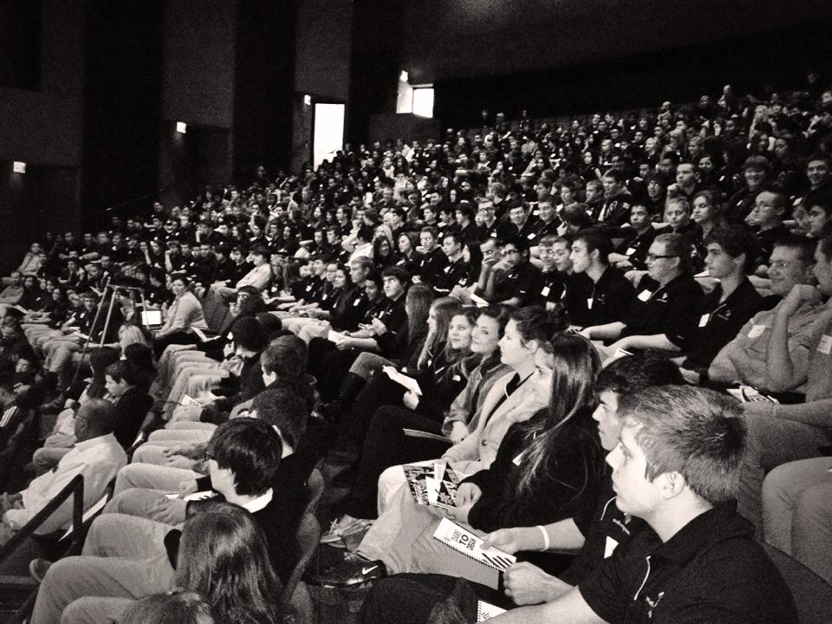
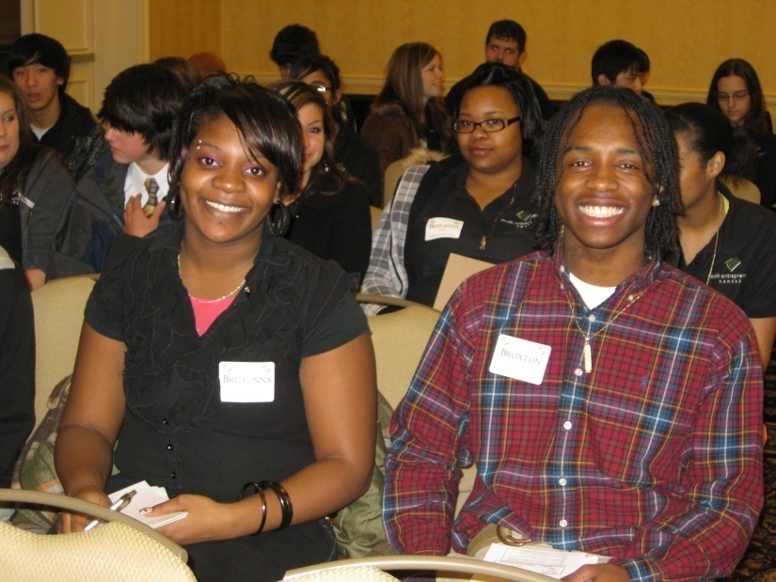
Dare to Dream
Dare To Dream

Slide 9
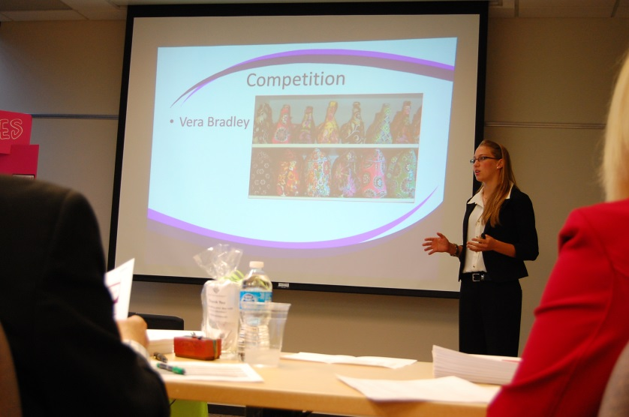
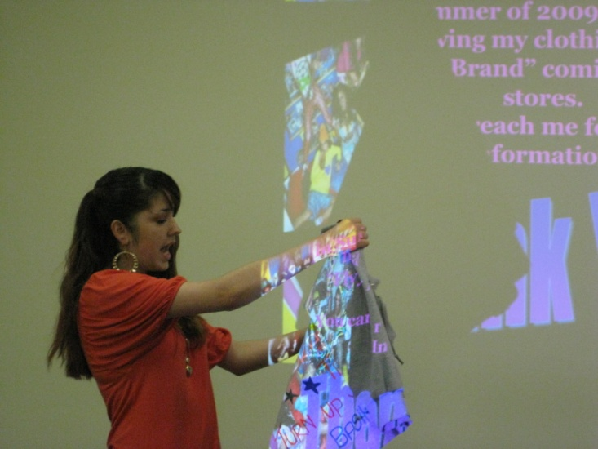
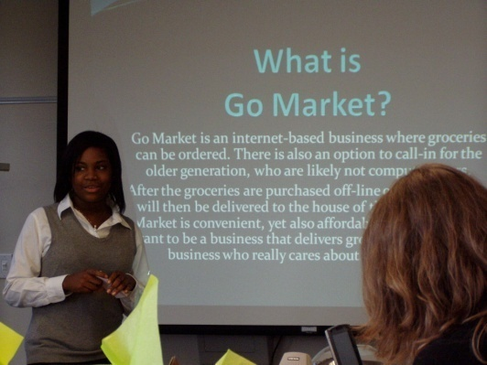
The Business Plan
Capstone Project: Researching , writing and presenting and individual business plan
Capstone project is researching and writing a comprehensive, individual business plan
Notes:
Students compete in a business plan competition to receive venture capital
Top student attends a national NFTE competition in New York

Slide 10
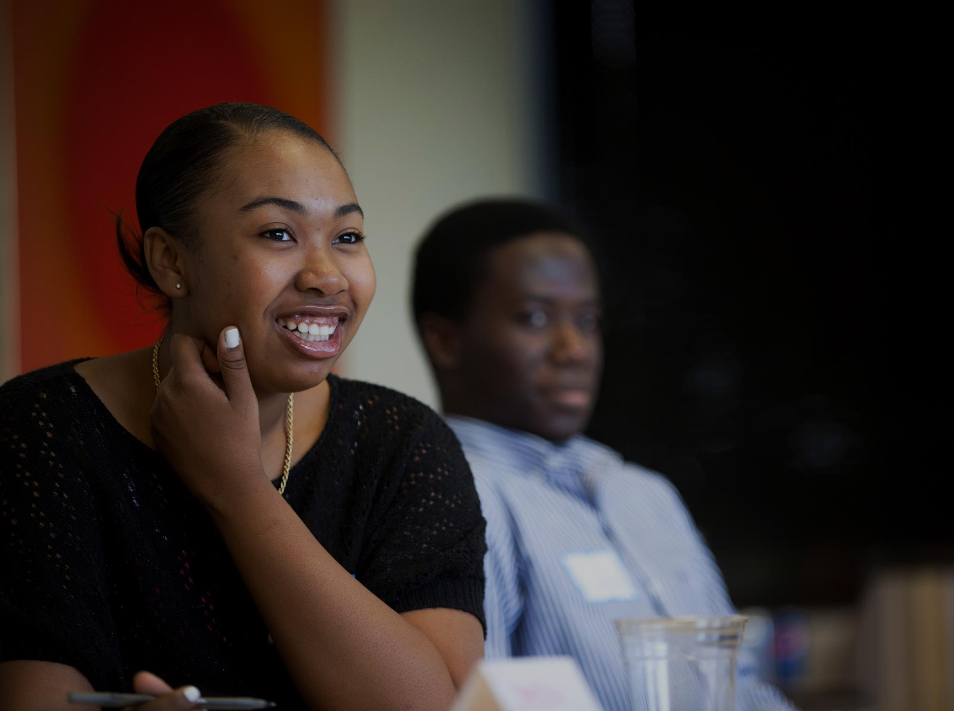
YE Academy
Biz Connect
Economics Academies
Summer Partnerships
YE Shark Tank
Passion to Purpose
Entrepreneurial Series
Community, Community, Community
Notes:
It’s important to us to have local buy-in in order for the program to succeed.
This is a sampling.
BEN

Slide 11
YE Tier II
Teacher training
Teacher & student access to YE digital platform
Teacher phone, web & email support
Teacher access to monthly teacher meetings
YE guest activity (1/semester/trimester)
Optional: fieldtrips, competitions, banquets
YE Academy eligible

Slide 13
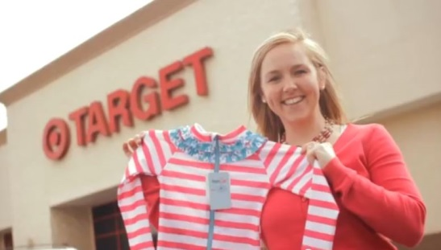
James Harris
Betsy Johnson
Notes:
Atlanta Program Coordinator at Usher’s New Look.
Quoted as saying that without the opportunities YE provided, he’d likely be dead or in jail.

Slide 14
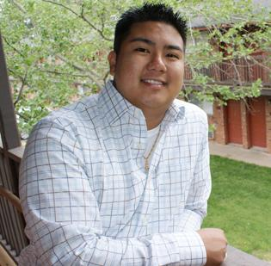
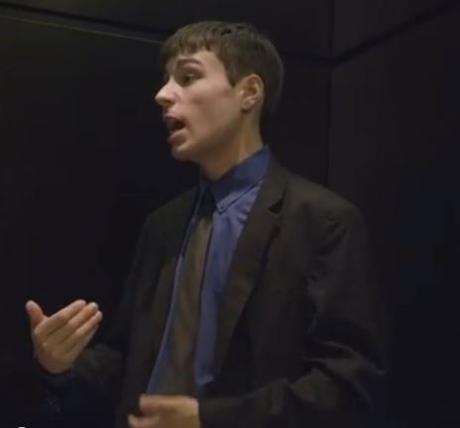
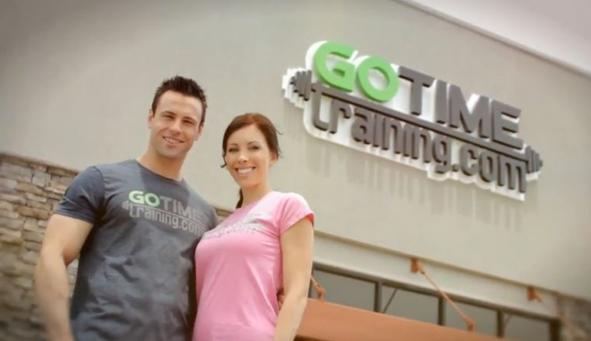
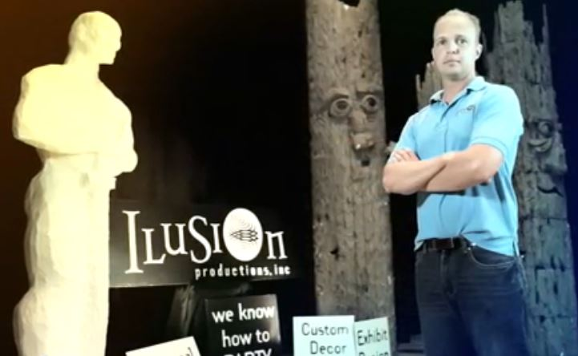
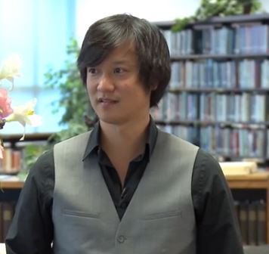
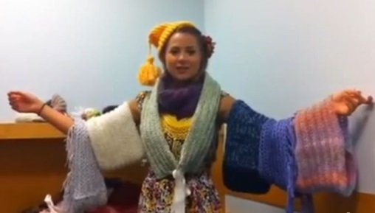
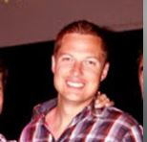
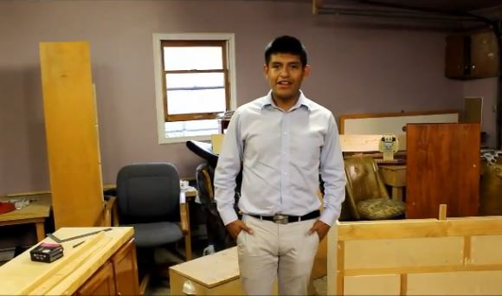
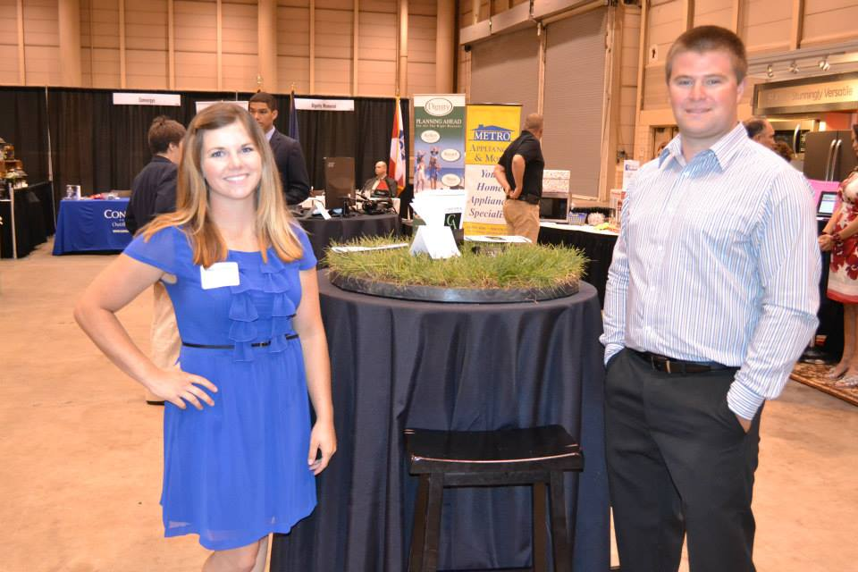
Notes:
And many, many more success stories.

Slide 15
The Future of YE
Proactive growth in Rural America, Kansas City Metro, Missouri, Nebraska and Oklahoma
Continued values-based, digital curriculum development
Varied models of delivery for maximum reach
Increased focus on YE Academy efforts

