Slide 1
Maximizing Your District’s Post-Secondary Partnerships, CTE Pathways, & SB155
CTE & College and Career Readiness in the Inner City (Wichita USD 259) and Urban/Rural (Valley Center USD 262) School Districts of Sedgwick County
Annual February CTE Conference
February 12, 2014
Preparing Students for Post-Secondary Education, Training, and Workforce Readiness
Notes:
259

Slide 2
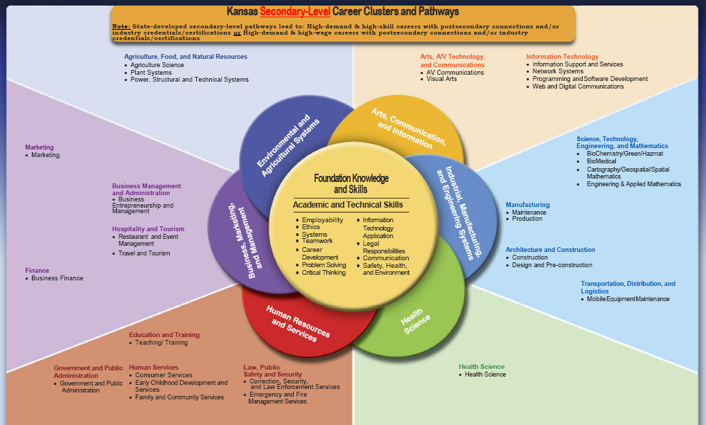
Notes:
259

Slide 3
FACTS of Support for CCR at the Secondary Level in Kansas and USA
56% College Graduates require 6 years to obtain their College Degree
Only 29% of High School Graduates have a College Degree
The Average Debt of College Graduates with 4 + year degree---$60 K
65% of all jobs by 2020 will require technical training beyond high school
In Kansas we are preparing 41% of students for STEM related careers, when 60% is needed NOW!
KANSAS ‘ Senate Bill 155----Enters the picture with hopes of jump starting high school students into a specific educational career program or skilled trade with potential Certification, Workplace Credential, new focus on Post Secondary Degree.
Currently 3 Million Jobs are available in the US with no workforce to fill them and only 12% of those needs jobs require a 4 Year Baccalaureate Degree http://www.theblaze.com/stories/2013/10/23/mike-rowe-of-dirty-jobs-speaks-about-hard-work-how-many-are-following-the-worst-advice-in-the-history-of-the-world/
Notes:
262

Slide 4
Key Ingredients to Success in CTE/SB 155
Advisory Committees---Local Business and Industry Partners --Expansion and Updating Required
Budget Requirements---Growth/Expansion of Programs = Dedicated Funds
Determine What We Are DOING RIGHT--Make it Stronger
Decide What We Must DO BETTER---Make it a REALITY
TIME---The Key Ingredient: PLC, Professional Development, Continued Education, and Sacrifice
CTSOs---Make Them a Priority—Funding and Supplemental Salaries
Grants---Go Get Them----Perkins, PLTW, RPSO, YCC, Farmers
Pathways are Just Opportunities for Student Learning--Today and Tomorrow
Support One Another--At All Costs/Team Approach
Post-Secondary --- CONNECTIONS
Notes:
262

Slide 5
Wichita 9,000 + Students
10 High Schools
East
Heights
North
Northeast Magnet
Northwest
South
Southeast
West
Metro Boulevard
Metro Meridian
16 Middle Schools & 3 K-8 Schools
Allison
Brooks
Coleman
Curtis
Hadley
Hamilton
Jardine
Marshall
Mayberry
Mead
Pleasant Valley
Robinson
Stucky
Truesdell
Wells
Wilbur
K-8 Schools
Christa McAuliffe
Gordon Parks
Horace Mann
Notes:
259

Slide 6
Wichita 259 Cluster and Pathways
Arts, AV Technology, and Communications
1. A/V Communications
A/V
Communications
2. Visual Arts
Graphic Design
Interior & Textile
Information Technology
3. Network Systems
4. Programming & Software Development
5. Web & Digital Communications
Business Management & Administration
6. Business Entrepreneurship & Mgmt.
7. Business Finance
Finance
Accounting
8. Marketing
Marketing Communications
Marketing Management
Marketing Research
9. Restaurant & Event Management
Culinary Arts & Management
Event Planning & Management
Health Science
10. Health Science
Human Resources & Services
11. Consumer Services
12. Early Childhood Development & Services
13. Emergency & Fire Management Services
14. Family & Community Services
15. Law, Public Safety, Corrections & Security
– Pre Law
16. Teaching & Training
Industrial, Manufacturing & Engineering Systems
17. Construction
18. Design & Pre-Construction
19. Engineering & Applied Mathematics (PLTW)
20. Manufacturing Production
21. Mobile Equipment Maintenance
Auto Collision & Refinishing
Automotive Technician
Motorcycle Technician
Notes:
259

Slide 7
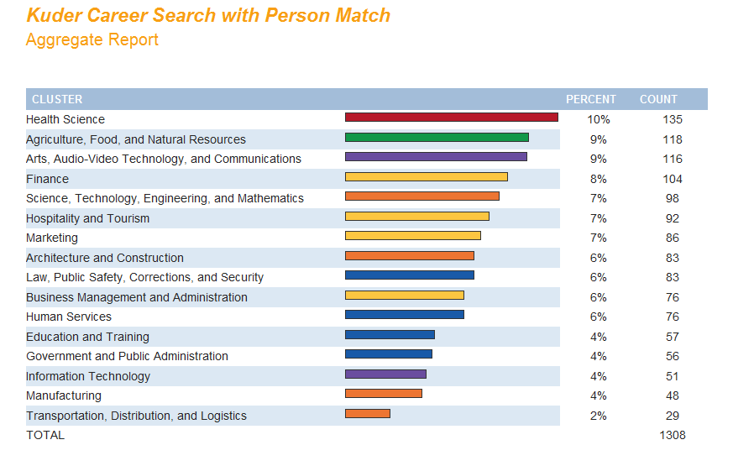
Valley Center Career Clusters & Pathways Beginning Year 2011-12 3 Clusters/5 Pathways
Notes:
262

Slide 8
= Existing Pathway(s)
= 2014-15 Pathway(s)
2014-15 13 Clusters & 17 Pathways
= Possible Future Pathway(s)
Notes:
262

Slide 9
SENATE BILL 155—The Bottom Line
Free/Paid College Tuition for Secondary Students in State approved High Demand courses (Jr. & Sr.)
Paid Transportation to Post-Secondary Institution
Certificate 8 – 16 weeks, Technical Certification 16– 32 weeks, and/or Associates Degree 2 years
Business & Industry Credential
Students May Earn Industry Credential
Assessment Paid by District
When Student Passes Assessment – District Compensated $1,000 (Net Profit = $1000 - Cost of Assessment)
Notes:
259

Slide 10
Dual Credit Opportunities
USD 259 & 262
Strengths
Great Opportunity for students!
Get a head start on technical education programs
Hands on Experience
Build Confidence
Challenges
Transportation
Communication – so many moving parts!
Counselors
Parents
Students
Administrators
Instructors
Notes:
259

Slide 11
SENATE BILL 155---Was it of Benefit?
Statewide Results - First Year Success
Approximately 5,800 secondary students enrolled in college level technical education courses generating more than 43,312 technical college credit hours – a 50% increase in college credit hours more than the previous year.
Notes:
259

Slide 12
Partnerships: Hutchinson Community College
NCCER Course Offering (National Center for Construction Research) Residential Carpentry I and II
Receive between 4-16 college credit hours in credentialed certificate program ( 1 or 2 year programs)
This course will meet for one or two consecutive periods daily
Safety Orientation 1 Credit Hour
Introductory Craft Skills 3 Credit Hours
Basic Carpentry 4 Credit Hours
Walls, Windows/Doors, Floors 8 Credit Hours
Total Credit Hours 16 Credit Hours
* College /Post Secondary Articulation from HCC Approved. Dual /Concurrent Credit will be an option to VC students enrolled for NCCER Residential Carpentry II.
Notes:
262

Slide 13
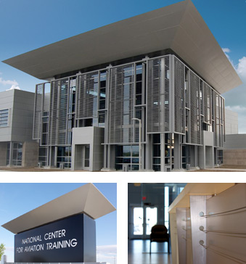
National Center for Aviation Training (NCAT) & Wichita Area Technical College (WATC)
After a century of leadership designing and manufacturing the world’s most advanced aircraft, Wichita now takes its rightful place as a global leader in aviation education. The National Center for Aviation Training built by Sedgwick County fuses Kansas’ aviation experience and expertise with cutting-edge instructional techniques and technology to forge a new educational standard.
WATC will provide opportunities for students in Aviation, Manufacturing and Engineering, and a variety of other programs of study. Realistically students could complete 30 – 50 college credit hours prior to graduation from HS.
Notes:
262

Slide 14
Partnerships: WATC & USD 259/262
Aviation / Aerospace College Core Schedule – Fall and Spring
AVC 100-Aerospace Safety 1 Credit Hour
AVC 101-Blue Print Reading 2 Credit Hours
AVC 102-Precision Instrument 1 Credit Hour
AVC 103-Geometric Dimension & Tolerance 1 Credit Hour
AVC 104-Quality Control Concepts 1 Credit Hour
AVC 105-Aircraft Familiarization 1 Credit Hour
AVC 106-Aerospace Blueprint Reading 2 Credit Hours
AVC 107-Fundamentals for Aerospace Manufacturing 1 Credit Hour
AVC 108-Aircraft Systems & Components 4 Credit Hours
CPU 101-Computer Applications (Optional) 3 Credit Hours
17 Credit Hours
*Semester students will attend class Monday-Friday from 7:30am-10:30 am OR Noon – 3:00.
Notes:
262 ---

Slide 15
WATC and SB 155: BLOCKS
Allied Health College Core Schedule – Fall and Spring
Human Anatomy and Physiology (2 semesters) 2.5 Credits
Taught at High School (50 Enrolled in Fall 2013 @VC)
Computer Applications 3 Credits
Principles of Nutrition 3 Credits
Medical Terminology 3 Credits
First Aide and CPR 3 Credits
Emergency Preparedness/Diseases, Disorders and Diagnostic Procedures 3 Credits ___________
17.5 Credit Hours
*
Notes:
262

Slide 16
WATC /SB 155 Concurrent/Dual Credit
College Programs of Study – Fall and Spring: 9-15 credits
Automotive
Allied Health
Aerostructures
Electro Mechanical
Business
Aviation
HVAC
Interior Design (NEW)
Mechanical Design
Medical Assistant
Machining
Welding
CNA
Composites
CAM
Robotics (NEW)
IT Essentials (NEW)
Note: WATC ACE Handout of Fall Block 2014 including Steps to Enrollment
Notes:
259 then WATC Handout

Slide 17
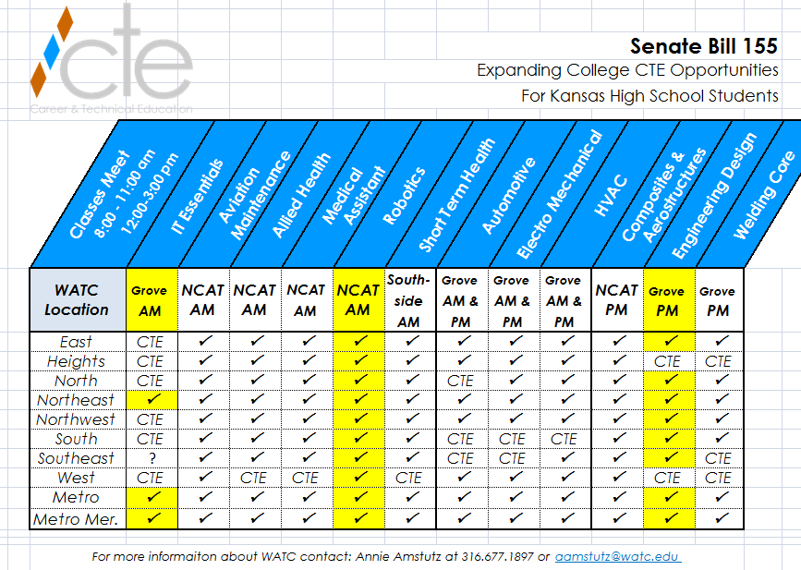
Notes:
259

Slide 18
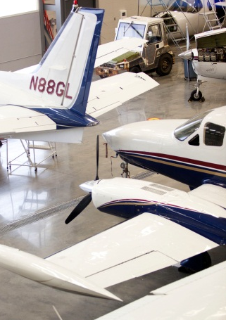
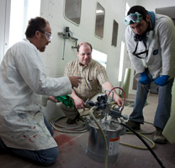
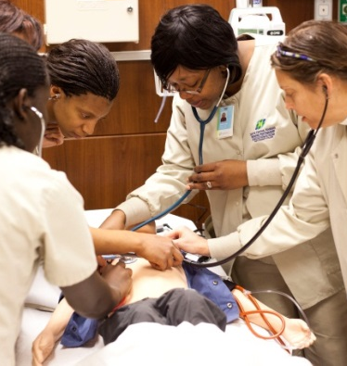
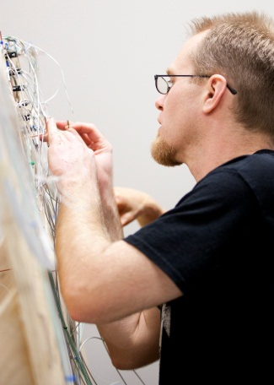
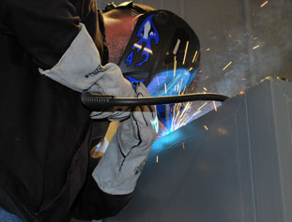
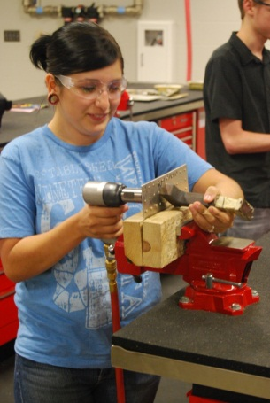
Dual Credit at USD 259 High School Locations
Automotive – North & South
Auto Body - South
Construction – (pending approval from KBOR) East, Heights, Northwest, & South
Machining – (under development)
Welding – Heights & West
CNA, CMA, HHA – West and North
Allied Health – West and North
Aviation – North and Northwest
HVAC (under development)
OSHA 10 – North and Northwest
Notes:
259

Slide 19
Post Secondary and Workforce Career Readiness Opportunities Emergency & Fire Management Services Hutchinson Community and USD 259 / 262 Schools
Firefighting (Receive college credit hours and/or credentialed certificate program). These courses will meet for three to five times weekly.
Introduction to LPSS 3 Credit Hours
Firefighting 1 3 Credit Hours
Firefighting 2 3.5 Credit Hours
LPSS Internship High School Credit .5-2.0 hrs.
Note: Dual/concurrent credit will be awarded to VC students enrolled in E & FMS Courses.
Notes:
259 then 262

Slide 20
Post Secondary and Workforce Career Readiness Opportunities Manufacturing Production Hutchinson Community College & NHS Brook’s Regional Center Valley Center High School
Welding Technology (Receive college credit hours and/or credentialed certificate program). These courses will meet for three or four consecutive periods daily.
Welding Technology 1 6 Credit Hours
Welding Technology 2 6 Credit Hours
Dual/concurrent credit will be awarded to VC students enrolled for Manufacturing/Production Courses.
Notes:
262

Slide 21
College Study, Concurrent Credit, & SB 155
2014 College and Career Readiness – Spring/Second Semester Student Participation
College Credit English 36 WATC/WSU@VCHS
College Speech 43 WATC/WSU@VCHS
College Algebra 15 WATC/WSU@VCHS
College Pre-Calculus 57 WATC/WSU@VCHS
College Study/Fire Science 5 @Maize/HCC/WATC
College Welding 1 @Newton/HCC
College Business Education 3 @WATC\
College Auto Service Technology 3 @WATC
College Aviation Tech/ HVAC/Welding 3 @WATC
College Human Anatomy & Phys. 51 WATC@VCHS
College Computer Aided Manf. 10 WATC@VCHS
College Allied Health C.N.A/CMA 3 @WATC
Career Residential Carpentry 11 HCC@VCHS
College Transportation/Auto Tech 30 WATC@VCHS
C.N.A Hybrid—16 weeks 19 WATC@VCHS
Total Student Participation 290 (increase +105 over FS (2013-14)
Most Courses OFFERED for CONCURRENT CREDIT 3 College Hrs. = .5 HS Dual Credit
Notes:
262

Slide 22
Valley Center USD 262 Credit & Tuition BENEFIT-SPRING 2014
Total College Credits and Tuition/Fee Cost Savings to Parents, Students, District, and Community as a result of Senate Bill 155 and WATC Reduced Tuition Fee
Total Tuition Hours Available to be Earned
1000
Total Dollar Savings in Tuition and Fees
$205,000
Notes:
262

Slide 23
Credentialing & SB 155 Reimbursement
CREDENTIALS Available For Students /Number Earned x $1K
AWS — Welding
C.N.A. — Nurse Assistants and Orderlies
MSSC/CPT — Manufacturing Skills Standards Council/Certified Production Tech.
ASE — Automotive Service Excellence – 4 Areas
HVAC/ICE/NCCER/NATE — Heating, Air Conditioning Technician
MTA — Microsoft Technology Associate
NCCER — National Center for Construction Education & Research Level 1
SB 155 Reimbursement from Post-Secondary Partners /Tuition $$$ x .75
Courses include: NCCER, Automotive Tech, CAM, Human Anatomy & Physiology
Notes:
259 then 262

Slide 24
Thank you for Your Participation Today
How Else Can We HELP YOU

Slide 25
Questions or Need Additional Information? Contact!
Jim Means, Executive Director of CTE
Career and Technical Education
Wichita Public Schools/USD 259
jmeans@usd259.net
316.973.4511
Diann Faflick, Career Facilitator
Career and Technical Education
Wichita Public Schools/USD 259
dfaflick@usd259.net
316.973.4511
PJ Reilly, District Director CCR/CTE/Adult Learning
Valley Center Schools/USD 262
PJ.Reilly@usd262.net
316.755.7070 Ext. 7114

