Slide 1
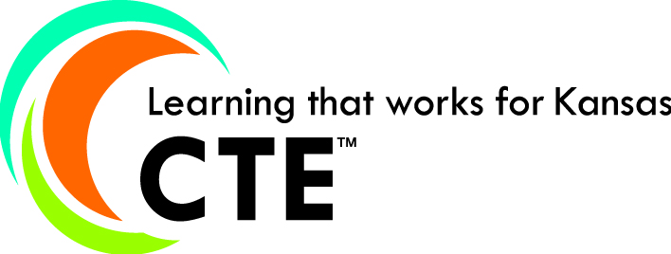
CTE Coordinators update
February 11, 2014
CTE Annual Conference
Manhattan
CTE Coordinators Update
Annual CTE Conference
Manhattan
February 11, 2014
Notes:
Take a photo to post to FB

Slide 2
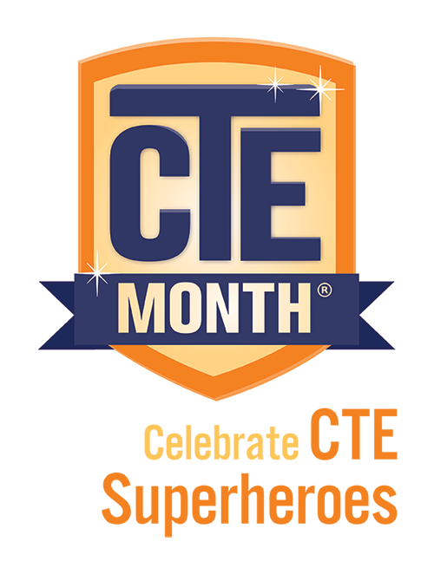
KSDE Facebook page

Slide 3
This is how Spring Hill rolls………

Slide 4
Notes:
As a school district, which of the following is your greatest strength in CTE? http://www.polleverywhere.com/multiple_choice_polls/3kWUVumoxCnY6ye

Slide 5
Notes:
Poll Title: In your school district, which of the following components of a CTE program needs the most improvement? http://www.polleverywhere.com/multiple_choice_polls/mXvFOuYd5jadENX

Slide 6
Notes:
What is the major obstacle standing in the way of CTE improving and growing in your school district? http://www.polleverywhere.com/free_text_polls/lZIkSwAhUMZFevX

Slide 7
KSDE CTE Goals: 2013-2018
Every Pathway has a Quality Improvement Plan Every Pathway has a True Statewide Articulation Agreement Every Cluster completes a Standards review Create a timely and relevant CTE Data system Provide Quality Professional Development for all CTE educators

Slide 8
Topic List for Today’s Session
Proposed Changes to Perkins*
New State-recognized Pathways
Tiered-funding model
Pathway Application*
Licensure update
Senate Bill 155
Alternatives to Industry-recognized Credentials or End-of-Pathway Assessments*
New Webpage
*Poll Everywhere text feedback

Slide 9
Proposed Changes to Perkins
Focused on Industry-recognized Credentials: program alignment and student attainment
Regional advisory committees (WIA-funded)
Funding Consortiums (regional, 1 post-secondary and surrounding secondary schools)
Increasing the amount of Perkins funds to be used for competitive grants or incentives for performance (currently 10%)

Slide 10
Notes:
Poll Title: Of the four proposed changes to Perkins, which one would you most support? http://www.polleverywhere.com/multiple_choice_polls/NyET4cFVHX9zVWG

Slide 11
Notes:
Poll Title: Of the four proposed changes to Perkins, which one would you support the least? http://www.polleverywhere.com/multiple_choice_polls/zmlwgyqGhyp5zXn

Slide 12
Notes:
What other changes would you like to see in the new Perkins? http://www.polleverywhere.com/free_text_polls/zLOys24YD3fdq5h

Slide 13
New State-recognized Pathways
When considering a new Pathway………..
1. Is it part of the national Career Clusters Model?
2. Does it lead to high-wage, high-skill, high-demand occupations?
1st step – KSDE CTE
2nd step - Kansas Advisory Committee for Career and Technical Education (KACCTE)
3rd step- Kansas State Board of Education

Slide 14
Funding CTE Clusters in a tiered system
Instead of universal 0.5 weighting for every CTE Cluster……..
Option 1 – weightings based on actual cost of Cluster.
Option 2 – weightings set up similar to KBOR model

Slide 15
Option 1 (based on 11-12 figures)
Option 1: CTE Cluster Weighting Based on Cost
Agriculture, Food & Natural Resources 1.1
Architecture & Construction 1.2
Arts, A/V Technology & Communications 0.5
Business, Management & Administration 0.6
Education & Training 0.8
Finance 0.7
Government & Public Administration 0.0
Health Science 0.8
Hospitality & Tourism 0.3
Human Services 0.3
Information Technology 0.9
Law, Public Safety, Corrections & Security 0.7
Manufacturing 1.1
Marketing 0.2
Science, Technology, Engineering & Mathematics (STEM) 2.1
Transportation, Distribution & Logistics 1.0
In 2011-2012, Option 1 would have required an additional $12 M to fund CTE Clusters

Slide 16
Option 2 (based on 11-12 figures)
Clusters with weightings over 1.2 2.1
Clusters with weightings of 1.0 to 1.2 1.1
Clusters with weightings of 0.8 to 1.0 0.9
Clusters with weightings of 0.6 to 0.8 0.7
Clusters with weightings of 0.4 to 0.6 0.5
Clusters with weightings of 0.2 to 0.4 0.3
Clusters with weightings of 0.0 to 0.2 0.0
Weightings for STEM is 2.1 (actual cost)
• Science, Technology, Engineering & Mathematics (STEM)
Clusters with weightings of 1.0 to 1.2
• Agriculture, Food & Natural Resources
• Architecture & Construction
• Manufacturing
• Transportation, Distribution & Logistics
Clusters with weightings of 0.8 to 1.0
• Education & Training
• Health Science
• Information Technology
Clusters with weightings of 0.6 to 0.8
• Business, Management & Administration
• Finance
• Law, Public Safety, Corrections & Security
Clusters with weightings of 0.4 to 0.6
• Arts, A/V Technology & Communications
Clusters with weightings of 0.2 to 0.4
• Hospitality & Tourism
• Human Services
• Marketing
Clusters with weightings of 0.0 to 0.2
• Government & Public Administration
In 2011-2012, Option 2 would have required an additional $9 M to fund CTE Clusters

Slide 17
Pathway Application
New features on the horizon
Piloting a self-assessment rubric this spring that will help develop a 3 year improvement plan
District-level Applications

Slide 18
Notes:
In the Pathways application system, what feature would you like to see added? http://www.polleverywhere.com/free_text_polls/TgSQm2EbROZC4bu

Slide 19
Notes:
In the Pathways application system, what current feature is no longer necessary? http://www.polleverywhere.com/free_text_polls/CEkwmiecZ2NIURh

Slide 20
CTE Teacher Licensure Update
Part-time “Permit” CTE certificate
To allow an individual with the experience, knowledge and skills to teach in a CTE pathway on a limited basis
The candidate would have to verify either work experience related to the CTE course(s) OR a degree/credential/passed a competency exam
Permit would be good for 3 years and the individual can only teach CTE in the school district identified on the certificate

Slide 21
SB 155 Excel in Career Technical Education Early Returns
*Estimates
Notes:
Bold innovative plan to enhance career technical education in Kansas---Recognition as “Top Ten Innovations to Watch” from Brookings Institute.
Aligns with Board goals--Board goals to increase number of Kansans with industry credentials & degrees and allows students to succeed in new Kansas economy. Skilled workforce is critical to keeping KS business competitive, rural communities health, and long-term econ growth for the state
Prepares students for college and career--Prepares students to enter workforce after graduation, continue in PS education and/or start a meaningful career while in college;
Great for students—allows them to begin an accelerated path toward a high demand technical career in an area in which they have an interest/passion, and the opportunity to earn college credit—tuition free
Promotes collaboration between secondary and postsecondary education—targets funding specific to CTE, promotes alignment of sec/PS CTE programs; efficiencies—equipment, instructors, facilities

Slide 22
Legislative change for Credential Incentive Program
Beginning with the class of 2014, graduates will now have until December 1 after graduating to earn an incentivized credential
2014 Graduates who earned a credential prior the end of May – report those students by May 30, 2014
If a 2014 graduate earns a credential after May 30, 2014, and before December 1, 2014, she/he need to be reported on the next school year’s report form (14-15 SY)

Slide 23
Recommendation for IPS
The Kansas State Department of Education strongly recommends that all districts implement individual plans of study (IPS) for all students in grades 8 through 12.
8th grade – career interest survey, develop individual plan of study (at a minimum, include career interests and all courses 9 – 12 + 1 year of post-secondary plans)
Notes:
Jay
First of all I want to thank Diann and Bill for presenting to us today. It’s always good to hear from the experts. And I’d also like to thank Kent Reed and Martin Kollman for their considerable efforts in evrything from developing surveys to providing support and guidance to educators regarding individual plans of study. Lastly I want to thank Suzy Oertel, our ELA consultant, who synthesized all of this information so nicely into the report and recommendation that Dr. DeBacker sent in her Friday notes. Being a former science teacher, I lean more towards technical writing so Suzy graciously stepped up and offered her time and talent.
The Kansas State Department of Education strongly recommends that all districts implement individual plans of study for all students in grades 8 through 12 with the IPS process beginning in 8th grade with career interest surveys and then developing an individual plan of study including courses from 9th grade through 12th grade and at least one year of post-secondary plans.
III. Be sure to touch on that, yes, the creation of the IPS is important but, even more important, is schools setting up a system where students consistently are referred back to the IPS, as students navigate their way through HS and into college and career, the IPS will serve as a guide. And as students career interests and talents change, so should the IPS change to reflect a new direction. If the IPS is created and then collects dust for the next 3 or 4 years while in HS, Its just another document with little meaning. It’s crucial schools set up a system where students are consistently re-engaged with their IPS to keep their focus on their hopes and dreams for college and career.

Slide 24
Reasons for IPS
Relevant → Higher Student Engagement
Efficient
Cost-effective
Cause more students to complete post-secondary training
Notes:
We base this recommendation on 3 reasons:
Best practice
Accreditation model – under career awareness and guidance, if schools want to be in the top category, all students in HS will have to have an individual plan of study
KSDE will provide support – we have a template of an IPS, we will provide trainings

Slide 25
Notes:
What other summative measures of student performance could serve as alternatives to industry-recognized credentials or end-of-pathway assessments? http://www.polleverywhere.com/free_text_polls/OjH8AmId4Os8GFl

Slide 26
New KSDE Website
KSDE CTE webpage

Slide 27
Q & A

