Slide 1
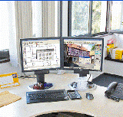
MATC CAD Collaboration
Presented by:
Norm Delay
Manhattan Area Technical College
Manhattan, Kansas
Presentation materials may be found online at: smokyhill.org/vnews/display.v/art/4c87b3ca37004

Slide 2
Presentation
- about the continuing collaboration between the Olathe North High School Culinary Arts students and the CAD Technology students at Manhattan Area Technical College that started in the Fall of 2008.
- how the project was conceived, the problems encountered with creating the project, issues that had to be addressed, and how the project has evolved.
- creating your own projects of this type.

Slide 3
Introductions first
My Back Ground
About The CAD Technologies Department at Manhattan Area Technical College
Notes:
I have 29 years of drafting experience with 5 years of running my own detailing company. I have drafting/design experience in the areas of Heating Boilers, Fire Fighting Vehicles, Pre-stressed Concrete, Aircraft Composite Plastics, Pneumatic Conveying Equipment Design, Extruded and Injection Molded Plastics for Domestic Water, Geo-Thermal Heating and Fire Protection, Concrete Grain Storage Facilities and Electrical Design.
I Came to MATC in the Fall 2005 where I teach 9 courses that draw upon my drafting/design experience.
The CAD Technologies department at MATC offers an AAS degree in three semesters. The department has a total enrollment of 30-45 students; with 10-15 new students each semester starting the program. The department teaches courses covering a broad range of drafting types; from hand sketching, concrete detailing, electrical, plumbing, HVAC detailing, wood construction detailing, steel detailing, machine detailing using Inventor, civil drafting (both Civil 3D and Microstation software packages are taught), AutoDesk Revit Design Suite (Architectural, Structural and MEP) and AutoCAD including both 2D and 3D design. We purchased a 3D printer to further enhance our 3D teaching capabilities.

Slide 4
Manhattan Area Technical College
DFT 215 commercial architectural drafting project scope
Notes:
DFT 215 is a course on the different types of commercial detailing. It covers items from commercial door framing to emergency exit stairs and some steel construction detailing. The majority of this course is now devoted to this “real world” project. I traditionally have 18-22 students in this course during the spring semester. This number matches very closely to the number of students in the Olathe class.

Slide 5
The project
The project covers the creation of a concept restaurant by the Olathe student’s, the transfer of that information to the MATC students via sketches, and the drawing/design of that student’s restaurant by the MATC CAD students.
Notes:
How it came about: Olathe North High School Culinary Arts instructor, Mike Chrostowoski, and myself where taking courses through Pittsburg State University. After he found out what I taught he approached me with an idea. To have his students design and sketch a restaurant and then have my college students complete the process in AutoCAD. Chef Mike’s students where already doing the design of the restaurant for their exit projects, but did not have finished drawings to use in their presentations.
When Chef Mike approached me it was late in the spring semester, early summer. I thought the idea sounded intriguing and agreed to work with him and his students. Little did I know that he was talking a start date of that fall. Needless to say I had to scramble to get ready for the semester. The first year was a bit rough, but we got through it and learned a lot of lessons.

Slide 6
Olathe to manhattan a transfer of information

Slide 7
Drafting Contract with students
TO: _______________, Manhattan Area Technical College
__________________, Culinary Arts, Olathe, KS requests you to prepare the following:
Description of work: Drawings for a restaurant concept, these will include the following:
Floor Plan – overall building layout with dimensions, patios, parking and major appliances in the kitchen and bar area, and door/window schedules.
Lighting Plan – building outline with overhead and ambiance lights with switches.
Seating Plan – building outline showing seating arrangement.
Three preliminary drawings will be required.
A preliminary floor plan drawing will be submitted for red-lining and approval on or before ____ 2009.
A preliminary lighting plan drawing will be submitted for red-lining and approval on or before ____ 2009.
A preliminary seating plan drawing will be submitted for red-lining and approval on or before ____ 2009.
The red-lined/approval drawings will be turned in on or before listed due dates for grading.
All communication between yourself and ___________, Culinary Arts, Olathe, KS will be documented. This will be discussed during lecture.
Due date: Final drawings __________ 2009
Notes:
Contract based on a real world drafting for hire contract that I have used in the past, modified to suit this project. Students are “paid” with a grade upon completion of the project. Drawings that are to be completed and due dates are specified in the contract, much as they would be in a drafting business contract. The scope of each drawing is then later discussed during lectures and with lesson handouts.

Slide 8
Student handouts
Project overview sheet
CA 601 Floor/Foundation Plan Lesson Plan
CA 602 Seating Plan Lesson Plan
CA 603 Lighting Plan Lesson Plan
CA 604 Renderings Lesson Plan
Notes:
This project has four parts to it, each is a completed drawing having varying point values and requirements. Some of these drawings are sent to Olathe for redlining by the student owners.

Slide 9
Final project points listing
Introduction: This project is a collaborative project between the DFT 215 CAD students of Manhattan Area Technical College and the Culinary Arts students from area high schools in Olathe Kansas. As such this project weighs heavily on your final grade, accounting for 47% of your final grade overall.
Not only is your grade for this course at stake, the grade of the Culinary Arts student and the reputation of MATC is on the line. Each student or team of students in this course will be assigned a student or team of students from the Culinary Arts Academy to work with.
This project is “real-world” and as such you will be signing a contract with the CAD Technology department for this project.
Below is the point schedule for this project along with important due dates.
Final Project List POINTS DUE DATES
Preliminary Drawings
Floor Plan 50 pts
Lighting Plan 50 pts
Seating Plan 50 pts
CA 601 Foundation/Floor Plan 150 pts
Foundation plan 50 pts
Floor plan 100 pts
CA 602 Seating Plan 75 pts
CA 603 Lighting Plan 75 pts
CA 604 Renderings 50 pts
Documentation - Presentation 75 pts
Total Points Possible 575 pts
Notes:
As with most every assignment in academia, this is a living document. I have changed the point values for the assignments over the semesters and have also added new drawings to the project. With this assignment moving into a 3d software package I was able to expand the project to include more drawings along with several rendered views of the completed project.
The total project accounts for almost half of the students final grade for this course. In addition I also have four other drawing assignments and several exams that make up the remainder of the students grade.
The student will be researching requirements for ADA seating, area required for passage by people with mobility impairments, the requirements for a sight impaired person to maneuver in this type of environment and all aspects of table sizes, seating arrangements and traffic walkways between seating groups. I have found several good websites for this research and share the addresses with the students.
This drawing is sent be redlined by the Olathe High student. The students are expected to discuss thoroughly the seating arrangements with their assigned student owner and to discuss all aspects of ADA seating requirements.
The lighting portion of the project is next. The student during this phase will be researching codes to insure that lighting for the restaurant meets code in all area of the design. This drawing is not sent to the student in Olathe for redlining as it is completed late in the semester and there would be little or no time for this process to be completed. The students handle the details of lighting, lighting types and placement by email and telephone conversations.
Renderings are required to complete the project. The Olathe Culinary Arts Students have used these in past exit presentations to show how the restaurant will look.
To incorporate the documentation section, the MATC students have to complete a presentation to a panel of college faculty and their fellow classmates. This also reinforces speaking skills, presentation skills and gives them a chance to show their work.

Slide 10
Foundation/Floor plan handout
Job Skill Demonstration Lesson
Lesson Title - CA 601 Restaurant Floor Plan
Lesson Objective – Upon completion of this lesson the Student should be able to:
Layout drawing to show necessary views for a floor plan.
Draw building floor plan for a commercial restaurant building based on customer sketches.
Designate fire exits on building floor plan.
Create multiple views at differing scales.
Communicate effectively with the customer.
Drawing must be to scale and with correct plotted line weights.
Understand and effectively demonstrate time management skills.
Introduction: This project is a collaborative project between the DFT 215 CAD students of Manhattan Area Technical College and the Culinary Arts students from area high schools in Olathe Kansas. As such this project weighs heavily on your final grade, accounting for 47% of your final grade. This portion of the project accounts for 150 points. The project will be worked on the entire semester with assignments due throughout the semester.
Students will be completing both a foundation plan and a floor plan for their assigned project. Research will need to be done on ADA requirements for building accessibility, fire escapes per code, and commercial grade equipment sizes.
The foundation plan will be worth 50 points and the floor plan will be worth 100 points.
Notes:
The first part of the project is to complete a first draft floor plan that will be sent to the student at Olathe High for redlining. Only the floor plan is sent for redlining as the foundation has nothing that would change. This handout shows what is the minimum requirements for this part of the project are.

Slide 11
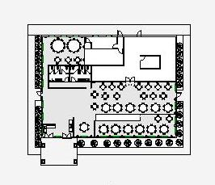
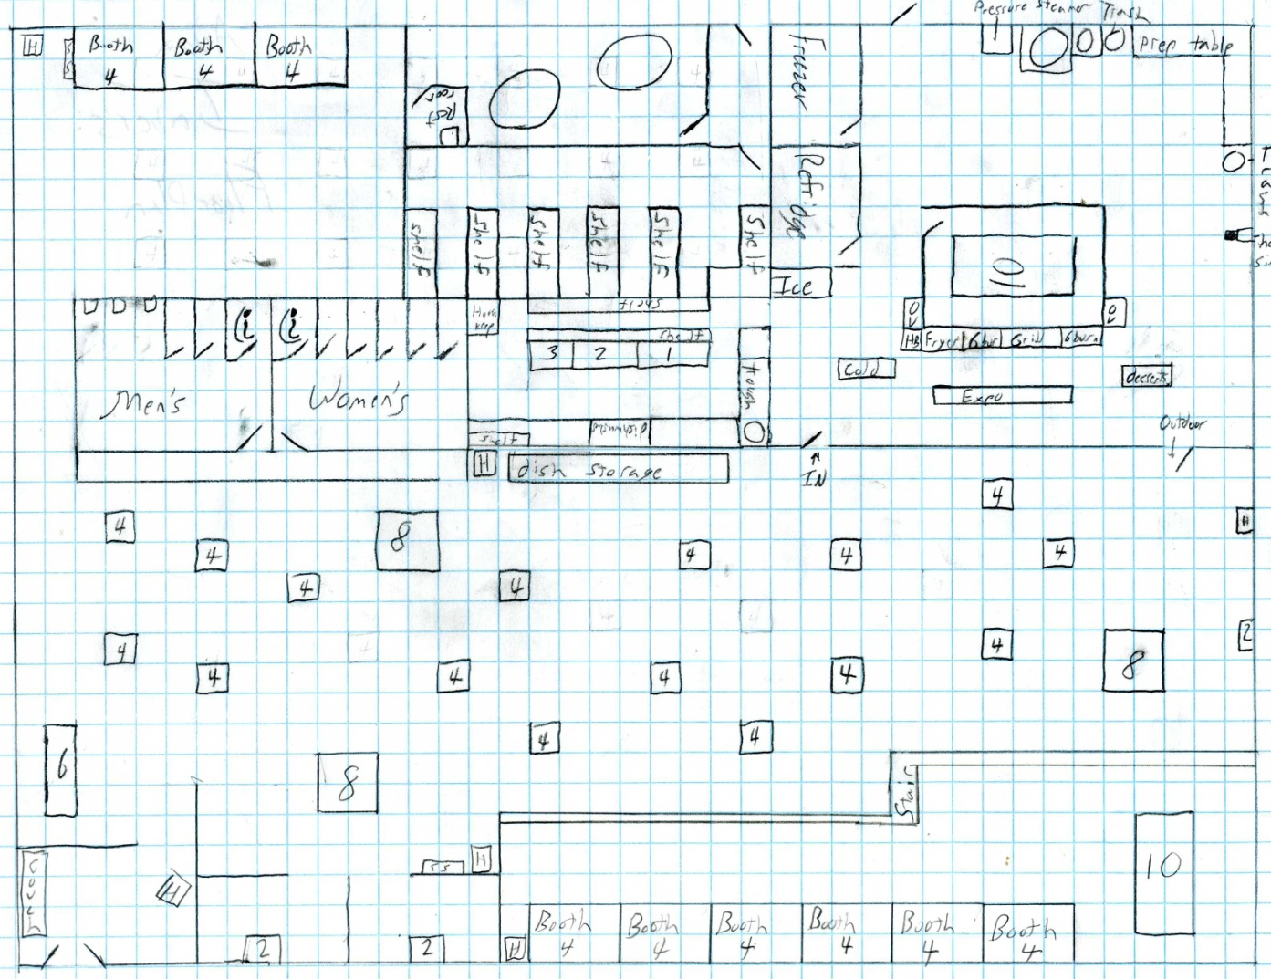
Sketches to first draft drawings to redline drawings
Notes:
Drawings sent to Olathe for redlining, as both a hardcopy and electronic file.
Redlining is the process where the owner receives a copy of the drawing or drawings and proceeds to review these drawings for any errors that may have occurred during the design process. This would include moving doors and windows, adding additional seating areas, changing the entrance design, all types of corrections would be made at this time. The drawing with the markings would then be sent back to the drafting contractor and they would proceed to make the necessary adjustments to the drawings; of course anything that would be a code violation would be discussed with the owner and the proper adjustments would be made on the drawings.
After the first set of redlines have been reviewed, the MATC student would proceed with completing the floor/foundation plans and continue on with the next drawing in the project. Any further discussions on the floor plan would take place via email or telephone conversations.

Slide 12
Problems encountered during the project

Slide 13
Redline drawings
Understanding what the customer meant with redlines on drawings.
Notes:
Communication with redline drawings between customer (non engineering/drafting) and the contract drafter is sometimes difficult at best. What the customer may want and what is being put on the drawings in the form of redlines is not always the same. Several phone calls/emails are generally necessary at this stage to insure that the customer gets what they really want. Code infractions, over crowding, misunderstanding the actual size of equipment where just a few of the problems encountered during this phase of the project.

Slide 14
Communications student TO student
Email
Problems
Telephone/Cell Phone
Problems
Face to Face Meeting
Problems
Video Conferencing
Notes:
Email worked once we got the right email addresses to everyone. Problem was that not everyone was checking their email daily. Thus several days would pass before I would get a panicked student in my office as the deadline approached for a drawing and they where still waiting on a response.
Telephone/Cell phone conversations are hard to document unless you are used to doing such. What needed to be done here was a hardcopy/email follow-up on the phone conversation so that both students where sure that what they said and wanted was heard and being worked on by the other student.
Face to face meeting would have been invaluable, however due to budget cuts, we could not arrange this. The solution was a video conference. This to had its problems, by the time we had worked out all the kinks at both Olathe North and at MATC, it was to late in the semester for this to be of any value. I am hoping that this fall this will happen during the first few weeks of the assignment. I would rather have a face to face meeting, but again due to budget constraints this may not be possible.

Slide 15
Examples of the finished project

Slide 16
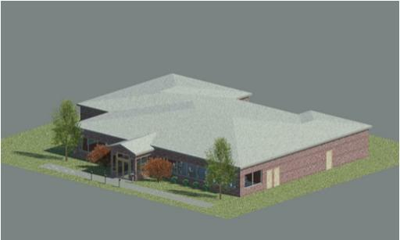
Final project drawings
Starting with the Fall 2009 semester, the projects are being done in AutoDesk Revit®.
Notes:
The following views are taken from AutoDesk Revit. This software is designed for this type of project and is being used by more Architectural and Interior Design firms around the world. The software is 3d based. These views where rendered within the program from the 3d model. This capability of the software makes it much easier to get presentation level views or even walkthroughs of the building.

Slide 17
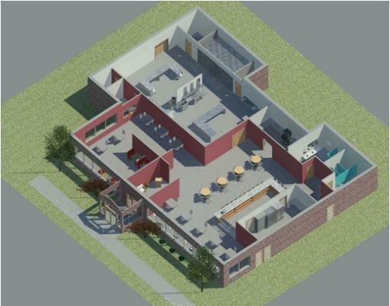
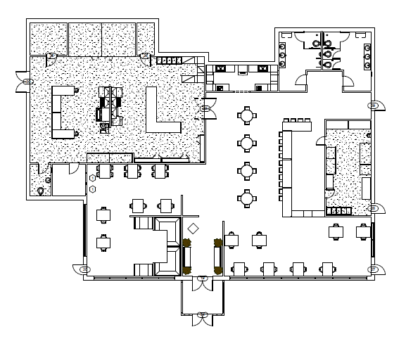
Final project drawings & renderings
Notes:
This slide first shows the line drawing of the view. The second shows the same view as rendered in Revit.

Slide 18
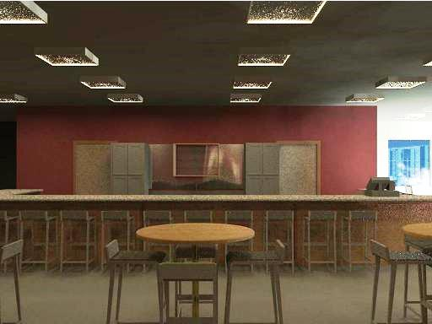
Final project Renderings
Notes:
This is the interior of the bar area.

Slide 19
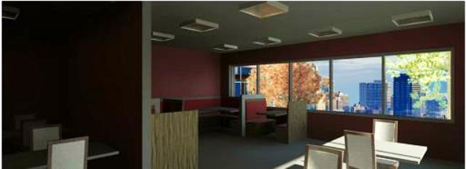
Final project Renderings
Notes:
This is the interior of the restaurant seating area.

Slide 20
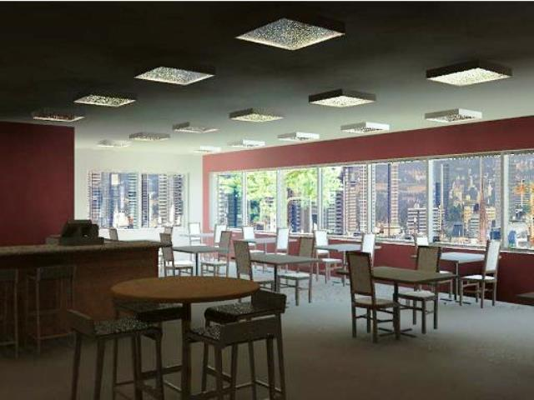
Final project Renderings
Notes:
This is the interior of the restaurant seating area.

Slide 21
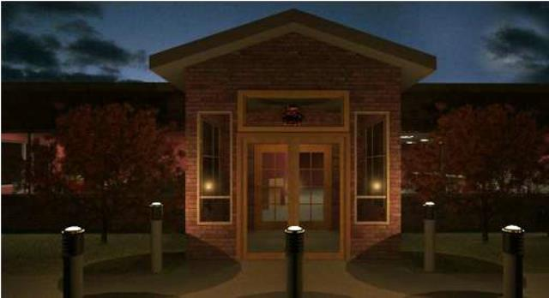
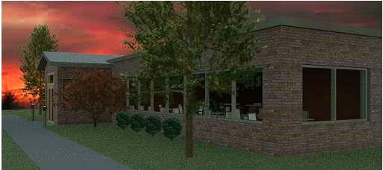
Final project renderings
Notes:
The first image is of the front entrance in early evening.
The second image is of the front entrance after dark.

Slide 22
Possible course incorporations
AG Studies
Welding
Construction Studies
Wood Shop
Machine Shop
Manufacturing Studies
Culinary Arts
Metals Shop
History
Dental
Biology
Chemistry
Nursing
Aeronautics
Robotics
Art Appreciation & History
Drafting Technology
Notes:
Now how can you start your own collaboration with another department at your schools, colleges, wherever. Here are just a few department/class listings to get you started thinking.
How could you tie some of these together? Now being in the drafting business, I can make a connection between most of these back to a drafting program. For instance, Dental Hygiene to drafting? Have the drafting students create a 3d model of a set of teeth. Then give them to dental to use a study tool. If it is done with the right materials, an instructor might even be able to paint cavities on the teeth. You could even go as far as breaking the jaw bone so the student would have that classroom experience.

Slide 23
Think about how you can incorporate this into your curriculum
Now consider how you could combine them into a larger project.
Consider including a college or school department that has a 3D printer and watch the ideas expand.
Notes:
Olathe North High School and MATC have collaborated in the creation of the culinary arts students restaurants. But I am fairly certain that sitting out there is someone with what they consider a wild idea for a project. They just need the right people to talk too about it to make it come to life.

Slide 24
Possible curriculum combinations
3D projects:
Chess sets
Room models
School tokens
Chemistry displays
DNA Models
Dental Models
Pre-Project Models
Historical buildings
3D Masterpiece Art Works
Notes:
A CAD department could draw a 3d model of your school, then have it printed out in sections to be used as a display. Or a historically important building, or battle field could be drawn in Civil 3D for your history students to look at. I am currently working with MATC’s BioSceince department on printing a 3D model of a DNA strand.

Slide 25
Incorporating this into your curriculum
All these projects/assignments could be started in one course/class, sent to the CAD class for drawings/models and then returned to the original class for follow-ups.
Let your imagination wonder!!
Think outside the box!
Any assignment that could include drafting style drawings is an opportunity.
Students at MATC have done design drawings for homes, public swimming pools and more.
CAD students have completed a 3D project of the entire MATC campus including landscape.
Notes:
If you can work with a college drafting department you could have them do prototype drawings for a small scale trebuchet or pumpkin catapult for a school design contest. I mentioned on an earlier slide, robotics. Imagine your drafting department designing a robot for a simple function, then having the shop class actually building the parts to be assembled, or using a 3d printer making the parts.

Slide 26
How you can also incorporate this into your curriculum
Contact a Technical College that has a CAD or Engineering Technology Department. Talk with the faculty about your ideas.
Talk with your schools Drafting faculty about ideas.
Talk with other faculty at your own schools and colleges for possible ideas for collaboration projects.
Notes:
When contacting a college or technical college I would strongly suggest that if all possible that you keep it within your local area. As I stated earlier in this presentation, getting students face to face is difficult if the distances are very far.

Slide 27
Questions and answers

