Slide 1
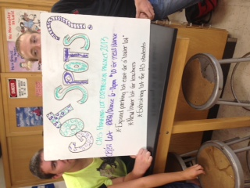
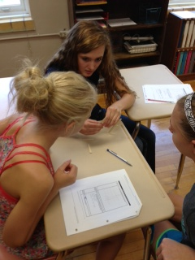
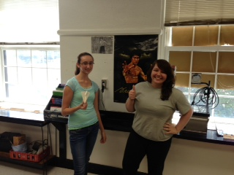
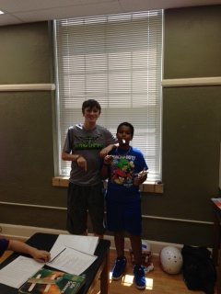
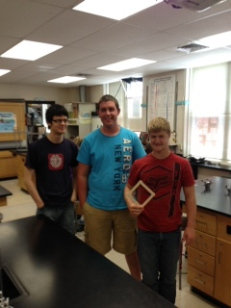
PAWS
Concordia Junior-Senior High School

Slide 2
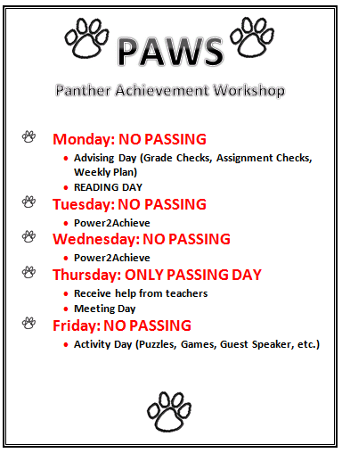

Slide 3
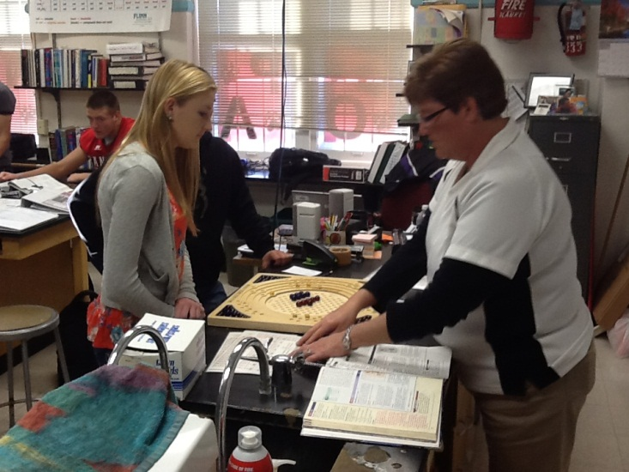
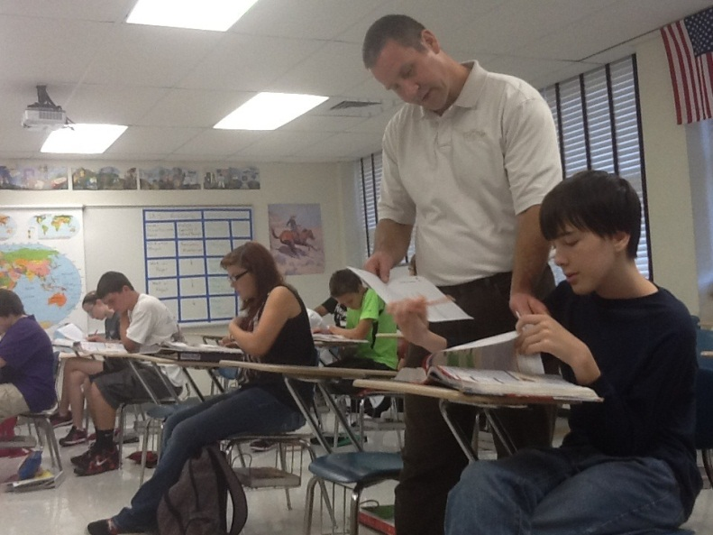
Advising Day
One-on-One student check
Grades
Missing Assignments
Weekly Plan
7th & 8th Grade Students receive Assignment Log
Attendance
Literacy For All
Silent Sustained Reading
English Language Arts and Literacy Standards
Roll-out of new strategies

Slide 4
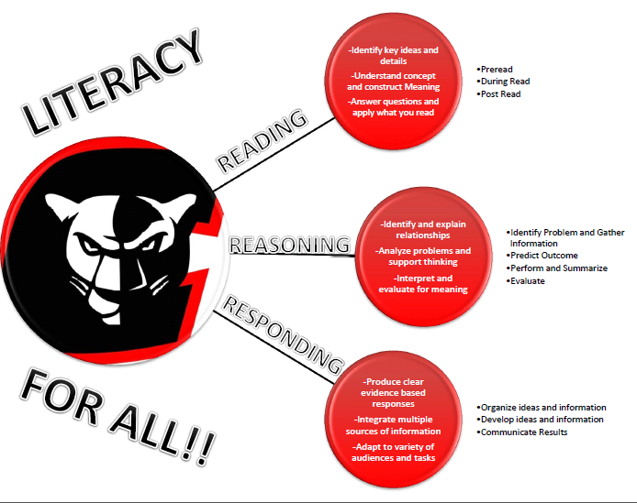

Slide 5
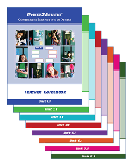
Power2Achieve
Power2Achieve® curriculum resources have been designed to help schools shape an intentional culture of excellence and ethics in order to increase academic achievement, improve student retention, enhance college and workforce preparation, and reduce disciplinary problems.
• Response to Intervention (RTI)
• Safe & Supportive Schools (S3)
• Core Curriculum Standards
• Social-Emotional Learning (SEL)
• Positive Behavior Interventions & Supports (PBIS)
• College and Career Readiness
• 21st Century Workforce Skills

Slide 6
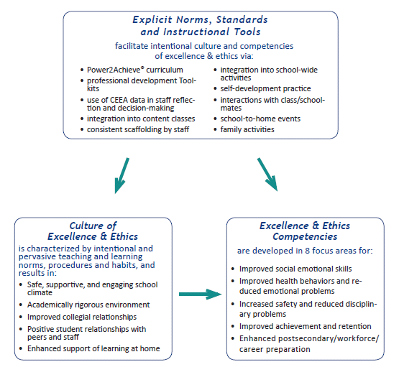

Slide 7
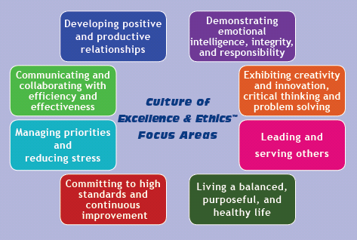
Curriculum targets the following focus areas:

Slide 8
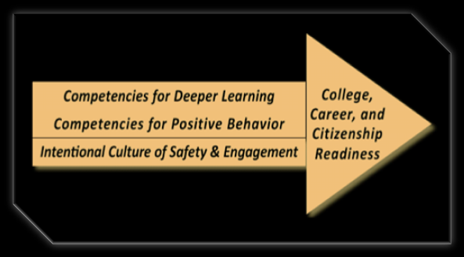
21st Century Outcome Ready

Slide 9
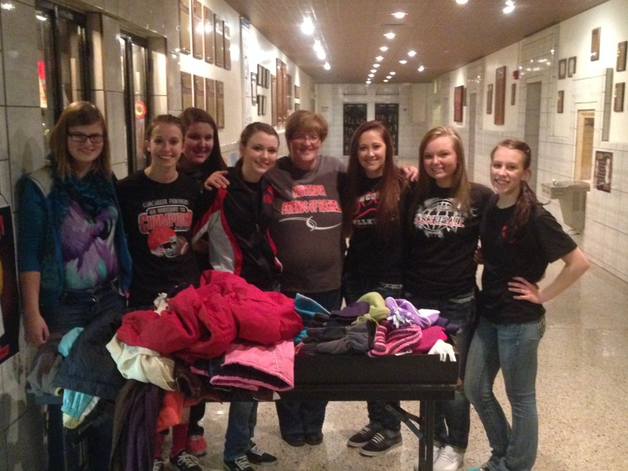
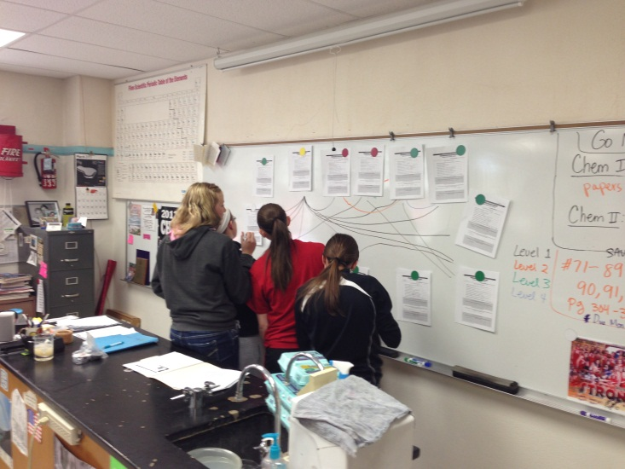
Meeting Day and Enrichment
Organizational Meetings Scheduled
Each Organization meets 1 time per month
Schedule 2-3 meetings every Thursday
Enrichment
One-on-one guidance from teachers
Test make-up
Assignment make-up
Lab opportunities

Slide 10
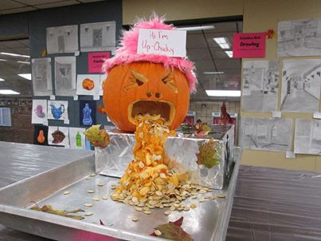
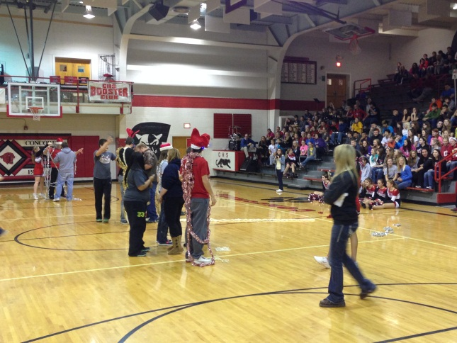
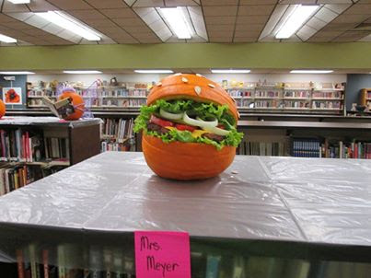
Activity Day
PAWS Competitions
PAWS Team Building
Reward Days
Pep Assemblies
Motivational Speakers
Career Exploration/Presentations
Winter Olympics

Slide 11
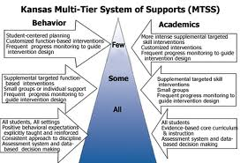
Student Intervention Service
Focused PAWS time
Small Group (Tier 3 Students)
Monday, Thursday, and Friday
At-Risk Teacher
Gathers missing assignments
Develops To-Do List for students
Helps tutor
Communicates with students teachers

Slide 12
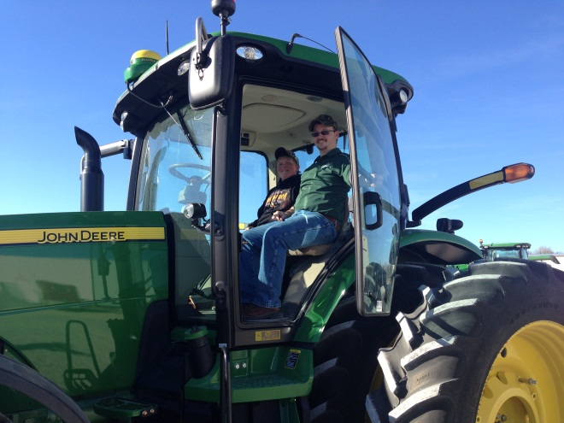
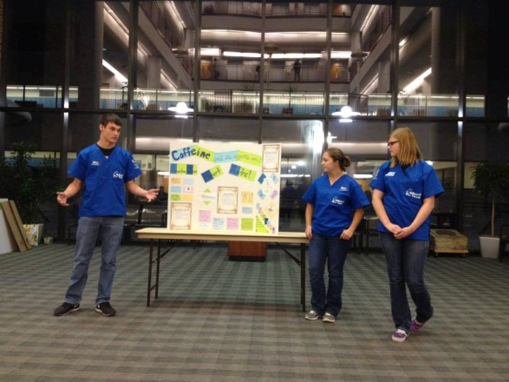
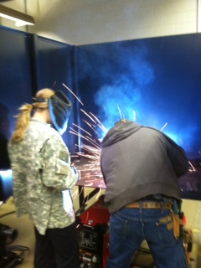
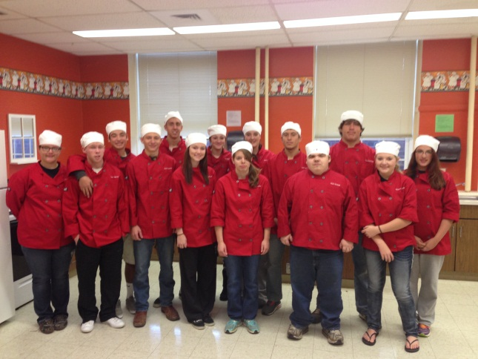
Future Ideas
Counseling Small Groups
Career Cruising
Interest Inventory
Learning Styles Inventory
Course Planning
Career Planning
Life Planning
Portfolio

Slide 13
Thanks!!!
Quentin Breese, Principal
qbreese@usd333.com
Bryce Wachs, Assistant Principal
bwachs@usd333.com
Cyndi Atwell, HS Counselor
catwell@usd333.com

