Slide 1
Travis Riebel- Director of CTE
Laura Benscheidt- Health Science Instructor

Slide 2
Our Mission: STUDENTS WILL GRADUATE WITH THE KNOWLEDGE, SKILLS AND BEHAVIORS TO BE COLLEGE AND CAREER READY

Slide 3
Pathway to employment
21st century life places complex demands on graduates looking for work – so enabling students to become self-confident, skilled and career-ready learners must be an integral part of their education.
Developing students for success in employment
Students in the CP develop skills that are genuinely valued by employers. The program’s curriculum framework develops:
linguistic proficiency or advancements
critical thinking skills
maturity and responsibility
time management skills
a strong work ethic
social and communication skills.

Slide 4
Just what is the International Baccalaureate?
The IB is unique because of its academic and personal rigor.
The IB aspires to help develop well-rounded students who respond to challenges with an open-mind, are confident of their identities, make ethical decisions, and are prepared to apply what they have learned in real-world, complex and unpredictable situations.

Slide 5
[
Depending on the school, a student may go for the full IB Diploma or take individual courses. Exams (fees) are marked externally by graders world-wide. College credit may be awarded depending on final scores.

Slide 6
So what is IBCP?
The International Baccalaureate® (IB) Career-related Programme (CP) is a framework of international education that incorporates the vision and educational principles of the IB into a unique program specifically developed for students who wish to engage in career-related learning.
The CP’s flexible educational framework allows schools to meet the needs, backgrounds and contexts of students. CP students engage with a rigorous study program that genuinely interests them while gaining transferable and lifelong skills.

Slide 7
What the CP offers students
The CP provides a comprehensive educational framework that combines highly regarded and internationally recognized courses, from the IB Diploma Programme (DP), with a unique CP core and an approved career-related study.
The CP develops students to be:
Academically strong
Skilled in a practical field
Critical and ethical thinkers
Self-directed
Collaborative
Resilient and determined
Confident and assured
Caring and reflective
Inquirers

Slide 8
*Take 2 DP courses & the exams (fees)
*Take the Personal & Professional Skills course
*Complete the Language Development component
*Complete the Service Learning component
*Complete the Reflective Project
*Career-related Studies: Earn either a
certification or be a completer
of an approved pathway

Slide 9
*Service Learning: *Personal and Pro Skills:
-50 hours minimum in pathway -5 themes to be covered:
-portfolio required w/ 5 outcomes Applied ethics
-3 formal interviews Effective communications
Intercultural understanding
*Reflective Project: Personal development
-Identify, discuss, evaluate an ethical Thinking processes
dilemma in your pathway
-Write a 3000 word paper or do a combo *Language Development:
of paper and project -Student learns or works on basics
of a 2nd language but also learn terms,
phrases fitting with the chosen path
-portfolio of progress maintained

Slide 10
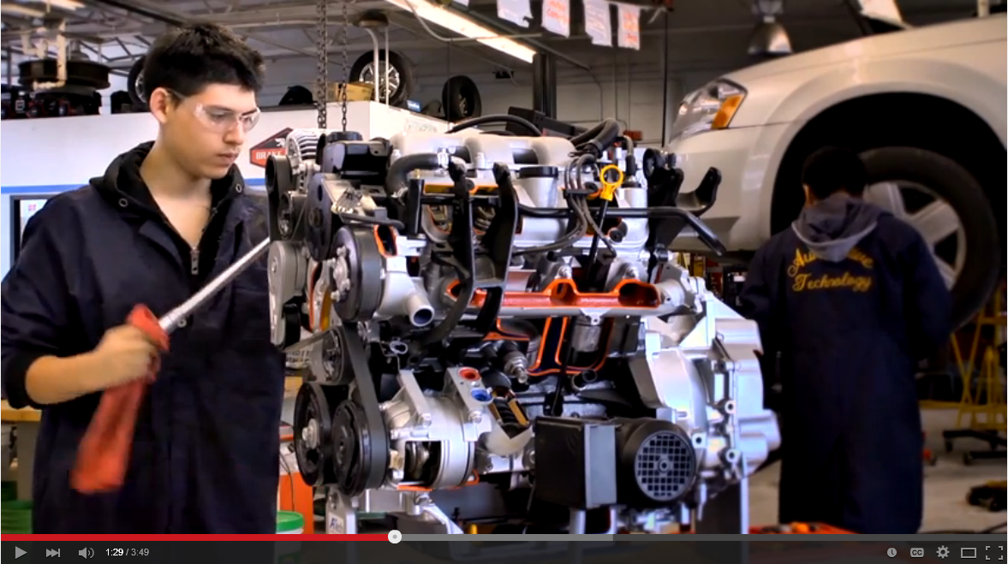
IBCP Video

Slide 12
How is a school authorized and reviewed?
App for Candidacy: $4000/ App for Authorization: $8000/ Annual fee: $8500 if only IBCP

Slide 13
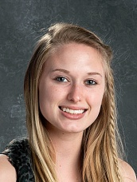
IBCP Candidate | Jadyn
Career Pathway | Health Science
Career Interest | Physical Therapy
First HHS/HCTEA IBCP Completion Candidate
..\..\IBCP\Jadyn Pledge.pdf
..\..\IBCP\jadyn project.pdf

Slide 14
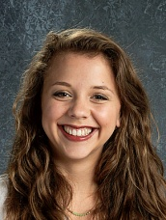
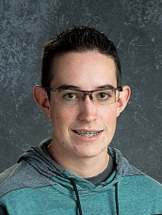
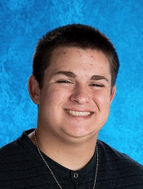
IBCP Candidate | Lance
Career Pathway | Engineering Applied Mathematics
Career Interest | Aerospace Engineering
IBCP Candidate | Julia
Career Pathway | Business Finance
Career Interest | Fashion Design
Class of 2017
IBCP Candidate | Nick
Career Pathway | Information Technology
Career Interest | Computer Networking
IBCP Candidate | Zach
Career Pathway | Health Science
Career Interest | Sports Medicine/ Rehab Medicine

Slide 15
Thank You!
To Learn More:
riebel.travis@usd308.com
benscheidt.laura@usd308.com
iba.org IB of the Americas (regional office)
IB Global Centre, Bethesda 7501 Wisconsin Avenue, Suite 200 West Bethesda, Maryland 20814

