Slide 1
Westar Energy and Topeka Public Schools STEM Education Partnership C. Patrick Woods Director of Talent Management & Diversity Westar Energy Eileen Caspers General Director of School and Career Programs Topeka Public Schools, USD 501 Michelle De La Isla Diversity and Inclusion Representative Westar Energy
WestarEnergy.com
Notes:
Westar Energy is the largest Electric Utility in Kansas serving 700,000 Customers across the eastern half of the state. Our mission is to provides safe, reliable, high quality electric energy service at a reasonable cost to all customers. We currently employ around 2300 Employee’s, just over half of our employees are in union or craft related positions, and half in our non union, corporate, supervisory roles.

Slide 2
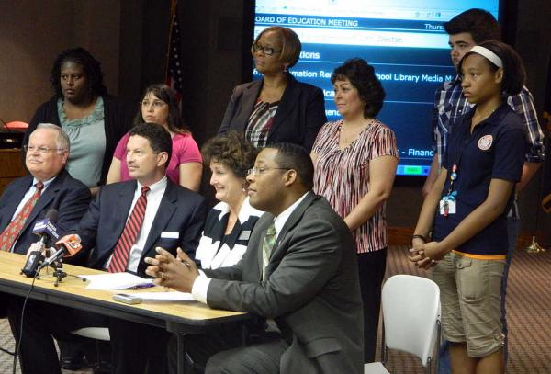
How we got here…
USD 501, Westar partner on career pathways
Topeka Capital-Journal – April 5, 2012
WRi & TPS Partnership Agreement 2016

Slide 3
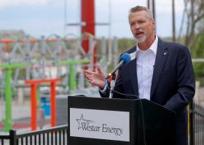
How we got here…
USD 501, Westar Energy Unveil “Education Station”
Topeka Capital-Journal – April 30, 2014
WRi & TPS Partnership Agreement 2016

Slide 4
Partnership: 4 significant components:
Promotion and enhancement of traditional Science, Technology, Engineering and Mathematics
Westar to serve as Industry Partner for STEM at the district’s new Topeka Center for Advanced Learning and Careers
Enhanced focus on experiential learning and STEM-related careers (both craft and professional)
Continuing Westar’s commitment to community (investment, engagement, volunteerism)
WRi & TPS Partnership Agreement 2016

Slide 5
1. Promotion and enhancement of traditional STEM
Westar becomes an industry partner for the STEM disciplines in the district, allowing Westar to be a partner in teaching and learning in the district in two ways:
The “What” –Though limited by state requirements for course offerings, the district has created new course offerings (STEM pathway courses, Energy Industry Fundamentals course, Power Plant Tech and Electrical Service/Line courses through post-secondary partnerships, etc.).
The “How” – By providing support to teachers looking to use new instructional practice that emphasizes practical application (i.e. field trips, interdisciplinary assignments based on real-life/energy industry topics, new options for hands-on learning, Externships for educators, etc.).
WRi & TPS Partnership Agreement 2016

Slide 6
1. Promotion and enhancement of traditional STEM
As one of the district’s industry partners for STEM, Westar collaborates with the district on everything from teacher professional development, curriculum writing in associated areas, to providing guest speakers for relevant courses, etc.
The district, with no request from Westar, recognized the company’s commitment to the community and its youth by naming a new facility at Kanza Education and Science Park the Westar Energy Education Center.
WRi & TPS Partnership Agreement 2016

Slide 7
2. Topeka Center for Advanced Learning and Careers
The TCALC program, a new program that is slated to begin in two academic years, will provide students with unique hands-on opportunities to apply their learning through interaction with business and industry in a new TCALC facility (financed by a bond initiative approved by Topeka voters in 2014).
On this campus, students will come to work on projects in consultation with business partners in multiple sectors (energy, health, human services, etc.) and undergo advanced studies in related disciplines.
WRi & TPS Partnership Agreement 2016

Slide 8
2. Topeka Center for Advanced Learning and Careers
Westar will be the industry partner for the district’s Environmental Science, Engineering, and Energy program established in TCALC.
TPS enhanced its STEM offerings so that they meet the requirements of the KSDE-approved STEM pathway, including courses relevant to the electric utility industry (Energy Industry Fundamentals, Power Plant Technology, etc.).
Westar maintained and later expanded its scholarship program, awarding 12 students pursuing education in 4 year programs as well as 4 pursing skilled craft degrees (This is a program open to students statewide).
WRi & TPS Partnership Agreement 2016

Slide 9
3. Experiential Learning and STEM-Based Careers
Westar and TPS work as partners to increase the knowledge of students of all ages of STEM-related career opportunities, through programs such as:
Westar Corporate Bigs Program
EYF
EYF-Corporate
Youth Entrepreneurs Partnership
Westar Energy Job Shadow Program
Fleet Services Internship Program (in partnership with Washburn Tech Auto/Diesel program)
WRi & TPS Partnership Agreement 2016

Slide 10
3. Experiential Learning and STEM-Based Careers
Likewise, we partner to increase the knowledge of staff about STEM-related career opportunities, practical application of STEM disciplines, and leadership principles through efforts such as:
Summer externships for relevant course instructors;
Job shadowing for senior leaders and members of the TPS Minority Leadership Academy;
Access to Westar’s Learning and Talent Development courses for TPS staff
Access to Westar leadership meetings for TPS senior leaders
WRi & TPS Partnership Agreement 2016

Slide 11
4. Commitment to Community
Westar will build on its investment in students and education through efforts such as:
Maintaining and expanding its scholarship program for all Kansas students.
Promoting volunteer opportunities in TPS schools for Westar employees.
Westar has at least one key leader per year to participate in the district’s Principal for a Day Program.
WRi & TPS Partnership Agreement 2016

Slide 12
STEM Pathway Creation
Kansas Energy Workforce Consortium (KEWC)
Established in May 2012
Collaboration with industry and education partners
Connection to the Center for Energy Workforce Development, the national organization for industry standards and certification in Energy
Component of Charter: Education Partnerships to fill the Energy Workforce Pipeline
WRi & TPS Partnership Agreement 2016

Slide 13
STEM: Energy Pathway Timeline
Nov 2014 – Presentation to KSDE BOE for pathway approval
2014 – Identified Intro, Technical, & Application –level courses
2013 – Pilot 3 locations
2014 - Developed STEM: Energy Pathway instead of a cluster
Spring 2015 schools submitted for STEM: Energy Pathways for 2015-16
2014 – Identified Industry Certifications
WRi & TPS Partnership Agreement 2016
Notes:
3 Locations: Pratt Community College, Flint Hills Technical College, and Cloud County Community College

Slide 14
STEM: Energy Pathway
WRi & TPS Partnership Agreement 2016

Slide 15
Next Generation Science Standards
● HS-PS3-3 Energy Content Standard: Design, build, and refine a device that works within given constraints to convert one form of energy into another form of energy.
● Science and Engineering Practice Standard: Developing and Using Models- show relationships among variables between systems and their components in the natural and designed worlds.
● Science and Engineering Practice Standard: Planning and Carrying Out Investigations- individually and collaboratively to produce data to serve as the basis for evidence, and in the design; decide on types, how much, and accuracy of data needed to produce reliable measurements and consider limitation on the precision of data.
● Science and Engineering Practice Standard: Using Mathematics and Computational Thinking- create a computational model or simulation of phenomenon, designed device, process, or system.
● Science and Engineering Practice Standard: Constructing Explanations and Designing Solutions- Design, evaluate, and/or refine a solution to a complex real-world problem, based on scientific knowledge, student generated sources of evidence, prioritized criteria, and tradeoff considerations
WRi & TPS Partnership Agreement 2016
Notes:
All of the science standards selected is for application.

Slide 16
Topeka Center for Advanced Learning and Careers (TCALC) Core Principles
Profession-based Learning – real-world, project-based through collaborations with business and community partners.
Professional Skills Development
Self-Discovery and Exploration – students learn
their strengths and passions
Entrepreneurial Mindset – where creative thinking and problem solving is encouraged. An innovative culture.
Responsiveness
WRi & TPS Partnership Agreement 2016

Slide 17
Electrify Your Future (EYF)
WRi & TPS Partnership Agreement 2016

Slide 18
EYF A Case Study in Education / Corporate Partnership
First hand experience meeting professionals in STEM fields
Face to face interaction with the workplace
Opportunity to follow up through Job Shadow
Higher likelihood for internship opportunity
WRi & TPS Partnership Agreement 2016

Slide 19
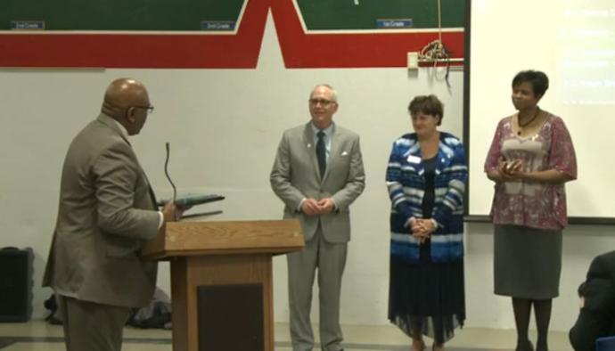
Results of this partnership?
WRi & TPS Partnership Agreement 2016
Notes:
This partnership won national recognition, such as the 1st Place Magna Award from the NSBA; as well as the Excellence in Advocacy Award from EEI.

Slide 20
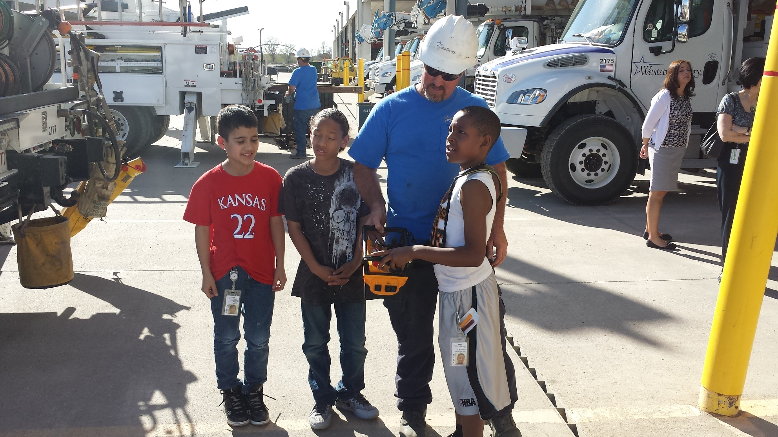
Results of this partnership?
WRi & TPS Partnership Agreement 2016
Notes:
This is why we really do this. Thx, Pw

Slide 21
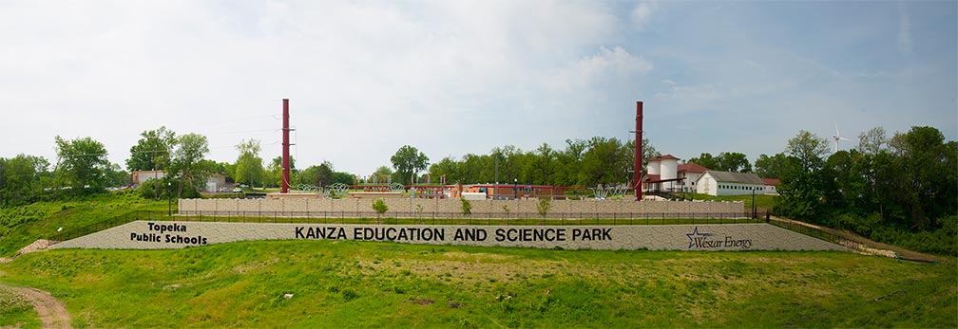
Questions?
WRi & TPS Partnership Agreement 2016

