Slide 1
Small Schools… Big Success
FIRST THINGS FIRST… GET A SNACK

Slide 2
Small Schools… Big Success
Doing What Is Best for Kids

Slide 3
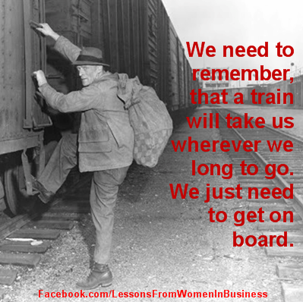
All Aboard!
Have a great time with what you do
Many hats>Leadership Roles
Advocate for Yourself
All staff has to buy in
Realize it’s not just about content anymore
Career>Major>College

Slide 4
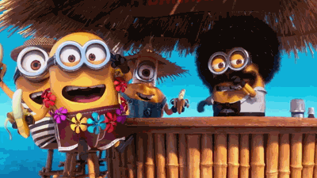
Planning for Success
Ideas put into action
Help from administration
Had entire staff trained in 7 Habits
Putting in time over the summer

Slide 5
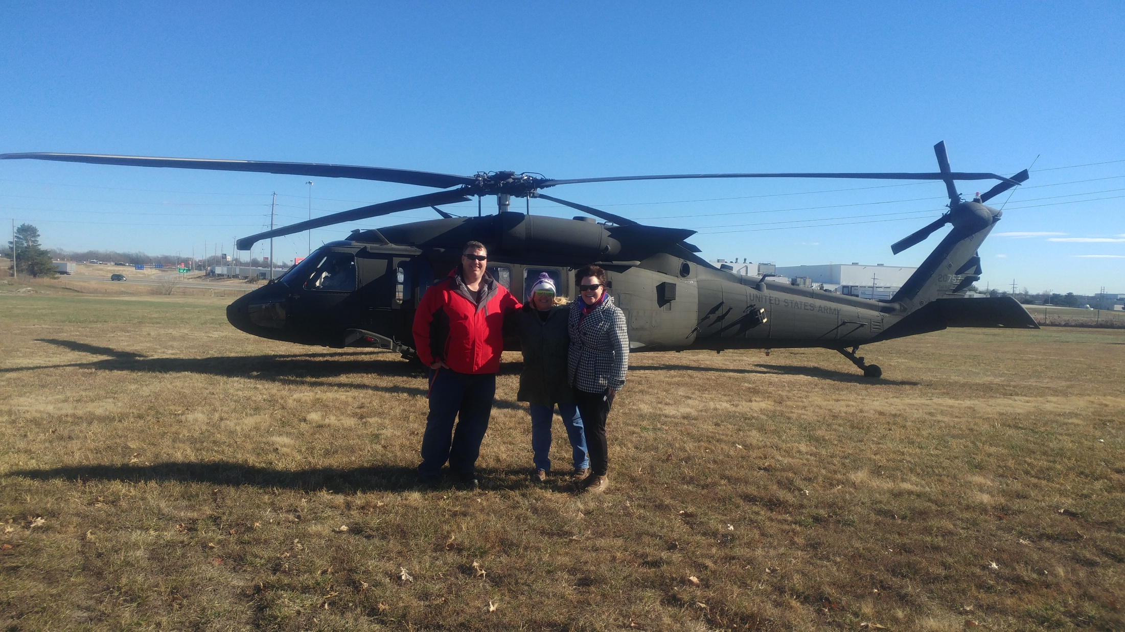
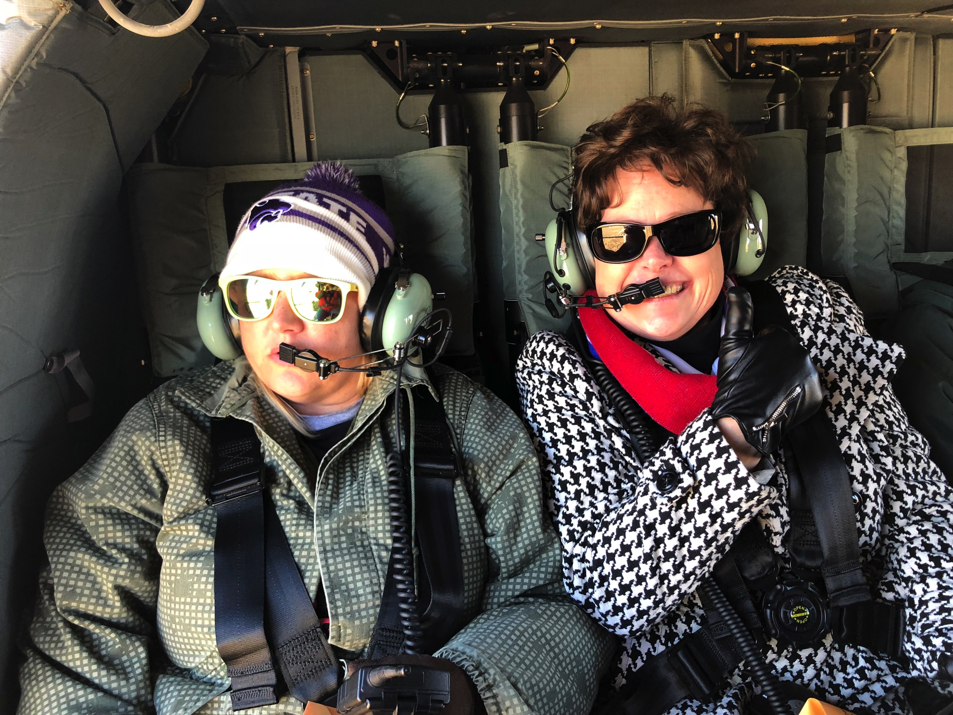
Ready for Take Off…
Find something that works for you
Communication is key
6-8 Plan
9-12 Plan
Growing Pains
Tweaking

Slide 6
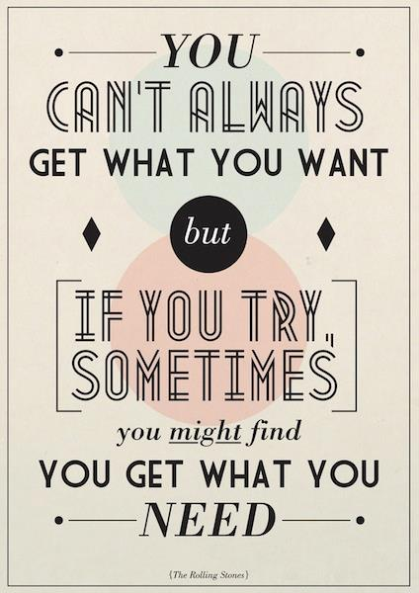
Getting What You Need
Borrow from others
Don’t re-event the wheel
Use your contacts!
Jobs for students
Ask for help

Slide 7
College Visits
Piloting a new type of visit this spring
Staff member alum take groups of junior students to their alma mater
Set up visits

Slide 8
Suggestions…
Books to Read
Mindset-Carol S. Dweck, PhD
The Last Lecture-Randy Pausch
Show the Last Lecture to seniors
Find something to make you laugh EVERYDAY!

Slide 9
CAP Class
“This is the most important class we are ever going to teach.” –Mr. Ford
Why is this statement true
How could you use this concept to drive needed change?
Share time…
What are your successes?
AKA… What can the rest of us steal from you?

Slide 10
Thank You!
Janella Newton USD 243 Lebo-Waverly 6-12 Counselor jnewton@usd243ks.org

