Slide 1

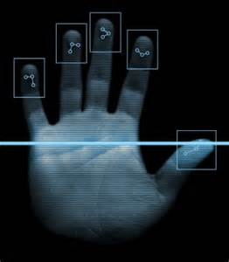
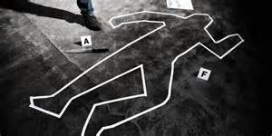

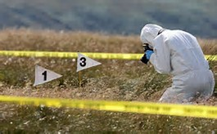

Welcome to Forensic
Crime Science
Ms. Scribner
Eisenhower High School
Goddard #265

Slide 2


Qualified Admission Course – articulated agreement with WATC for college credit
Science credit for high school graduation
AND
Science credit to enter college

Slide 3

Law, Public Safety & Security CTE
Application Class—Forensic Science Comprehensive #44225 (1 credit)

Slide 4
Video
https://animoto.com/play/0bzvOx41xtEHPKanaD2SfQ

Slide 5

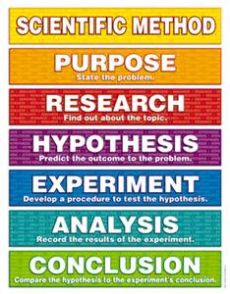

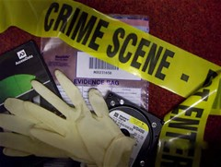
Science
Forensic science is any scientific field that is applied to the field of law
Scientific Method
Application of scientific concepts
Lab Reports
Data Collection
Analysis of Data
Documentation
Drawing Conclusions
Formal letters communicating results

Slide 6
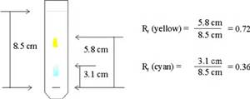
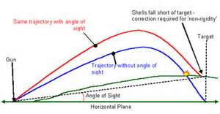
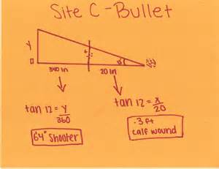
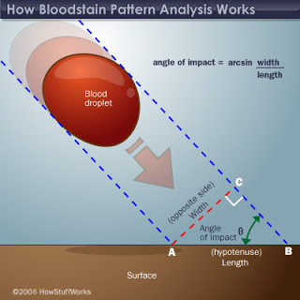
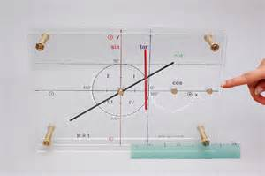
Mathematics
Geometry –position and space
Trigonometry-angle
Angle of Impact
Time of Death
Rf Value

Slide 7

Common Core
The Common Core asks students to read stories and literature, as well as more complex texts that provide facts and background knowledge in areas such as science and social studies.
Students will be challenged and asked questions that push them to refer back to what they’ve read.
This stresses critical-thinking, problem-solving, and analytical skills that are required for success in college, career, and life.

Slide 8

College and Career Ready
Students are “employees” of the ABC Forensic Science Company. They can “try on” the career of a lab technician, field investigator, or law enforcement.

Slide 9
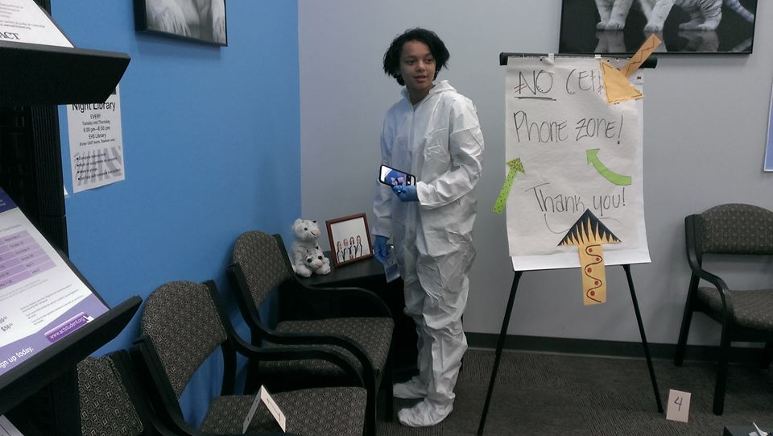
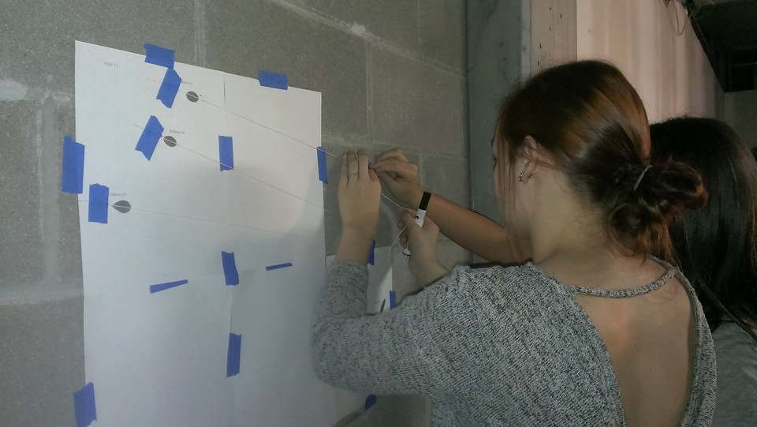
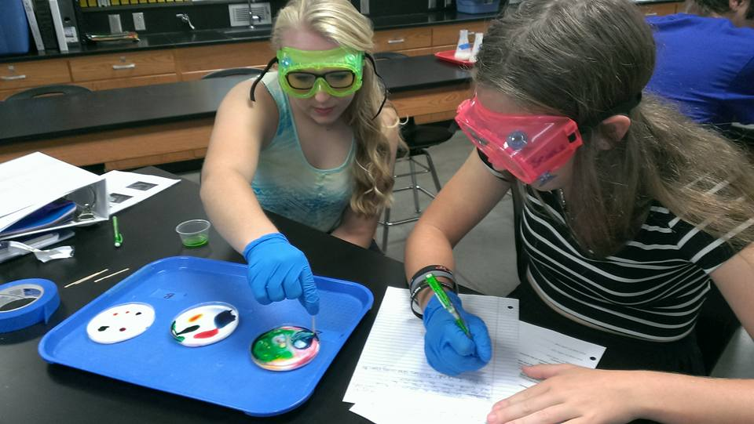
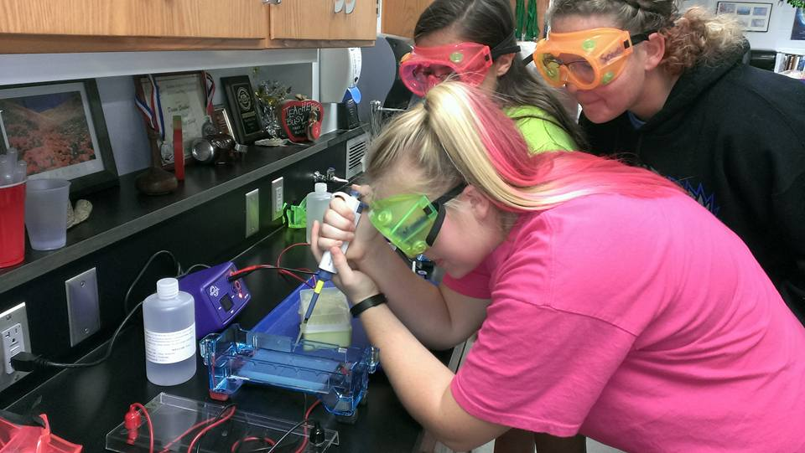
Engaging Students

Slide 10
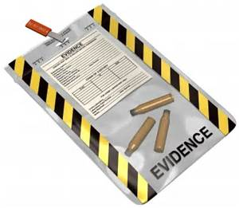
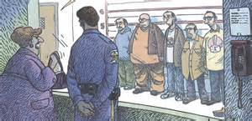
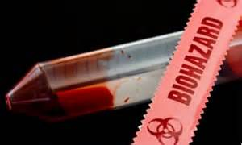
Compentencies
Introduction
Discuss careers available in the field of forensic science and training required for each
Distinguish individual evidence from class evidence
and discuss its relevance in a court of law
Justify use of observation skills and debate validity of eyewitness accounts of events
Practice HazMat and Bloodborne Pathogen safety

Slide 11

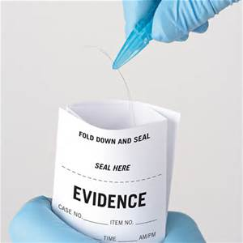
Crime Scene Investigation
Differentiate procedures for securing & documenting a crime scene
Perform evidence collection and storage
Trace Evidence
Develop, analyze and classify fingerprints
Identify & compare various types of shoe, tire, palm,
lip, and bite prints
Analyze, identify, and compare various hair samples
Compare various types of fibers through physical and chemical analysis

Slide 12
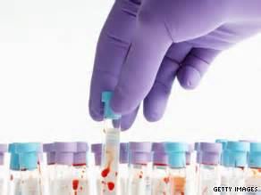
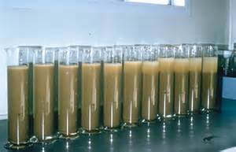
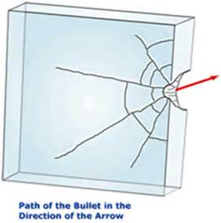
Drugs & Toxicology
Perform tests to identify various drugs and/or
poisons
Research and examine how various drugs &/or poisons affect and/or move through the human body
Soil & Glass Analysis
Deduce, compare & contrast characteristics of
various types of sand and soil
Use refractive index and density to determine
differences in small particles of glass

Slide 13
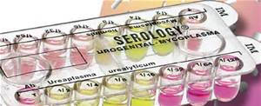
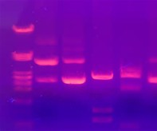
Serology
Distinguish between human and animal blood
Accurately type blood
Explore bloodstain patterns as a function of velocity, direction and height of fall
DNA Analysis
Describe crime scene evidence collection and processing to obtain DNA
Isolate and extract DNA from cells
Justify use of DNA to determine family connections
Examine use of DNA in the legal process

Slide 14
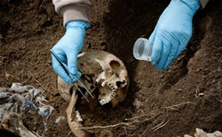
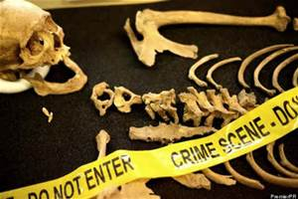
Forensic Entomology
Outline the succession of various types of insects
found on a body as it decomposes
Deduce time of death using insect evidence
Human Remains
Use a human skeleton to determine gender,
age range, height and race
Predict time of death using rigor mortis, algor mortis,
livor mortis, and stages of decomposition
Distinguish between cause, manner, and mechanisms of death

Slide 15
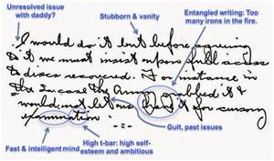
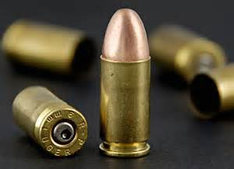
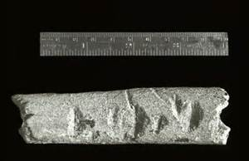
10 Handwriting/Document Analysis
Characterize facets of individual handwriting
Distinguish between different handwriting styles
Conduct an experiment using paper chromatography to determine the ink used
Describe features of paper currency used to detect counterfeit bills
11. Ballistics & Tool Marks
Distinguish between types of firearms and ammunition
Use bullet trajectory to determine position of shooter
Design and conduct scientific investigations to match tool marks in a criminal investigation
Distinguish between impressions with microscopic examinations

Slide 16


Equipment Needed for Success:
Pen or Pencil (everyday)
3-Ring Binder (at least 1½ inches
1 Glue Stick
Scissors
1 Roll of Clear Tape
OR
1 Roll of Masking Tape
non-latex gloves

Slide 17

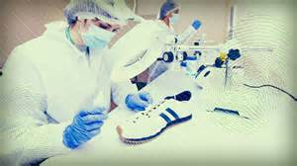

DAILY ROUTINE
Copy Daily assignment in notebook.
JOB PREP----BELLWORK assignment. (3‑5 min.)
STAFF BRIEFING--- overview of day's lesson/work. (2‑3 min.)
TASK---Lesson/work, lecture notes, AV notes, lab, etc.(approx 45 min.)
Clean up/storage. Review of assignments given. (5 min.)

Slide 18
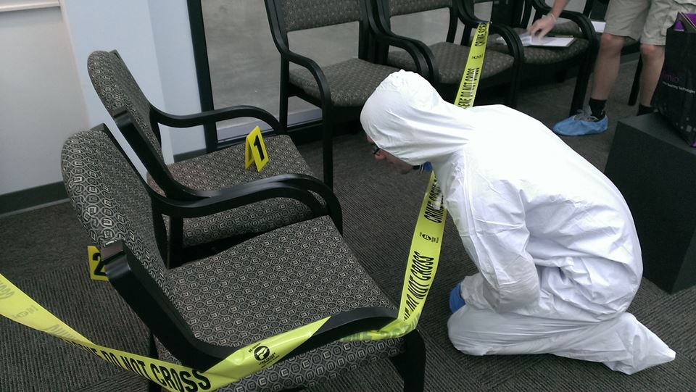
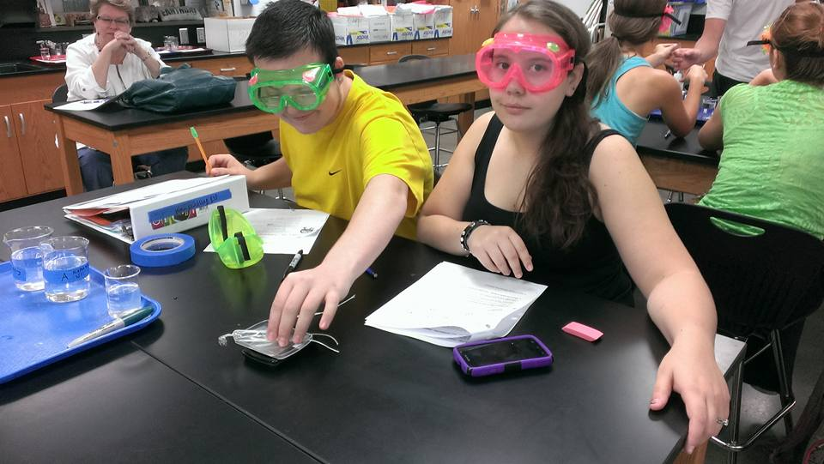
Hands-On application of scientific concepts

Slide 19
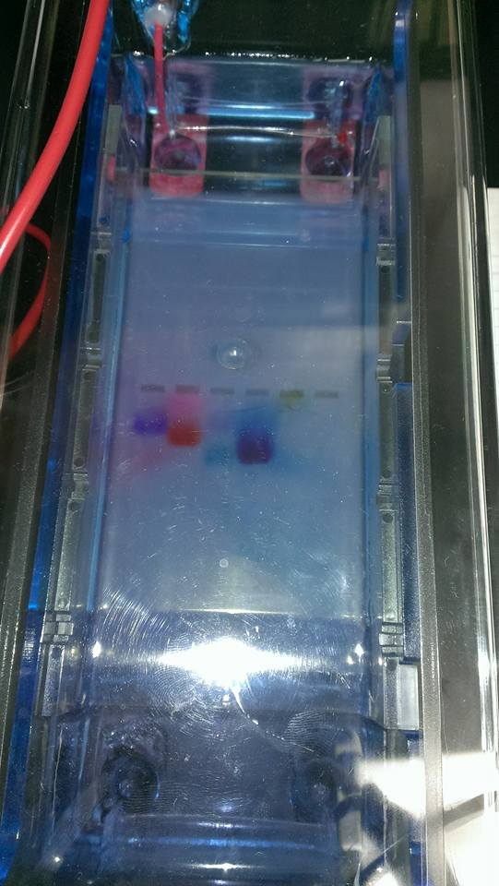
Electrophoresis

Slide 20
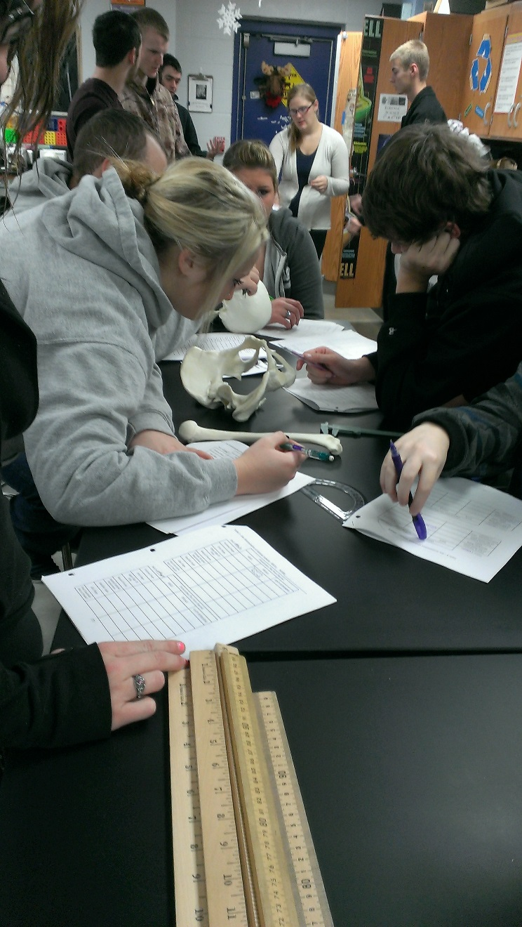
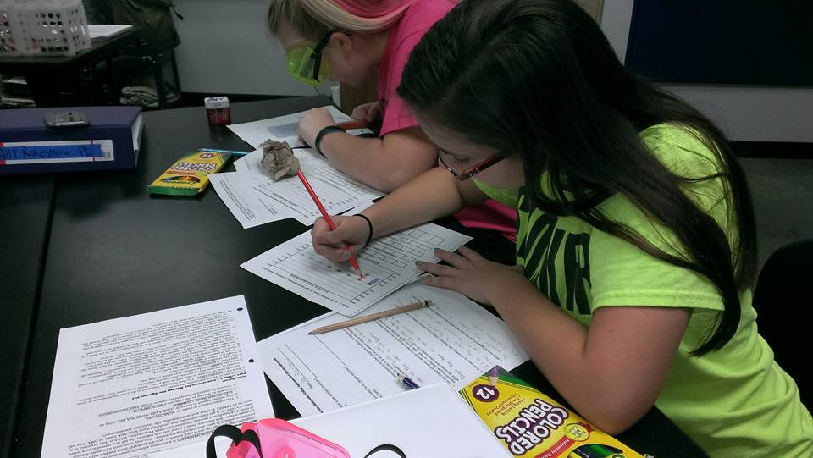
Documentation—writing for comphrension

Slide 21
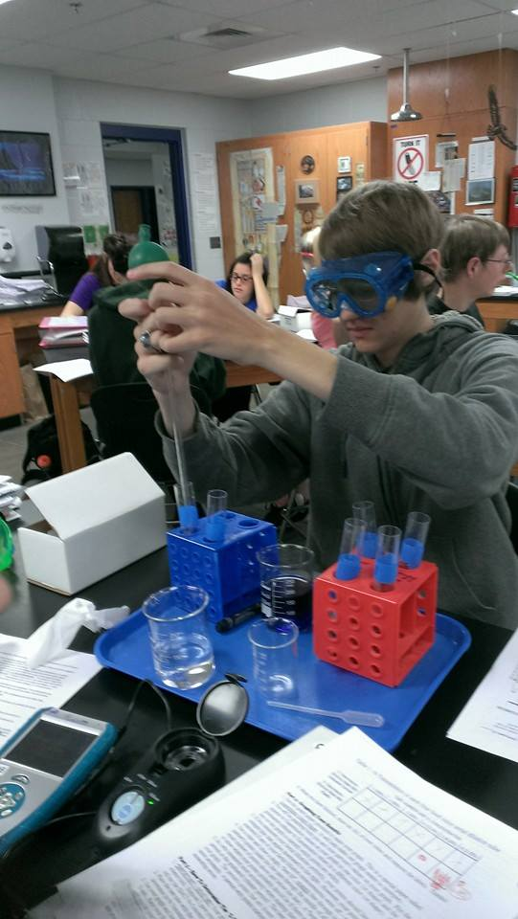
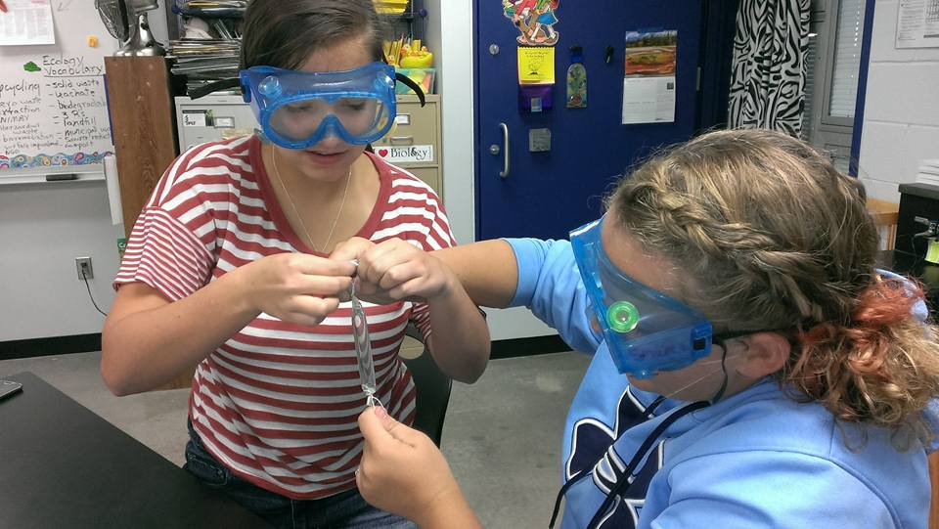
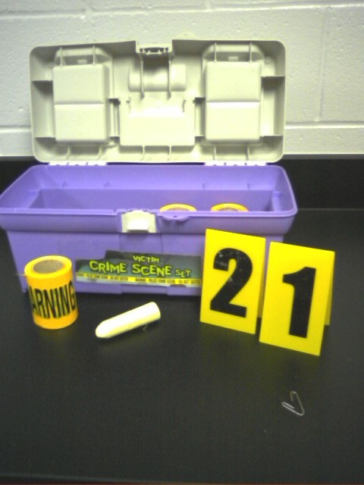
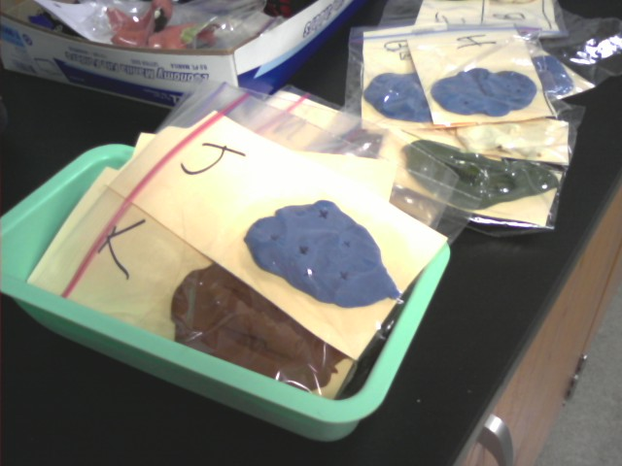

Slide 22
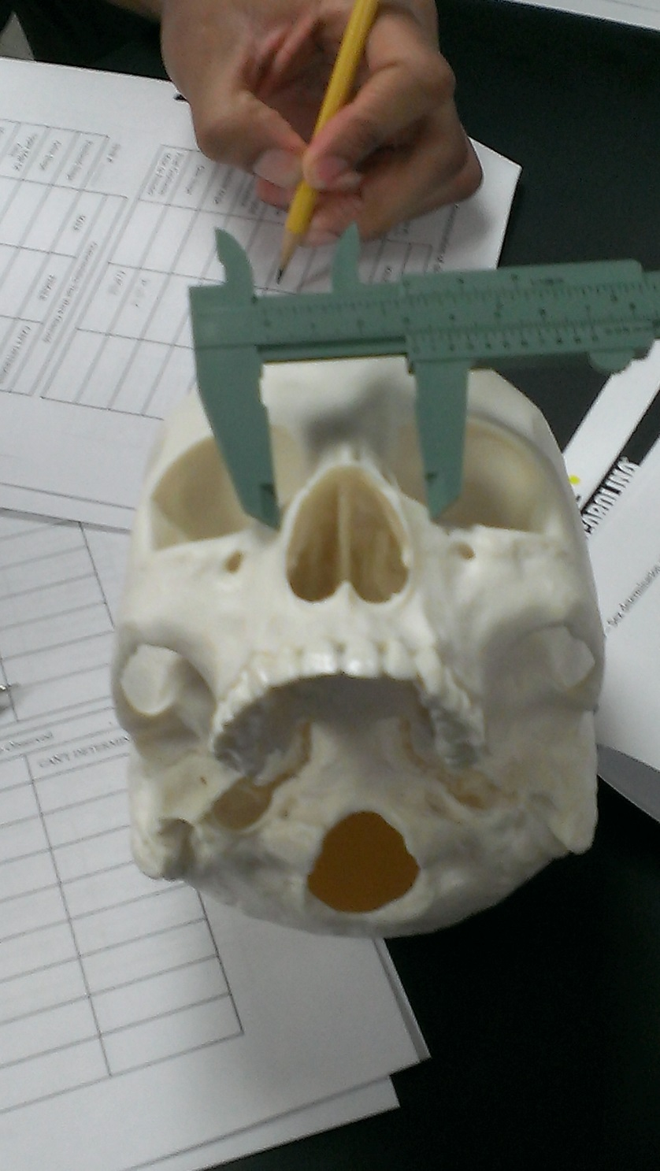
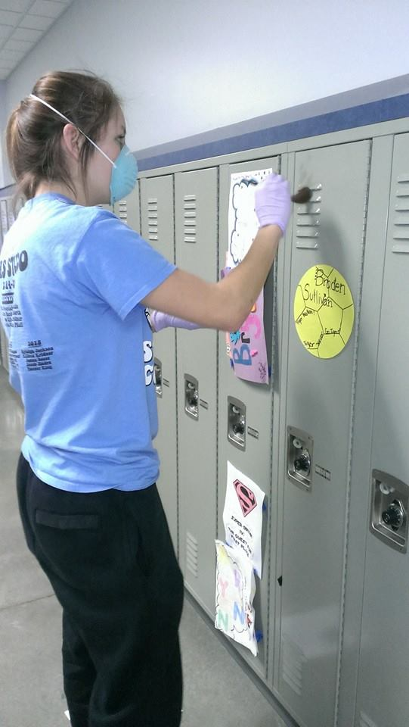
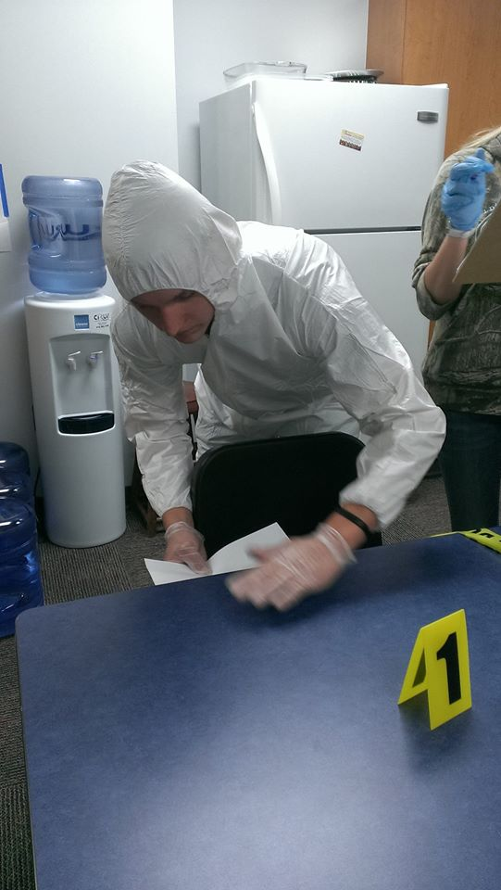

Slide 23
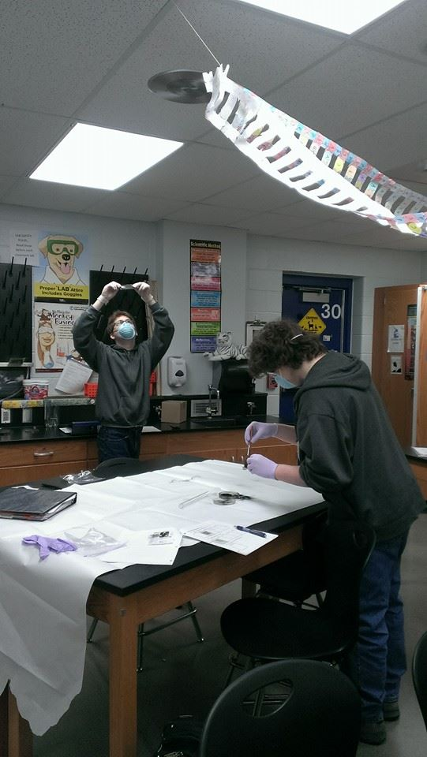
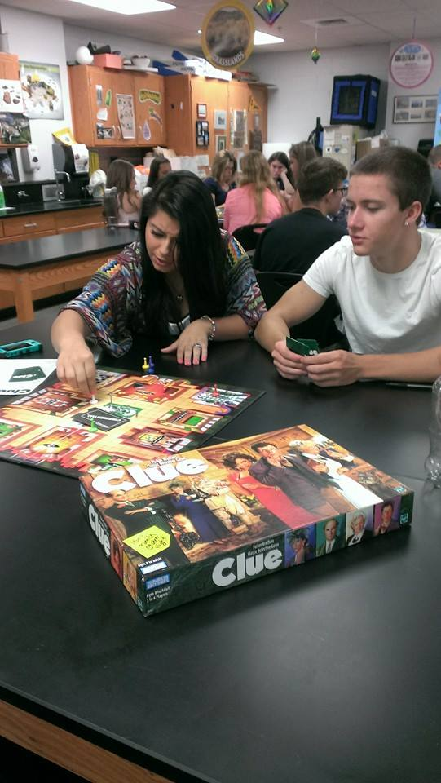
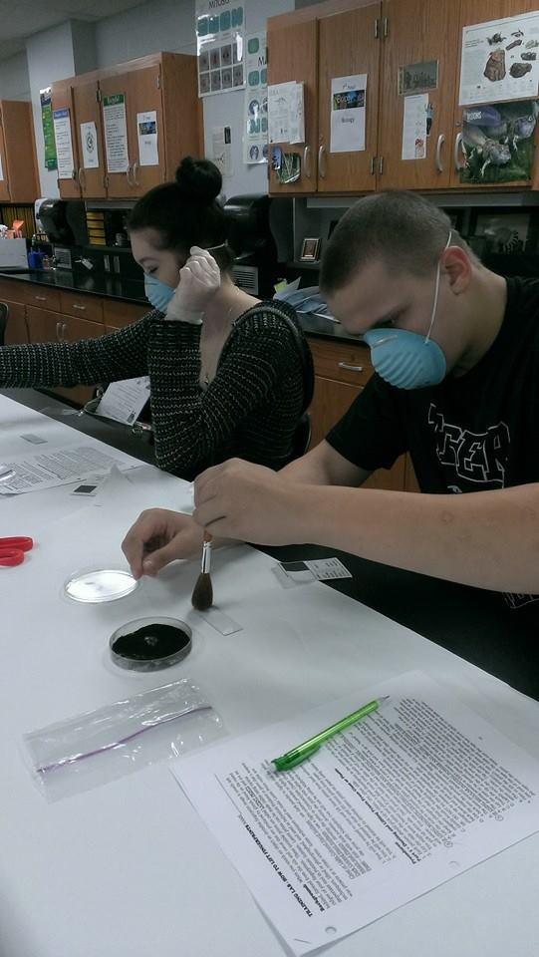

Slide 24
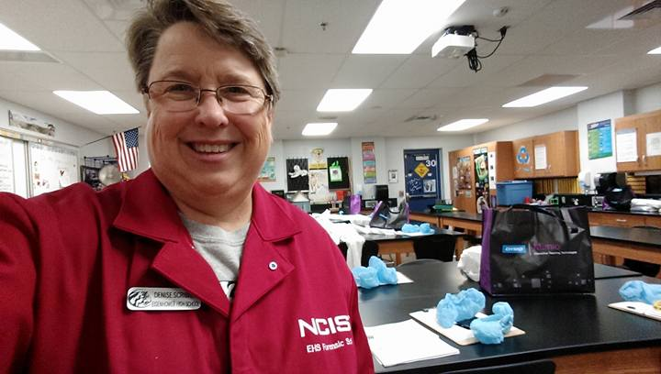
Questions?
Email: dscribner@goddardusd.com
Class website can be found at:
http://ehs.goddardusd.com/scribner
Facebook page: search
Eisenhower High School Forensic Science Class—LIKE and FOLLOW

