Slide 1


Connecting Students to Career Development
Travis Riebel- Director of Career and Technical Education
Kent Blessing- Career Development Coordinator
Shirley Yoder- CTE Curriculum Specialist

Slide 2
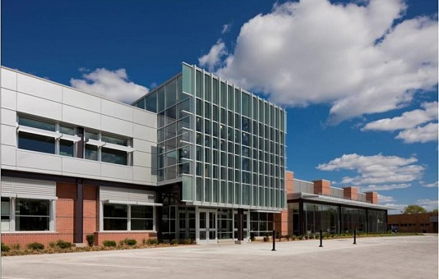

Our Mission:
STUDENTS WILL GRADUATE WITH THE KNOWLEDGE, SKILLS AND BEHAVIORS TO BE COLLEGE AND CAREER READY

Slide 3





Student Career Path…

Slide 4
Creating a Culture of Career Development
Making ‘Career Development’ personal means creating a culture of authentic career conversations.

Slide 5
At its core, Personal Career Development is…
…a matter of purpose,
personhood,
& provision.

Slide 6
There are three different work orientations to meaning and purpose:
  Work as a job.
  Work as a career.
  Work as a calling.
          Source: Amanda White & Barbara Calusek, Suggestions for Group Counseling: Finding Meaning & Purpose in the Labyrinth of Career Uncertainty & Change, Career Developments, Summer 2015, Volume 31. No. 3

Slide 7
Students need to begin…
…defining what a future workplace really looks like; its meaning, its purpose, and how they personally fit best into all those areas.

Slide 8
The career development & exploration process really is quite eclectic.
Devoting more and proper time to the why in the early stages will produce more realistic and beneficial what in the latter stages.

Slide 9
Collaboration in Career Development
It takes a village…..
Reno County Perkins Consortium
  Purchased Career Cruising and hosted training.
  USD 308 Collaboration between CTEA staff, district administration, building leadership, counselors and teachers.
..\..\Career Cruising\Copy of Career Development Across the Grades (3).xlsx

Slide 10
Hutchinson USD 308 Implementation
K-5: Counselors and classroom teachers
6th: Counselors and teachers. Career exploration activities
7-8: Counselors and select teachers
9-12: Students enroll in Career Cruising developing and individual plan of study
9th: Career Advisors
10-12 Counselors, both HHS and CTEA teachers (English classes)

Slide 11
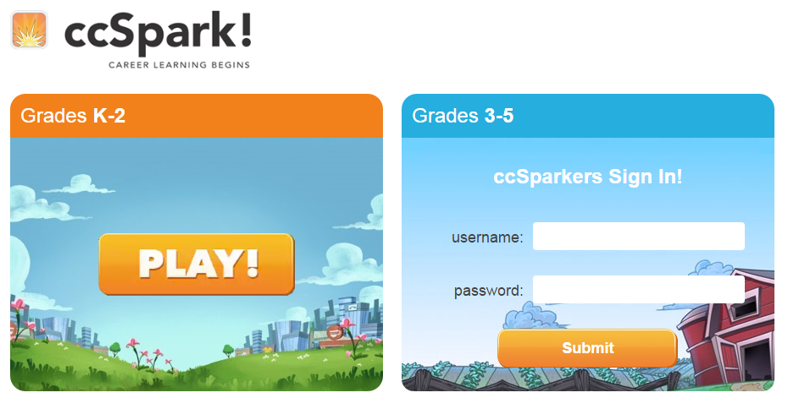
ccSpark! uses a fun, educational role-playing game to help K-5 students learn about careers, life-planning, and social skills.
..\..\Career Cruising\ccSpark_CommonCore.pdf

Slide 12
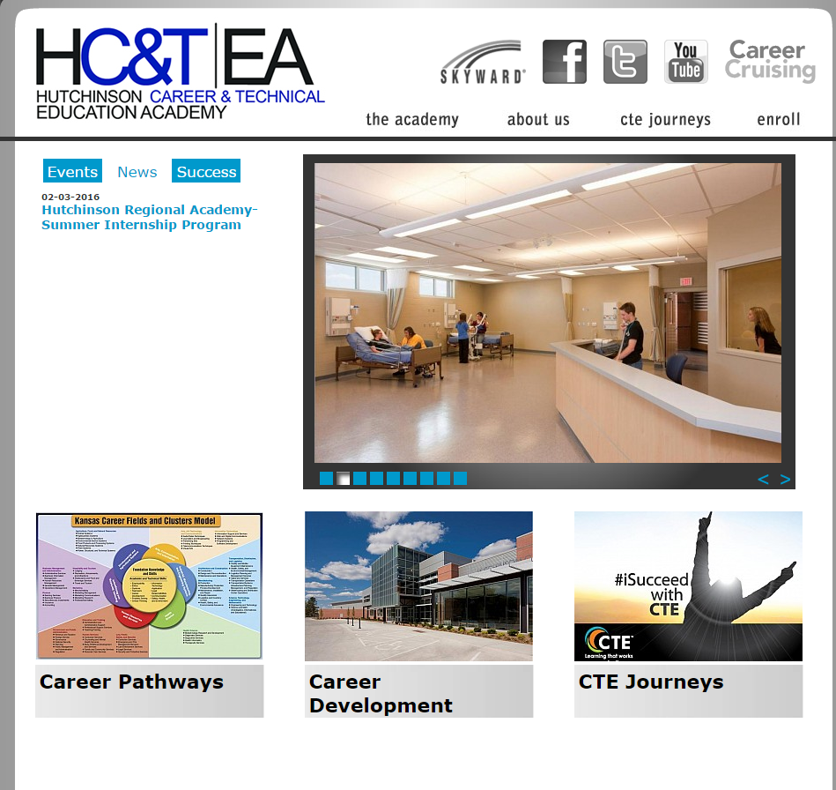
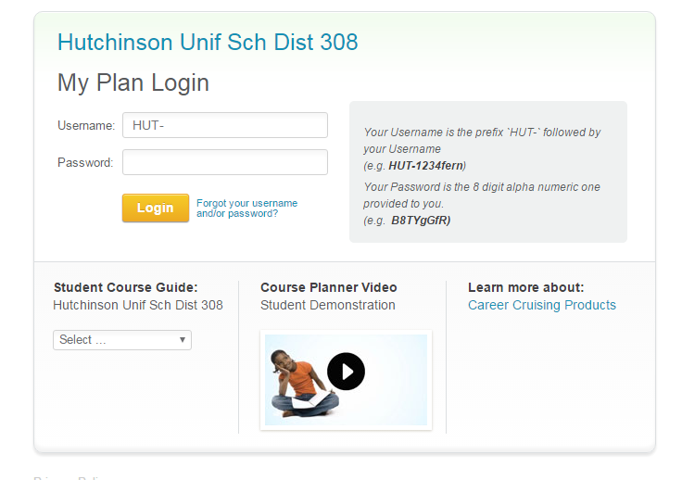

Slide 13
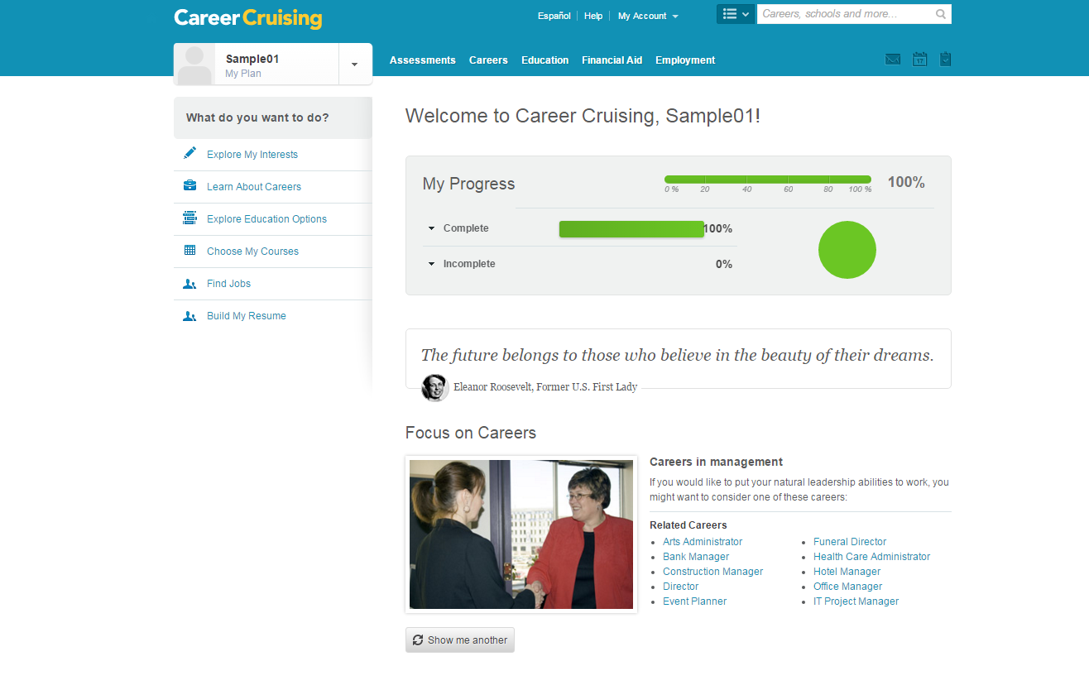

Slide 14
https://www.careercruising.com/school/login.aspx

Slide 15
Thank you!
Travis Riebel- riebel.travis@usd308.com
Shirley Yoder- yoders@usd308.com
Kent Blessing- blessing.richard@usd308.com

