Slide 1
Make The Stage! CTSO Competitive Edge
©2014, MBA Research,
Columbus, Ohio; All rights reserved.

Slide 2
Objectives
Overview of MBA Research
Integration into CTSO’s
Five tips for competition prep
Best practices
©2014, MBA Research,
Columbus, Ohio; All rights reserved.

Slide 3
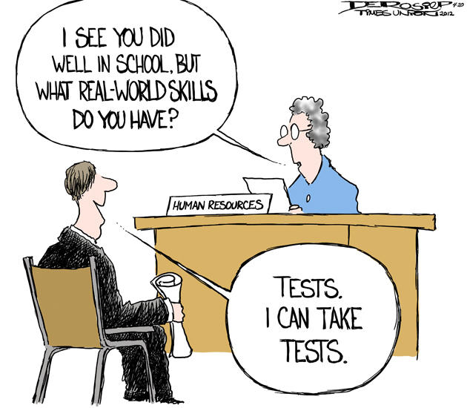
What Are Your Challenges?
©2014, MBA Research,
Columbus, Ohio; All rights reserved.

Slide 4
Day 1
Speed Networking
Name
School
What you teach
Something fun about yourself that no one would know by looking at you

Slide 5
MBAResearch Mission
. . to support educators
in the preparation of
Students for careers in
business and marketing
©2014, MBA Research,
Columbus, Ohio; All rights reserved.

Slide 6
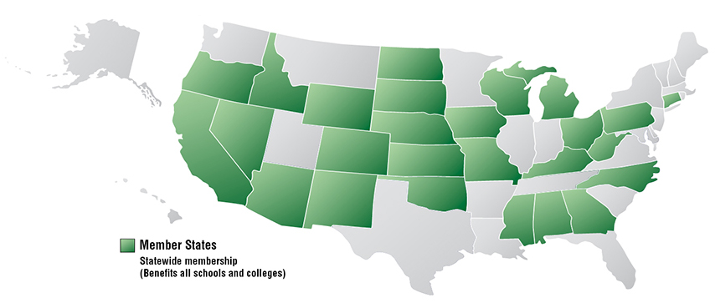
Member States
©2014, MBA Research,
Columbus, Ohio; All rights reserved.

Slide 7
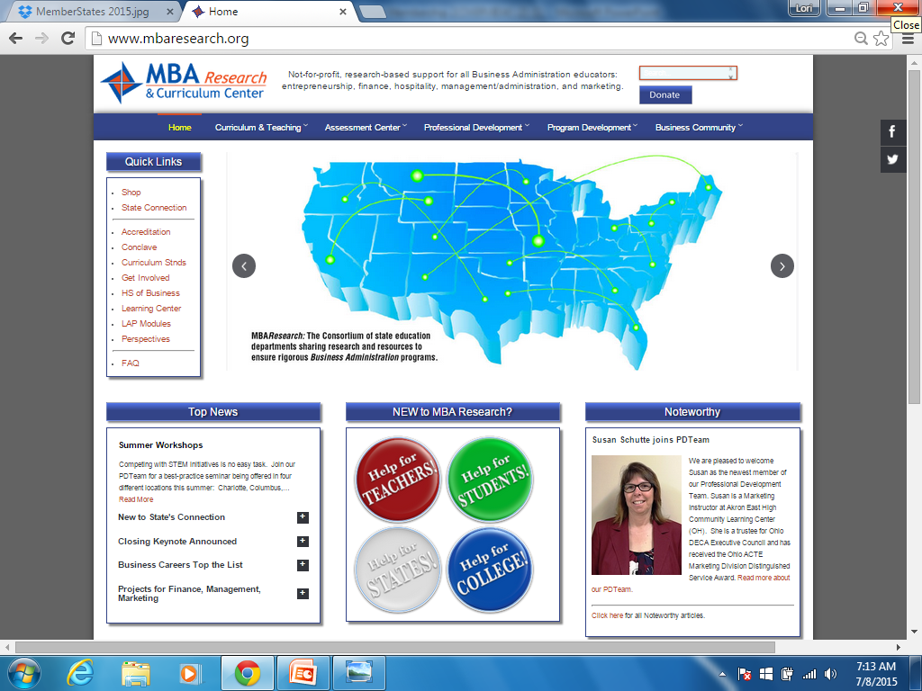
www.mbaresearch.org

Slide 8
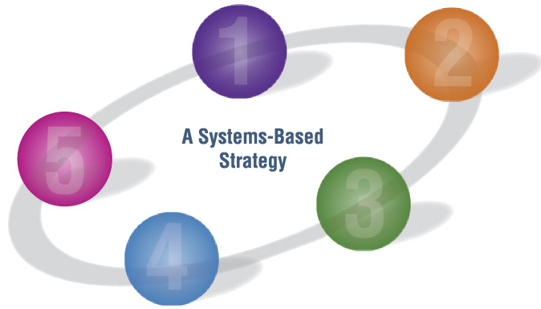
MBAResearch Instructional System
Business
Standards
Proof
Curriculum
Instruction
©2014, MBA Research,
Columbus, Ohio; All rights reserved.

Slide 9
Integration into CTSO’s
Standards development
Competitive event sponsorship
Competitive event taskforce support
Alignment with national standards
©2014, MBA Research,
Columbus, Ohio; All rights reserved.

Slide 10
Five Keys to Helping Students Prepare
Curriculum alignment
In depth instruction
Regular assessment
Emotional intelligence
Practice under pressure
©2014, MBA Research,
Columbus, Ohio; All rights reserved.

Slide 11
Introduction - GNAP
Greeting
Name
Affiliation
Purpose
Hello, Good Morning
My name is ….
I am the manager of…
I want to thank you for asking me to create a financial projection for XYZ

Slide 13
ICBETC
Introduction
Competencies
Budget
Effectiveness
Timeline
Close
GNAP
Use the competencies in presentation
Create a budget
Tell how you will measure effectiveness
Create a timeline
Close the sale

Slide 14
Additional Keys
1 | Confidence, Confidence, Confidence!!! This is 90% of the battle!
2 | Write down all of the Performance Indicators (PI)
3 | Know your role and the judges role
4 | Good Introduction - GNAP - Smile :) - Firm Handshake & eye contact
5 | Talk about each PI & draw judge into conversation - DO NOT read directly from notes - use bullet points as talking points
6 | Draw Pictures, graphs, charts, timelines if applicable
7 | CLOSE the deal - "Can we get started . ." Are you ready to buy?"
8 | When leaving the judge remember to: Thank them, good handshake, repeat their name
9 | NO GUM! This WILL cost you valuable points!
4 P's of Role Playing
Punctual - Be on time (10 minutes early)
Polite - Remember to GNAP and Close (thank the judge by name)
Positive - Be confident in all of your actions
Performance - Talk about all Performance Indicators as much as possible (put them on an Agenda for the judge)

Slide 16
Resources for Competition
LAP’s
Learning Center
Mbatest.org
Test Development
Professional Development
©2014, MBA Research,
Columbus, Ohio; All rights reserved.

Slide 17
LAP Modules
Role plays
Post-tests
Answer keys

Slide 18
Thank You
https://www.surveymonkey.com/r/KSstage16
Twitter – Twitter.com/MBAResearchNews
Facebook – Facebook.com/MBAResearch
Website – www.MBAResearch.org
Phone – 614.486.6708 800.448.0398
Customer service – Service@MBAResearch.org

