Slide 1
Google Classroom
CTE Conference
Feb. 2016

Slide 2
What is it?
Definition:
  Classroom is a free web-based platform that integrates your Google Apps for Education account with all your Google Apps services, including Google Docs, Gmail, and Google Calendar.
Established & released publicly August 2014.
Do you have to have gmail? NO
What does it Cost? FREE for schools using Google Apps for Education

Slide 3
How is it used?
Just a few of the many. . .
Communication tool in the classroom when not in person
  Post announcements and share resources needed for class
Assignments turn in
  Created by you or they can create their own
Incorporate other Google applications
  Docs, Sheets, Slides, Forms
**Quizzes created (Google Forms) and graded with Flubaroo
  ** Student grade, answer key, and feedback emailed automatically

Slide 4
Let’s Get Interactive
…Here’s the plan
Create a New Class (as a TEACHER)
Tabs and usage
  Setting up course-related resources for student access
Invite with Class Code to join or manually add students
Post an announcement or question
Post an assignment
  Types of assignments and how to Turn in

Slide 5
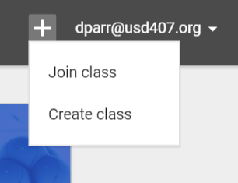
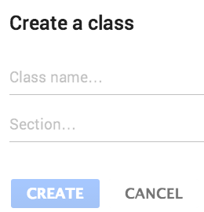
To Create a New Class
www.classroom.google.com
  Create an account based on your role (teacher or student)
    STUDENTS: Join Class
    TEACHERS: Create Class
  Take Tour

Slide 6
Tabs and Usage
Stream
  Where you view all Posts (Announcements, assignments, questions)
  Can Reuse Posts, edits, save for later, and move to top if needed.
Students
  Adjust posting and comment permission settings
  Invite and delete students from class
About
  Additional course details
  Post course materials and resources (syllabus, book site, etc.)

Slide 7
Adding Students
Manually added by teacher
Class Code (posted or via email)
Code can be reset or disabled
Both the Teacher and the Student will have a class folder
in their Google drive automatically created within a CLASSROOM folder.
Don’t Delete or mess with it.
Students may use this path to find assignments.

Slide 8
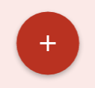
Create
Announcement or Question
Click in lower right to choose what to create in your Stream
  Announcement: Used to communicate notices or reminders to the class
  Question: Used to post a question to your class with a selected due date
  Choose whether or not students can edit their answers as well as see and reply to each other's answers
  After you post a question, you can also see the number of students who have and haven’t answered.
  Both allow you to link to other sources and choose multiple class streams to post on.

Slide 9
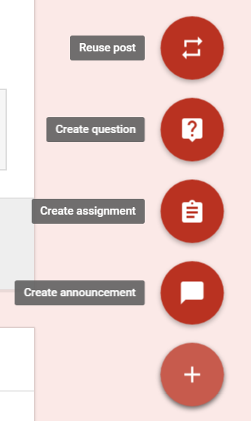
Create Assignment
Looks similar to an Announcement
  Set Due Date
  Links to other sources
    Files have 3 settings to choose from.
    Students can ADD or CREATE their assignment type to turn in.
  Assign option will put the post on student stream immediately or
  Save Draft to post later.
  Teacher sees simultaneously who has marked DONE or hit TURN IN (Doc).
  Google Classroom does not have a setting to post or schedule in the future.

Slide 10
“Everything you Need to Know in Google Classroom”
The Gooru.com
      Part 1
      Part 2
      Part 3
There are lots of online resources and new functions being developed and released.

Slide 11

Resources
Classroom Support
  https://support.google.com/edu/classroom/answer/6020279?hl=en
Classroom Help FAQs
  https://support.google.com/edu/classroom/answer/6025224?hl=en
Everything Google
  http://www.everythinggoogle.com/

Slide 12
Denise Parr
Russell High School dparr@usd407.org
Thanks for attending!!

