Slide 1
Let Go! Let Them Learn
MBAResearch Professional Development Team
Brenda Clark
Director of Professional Development
©2014, MBA Research, Columbus, Ohio; All rights reserved.

Slide 2
Get Out of the Way and Let Them Learn!
“ [Learners] construct solutions, thus shifting the emphasis toward the process of learning.” PBL Handbook
©2014, MBA Research, Columbus, Ohio; All rights reserved.

Slide 3
MBAResearch Mission
. . . to support educators
in the preparation of students
for careers in
business and marketing
©2014, MBA Research,
Columbus, Ohio; All rights reserved.

Slide 4
Member States

Slide 5
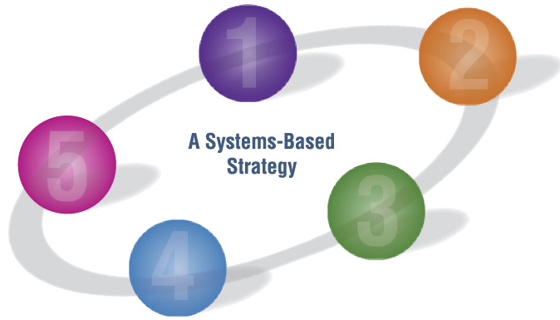
MBAResearch Instructional System
Business
Business
Standards
Standards
A Systems-based Strategy
Proof
Proof
Curriculum
Curriculum
Instruction
Instructional Materials
©2014, MBA Research,
Columbus, Ohio; All rights reserved.
Notes:
5

Slide 6
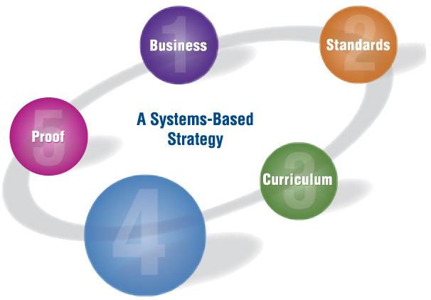
Instruction

Slide 7
Research says…
Increases
Student mastery of knowledge and skills
Long-term retention of content
Satisfaction
Better prepares students to integrate concepts
Improves 21st Century Skills
Source:
Buck Institute for Education (2009). Does PBL Work? Retrieved July 9, 2014, from http://bie.org/object/document/research_summary_on_the_benefits_of_pbl
©2014, MBA Research, Columbus, Ohio; All rights reserved.

Slide 8
Project Based Learning
The main course, not the dessert.
©2014, MBA Research, Columbus, Ohio; All rights reserved.

Slide 9
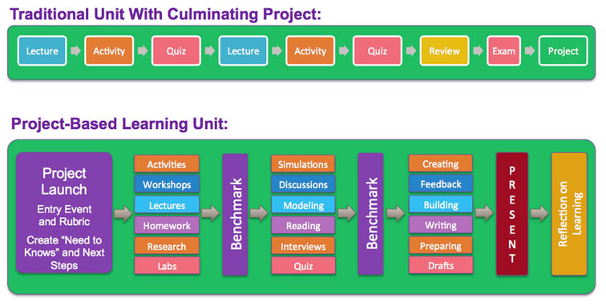
Project or PBL?
http://www.teachthought.com/learning/difference-between-doing-projects-and-project-based-learning/
te@chthought blog by Terry Heick
©2014, MBA Research, Columbus, Ohio; All rights reserved.

Slide 10
Project Based Learning: Explained
©2014, MBA Research, Columbus, Ohio; All rights reserved.

Slide 11
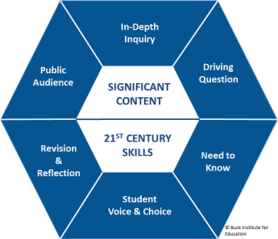
Components of PBL
©2014, MBA Research, Columbus, Ohio; All rights reserved.

Slide 12
©2014, MBA Research, Columbus, Ohio; All rights reserved.

Slide 13
Business Economics The Vacant Lot Project
★ Learning outcomes:
Innovation skills
Opportunity costs
Use of decision matrices
©2014, MBA Research, Columbus, Ohio; All rights reserved.

Slide 14
Business Economics The Vacant Lot Project
★ How can a vacant lot be put to best use?
©2014, MBA Research, Columbus, Ohio; All rights reserved.

Slide 15
Business Economics The Vacant Lot Project
★ Community research/interviews
★ Decision matrix
★ Public presentation
©2014, MBA Research, Columbus, Ohio; All rights reserved.

Slide 16
CAN YOU LET GO?!?
Facilitating PBL:
Team project meetings
Organized CHAOS
Endless possibilities
Planning is key
Judging projects
An open mind
©2014, MBA Research, Columbus, Ohio; All rights reserved.

Slide 17
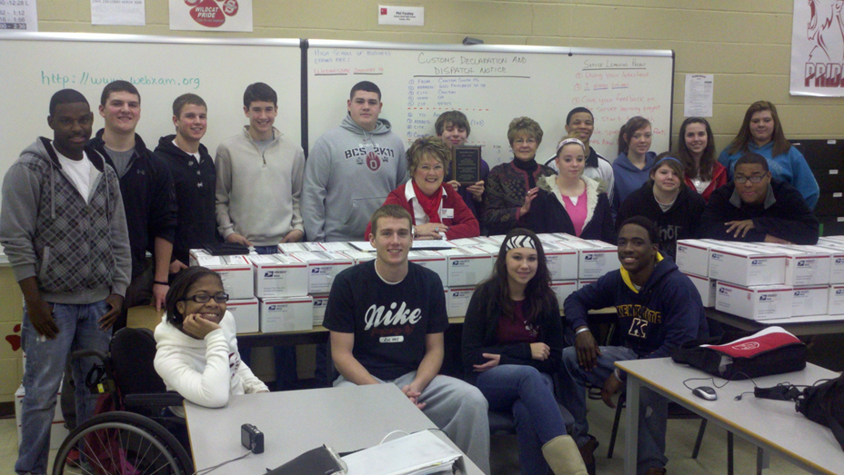
Lesson Learned
©2014, MBA Research, Columbus, Ohio; All rights reserved.

Slide 18
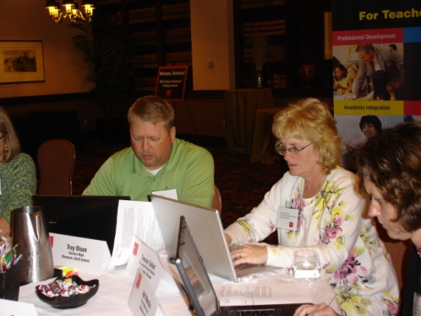
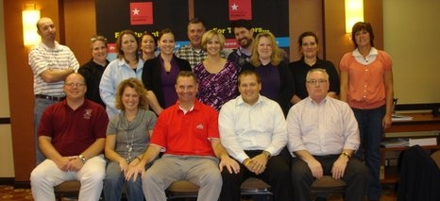
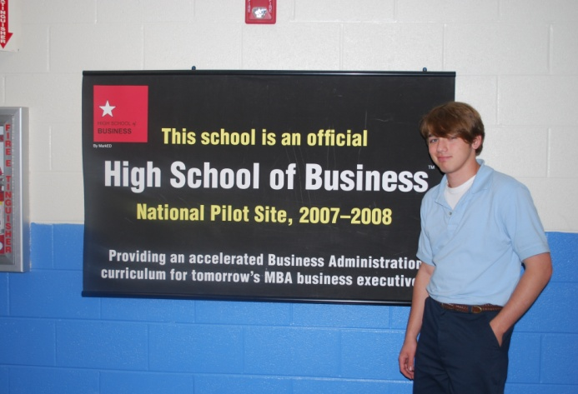
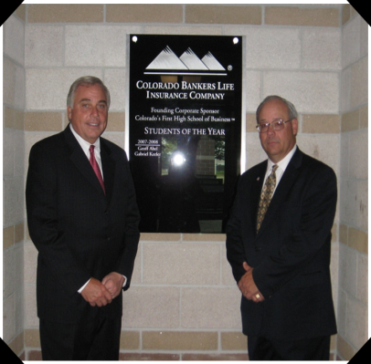
High School of Business
www.mbaresearch.org/HSB
©2014, MBA Research, Columbus, Ohio; All rights reserved.

Slide 19
Coming Fall of 2016!
Teaching students about project management? Free PBL projects will be available from PMIef next fall!

Slide 20
Resources
MBA Research and Curriculum Center: www.mbaresearch.org
Buck Institute for Education: www.bie.org
Edutopia: www.edutopia.org

Slide 21
Free Project

Slide 22
Driving Question
Would you do business in China?

Slide 23
Project Description
China and U.S. Secondary Research

Slide 24
Contact Information
http://www.mbaresearch.info/download/ChinaDynasty_DL.pdf
Twitter – Twitter.com/MBAResearchNews
Facebook – Facebook.com/MBAResearch
Website – www.MBAResearch.org
Phone – 614.486.6708 800.448.0398
Customer service – Service@MBAResearch.org
©2014, MBA Research,
Columbus, Ohio; All rights reserved.

