Slide 1
Construction Pathway
Student Production Classes

Slide 2
Using classes together
Construction
Furniture and cabinet making
Cad / Technical drawing

Slide 3
Project Based
Research community opportunities;
Lyons City hall
Nickerson City Hall
309 School District - Ticket Booth- Cafeteria remodel
Sports Posters - Senior posters & group photos

Slide 4
Lyons City Hall
Judges Table
New building - needed a moveable judges table for new community / multipurpose room.
Research old building and new building needs - Field trip

Slide 5
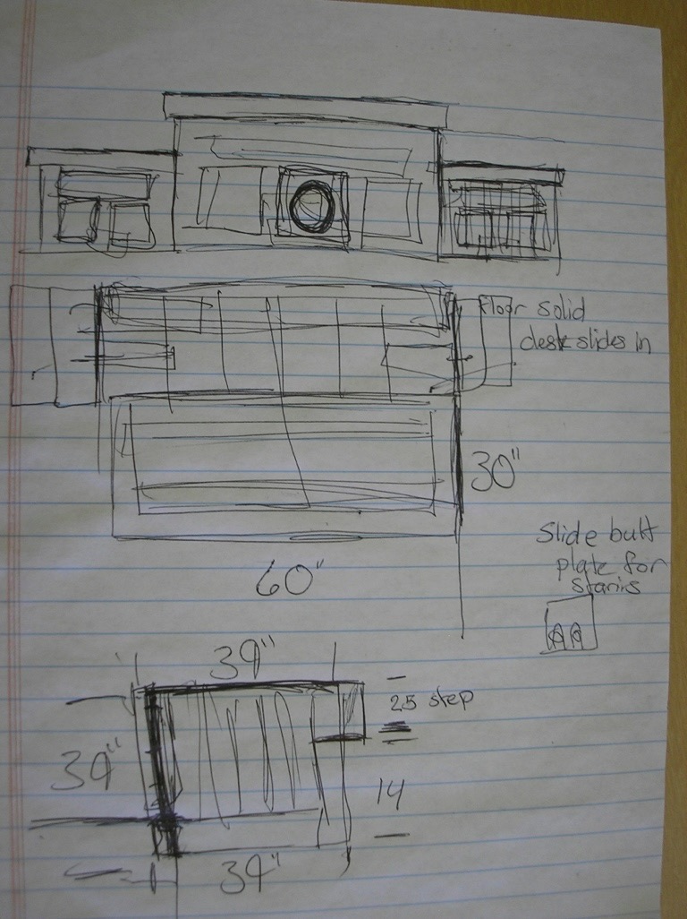
Initial Sketches
Rough dimensions
Cardboard mockup

Slide 6
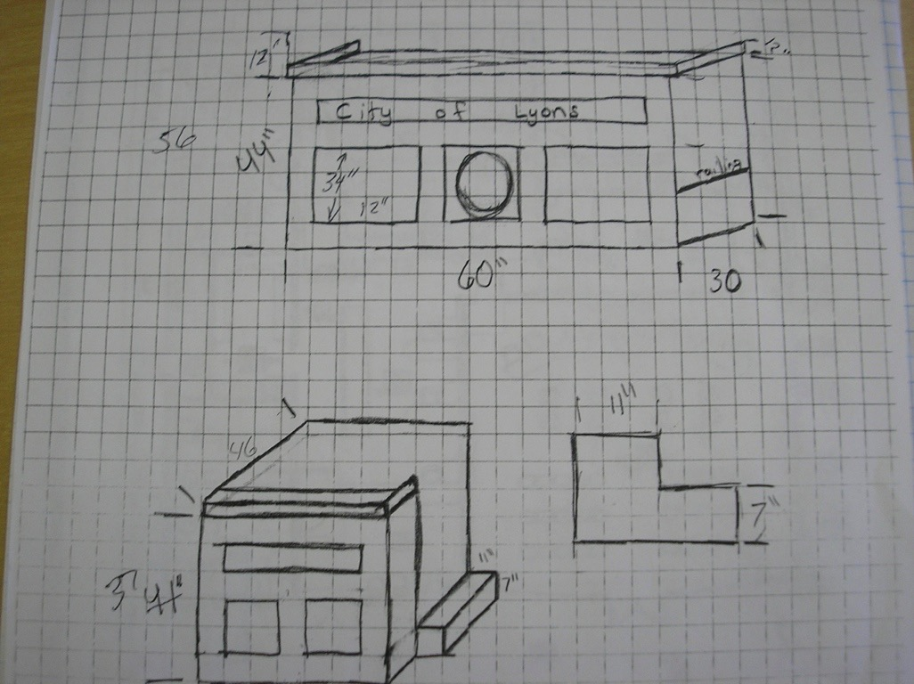

Slide 7
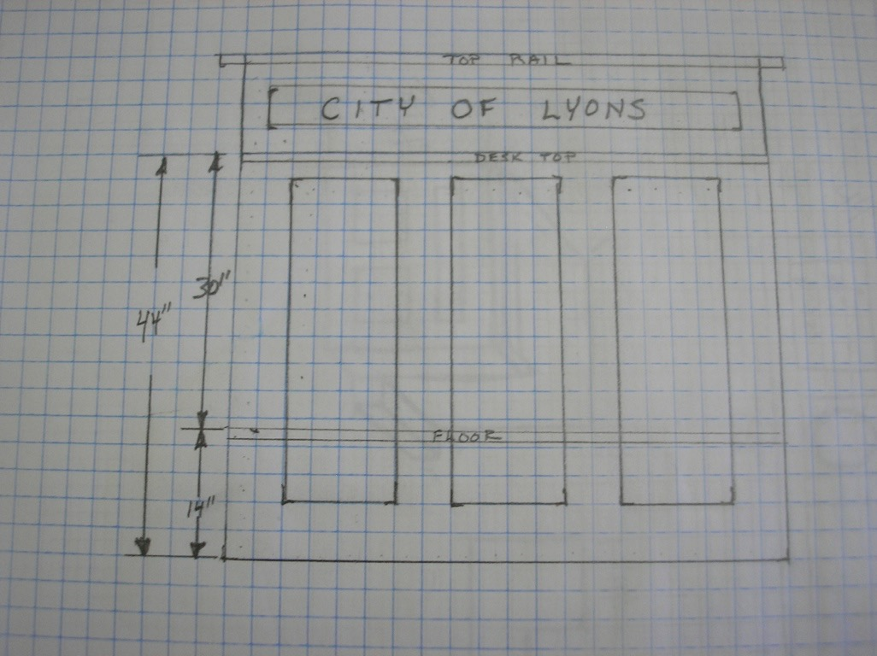

Slide 8
Cad Drawings

Slide 9
Inventor Software

Slide 10
Break production into manageable Parts
Figure material needs and send order- 6/4 walnut
Pick a project manager or you be the manager.
Cut rough pieces for Gluing. Check measurements. two students together. I send the cut list to them.
Had 1 student set up and cut raised panels.
Set teams to rough sand.
Collect all parts labed

Slide 11
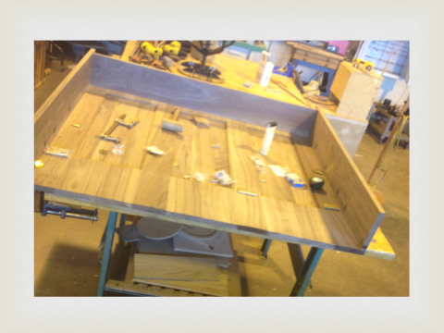
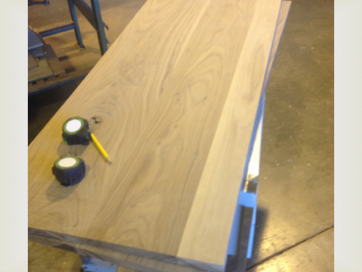
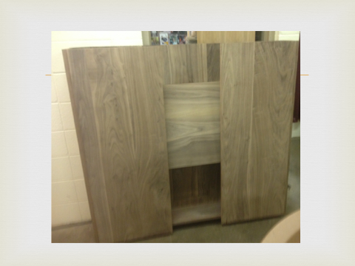

Slide 12
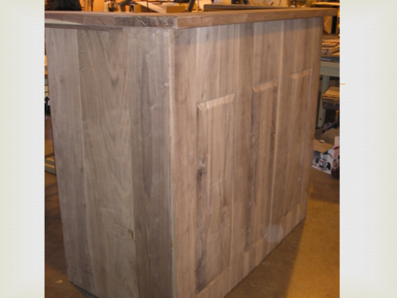
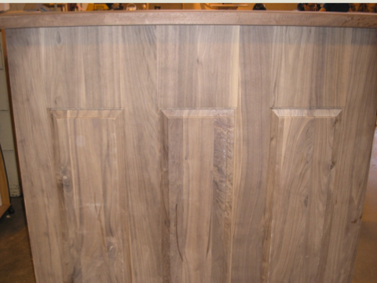
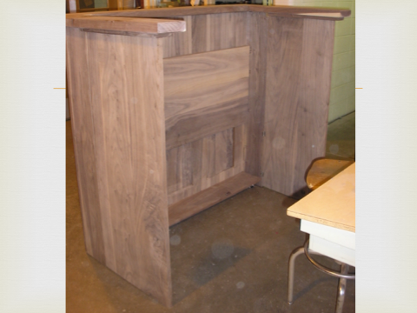
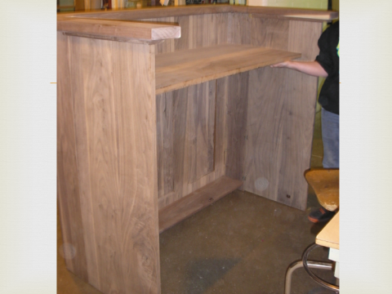

Slide 13
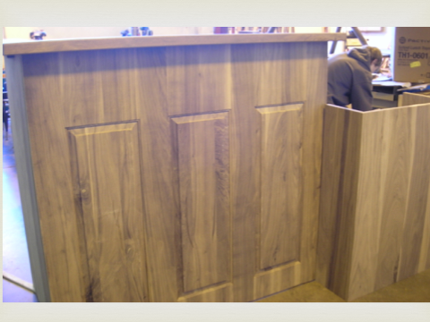
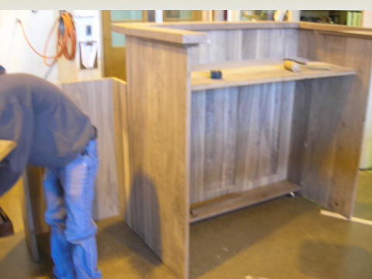
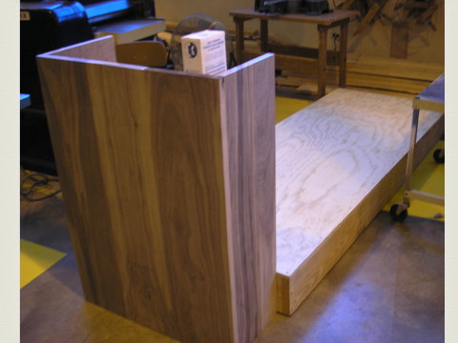

Slide 14
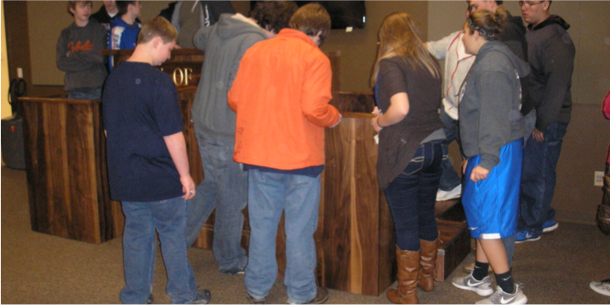

Slide 16
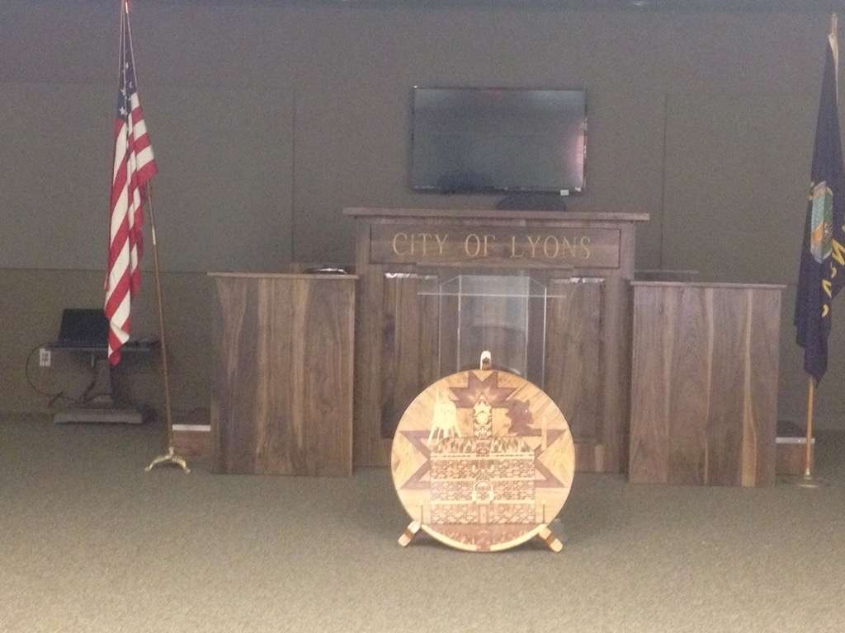

Slide 17
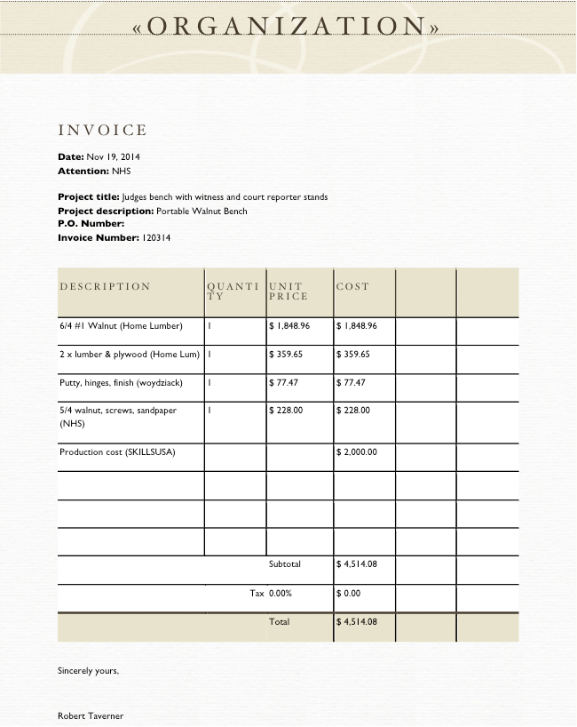

Slide 18
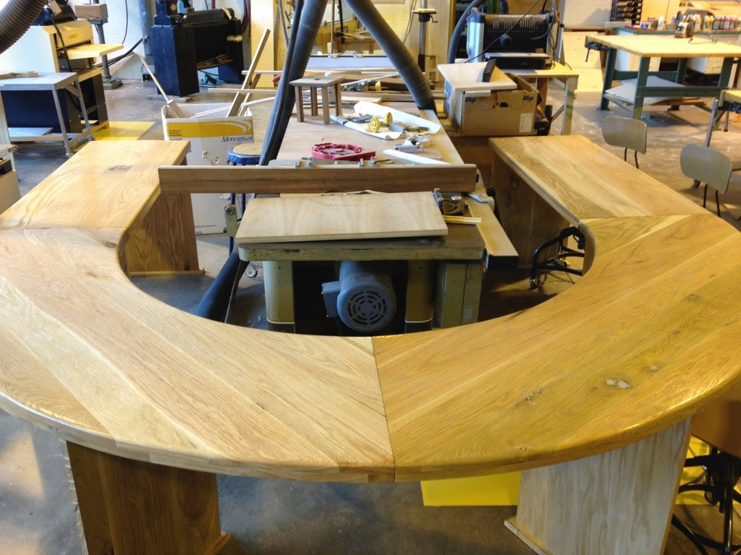
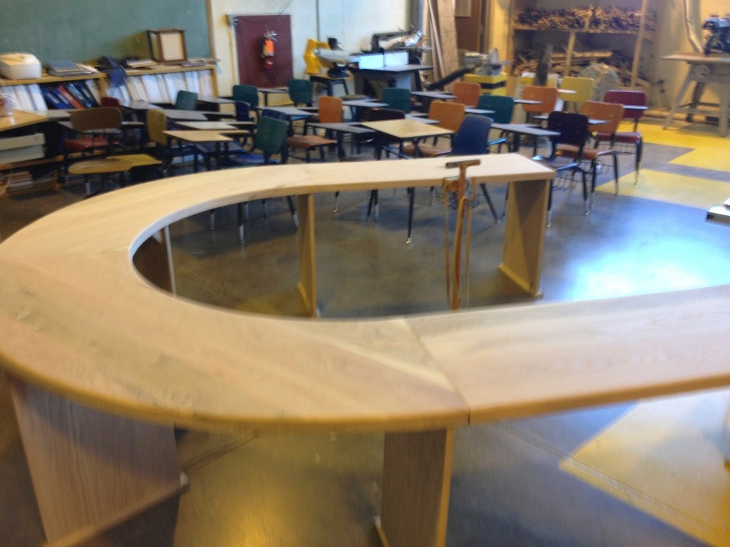
Nickerson City hall conference table
Same process - Field trip - rough dimensions - drawings - approval- order material - Production - delivery.

Slide 19
Cafeteria remodel
Upon principal request - Budget set @ 6k.
Submitted proposal to Board for final approval.
Submitted plans 3D print and budget outline.

Slide 20
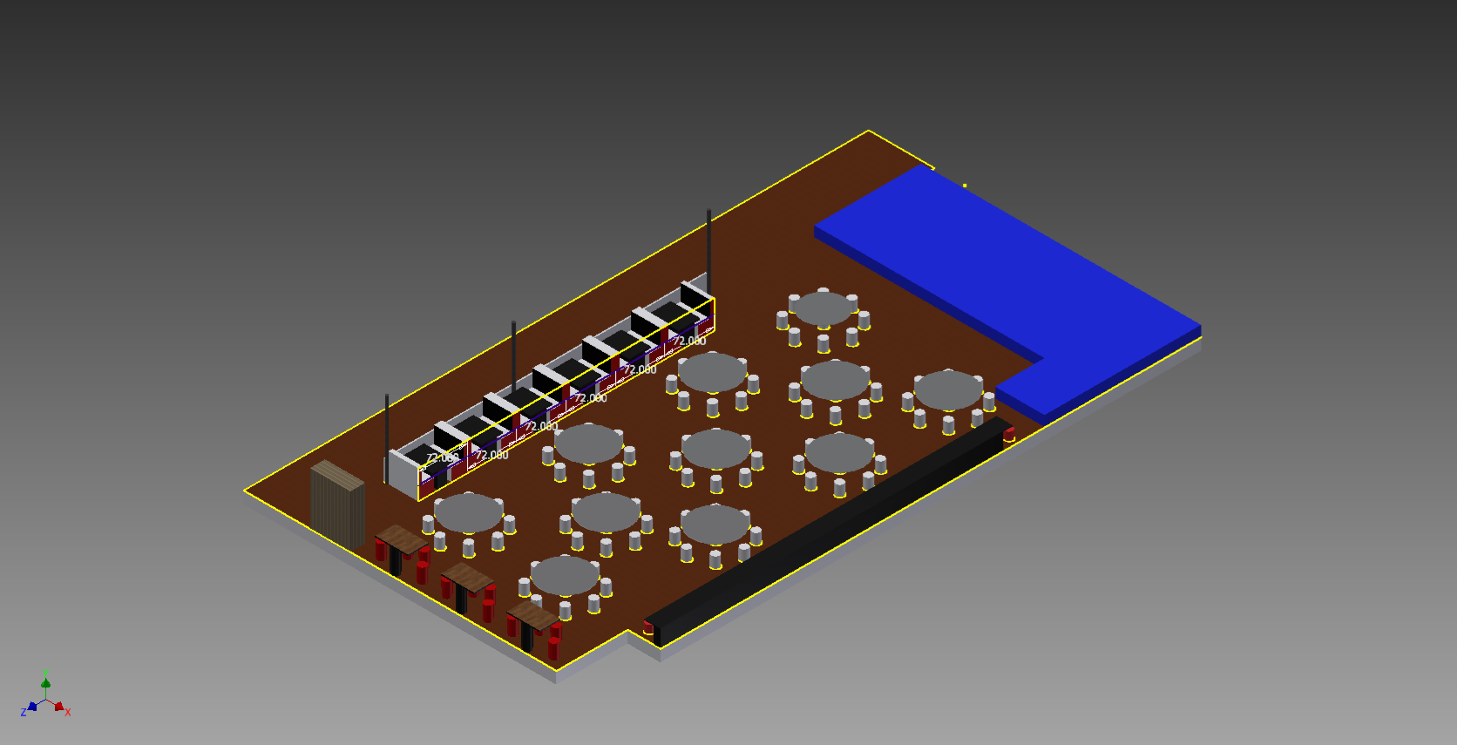

Slide 21
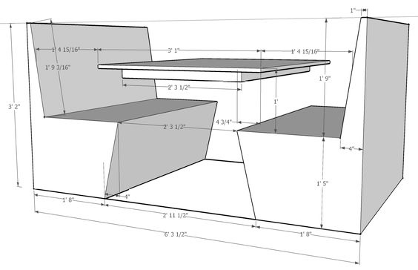
Booth drawings on-line

Slide 22
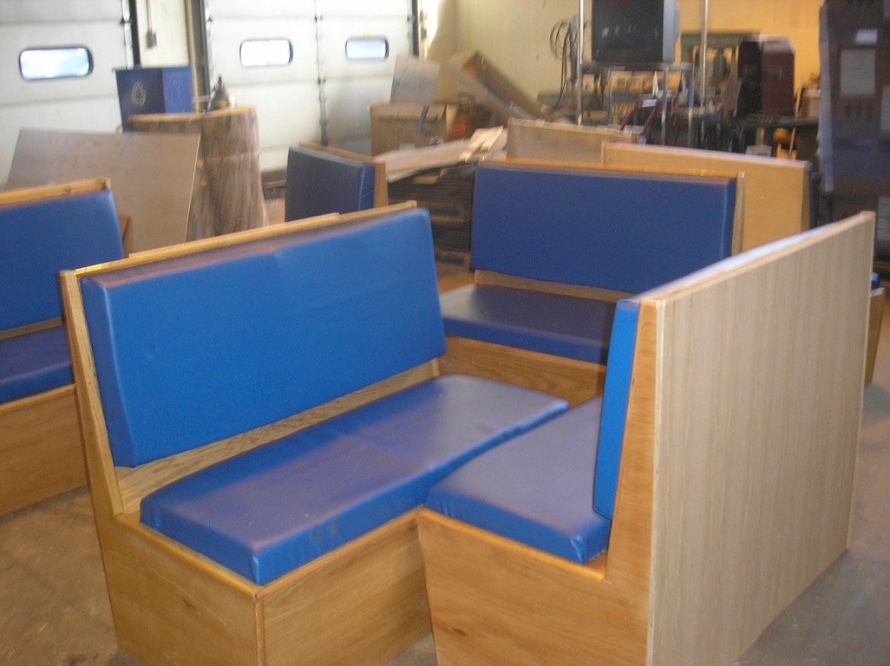

Slide 23
Butcher Block Tables
Had students mass produce;
First step - select from 1 1/2” material precut.
Make 6 rows 49” long
Plane and sand to appropriate thickness
Glue together 6 rows
Glue together 3 rows of 6 now approx 18” wide x 49” long
Plane 18” pieces to 1 1/4”, match and glue for 30” width
Sand, Sand, Sand, cut to size, router edges, sand
Pour epoxy resin (Bar coat) 2 gallons

Slide 24
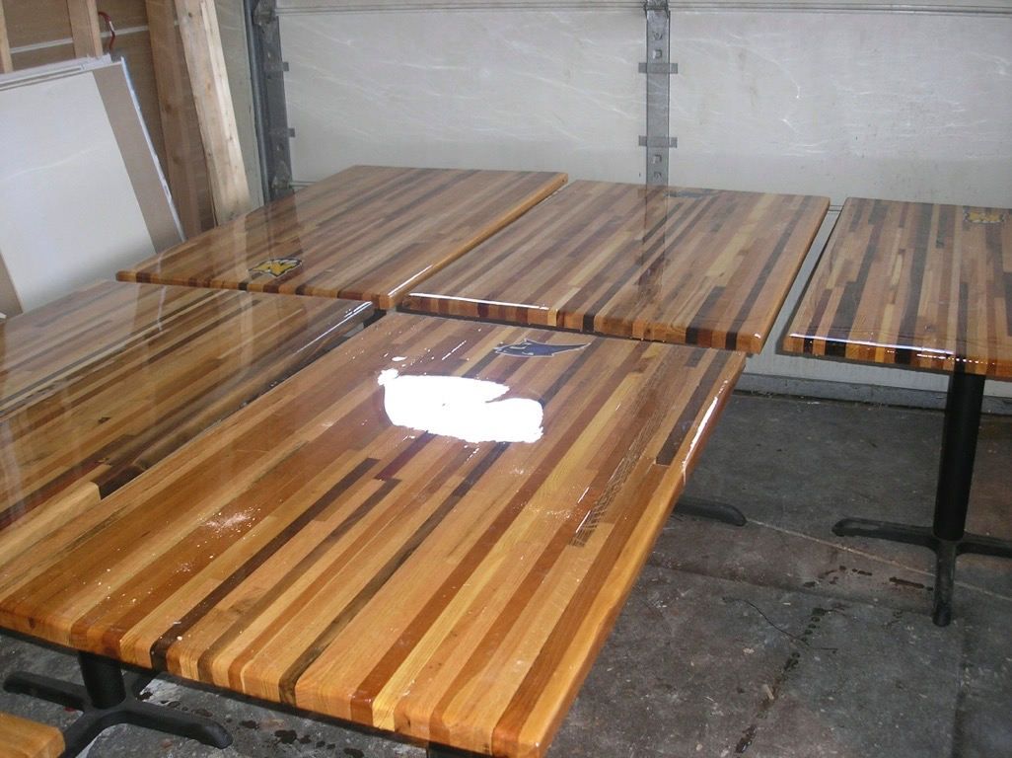

Slide 25
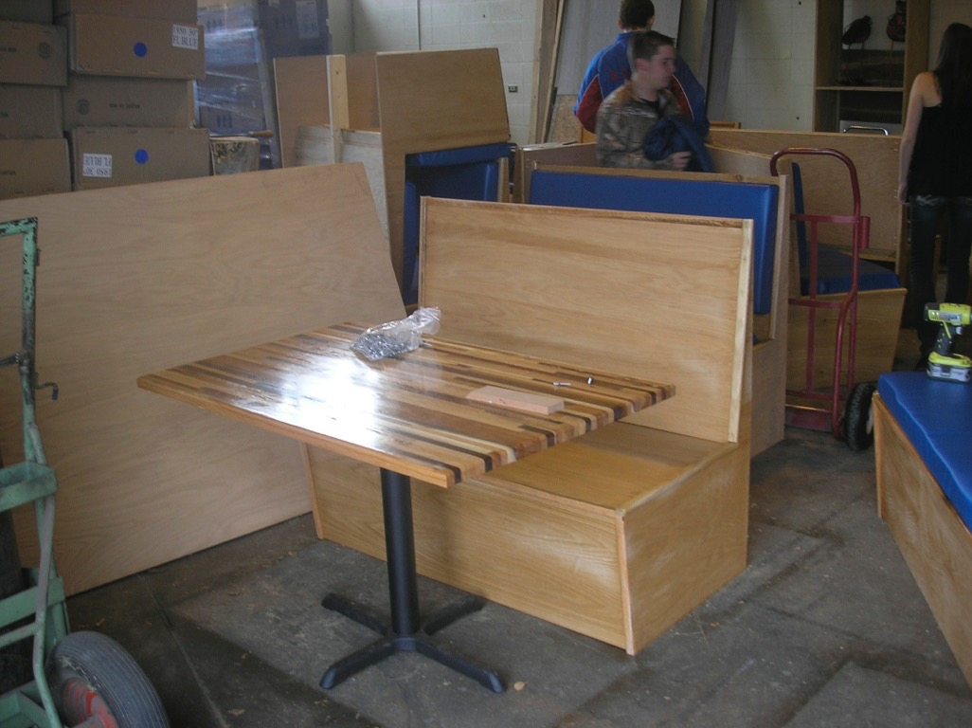

Slide 26
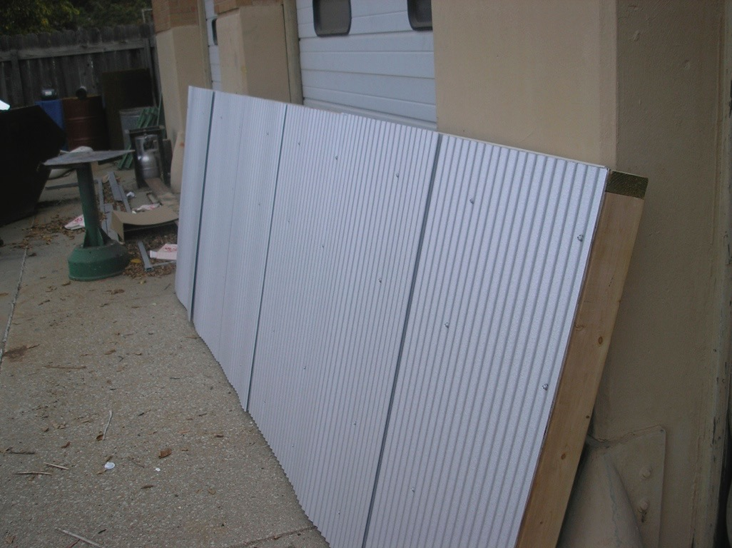
Half wall divider

Slide 27
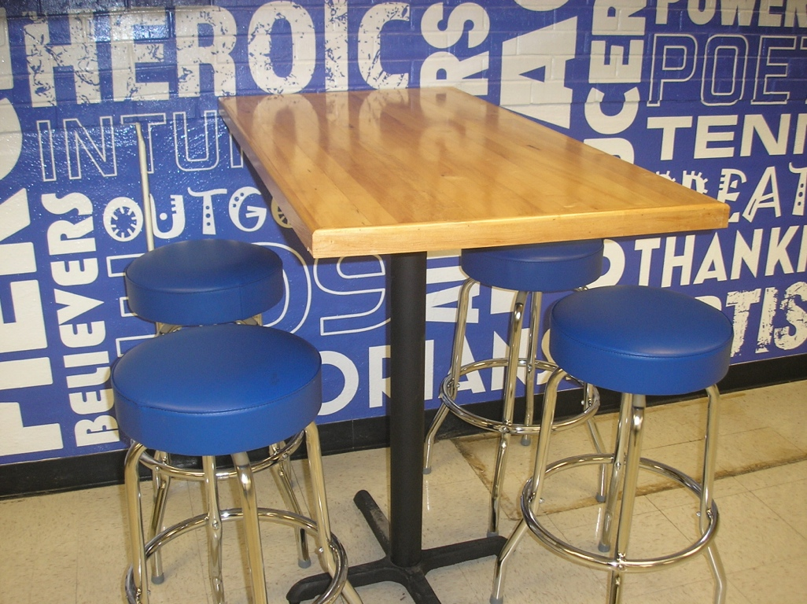
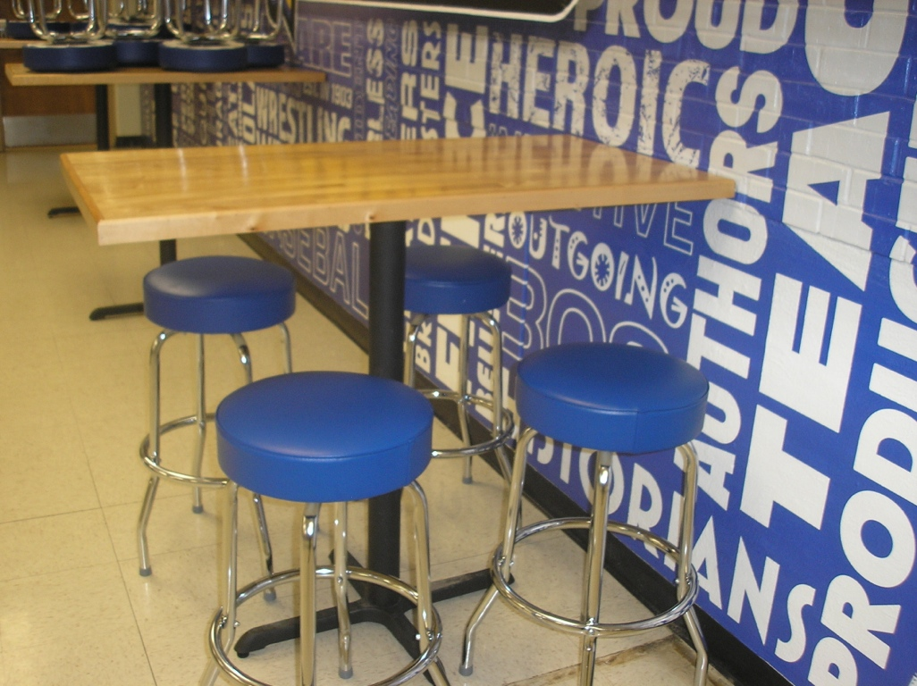
4 Top Tables
Reclaimed Gym Floor

Slide 28
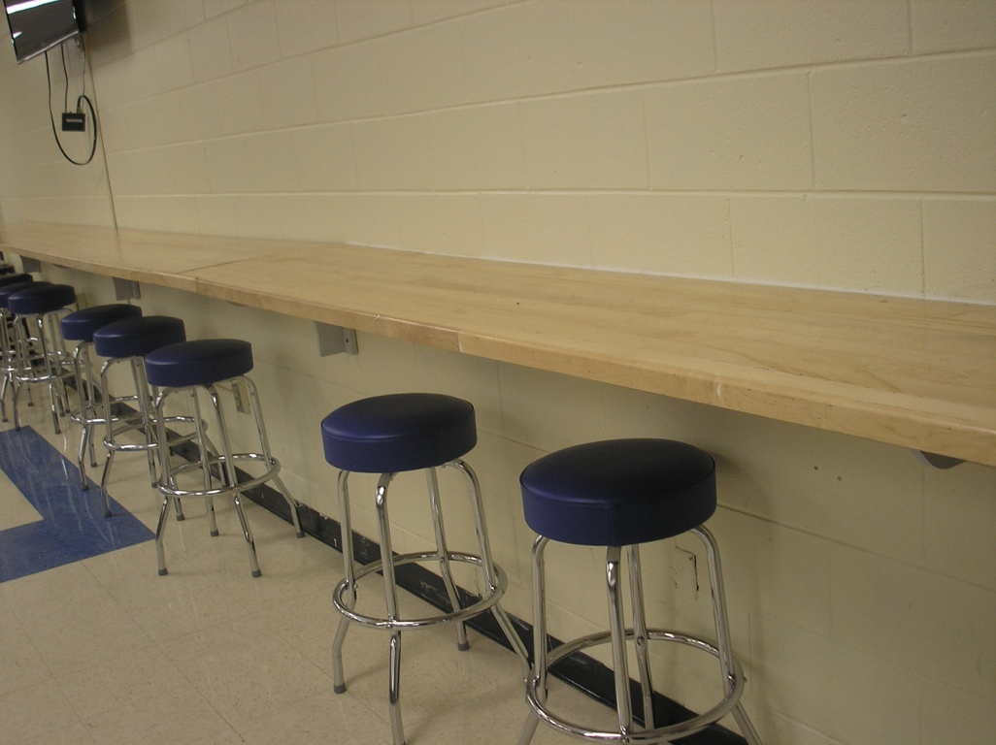
32 Foot Bar height Table

Slide 29
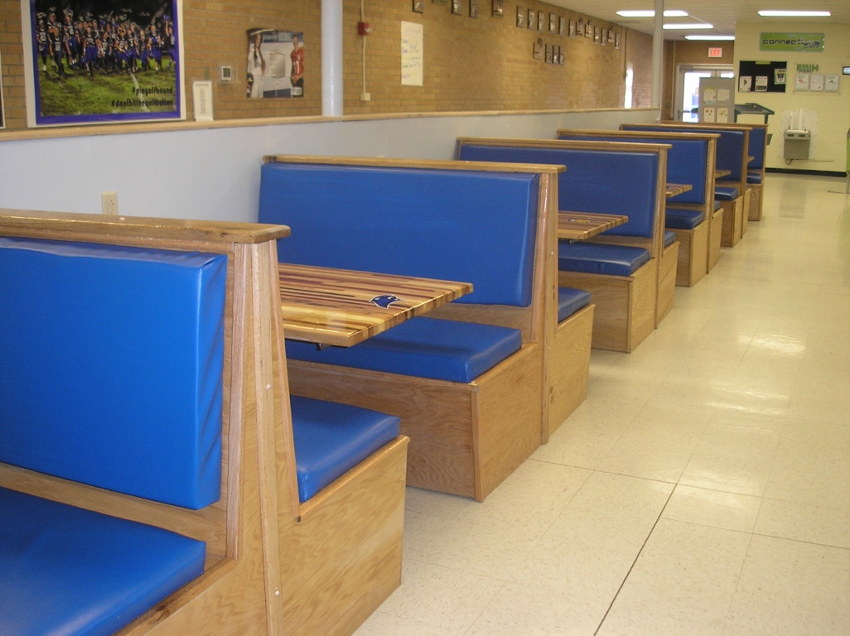

Slide 30
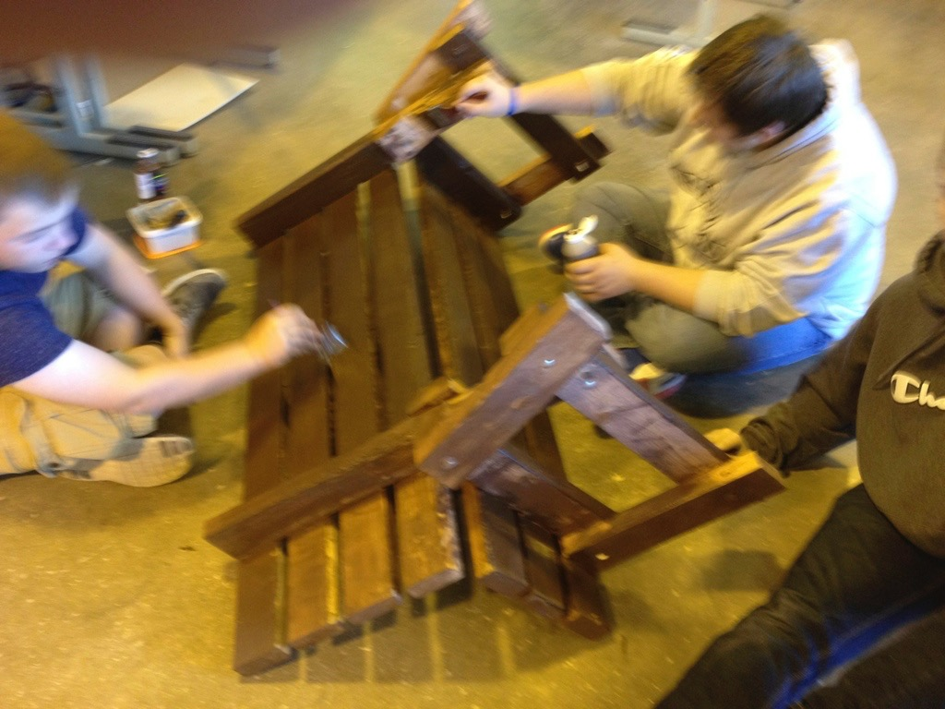
Park Benches

Slide 31
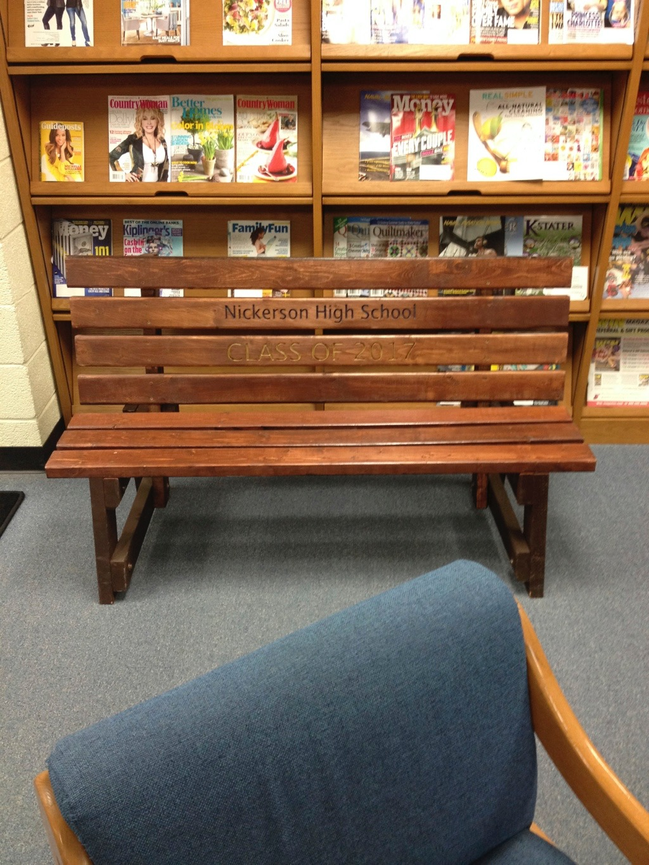

Slide 32
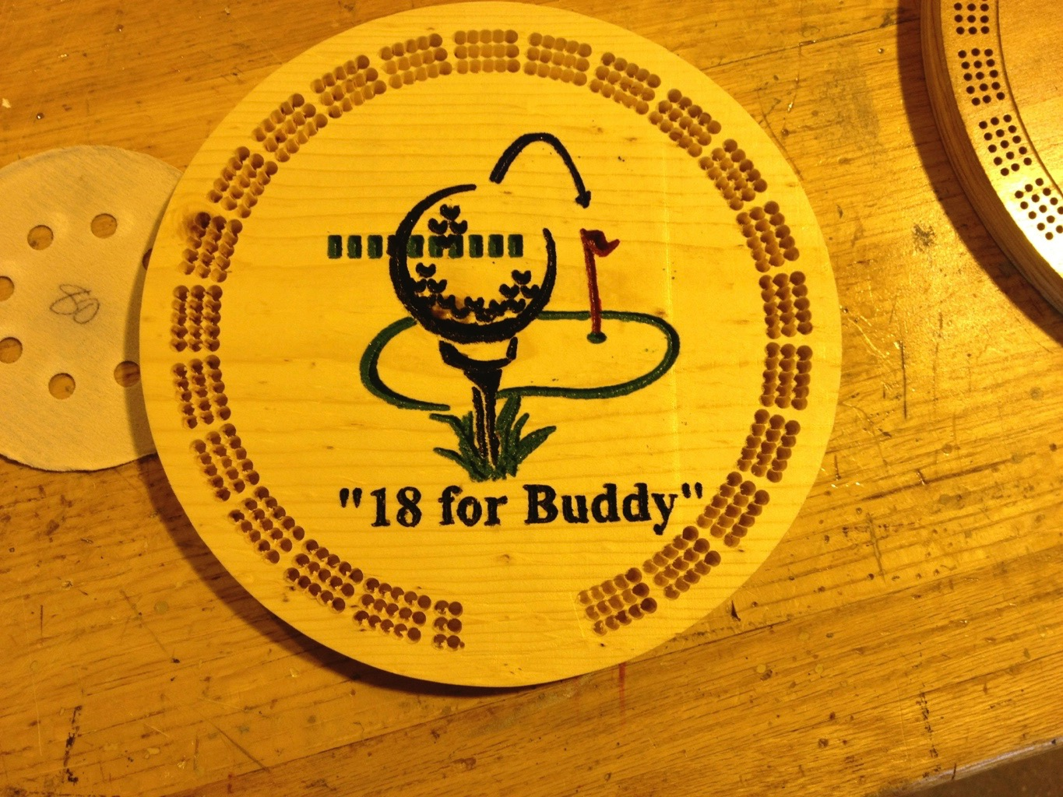
Cribbage boards

Slide 33
Ticket Booth
Design in Cad class with Revit and Chief Architect
Get specs from client
Offer several size sheds
Final approval of Drawings - order material
Teach all basic wall, floor, ceiling roof, door, window construction.

Slide 34
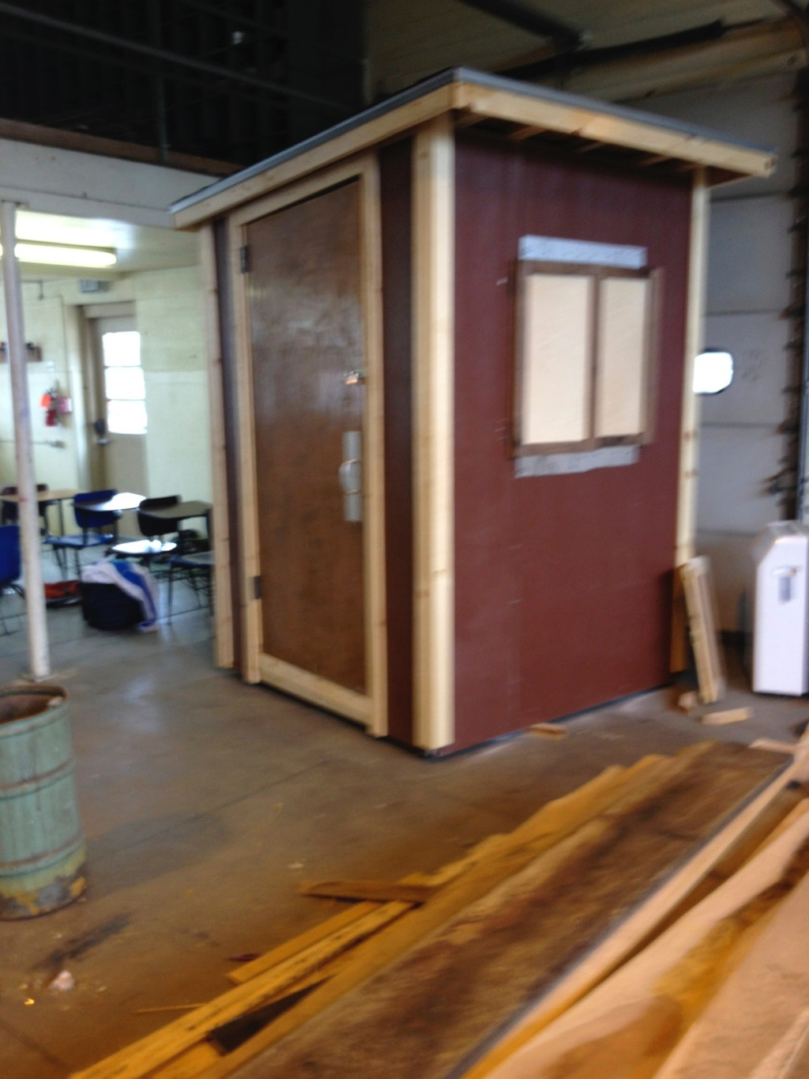

Slide 35
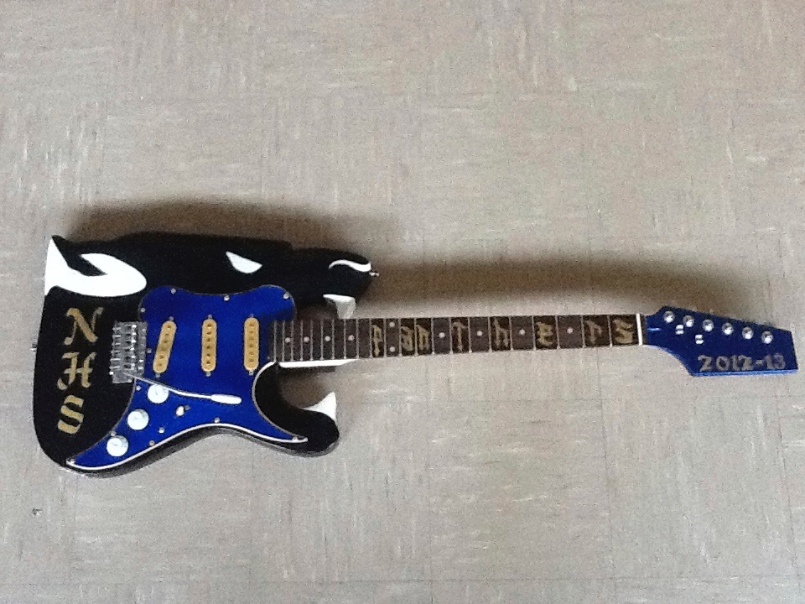
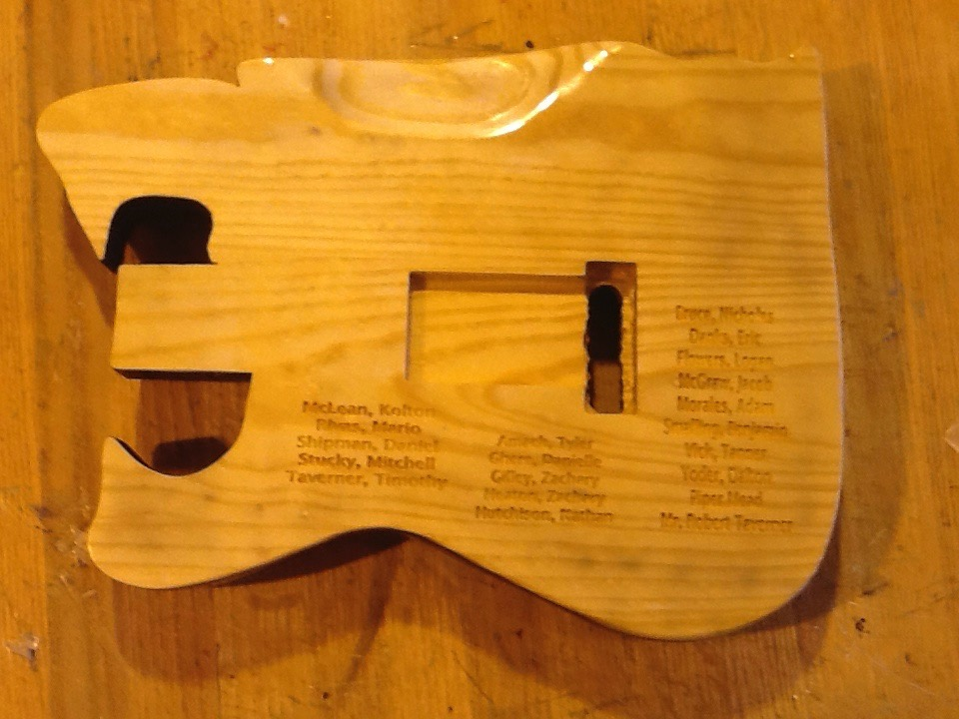
Pep Band Guitar

Slide 36
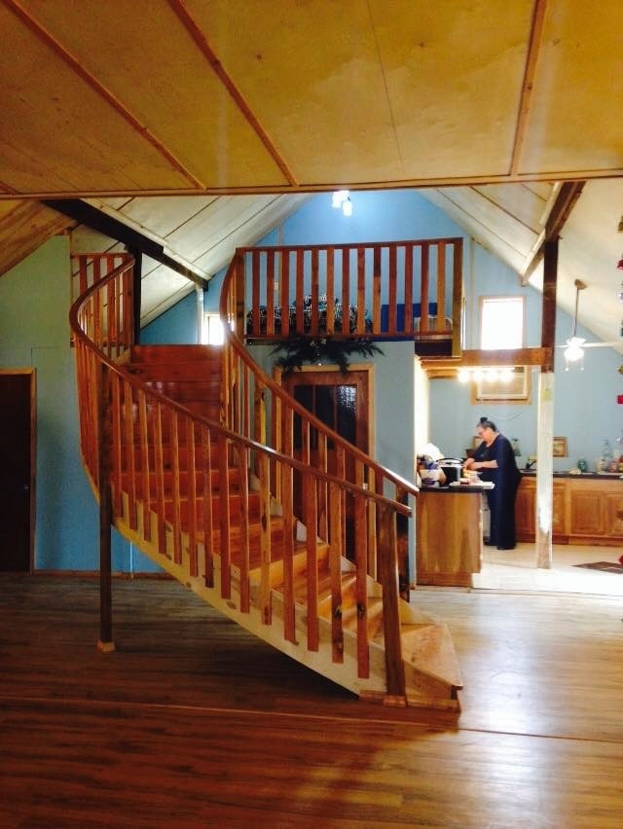
Curved stair case

Slide 37
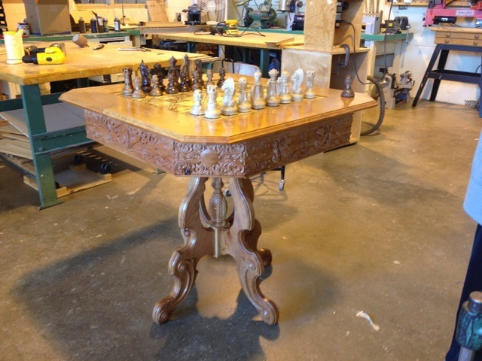
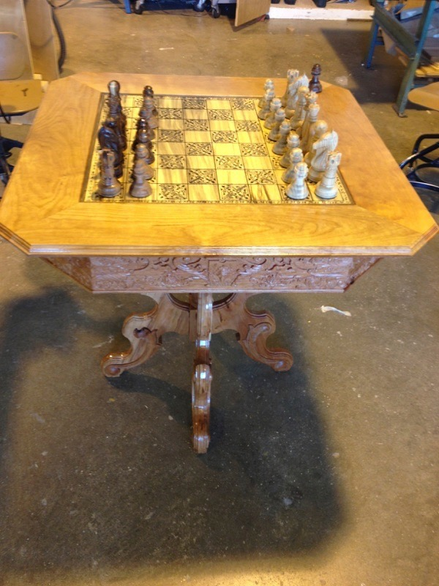
Chess Table CNC

Slide 38
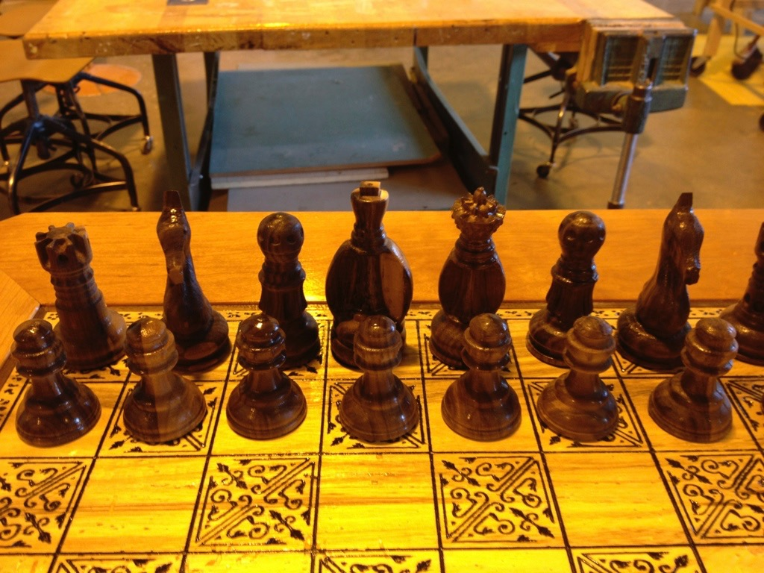
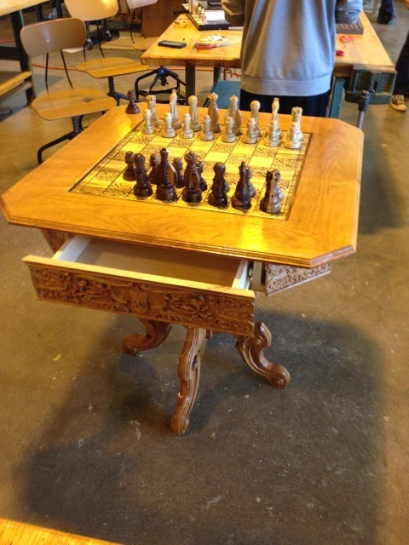
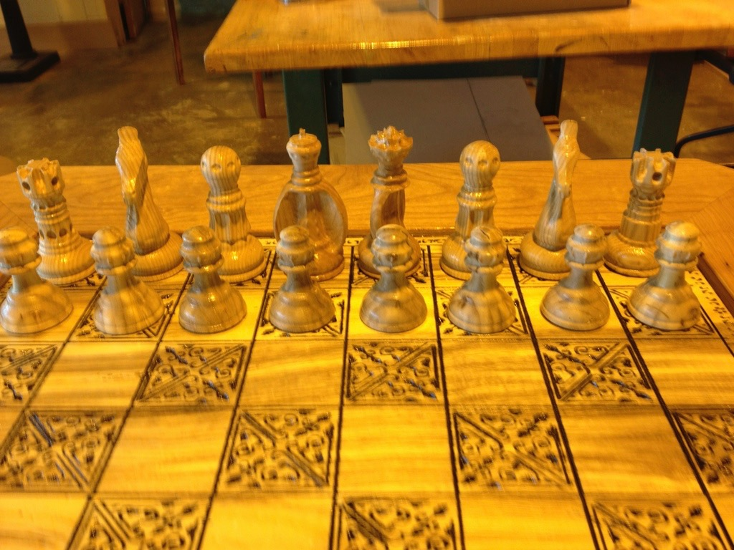

Slide 39
