Slide 1
With Collaborative Conversations… Sandboxes Disappear Mariah Cline, Larry McLemore, Kim Zant

Slide 2
Sandbox Activity
We Need Four Volunteers
INSTRUCTIONS
Everyone else create a circle around the four
The four volunteers can only see in their box (no peeking and no talking)
Individuals in circle can tell “your” volunteer only what you see

Slide 3
It’s Easier To See The Big Picture When…
Stage 1: Clarifying Vision
1) Identify our goal: Liberal High School enrollment in Senate Bill dual credit and concurrent classes. Assure students are placed in the correct classes/pathways based upon aptitude, maturity and interest.
2) How are we going to meet our goal? Increase awareness by communicating advantages of the class offerings.
3) What do we need to do next? Reflect, Act , and Evaluate.
Stage 2: Articulating Theories
1) The Vision of the Conversation: Our actions, we agreed, would always have “our” students’ as the focus. The action developed was to speak weekly at Liberal High School’s advisory period (E-time) about the advantages of the classes. We agreed to openly and honestly communicate with each other, even when it’s uncomfortable (see attached handout).
Stage 4: Reflecting and Enhancing
1) Analyze process and data: Bi-monthly meetings with Liberal High School and SCCC to analyze the data and collaborate on next steps.
2) Revise theory of action: Revisions took place as we went. We expanded the e-time visits to include more representatives from the college. We added advising sessions, college visits and an All Saints’ Day (SCCC Enrollment Day) at Liberal High School.
3) Plan future action: Finish developing a process for continual improvement and further requirements. Expand actions to further unify Liberal High School and SCCC (six year plan).
Stage 3: Implementing Action
1) Determine questions: Why were students not taking the classes and/or the right classes for college credit? What barriers can we control? Are connections being made with the right people?
2) Enhance advising plan: Exposed students to programs, followed-up with small group and one-one-one meetings. Determined entrance assessment needs. Identified key people in communication process.
3) Take action: Communicated daily and responded promptly to needs and ideas.
Notes:
Secretary, to enrollment, advising, faculty, etc.

Slide 4
Reflect, Act, Evaluate
Reflect: Why were LHS students not taking full advantage of the Senate Bill dual credit and concurrent classes? How could we get students to utilize this opportunity?
Evaluate: Analyze changes in enrollment in the specific areas mentioned. Enhance the process to better meet the needs of our students.
Reflect: Data showed 26% increase in enrollment the following school year in the identified areas. Identify the need to be able to duplicate the process as well as streamline and expand it.
Act: Refine the steps into a process understandable to all faculty/staff and other area high schools.
Evaluate: Analyze the effectiveness and adjust as needed to ensure clarity and sustainability.
Act: We visited and found that students had no knowledge and exposure to specific opportunities. Decided SCCC faculty would go to high school e-times and LHS counselors promoted the opportunities. LHS students would come tour classes at SCCC.
Notes:
Talk about the way we added class offerings, schedule changes based on the needs of students.

Slide 5
Growth
Notes:
Senate bill started taking away technical classes, yet our students are seeing the value of these offerings.

Slide 6
2015-2016 LHS/SCCC Data
170 students at LHS are taking an AP course at LHS (which could lead to college credit)
269 students are taking a College Level Course (both at SCCC and LHS)
209 are taking the course for dual credit (through SCCC)
144 students are taking Technical Courses at SCCC for dual Credit
583 College Level Courses are being utilized by LHS Students
Notes:
As Senate Bill Courses Decrease, Our Numbers Dual Credit Numbers Increases

Slide 7
Connect the Dots Cards
Everyone gets a card
Read your card
Walk around and talk to people and find out who’s need you can meet with your card
Notes:
Use or Toss for the Launch activity…..

Slide 8
Why Our Efforts are Working…
Shared Vision
Value, Quality, Student Success, Integrity, Trust
“Our” Students
Everyone is Valued
Failure is Accepted
Look for the Opportunity to Build
Timely Communication builds Trust
Continual Collaborative Conversations
Move Forward

Slide 9
Future Need (continue the cycle)
Reflect: Why were LHS students not taking full advantage of the Senate Bill dual credit and concurrent classes? How could we get students to utilize this opportunity?
Evaluate: Analyze changes in enrollment in the specific areas mentioned. Enhance the process to better meet the needs of our students.
Reflect: Data showed 26% increase in enrollment the following school year in the identified areas. Identify the need to be able to duplicate the process as well as streamline and expand it.
Act: Refine the steps into a process understandable to all faculty/staff and other area high schools.
Evaluate: Analyze the effectiveness and adjust as needed to ensure clarity and sustainability.
Act: We visited and found that students had no knowledge and exposure to specific opportunities. Decided SCCC faculty would go to high school e-times and LHS counselors promoted the opportunities. LHS students would come tour classes at SCCC.
Notes:
Talk about the way we added class offerings, schedule changes based on the needs of students.

Slide 10
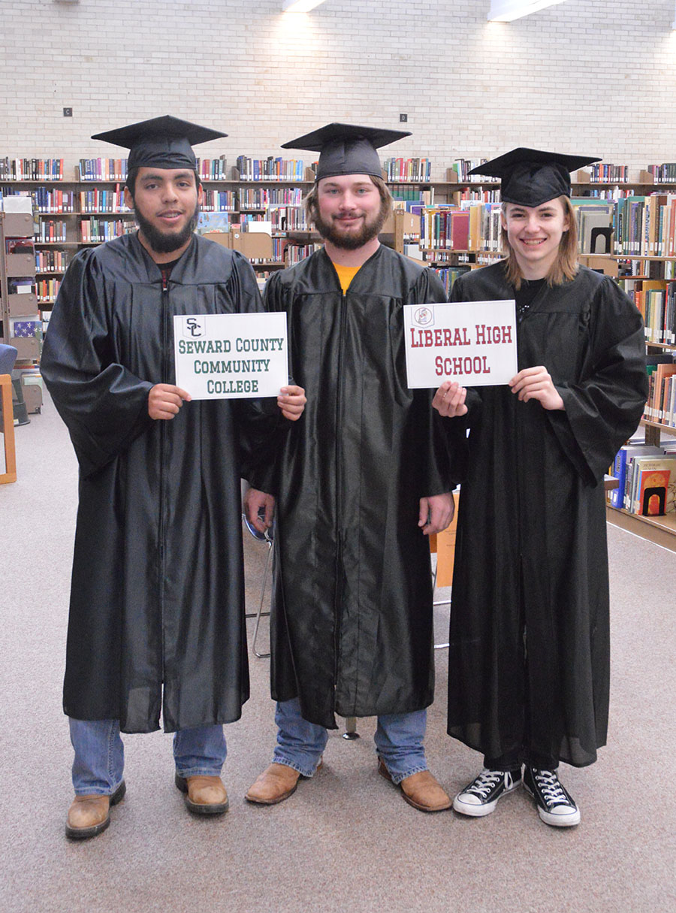
Coming May 2016….

Slide 11
Conclusion Challenge
Stand up, join hands with your neighbor
Push until one of you moves one of your legs
They are the Winner
Questions?
Notes:
they win at this activity and we applaud them. But the key is that we all also win, because we MOVED FORWARD!!! The key is it not about being a winner and someone being a loser. We accept failures. We allow ideas, changes and when (not if) we fail, we are okay. We reflect/evaluate/then act. This keeps us moving forward. )

