Slide 1
Planning for Success: The Kansas Individual Plan of Study Program
CTE Conference February 9, 2016

Slide 2
Career Ready
The labor market is increasingly requiring higher levels of education for employment
By 2020, 71% of jobs in Kansas will require a postsecondary credential (certification through an advanced degree)**
Currently, just over half of working-age Kansans have a post-secondary credential
Most job openings will be for “middle skill” jobs (requiring more than a diploma but less than a four-year degree)
**Georgetown Public Policy Institute

Slide 3
Obstacles to Students Completing a Post-secondary Credential
“4 year or Bust” Mentality
Higher Cost of Higher Education
Lack of Purpose
Incomplete, Partial, or Poor Planning

Slide 4
Planning for Success
An individual plan of study allows:
Exploration of all forms of post-secondary education
Students and families to plan a more cost-effective educational pathway including dual-credit courses and certification programs
Students to select courses based on their career interests

Slide 5
An Individual Plan Of Study Is Not A Checklist!
An Individual Plan of Study is a living document that facilitates a conversation with a student regarding his or her future. At the very least, it includes:
Career interests identified by the student through an authentic career interest survey or assessment.
A roadmap based on the student’s interests and talents and graduation requirements
Includes approved coursework for the student's educational and career goals
Includes developmentally-appropriate, work-based learning experiences.
The individual Plan of Study is most powerful when accompanied by meaningful conversation and activities that help the student identify and set goals.

Slide 6
Essential Components Of An Effective Individual Plan Of Study: IPS/SIS Interface
Notes:
We have identified 18 components; however, we will highlight the four most important components here.

Slide 7
Essential Components Of An Effective Individual Plan Of Study: Interest Inventory Progression
Identifying Talents, Interests, Strengths and Learning Styles
Middle Grades
Career Focused Surveys and Ability Profilers
High School Grades
Related Careers
Post-Secondary Options

Slide 8
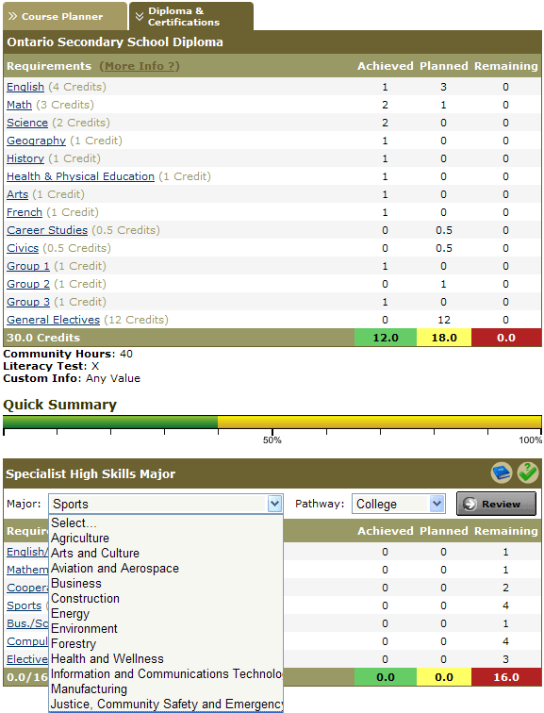
Essential Components
Essential Components Of An Effective Individual Plan Of Study:
Course Mapping and Credit Evaluation

Slide 9
Essential Components Of An Effective Individual Plan Of Study: Portfolio

Slide 10
IPS Process
Schools must develop comprehensive career guidance systems to allow all students to develop, re-visit, and revise their individual plans of study consistently beginning in the middle grades and continuing through high school into post-secondary.
KSDE, in conjunction with principals and counselors, is preparing both grade-level career exploration activities and a career guidance training model for all school staff.

Slide 11
3A High School Process
Halstead High
254 students, 14 pathways
12 teachers out of 20 teach a pathway class
Conversations
Administration, BOE, Counselor, Teachers, Students
Research to develop a tool
Created from samples and local needs

Slide 12
Implementation
Change of culture
Staff support of process
Not just about the master class schedule
Meeting with students
Fluid
Revisit schedule
Sharing with Parents

Slide 13
Planning for Success: The Kansas Individual Plan of Study Program
KSDE Agency Staff Briefing
January 29, 2016

