Slide 1
Meeting Social and Emotional Character Development Standards in Family and Consumer Sciences Education
Gina Bergin
Mission Valley
Janet Holden
Northern Heights
Megan O’Boyle
Piper
Sally Yahnke
Kansas State University

Slide 2
Is Family and Consumer Sciences Social Emotional Learning?
Kansans Can—Kansas Accreditation—Kansas Connections

Slide 3
FAMILY AND CONSUMER SCIENCES VISION

Slide 4
Family and Consumer Sciences empowers individuals and families across the life span to manage the challenges of living and working in a diverse global society. Our unique focus is on families, work, and their interrelationships.

Slide 5
Family and Consumer Sciences Mission:
--to prepare students for family life, work life, and careers in Family and Consumer Sciences
--providing opportunities to develop the knowledge, skills, attitudes, and behaviors needed for:

Slide 6
•Strengthening the well-being of individuals and families across the life span. •Becoming responsible citizens and leaders in family, community, and work settings. •Promoting optimal nutrition and wellness across the life span. •Managing resources to meet the material needs of individuals and families. •Balancing personal, home, family, and work lives.

Slide 7
•Using critical and creative thinking skills to address problems in diverse family, community, and work environments. •Successful life management, employment, and careers development. •Functioning effectively as providers and consumers of goods and services. •Appreciating human worth and accepting responsibility for one's actions and success in family and work life.

Slide 8
What Is Social and Emotional Education—And Why Is It Important?
Social and emotional competence is:
--the ability to understand, manage, and express the social and emotional aspects of one's life
--enable the successful management of life tasks such as learning, forming relationships, solving everyday problems, and adapting to the complex demands of growth and development
--includes self-awareness, control of impulsivity, working cooperatively, and caring about oneself and others
--process through which children and adults develop the skills, attitudes, and values necessary to acquire social and emotional competence.

Slide 9
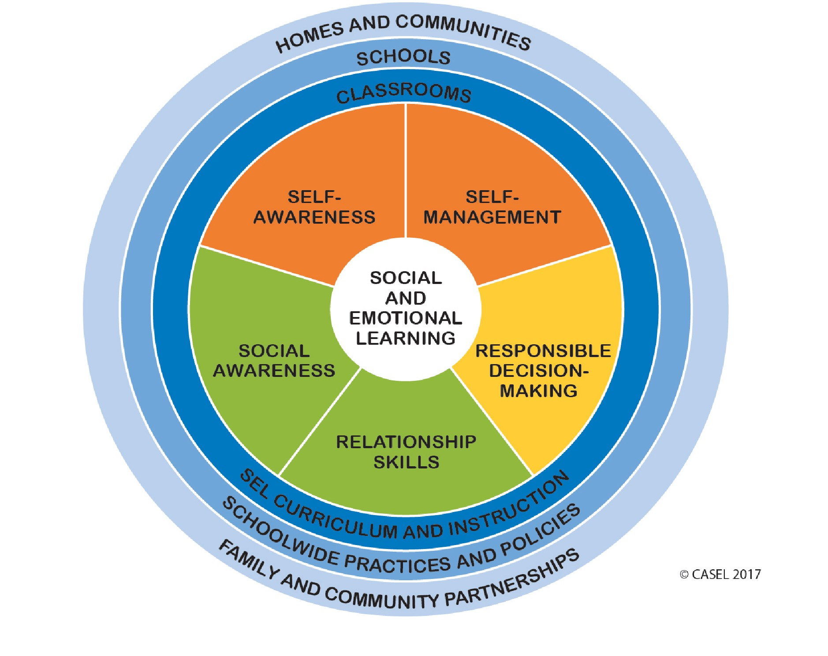

Slide 10
Kansas Social, Emotional, Character Development Model Standards (Adopted by the Kansas State Board of Education, April 2012)
The purpose of the Social, Emotional, and Character Development Standards in Kansas is to
--provide schools a framework for integrating social-emotional learning (SEL) with character development so that students will learn, practice and model essential personal life habits that contribute to academic, vocational, and personal success
--learning to be caring and civil, to make healthy decisions, to problem solve effectively, to value excellence, to be respectful and responsible,
--to be good citizens and
--to be empathic and ethical individuals.

Slide 11
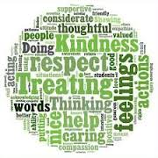
SEL Standard Categories
•Character Development
•Personal Development
•Social Development

Slide 12
Examples of SECD Standards in Family and Consumer Sciences

Slide 13
Is Family and Consumer Sciences Social Emotional Learning?
The answer is….. YES!

