Slide 1
ACTIVATING an entrepreneurial mindset in high school students
Jennifer Steinert, Business Instructor Hoisington High School

Slide 2
What is an entrepreneurial mindset?
The Network for Teaching Entrepreneurship defines the entrepreneurial mindset as the set of attitudes, skills and behaviors that students need to succeed academically, personally and professionally.
Initiative and self-direction
risk-taking
flexibility and adaptability
creativity and innovation
critical thinking and problem solving
ability to see opportunities

Slide 3
How do the students benefit?
Work skills
Soft skills
Confidence
Awareness
Notes:
Work Skills: running a cash register, customer service, work ethic, working with technology
Soft Skills: communication skills, interpersonal skills, adaptability, project management, problem solving,
Confidence: students develop a confidence they didn’t have before. They thrive and take pride in their projects.
Awareness: students become aware of the nature of business and the importance of community
I’ve seen students who struggle either academically or behaviorally in the classroom thrive when they are working

Slide 4
The Red Zone
Sell snacks and drinks to students and staff
Open 10 minutes before school
FBLA members open
Open every class period except during my plan time
ABD students operate
FBLA members work during seminar time
Must follow nutrition guidelines

Slide 5
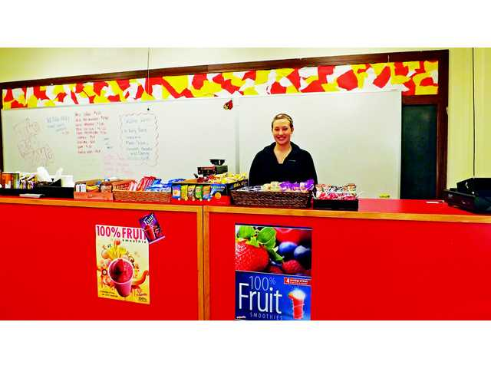
In The Beginning (2012)
Located in an unused classroom
Used old counters that were no longer being used
Used funding from FBLA to purchase start-up supplies
Small menu
Notes:
Like most entrepreneurial ideas, the idea of a snack shop came from an simple statement. A student said, “I wish we had place at school to get coffee.”
Approached my principal and with full support went on a search for a location.
Start-up supplies: cash register ($50 at Walmart), baskets from home, purchased snacks and supplies at Sams

Slide 6
Today (2017)
Larger, more accessible location
Comfortable and relaxing environment
Expanded menu
New vendors
KS Department of Health & Environment
Notes:
Location: library unused and full of ancient reference books
Couch, 2 loveseats, round tables
Added more entrees
Going to Sams is not convenient for us; contacted district food service
Be compliant with KS Department of Health & Environment

Slide 7
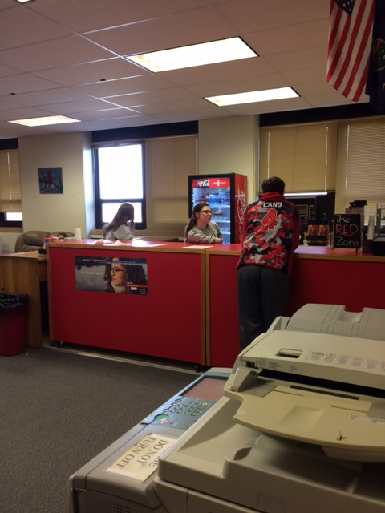
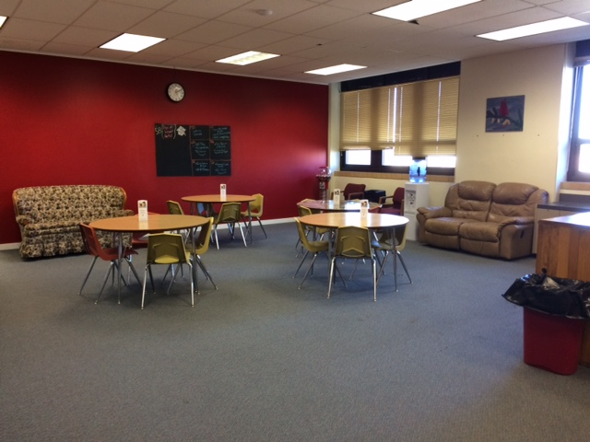

Slide 8
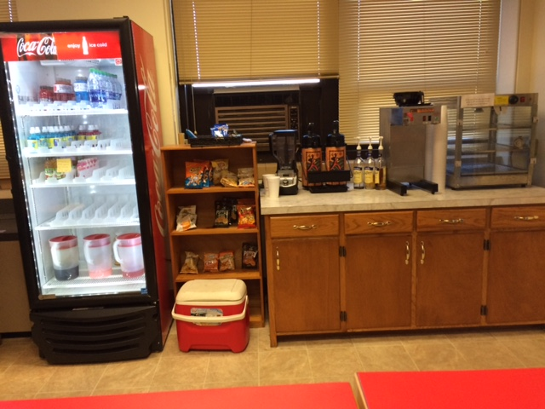
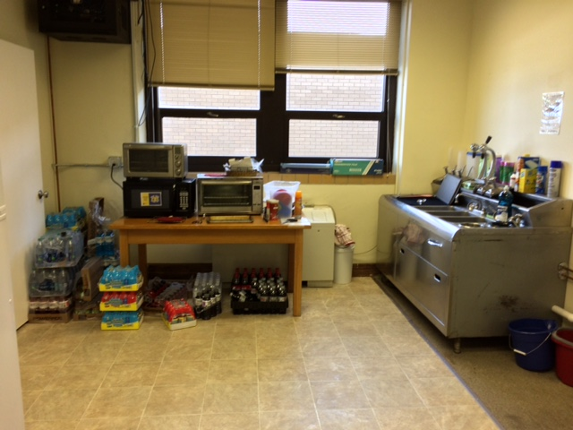

Slide 9
Rules
Students are allowed to come in with their teacher’s permission
Often used for group projects
No cell phones
Monitored by myself
Security cameras

Slide 10
Worker Responsibilities
Wait on customers
Maintain a clean environment
Keep food and drinks stocked
Record low inventory items
End of day clean up

Slide 11
Profit
Back into the store
FBLA activities
School activities

Slide 12
Where to start?
Administrative support
Be prepared!
Have a plan in place
Discuss the benefits
Visit other schools with student-run businesses
Hesston
Garden Plain
Notes:
When you approach your administrator, you need to be prepared. This idea might seem completely off the wall to them.
Already have a plan in place as far as location, how it will be managed,
Explain how the students who work in the store will benefit (work ethic, responsibility, communication skills, experience, other soft skills)

Slide 13
Funding & Student Involvement
Funding
Be resourceful!
Grants
Economic Development Committee
CTSO
Student Involvement
Create excitement
Help plan
Work days
Notes:
Resourceful: Find things around your building that aren’t being used that you can use, send emails out to the district asking for items that you might need, look for things at your house, garage sales, can something be made? The shop class has been a great help!
Grants: small or large
Economic Development Committee: have money to spend on new or revitalizing business; can also loan money at low interest rate
CTSO: have money in FBLA or DECA accounts to use? Fundraisers

Slide 14
Vendors
Locating vendors
Ben E. Keith (used by food service)
Hiland Dairy (used by food service)
Prairie Fire Coffee Roasters
Dr. Smoothie
Coca-Cola (school contract)
Local grocery store

Slide 15
Financial Reporting
Discuss with finance director
Set up a separate activity fund
Submit purchase orders
Track on spreadsheet
Reconcile with secretaries
Involve students
Notes:
Can run it through your CTSO or might be able to set up a separate fund. We operate under the FBLA umbrella which allows us to use that tax exemption
Responsible students help with this

Slide 16
Apparel Printing & Embroidery
Started in 2015
Decide on printing method
Obtain equipment
Donations
Used equipment
Establish accounts with vendors
Alphabroder (shirts, hats, bags, etc.)
Transfer Express (heat transfers)
Q Digitizing
Melco
Notes:
Talk about how I had my own business & donated equipment and shirts to school

Slide 17
Profit
30% back into entrepreneurship fund
25% Cardinals Care
45% student payout

Slide 18
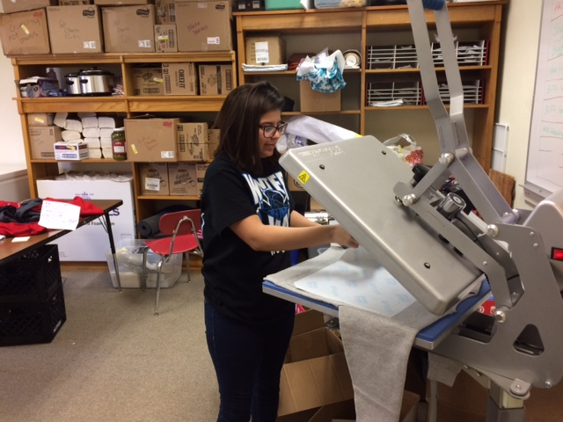
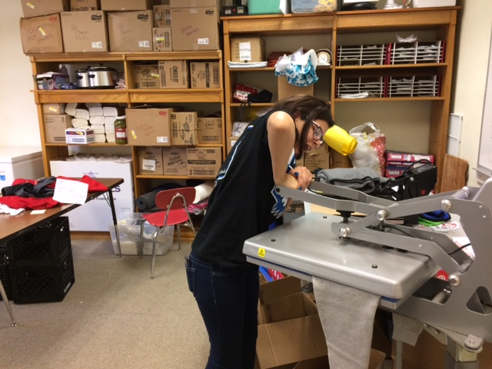

Slide 19
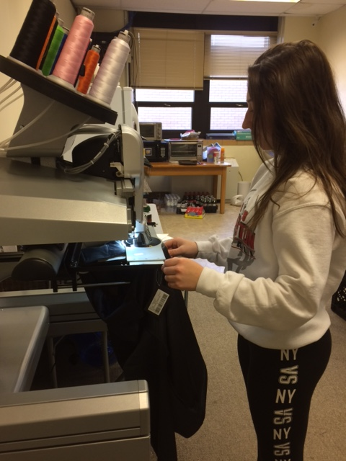
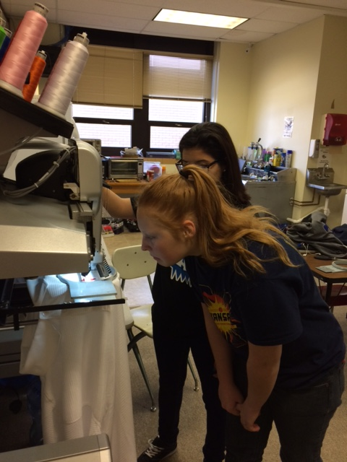

Slide 20
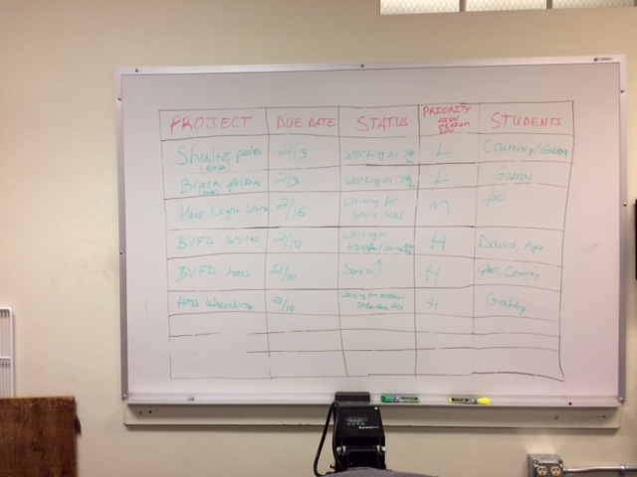

Slide 21
Community Involvement
Host a Chamber of Commerce coffee
Join the Chamber of Commerce and attend coffees with students
Approach businesses about what you can do for them

Slide 22
My Advice
START SMALL!
Visit other schools
Involve students

Slide 24
Contact Information
Jennifer Steinert, Hoisington High School
jsteinert@usd431.net

