Slide 1

Doing More with Less
(...while trying to be politically correct!)
*Come to this presentation! We will have PROFOUND information AND snacks!
USD 243 Lebo-Waverly
Penny Fleming: pfleming@usd243ks.org
Janella Newton: jnewton@usd243ks.org

Slide 2


We are NOT talking about...
Money
Politics

Slide 3
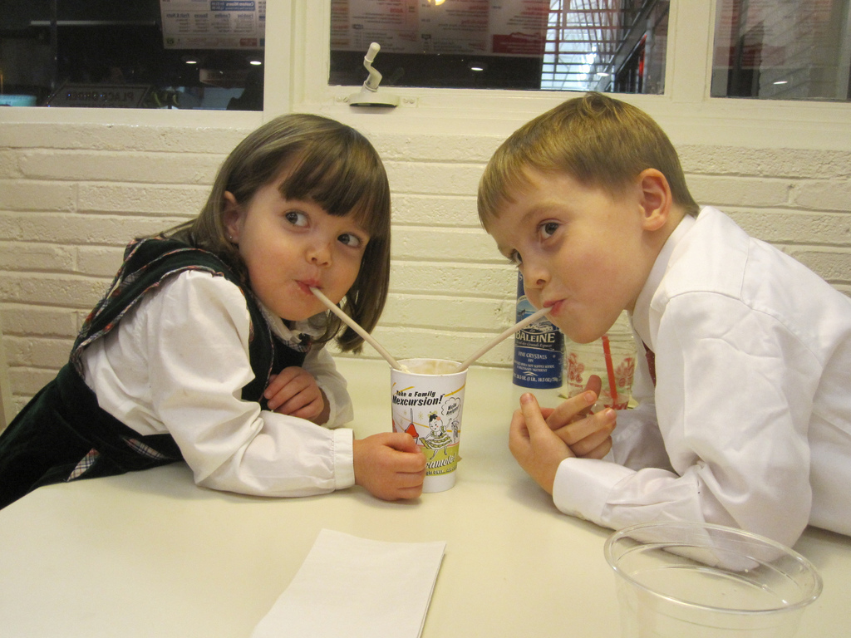
A little about us...
Two 1A Jr/Sr High Schools (6-12)
238 students total
  Share a counselor
  Share an art teacher
  Share a FACS teacher
  Share a librarian
  Share a physics teacher
  K-12 Principal at each
  K-12 Music and PE teacher at each

Slide 4
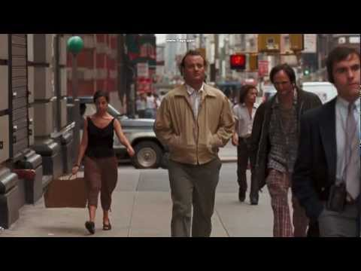
Sometimes, it’s really hard to stay positive!
Pathways were a mess
One student attending technical college
Minimal students taking concurrent credit
A HS counselor at each school
  Did not collaborate
Administration
  Did not collaborate

Slide 5


Baby Steps...
Took over as district CTE coordinator
Set-up webpage
Set-up twitter account
Started conversations with staff AND students

Slide 6

Working for Change
Things to get to where we need to be
  Work together as a district
  Staff/Admin buy in
  Student (current & former) input
  Administrative Support
  Licensed Personnel Guide

Slide 7

Audio Visual?
….you’ve got to be kidding me!!

Slide 8

FROM A SMALL TOWN TEACHER’S POV...
*Hands are tied with regards to a schedule.
*Small schools are bogged down with only one teacher per core area.
*Eight periods a day; six preps
*Desire to do more...but how could I do more and still stay within the curriculum ?
*FRUSTRATION FRUSTRATION FRUSTRATION

Slide 9
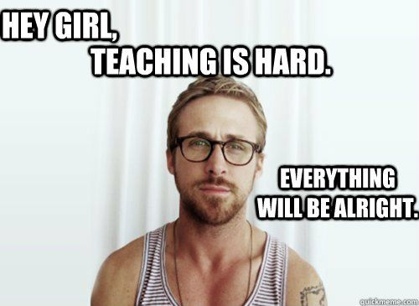
WHAT I COULD DO:
*Teach ELA from 9-12
*Teach speech (elective)
*Teach a college comp class
*Teach a theater class

Slide 10
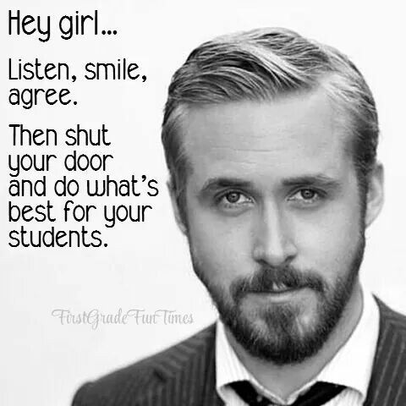
What I wanted to do:
*Gift my students with the technology knowledge that they will truly need after high school.
*Engage my students in enjoyable activities as they learn
*Gift my students with the awareness of leaving a positive digital footprint.
*Give my students more of a choice when it comes to attaining an education.
*TRULY DO WHAT IS IN THE BEST INTEREST OF MY STUDENTS!!!

Slide 11
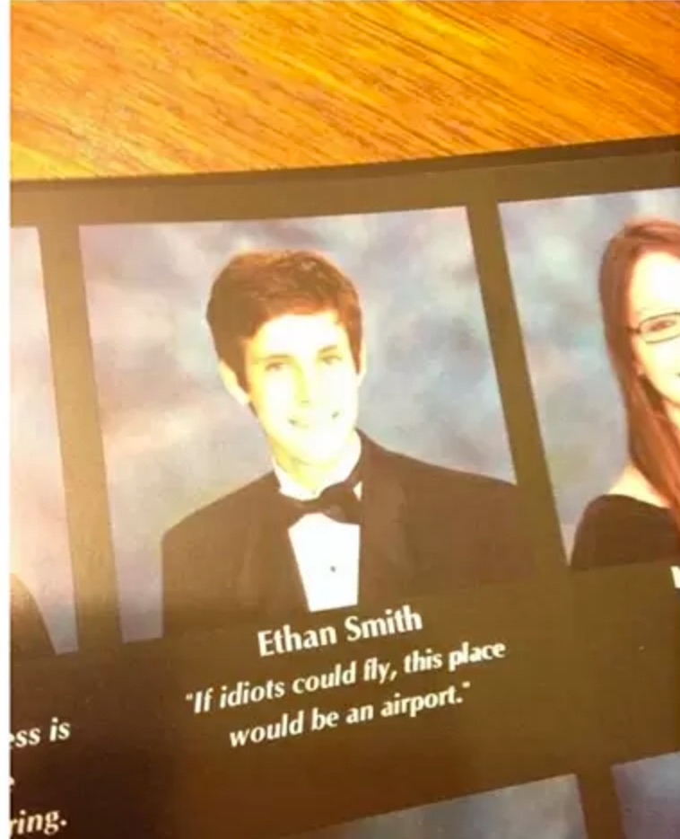
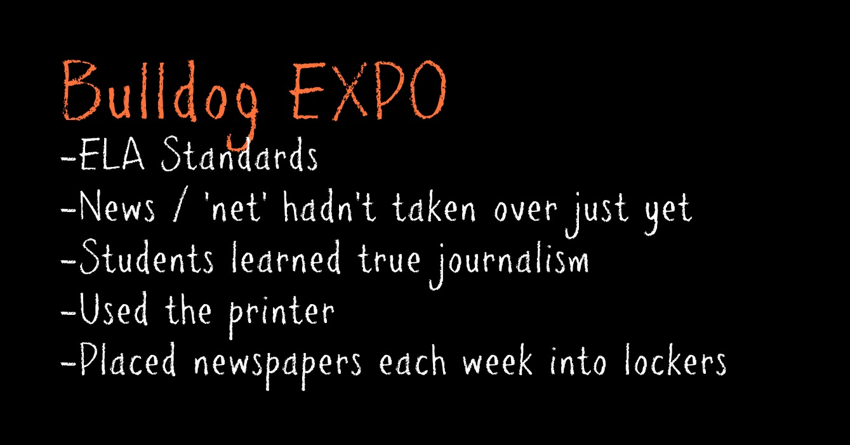

From humble beginnings...
Yearbook
-watched students thrive in an environment rich in technology and hands on learning

Slide 12

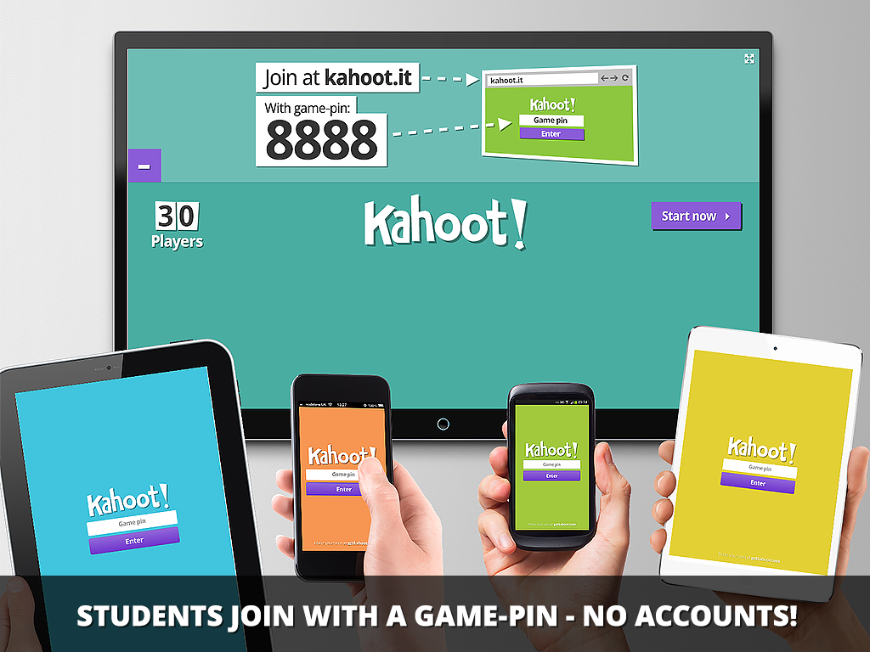
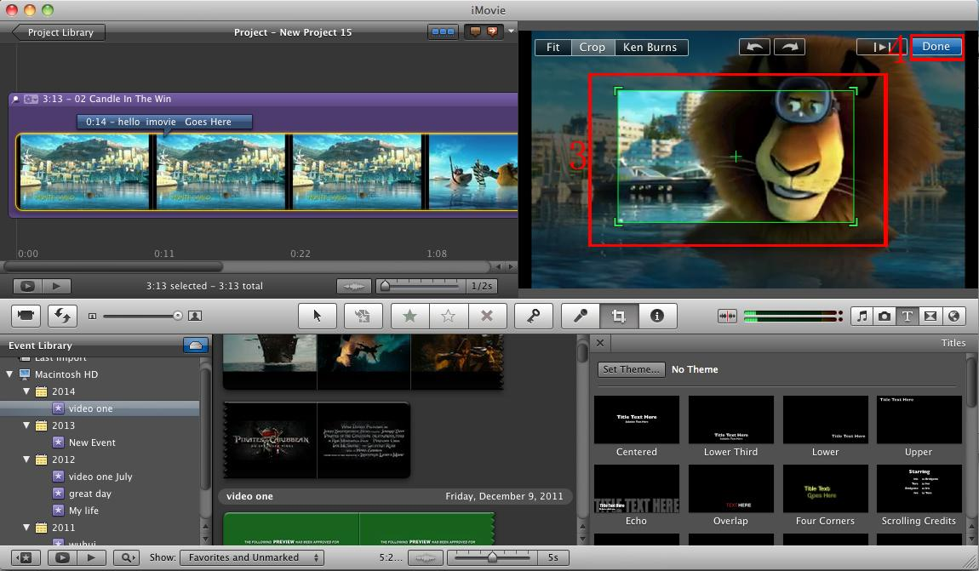
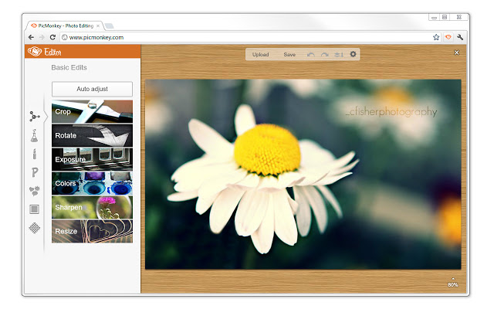

...but wait
By integrating technology into the classroom, teachers are changing the way they used to teach (lectures six hours a day) and providing students with the tools that will take them into the 21st century...When you do, you will find that technology an have a profound impact on your students learning.
I believe I’m supposed to be doing more than this.
NEW CENTURY =
NEW CLASSROOM

Slide 13

...and then, one year it happened
BULLDOG BUZZ
was born

Slide 14
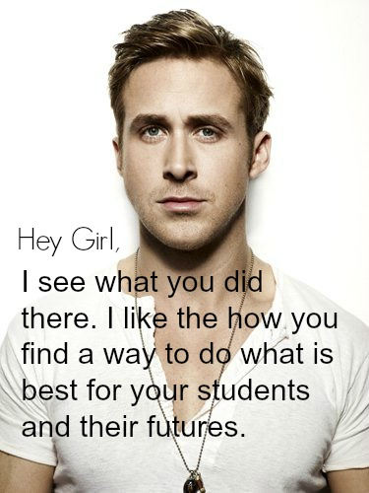
Audio & Visual Technology
Started as a simple elective that fit underneath the umbrella of my license

Slide 15
It takes nearly nothing
Phone cameras
YouTube account
Facebook account
Twitter account
iMovie
...but it’s a whole lotta’ fun

Slide 16
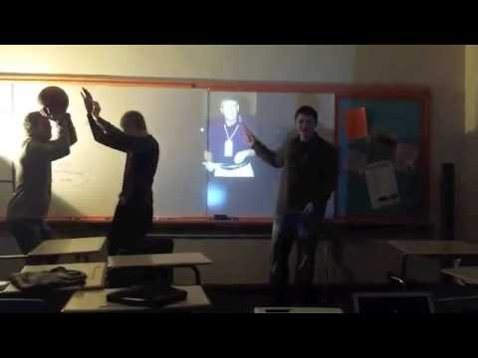
Bulldog Buzz, ed 1

Slide 17
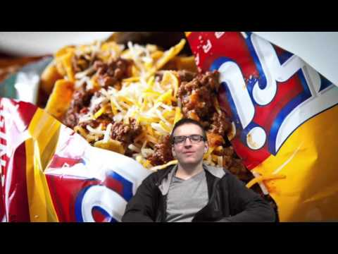
Special Announcements

Slide 18
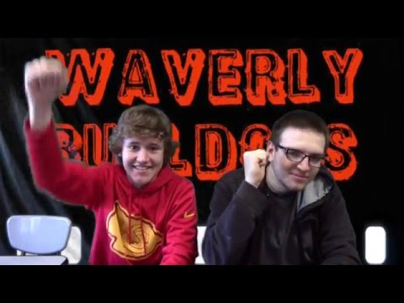
A tad bit more advanced

Slide 19
New pathway…
WITH FUNDING
About Town
Senior Spotlight
Guest Speakers
Sports Recaps
Weather
Student talent/Out of the Box
Teacher Bio
Newt’s News
Joke of the Week
Sibling Rivalry
Surveys
Movie Reviews
Super Bowl Contest
Christmas Edition
Superintendent interviews/lack of school funding
Community Interviews
Scholars Bowl
Advertisements
Valentine’s Messages
Visual Arts Pathway

Slide 20

Places to go and take your students
ICC FabLab
Technical College Visit
University Visit
Expose them to things they may not get to see on their own

Slide 21


People students can benefit from hearing
Randy Watson
Bill Cordes
Pat Bosco
Frank Tracz
Temple Grandin

Slide 22
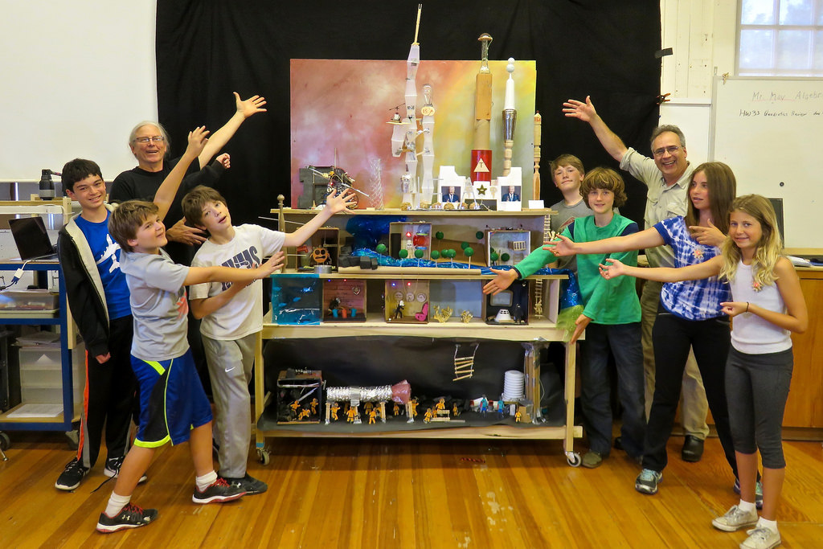
Share Time & Questions
Find your tada!
What good things are you doing?

