Slide 1
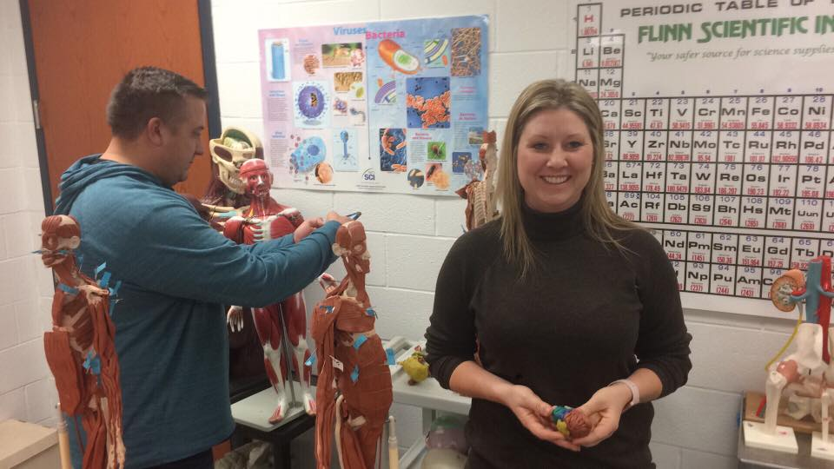
Health & Bio Sciences
Martin Kollman
February CTE Conference

Slide 2
Health & Bio Sciences
Health Science
Biomedical
Biochemistry
Teachers: Biology, Chemistry, P.E., FACS, Health, Agriculture, Engineering, Athletic Trainers, and professionals (RN, MD, LPN, PA, EMT, Fire Fighter, Rad Tech…..)

Slide 3
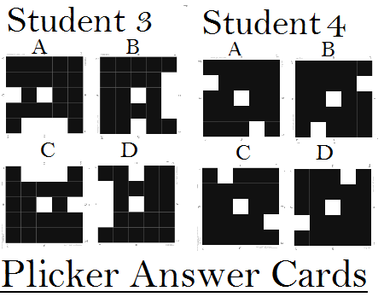
Introduce Yourselves!
Name – Martin Kollman
School - KSDE
What you teach – Informatics, Teacher Ed , Health & Tech Studies
Favorite teaching resource – Plickers (card) & Poll Everywhere (text)

Slide 4
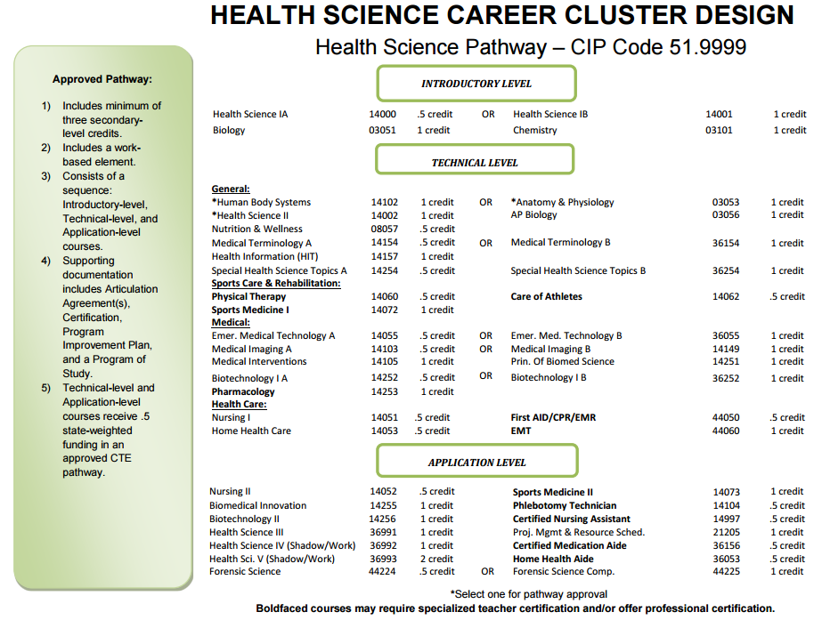
116

Slide 5
Proposed Changes
Revising Health Science 1, 2 & 3
Have a consistent set of competencies that are more specific.
Better alignment to needs of postsecondary programs and careers.
Add Exercise Science Course

Slide 6
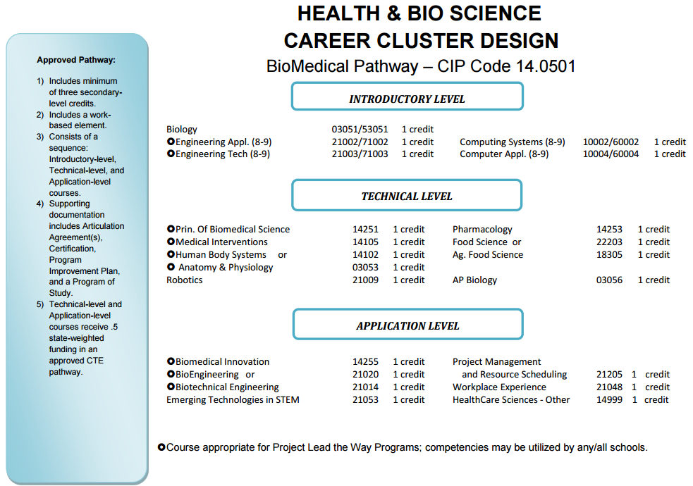
52

Slide 7
Proposed Changes
Reevaluate the introductory course options and competencies.
Rewrite some of the course competencies in engineering areas to make sure they aren’t copies of PLTW.
Engineering courses are up for review.

Slide 8
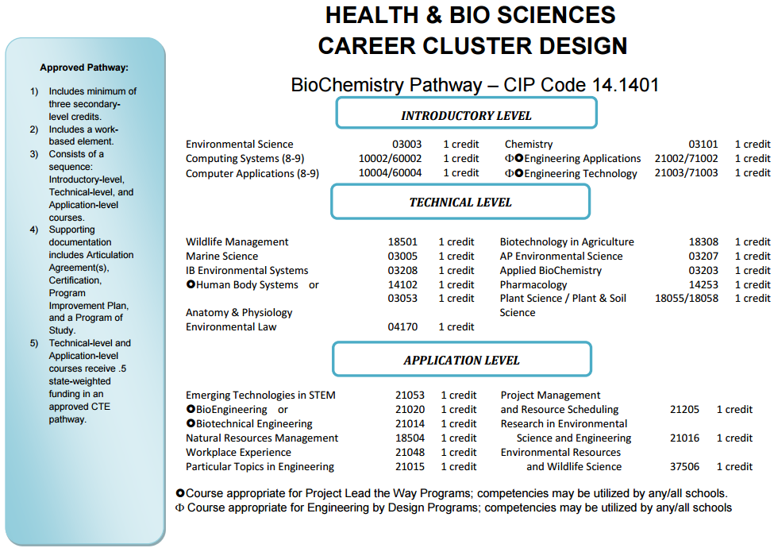
46

Slide 9
Proposed Changes
Reevaluate the introductory course options and competencies.
Rewrite some of the course competencies in engineering areas to make sure they aren’t copies of PLTW.
Engineering courses are up for review.
Does this meet needs of local industry and college programs?

Slide 10
Connect with Others!
KSDE Listserv: mkollman@ksde.org
Google Group: https://groups.google.com/forum/#!forum/ks-health-biomed-biochem-teachers
Facebook: https://www.facebook.com/kshealthscienceteachers/
Butler Workshop - Feb 22nd – El Dorado, KS: https://goo.gl/forms/crqjzzmANUo7VIYw2
Other Events & Activities?

Slide 11
Publishers & Resources
PassAssured – Training for Pharmacy Tech ($11-$15/hr) & Medical Billing/Coding is coming out in 2017.
National Healthcareer Association (NHA) – Medical Assistant Certification (CCMA), Phlebotomy Tech, Medical Admin Assistant, EKG Tech, Billing & Coding & more……..
iCEV – Online resources for teacher & students with career information, videos, online assignments and certification opportunities.

Slide 12
Publishers & Resources
Anatomy In Clay – Hands-on learning for anatomy with skeletal structure model and clay. Human, dog, horse and individual specific area human models.
Goodheart-Willcox – Print, digital & online lesson plans, exams, PPTs, workbook & website for:
Introduction to Health Science
Intro to Medical Terminology
Medical Terminology
Charting Your Career
Anatomy & Physiology
Essential Skills for Health Career Success
Medical Law & Professional Ethics
Health Science Concepts & Applications.

Slide 13
Publishers & Resources
Precision Exams – National Health Science Assessment http://www.healthscienceconsortium.org/assessment/
Member Price Discount ($12)
To Setup: 801-653-9356 – or – support@precisionexams.com
18 other end of class assessments, certifications & stackable options for pathway.
Biotechnology, Dental, Exercise Science, Food & Nutrition, A&P, Medical Assistant, Forensics, Medical Terminology, Nutrition & Wellness, Tech Enhanced A&P

Slide 14
National Health Science Assessment

Slide 15
Anatomy & Physiology
Web Anatomy - http://msjensen.cbs.umn.edu/webanatomy/
Anatomy Arcade - http://www.anatomyarcade.com/
One Minute Heart Video - https://www.facebook.com/kshealthscienceteachers/videos/1845901745694934/

Slide 16
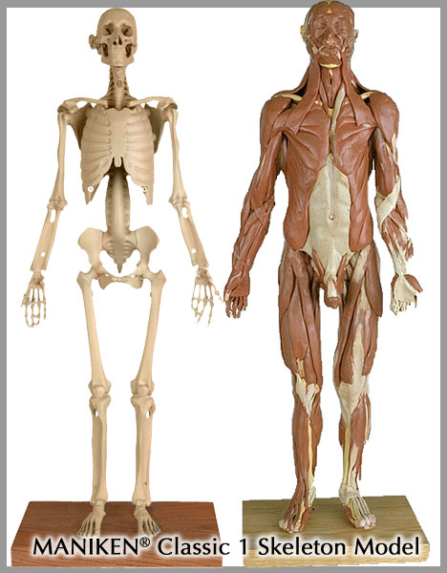
What Resources Do you Have?
Books & Curriculum
Online Resources
Apps
Models
Software

