Slide 1

IPS From A to Z
Joe Ryan Smoky Hill CTE Coordinator
Joni Clark-Leiker JCL Consulting

Slide 2
*Post-Secondary Education completion is more important than ever before
(And it’s not getting any cheaper)
*Post-Secondary Education – Military, Certificate Programs, Apprenticeship programs, 2-year Tech/Community Colleges, 4-year institutions
Notes:
Nearly 80% of KS HS graduates enroll in 2 & 4 yr institutions but only around 40% of those complete a degree and many of those are saddled with 10 years worth of student loan debt

Slide 3
Compelling Reasons for Individual plans of study
Better answers “Why”
Better opportunity to engage students and families
Career exploration done prior to post-secondary
Encourages research and planning of multiple post-secondary options (job, military, 2-year, 4-year)
More students completing a post-secondary credential in less time and with less student loan debt
Notes:
“Why” refers to students asking why they are taking certain courses (taking courses because they are related to their career aspirations as opposed to other more feeble reasons)
“Safe” – not as costly related to time and money if done while in HS as opposed to PS

Slide 4
Schools are not required to use a vendor for IPS. As long as the four minimum components of an IPS are present, schools can create their own IPS system
By the 2017-2018 school year, every middle school and high school in Kansas will have an IPS product and process in place

Slide 5
State Minimum IPS Components With Example Resources
A graduated series of strength finders & career interest inventories to help students identify preference toward career clusters
8th – 12th Course builder function with course selections based on career interests
A general post-secondary plan (military, apprenticeship, 2-yr., 4-yr)
Portable electronic portfolio
Notes:
KATHLEEN
The minimum IPS components required of a school include these four components:
A graduated series of strength finders and interest inventories
A course builder function where courses are based on career interests
A General post-secondary plan
A portable electronic portfolio

Slide 6
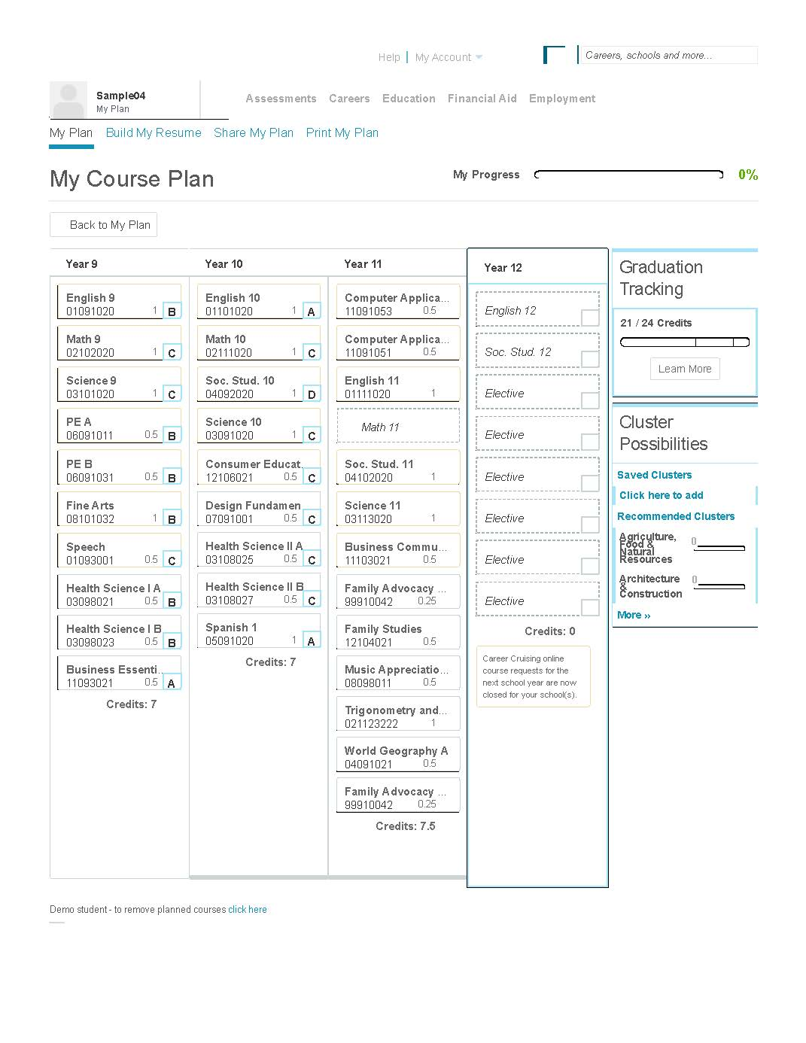
Component 2: 8th – 12th Course Builder Function With Course Selections Based On Career Interests
Notes:
The second component asks schools to use methods of course planning that align with cluster possibilities based on interest inventories and strength finders, and graduation tracking.
In this slide, we see that the student’s four year plan is clearly articulated.
In addition, we see the graduation tracking and course history for the student as well as cluster possibilities based on interest inventories completed.
This model comes from a vendor; however, a school can choose to capture this information however they see fit.

Slide 7
IPS Process
4 Models currently being utilized in Kansas schools:
1. COUNSELOR-CENTERED
2. Career Advisor system – all staff
3. CAREER ADVOCATES
4. Hybrid
Notes:
In Ks. Research indicates that are 4 advising models utilized in schools:
Counselor centered- the school counselor is responsible for implementation of the advising model and is the primary contact for students and families.
2) Career advisor system- this model utilizes staff members as advisors for students and families; the counselor acts as the model coordinator training staff and offering secondary support.
3) Career advocate- this model utilizes trained advocates that serve students and families in the advising process in addition to the school counseling program.

Slide 8
IPS can have many different looks
Many tools available
Career Cruising, Kansas Career Pipeline, Naviance, KIPS, developed system
But these are just tools to help you implement your plan

Slide 9

An Implementation Plan
Implementation Team
Creating a Career Development Vision
Building Your Career Development Vision
Delivering Your Vision
Developing/Identifying Career Development Resources/Materials
This is a process...

Slide 10

Your Implementation Team
Administration
Counseling Staff
Teachers
Career Advocates
Others

Slide 11

Creating Your Vision
District Analysis…
Career Development & IPS Scoring Rubric…
Where Are We Going…
How Do We Get There...

Slide 12

Building Your District Career Development Vision
Map District Career Development Activities
Align with KSDE IPS targeted areas
Build an IPS Framework
Identify and map Programs of Study
Identify Delivery Model
Delivery of supporting areas of Career Readiness

Slide 13

Delivering Your Vision
Staff
Marketing to Students
Marketing to Parents and Community
Developing Career Development Resources and Materials
Align Activities with KS Comprehensive Counseling Standards

Slide 14
Contact Information
Joe Ryan
Smoky Hill CTE Coordinator
605 East Crawford, Salina 67401
785-825-9185
jryan@smokyhill.org
Joni Clark-Leiker
JCL Consulting
1150 LaHacienda Dr, Colby 67701
785-443-3647
consulting.jcl@gmail.com

