Slide 1
Redefining the Instructional Process for the CTE Classroom
Presented by
Dr. Mark L. Johnson,
University Professor, PSU
Dr. Jeanea Lambeth,
Assistant Professor, PSU

Slide 2
A walk through CTE Instructional Methodology
1917
Smith Hughes Act
2016
CTE Teaching Today
1932
E. C. Tolman Defines Latency Learning
1964
Carl Perkins Act
1961
W.R. Miller
Defines the 4 Steps to Teaching

Slide 3
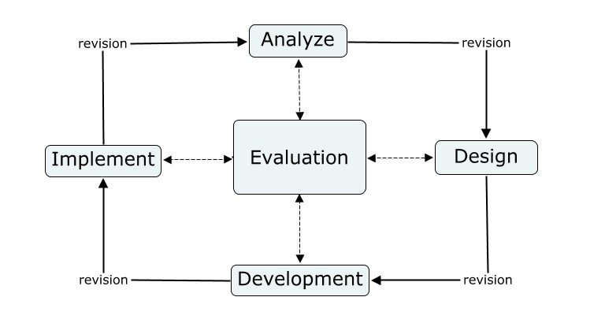

Slide 4
Traditional 4 Step Method
1. Prepare the student for the lesson
2. Show the student how to perform the task
3. Have the student show you how to perform the task
3. Assess the student performance
Students Watch and Listen

Slide 5
Improved Technique
1. Prepare the student for the lesson
2. Show the student how to perform the first STEP of the task
3. Have the student show you how to perform the first step
4. Check for student understanding and performance
5. Correct as necessary
6. Repeat process for each step
Students Performs with Instructor

Slide 6
Case in Point
Class 1 using TRADITIONAL Method
12 Students
Pretest average score of 60
Post test score, 7 - 100s, 5 - 90s
Class 2 using IMPROVED Method
14 Students
Pretest average score of 62
Post test score, 14 - 100s

Slide 7
See for your self
A comparison of 3 methods

Slide 8
Delivering With lecture
Refer to Gold 8½ x 8½ paper.

Slide 9
Delivering traditional method
Refer to White 8½ x 11 paper.

Slide 10
Delivering Improved method
Refer to Blue 8½ x 8½ paper.

Slide 11
Delivering Improved method
Get 100% performance the 1st time,
every time!
You model the step
The learner replicates the step
You check for understanding
You coach for improvement
The learner makes the needed adjustment
REPEAT for each step.

Slide 12
References
ADDIE Model (n.d). Retrieved from: http://educationaltechnology.net/the-addie-model-
instructional-design/ 8/27/2016
Miller. W. R. & Rose, H. C., (1961). Instructors and their jobs. Chicago, IL: American
Technological Society.
Miller, W. R. & Miller, M. F., (2009). Instructors and their jobs. Homewood, IL: American
Technical Publishers, Inc.
Tolman, E. C., (1932). Purposive behavior in animals and men. New York: Century.

