Slide 1
State–of–CTE
2017 February Conference
Kansas leads the world in the success of each student.
Notes:
Thank yous to service centers who put on this conference

Slide 2
Notes:
Have them stand up if……..
Led a student to a certification
Teach a dual-credit college CTE course
Ann Mah
Consultants

Slide 3
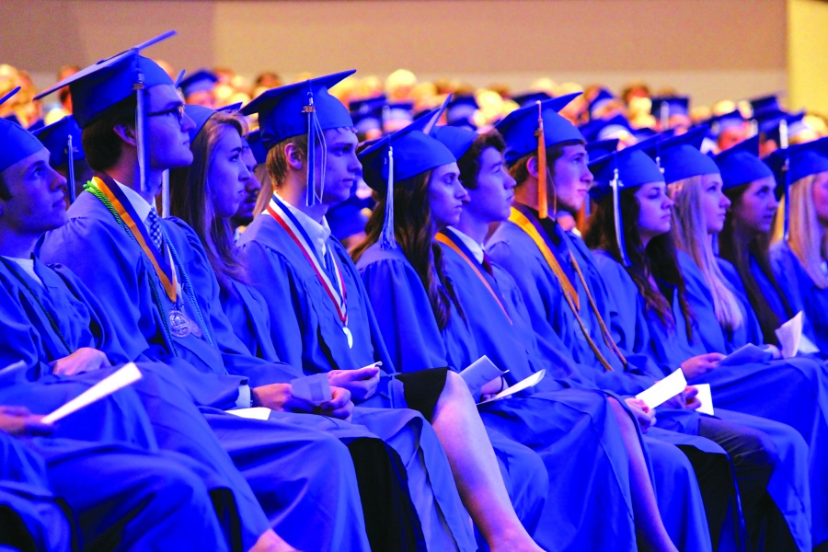
A Successful Kansas High School Graduate means
An individual has the
academic preparation,
cognitive preparation,
technical skills,
employability skills and
civic engagement
+
Leadership development
to be successful in postsecondary education, in the attainment of an industry recognized certification or in the workforce, without the need for remediation.
Every CTE Course
Every CTSO

Slide 4
First-ever Statewide CTE Student Honors Program
CTE Scholar Criteria:
*CTE GPA
*Technical Skill Attainment
*Leadership
*Community Engagement
*Professional Learning Experience
*Career Vision

Slide 5
The Value of CTE
There is Life After College
“Sprinters”
Finished postsecondary credential on time
Little to no student loan debt
Landed a job that fit the credential
One thing in common – apprenticeship, job, or internship in late teens (Professional Learning Experiences)
Notes:
In Jeffrey Selingo’s book – There is Life After College
“coming-of-age, real-world experiences in the late teens – particularly apprenticeships, jobs, or internships – actually matter more nowadays in moving from school to career.”

Slide 6
Increasing Access to Quality CTE
Aspirational Goal
Every secondary student is able to access CTE related to her/his respective career interests

Slide 7
KSDE CTE Team Purpose
Support and Empower Schools to Prepare Each Student for Career Success.
Need Assistance? Contact KSDE CTE and we’ll come to you!
KSDE CTE
Twitter - @KSDE_CTE
Notes:
Tell us how we can further support you on the feedback board by registration
Stress school visits
The best part of the video is the kid that produced the film has found his niche in life. He is a senior who until this year had not said two words to me, now I can't get him out of my office. He has a full ride to BCC to do videos and editing for them. Stories like his are why we do what we do.

