Slide 1
Using IPS Data to Meet The Needs of Students
To Develop Tomorrow's Teachers

Slide 2
Frankey Schmidt
FACS Teacher
Cimarron High School
fschmidt@cimarronschools.net

Slide 3
Bill Losey
SWPRSC
bill.losey@swplains.org

Slide 4
CHS Career Cruising Data
Cluster | # Students | Cluster | # Students
Ag, Food & Nat. Resources | 31** | Hosp & Tourism | 2
Archit. & Construction | 42 | Human Services | 17
Arts, A/V Tech & Comm | 68* | Information Technology | 3
Bus. Man. & Admin. | 13 | Law, Pub. Safety, Correct. | 7
Education & Training | 18* | Manufacturing | 13
Finance | 1 | Marketing | 3
Gov. & Pub. Admin | 0 | STEM | 19
Health Science | 43* | Transportation Dist, Logist. | 16
** Added two new pathways * Added one new pathway

Slide 5
Problem
“The Topeka Capital-Journal reports that (KSBoE) board members learned from the state education department Tuesday that there are 90 elementary school teacher openings in Kansas. They also learned there are more than 80 vacancies for special education teachers.”
September 13,2017

Slide 6
Problem
“In addition, 461 teachers “left the profession” after the 2016-17 school year, 93 more teachers who left the profession in 2015-16. There are also 7,481 teachers in Kansas this year who have just one to three years of experience, an increase of 839 over 2016, adding to the “greening” of the state’s teacher workforce.”
The Topeka Capital Journal Sep 11, 2017

Slide 7
Solution
Develop a pathway to help students interested in teaching in an environment where there are not funds to expand CTE programs.
Cimarron HS in partnership with their regional service center met to develop a plan to grow their own teachers using the education pathway design sheet as a starting point.
Blended learning become the obvious answer

Slide 8
Solution
Other Schools that participate
Ness County
Spearville
South Gray
Stanton County
Other schools that have the pathway approved but waiting for students to enroll
Sublette
Rolla

Slide 9
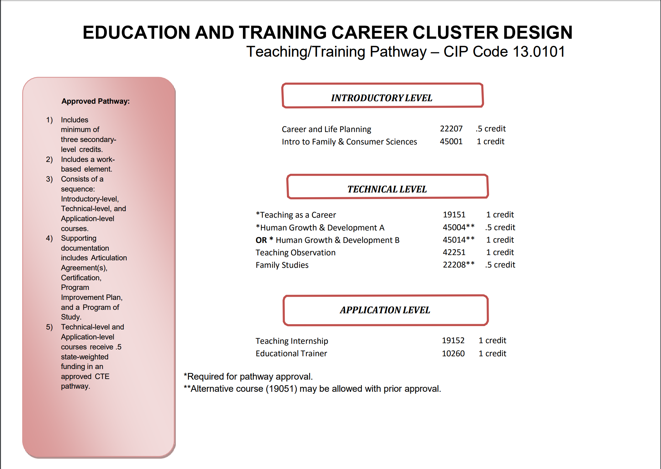

Slide 10
Personnel
Career and Family Planning - local teacher or virtual course available through SWPRSC
Intro to Family & Consumer Science - Taught locally when available
Human Growth & Development - Taught locally or virtually if needed
Teaching as a Career - Taught virtually
Teaching Internship - Setup collaboratively between each school’s cooperating teacher, their CTE coordinator and SWPRSC

Slide 11
Costs
Access to any virtual content - $125 per student for the year
Access to a virtual teacher - $185 per student for a semester

Slide 12
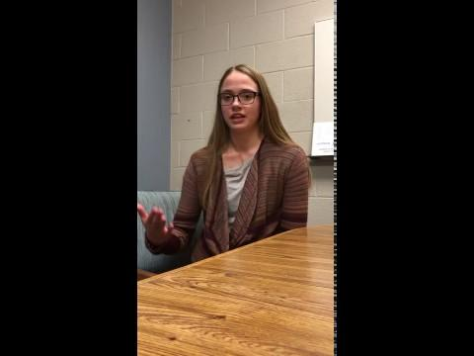
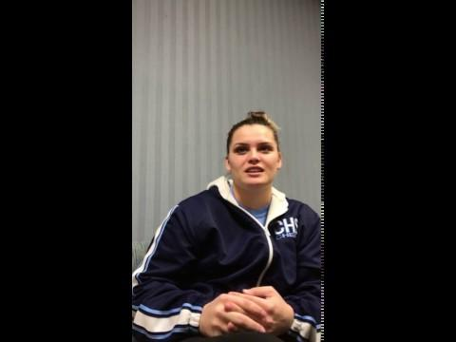
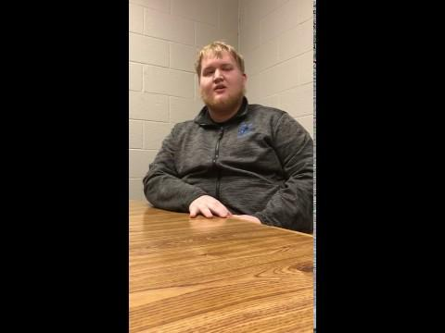
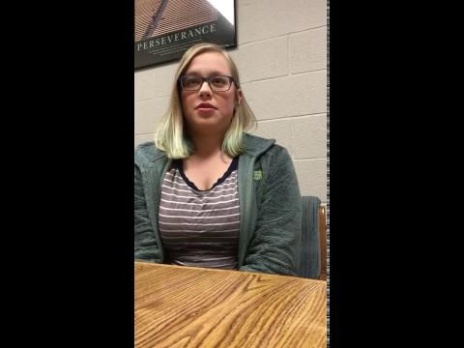
What our students say

Slide 13
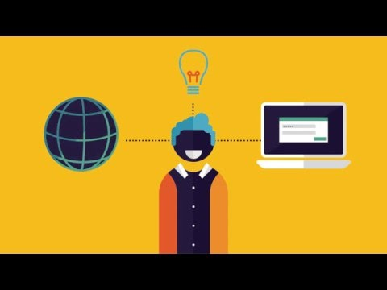
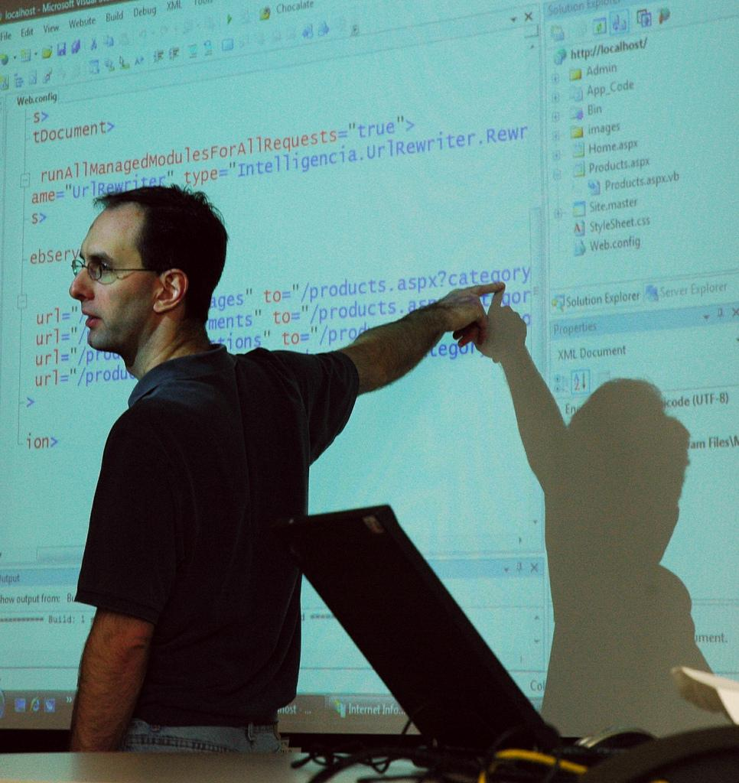

What is Blended Learning?
A mix of face-to-face and online learning
Courses that are asynchronous
Increased opportunities to differentiate

Slide 14
Why Blended Learning?
Improve ability to personalize learning
Potential for individual progress
Improve student engagement and motivation
Shift to online state testing
Need to extend time and stretch resources
Potential to extend the reach of effective teachers
Ability to improve working conditions
Decrease costs
Student and parent adoption of learning applications
Interest in narrowing the digital divide

Slide 15
Tips to Use Blended Learning
Start Small
There are many technology and tools
Choose one digital tool or technology to try when starting
Become comfortable with one before going into another
Mistakes Happen
That’s how we learn so do not give up
Ask students for help with technology they have grown up with

Slide 16
Tips to Use Blended Learning
Don’t just use technology to use it. Replace it with something that is outdated.
Use it inside and outside the classroom
Use discussion boards
Access is available everywhere even if they do not have internet at home
Keep parents informed and updated
Have a policy in place on how to count achievement for eligibility

Slide 17

A Vision of K-12 Students Today

Slide 18
What’s Blended Learning with a CTE twist?
What does your IPS software management tell us that students are interested in?
Do the interest surveys match up to your offerings?
With so many career options how can we staff that many courses?
Drop your students into online virtual courses.
Courses are asynchronous so scheduling issues are non existent

Slide 19
Future Goals
Partnerships - Field trip to FHSU school of Education
Physical Environment -Challenging since we operate in a virtual environment. Each school determines their own needs.
Professional Development - Developing skills to work in a blended teaching environment
Instructional Strategies - Expose students to all levels of teaching

Slide 20
Using Blended Learning Beyond the Teaching Pathway
Archeology
Astronomy
Biochemistry
Careers in Criminal Justice
Cosmetology
Early Childhood Education
Fashion and Interior Design
Health Science
Hospitality and Tourism
International Business
Intro to Ag Science
Intro to Culinary Arts
Intro to Manufacturing
Law and Order/Legal Studies
Peer Counseling
Sports and Entertainment Marketing
Veterinary Science

Slide 21
Using Blended Learning Beyond the Teaching Pathway
Career Explorations
Journalism
Photography
Web Design
Programming - Java
Programming VB: Net
Image Design and Editing
Green Design Technology
Game Design
Digital Arts
Computer SCience
C++Programming
Audio Engineering
#D Art animation
Accounting
Entrepreneurship
Marketing

