Slide 1
CSI on FIRE!
Wichita High School South
USD259
Notes:
An awesome experience for students that will get them excited to be in your class!

Slide 2
What’s in this Presentation? How to WOW your students!
We are going to recreate a structure fire where our fire and EMT students will stabilize the scene.
The forensic science class will process the scene and collect evidence.
Law enforcement and youth court students will handle the arrest, interviews and create a case & conduct a jury trial.
It’s Real life experiences for LPSS students
Notes:
Attending this presentation will give you the tools to conduct an activity that brings all pathway classes together and give them a real life experience of how to each branch of the LPSS in interdependent. Sharing our success and seeing how things can be made/set up will help teachers ignite a fire in their classroom tnat will make students thirst for more knowledge and skills. It will be a Show-and tell presentation!

Slide 3
CSI on FIRE !
Classes in the Law, Public Safety, & Security Pathway
Law Enforcement
Youth Court
Fire Science
EMT
Forensic Science
One Activity
5 Classes
150 Students
Notes:
The aim was to give students real life experiences in content area. To let them experience how every class in the pathway gives them the skills needed to work together and cooperate to fulfil their job requirements. Students from Journalism and Media studies jumped in to cover the story by writing articles in the School magazine and having video presentations!

Slide 4
CSI on FIRE !
Professional Learning Experiences
Classes Involved
Preparation
Execution
Reflection
Questions
O
V
E
R
V
I
E
W
Notes:
Career and Technical Education (CTE) Pathways came together from Law, Public Safety, and Security (LPSS) to provide a real life activity for students to practice the skills they had learned. I made them realize team-work was crucial in any career.

Slide 5
CSI on FIRE !
Kyle Haught- Fire Science
& EMT
Chitra Harris- Forensic Science
Melissa Seiwert-Law Enforcement & Youth Court
David Young- Residential Carpentry
Shane Russell- School Resource Officer
About the Staff
Notes:
This list would be extensive if we included every staff member who helped make this activity a success. To mention just a few who contributed their time and resources to plan and execute the project we have Kyle Haught……

Slide 6
CSI on FIRE !
To provide a realistic experience without the dangers of the real-world.
Give students the opportunity to make mistakes without real-world consequences.
Reinforce the need for cooperation and team work to solve problems.
Professional
Learning
Experiences
Notes:
A good way to instill the importance of soft skills while testing content as well!

Slide 7
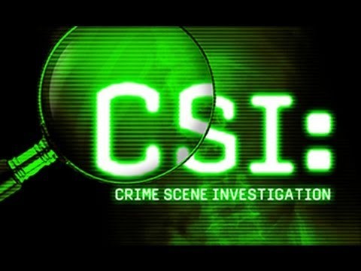
Classes Involved
Notes:
This activity simulates the team effort to solve crime and keep the community safe. Always working together and cooperating with one another is our Fire service personnel, EMTs, Police officers, Forensic Investigators, and the Law.

Slide 8
Preparation Timeline
August /September: Planning & Grant Writing
December: Grant Received/materials ordered
February: Residential Carpentry scene prep.
March: Crime Scene set up
April: Activity, Pre & Post Survey, Reflection
May: New ideas, improvements, pre-planning for the next year.
Notes:
Thorough planning and preparation where teachers spent their plan time and evenings brainstorming ideas proved indispensable. Here it is ready-made, tried and tested for you to use in your school and enjoy!

Slide 9
Preparation
The Plan
The Grant
A Drug deal gone bad
Friends under the influence at illegal meth lab. One goes upstairs to sleep it off.
Another gets shot when an argument escalates.
To cover up the crime, suspect sets the house on fire to destroy evidence.
Education Edge Grant awarded $4000.00
Items Received:
Fire rescue dummy
2 Industry standard Cameras
Evidence Collection Kit
Law enforcement kit
Drywall and siding, paints, LED lights etc.
Notes:
Based on materials available, Evidence created and Student skills to be tested, the narrative was directed to fit the testing of skills learned throughout high school years in the LPSS pathway.

Slide 10
WICOR WIZARD AWARD
Notes:
This activity covered all the AVID elements of Rigor and relevance. In planning, execution & reflection, there was organization and reading, in execution there was collaboration and inquiry and in reporting and reflection,there was ample scope for writing.

Slide 11
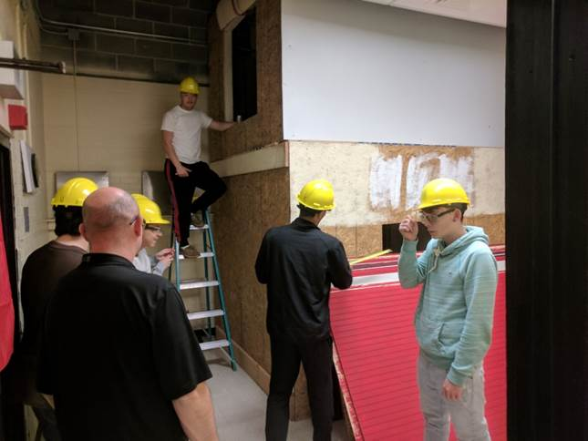
Crime Scene Construction
Notes:
Residential Carpentry students construct the structure, drywall, paint and get the set ready as a 2 story a meth lab.

Slide 12
Creating the burnt body
Notes:
A plastic skeleton gets a coat of foam and paint to resemble the charred remains of a human being.

Slide 13
Evidence Set up
c
Notes:
Attention to detail made this an exciting activity and was the center of every conversation for every student who was later allowed to walkthrough the crime scene.

Slide 14
Forensic Crime Labs Students get ready to analyze evidence
Notes:
The South High Crime Lab had many units to be able to analyze all the types of evidence that would likely be found at a crime scene.

Slide 15
Law Enforcement Review Protocol
Notes:
These students made their own police badges and worked as per protocol.

Slide 16
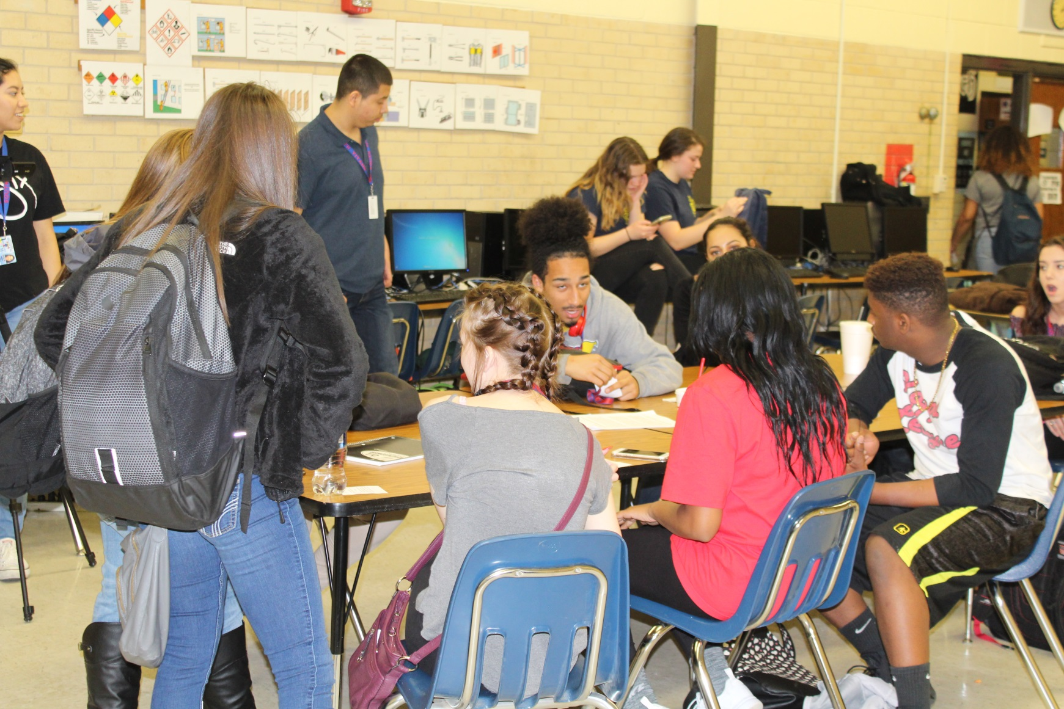
Youth Court Practice
Notes:
Youth court practice their skills every class as they help School administrators deal with discipline issues on a daily basis.

Slide 17
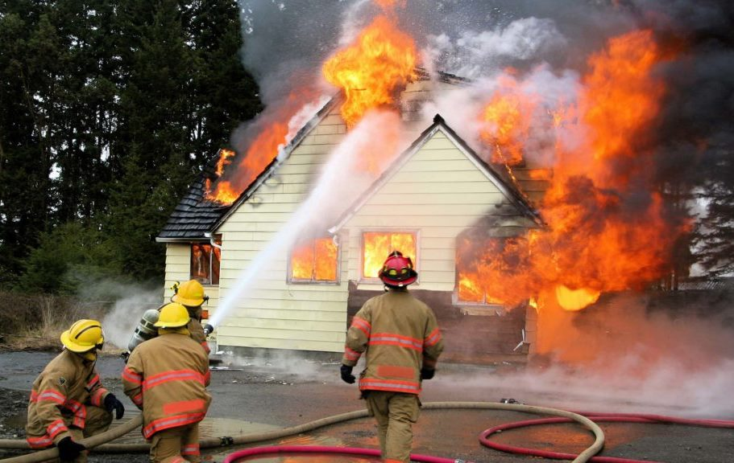
Execution: CSI on FIRE!
Notes:
The teachers planned the activity like a CSI episode! We planned the props according to the crime that was to be investigated and took care of every detail to make it as real as possible…The fire, smoke the alarms, the fire truck sirens and the hustle of crowds as students converged on the scene.

Slide 18
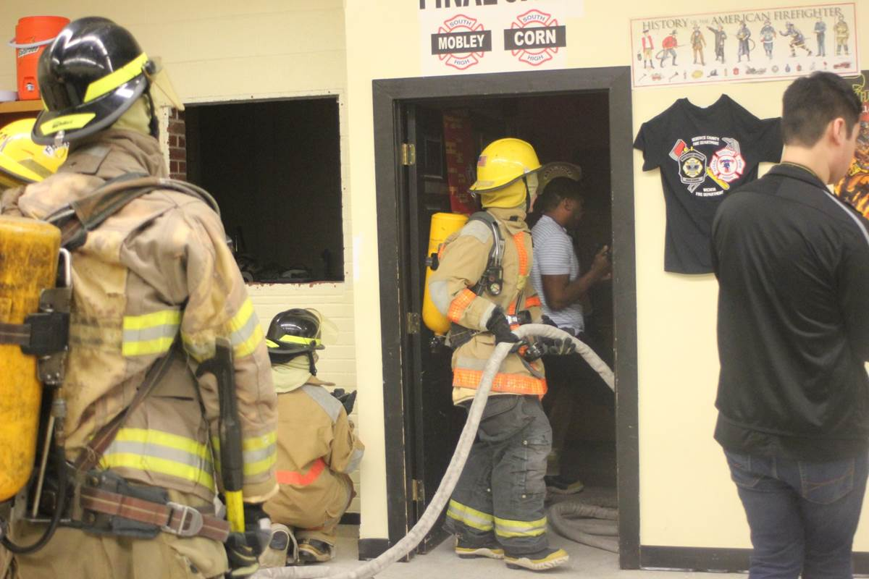
Fire alarm sounds & Fire Fighter squadrons arrive
Notes:
The Firefighter gear is really heavy and cumbersome, but students had to wear it correctly and quickly. They scrambled to get dressed and sprang into action under the instructions from their commander.

Slide 19
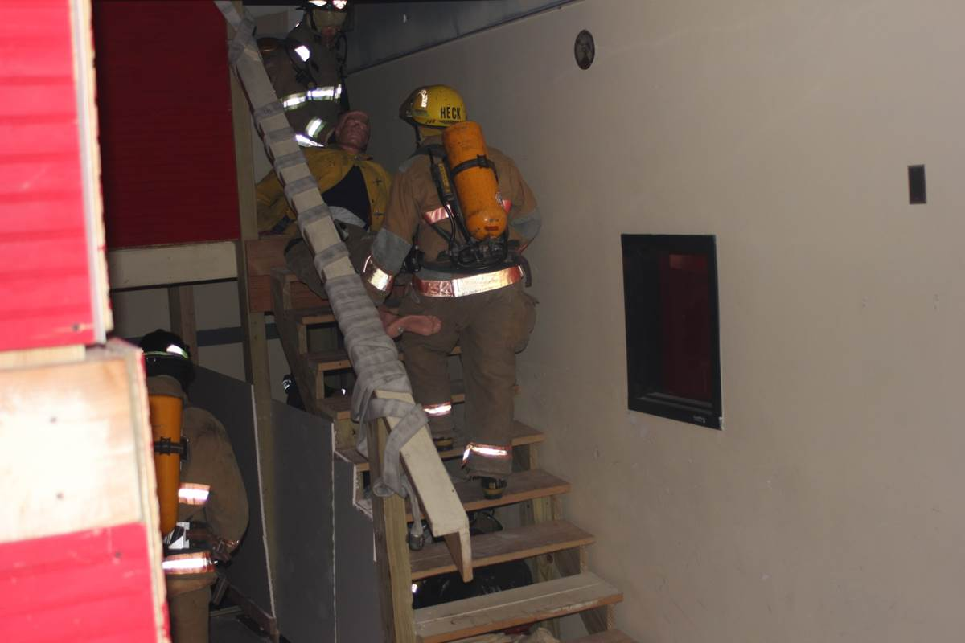
Search and Rescue begins
Notes:
Students had to rescue a heavy man (dummy), and carry him down the stairs. They had to check for hot spots, break a wall and put out the fire completely.

Slide 20
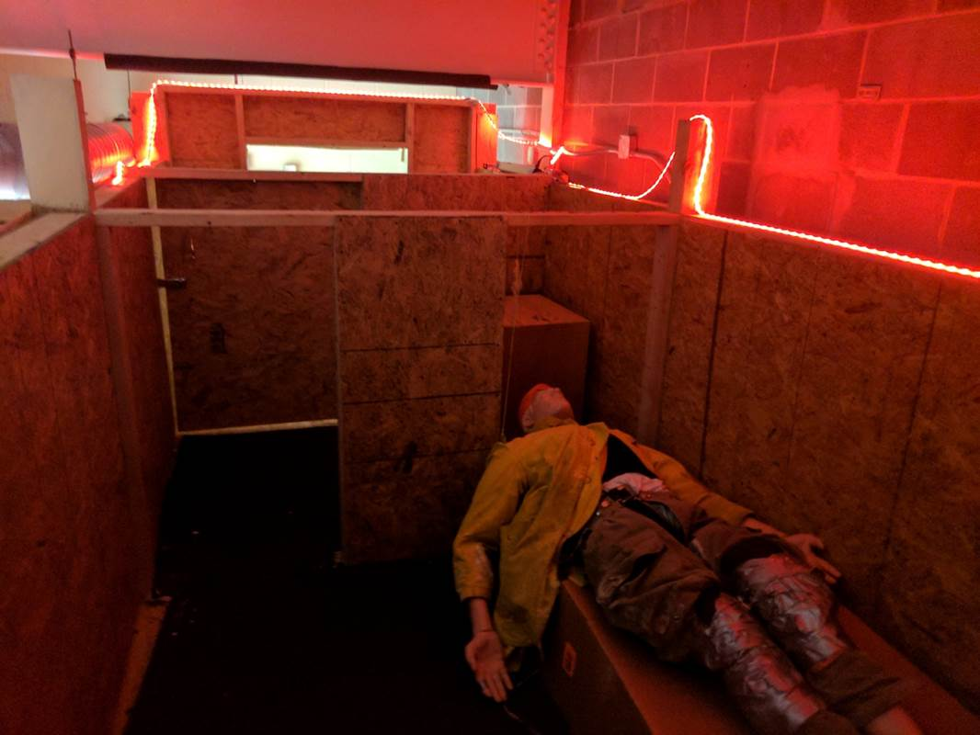
Fire and Smoke simulations
Notes:
The Fire science teacher set up the scene to look like it was really on fire. He used LED lights to provide the hot glow and a fog machine to make the smoke.

Slide 21
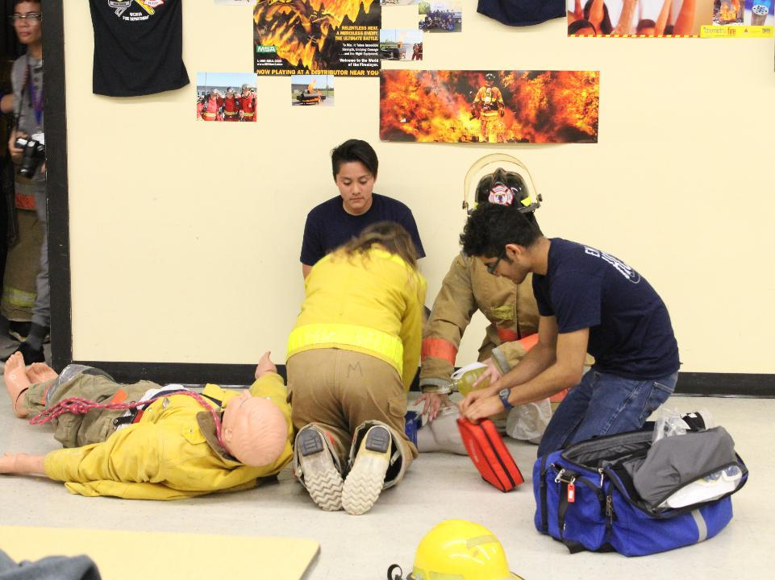
EMT Students revive the rescued victim
Notes:
All the skills learned were put to test and the students resuscitated the victim by working on the dummy & using all their gear efficiently and appropriately.

Slide 22
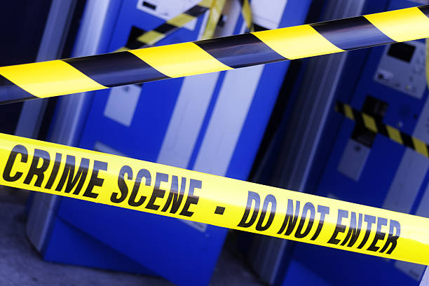
Law Enforcement secures the Crime scene
Notes:
Police officers secured the perimeter with crime-scene tape to protect the crime scene and check for safety.

Slide 23
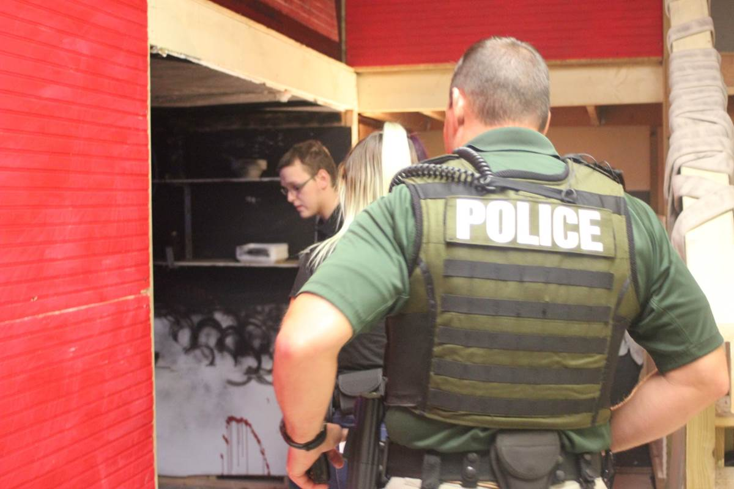
Checking before an All-clear
Notes:
Officer Shane Russel and student Officers check the building before handing it over to CSI. Support for this activity from our police officer and his very presence and participation made the experience very realistic.

Slide 24
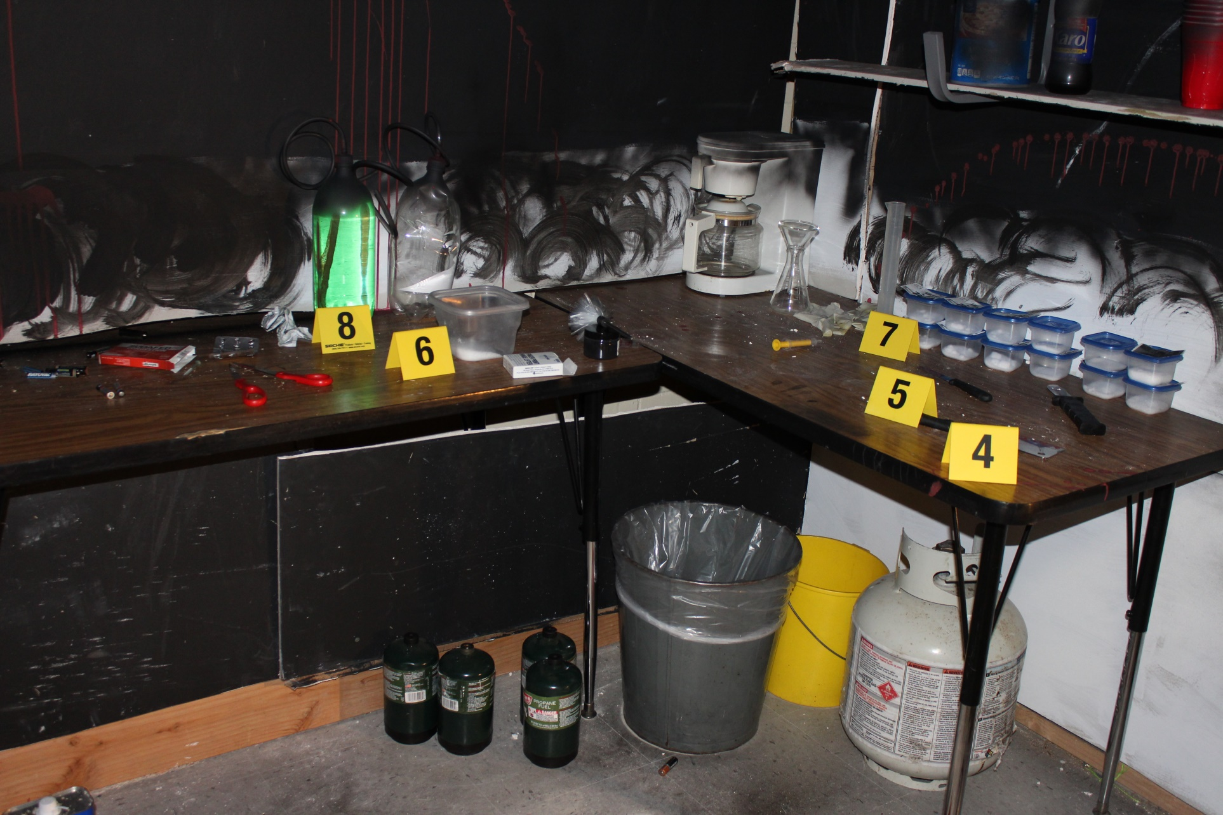
CSI mark & Record evidence
Notes:
Evidence was meticulously laid out to support the incident of a drug deal gone bad, a murder and a cover up. Teacher checked to see if investigators had seen & marked every piece of evidence and missed none.

Slide 25
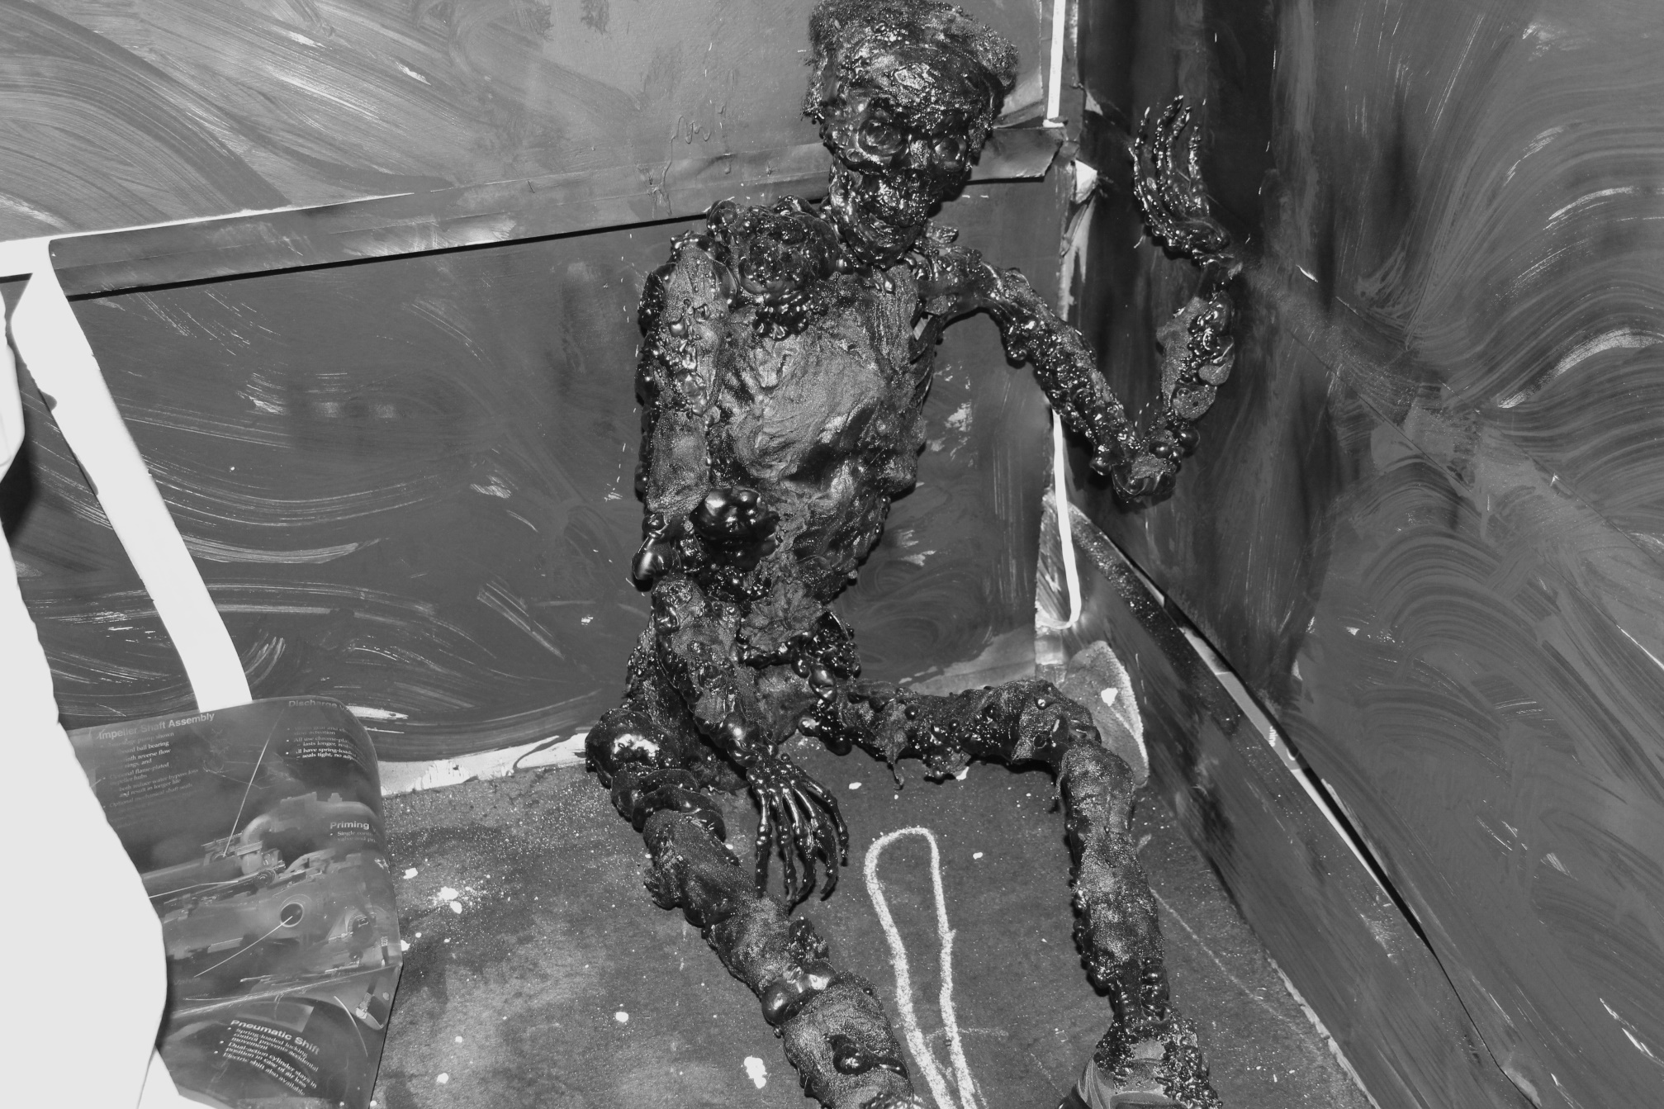
A Body is discovered
Notes:
Investigators discover burnt human remains and call the biohazard unit. It really looked gross in the dark burnt corner of the room.

Slide 26
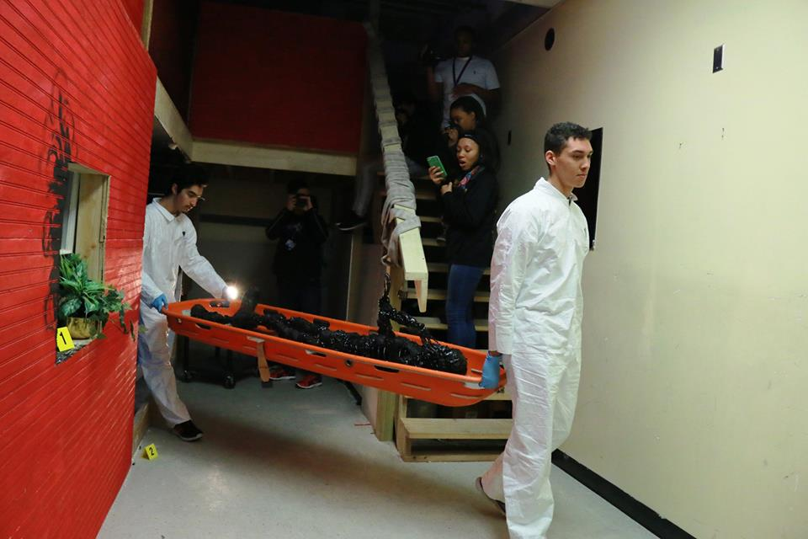
Burn victim is removed
Notes:
The Biohazard unit suited up and improvised on a stretcher to dramatically carry the body out of the building. The expressions on the faces of those who watched was awesome evidence of the success our burn victim mannequin.

Slide 27
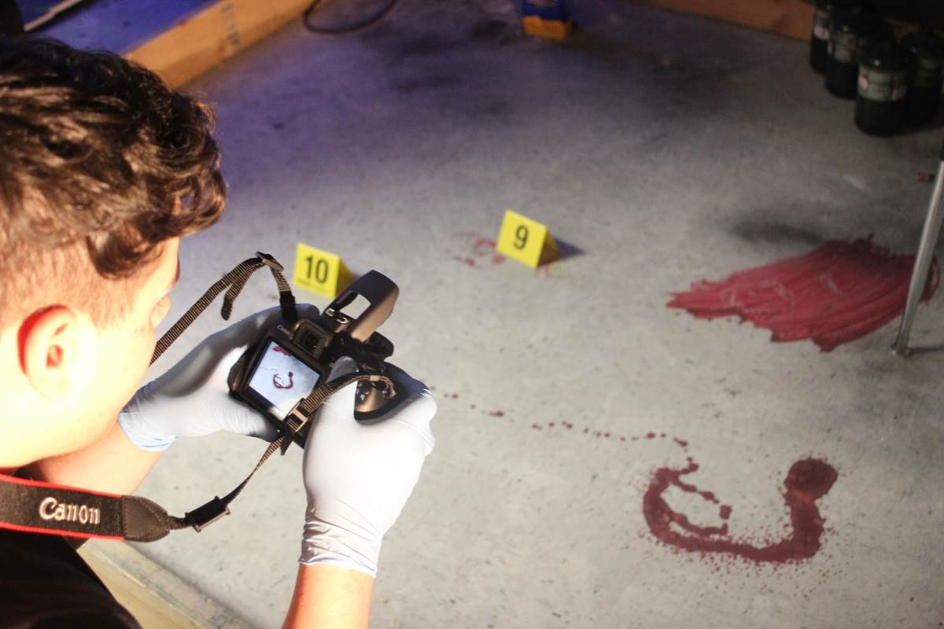
CSI collect evidence
Notes:
Students knew how to use the tools in photographing evidence with a scale, marking with a tent, and recording & preserving anything they collected with a chain-of-custody form.

Slide 28
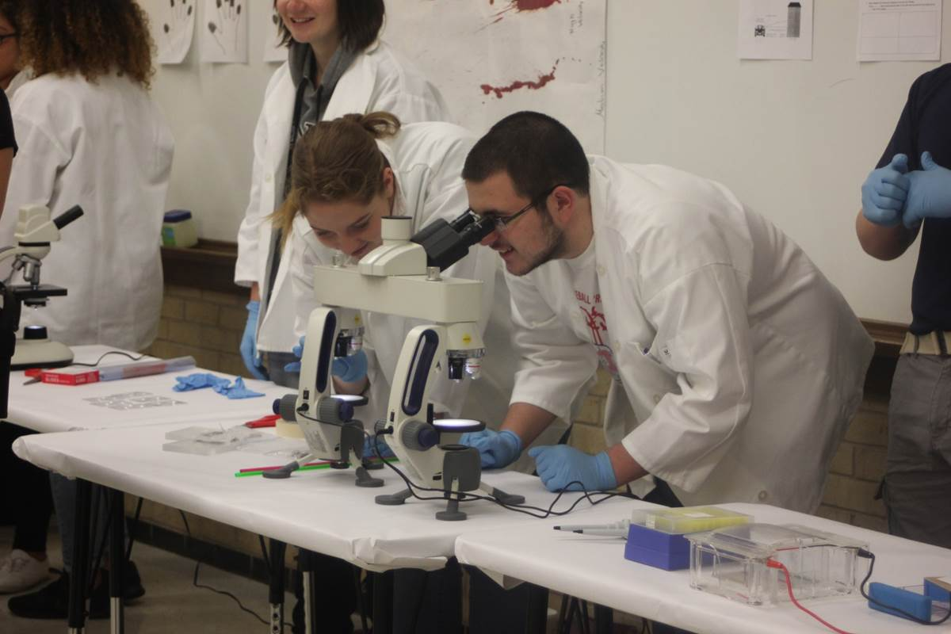
Crime Labs Process the Evidence
Notes:
Each lab had two investigators processing the evidence. They were quizzed and tested about their findings! They had to prove the results beyond a doubt.

Slide 29
Fingerprints & Shoeprints
Notes:
Fingerprints and shoeprints were lifted and processed. Students from other classes were asked to compare and match the prints as an extended activity.

Slide 30
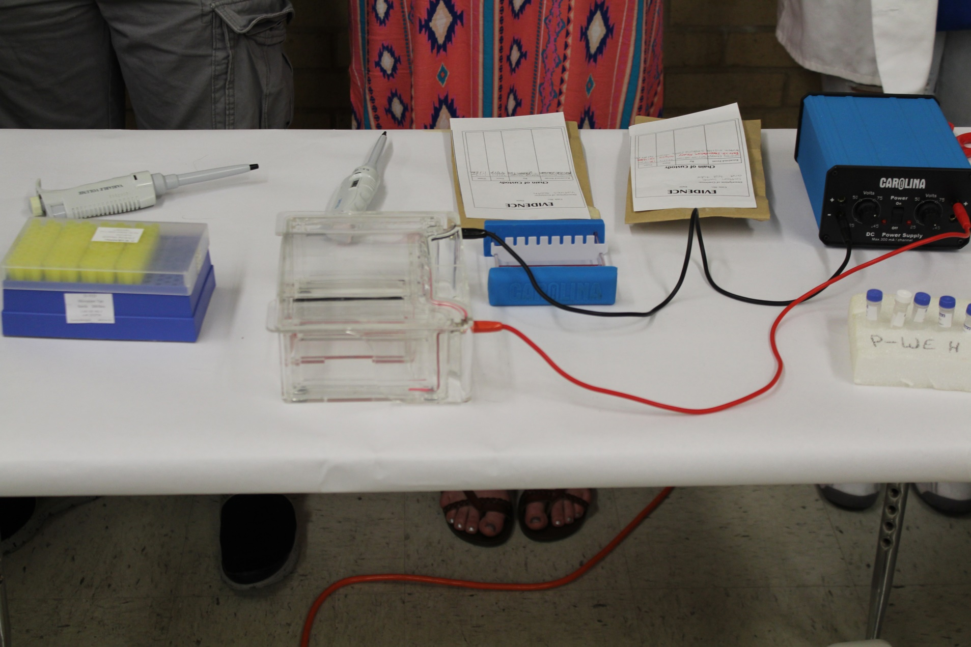
Analyze DNA samples
Notes:
DNA samples were pre- made so that they would run on the gel to provide bands that matched crime scene and suspect. As people walked through they explained their findings as they compared the resulting DNA Fingerprints.

Slide 31
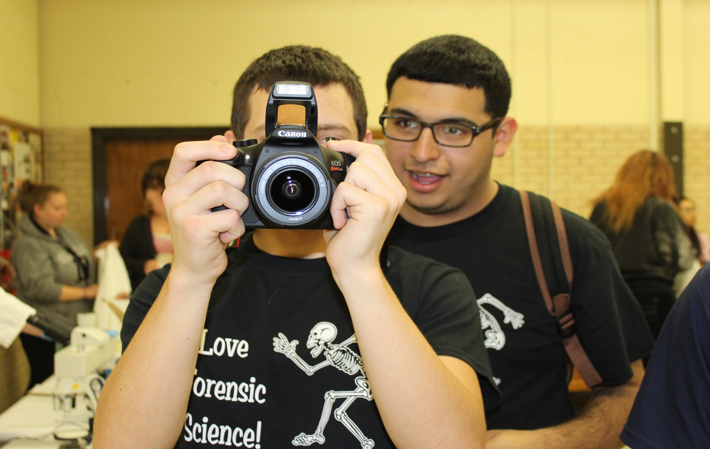
Photograph and Document Evidence
Notes:
Students were thorough in documenting the evidence.

Slide 32
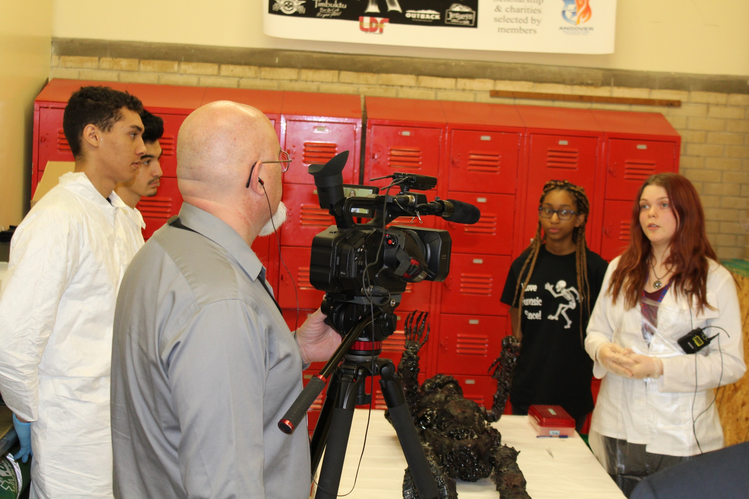
Coroner explains Autopsy
Notes:
Student played the part of the coroner so well! She explained what her findings were and answered every question like a professional.

Slide 33
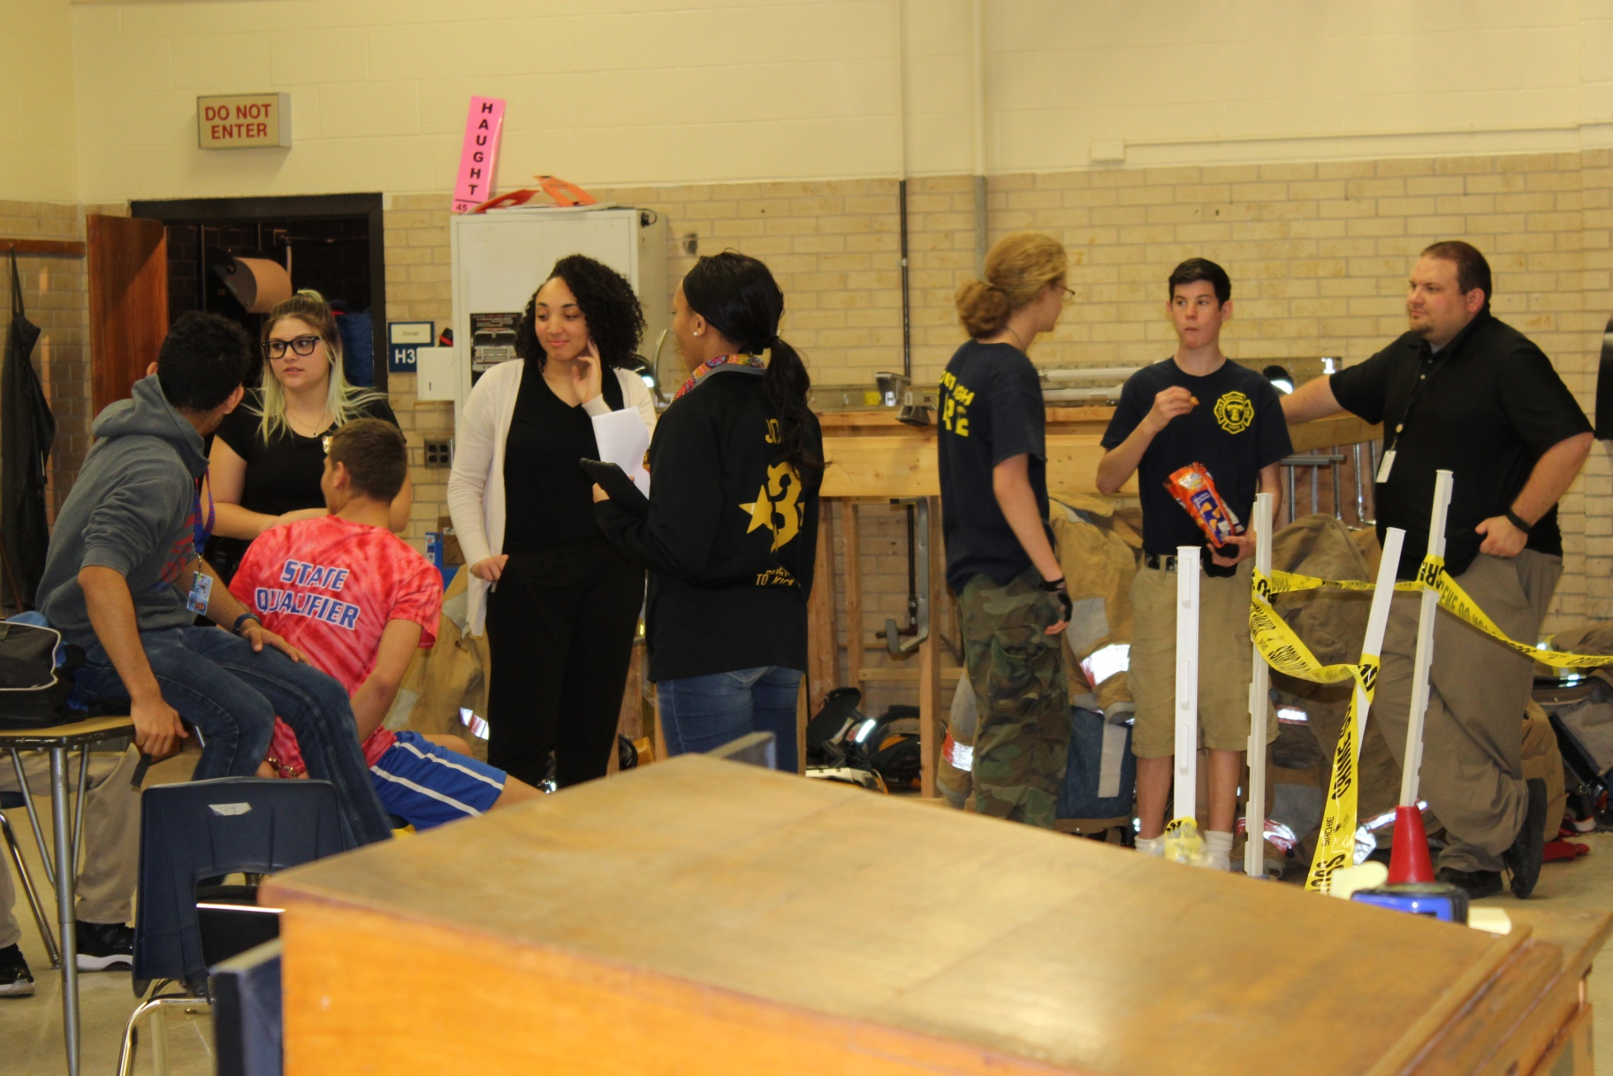
Arrests are made
Notes:
The suspect in the red T-shirt is hand-cuffed.

Slide 34
Intense Interrogations
Notes:
Interrogation techniques were used and interesting cross questions were recorded in the proceeding.

Slide 35
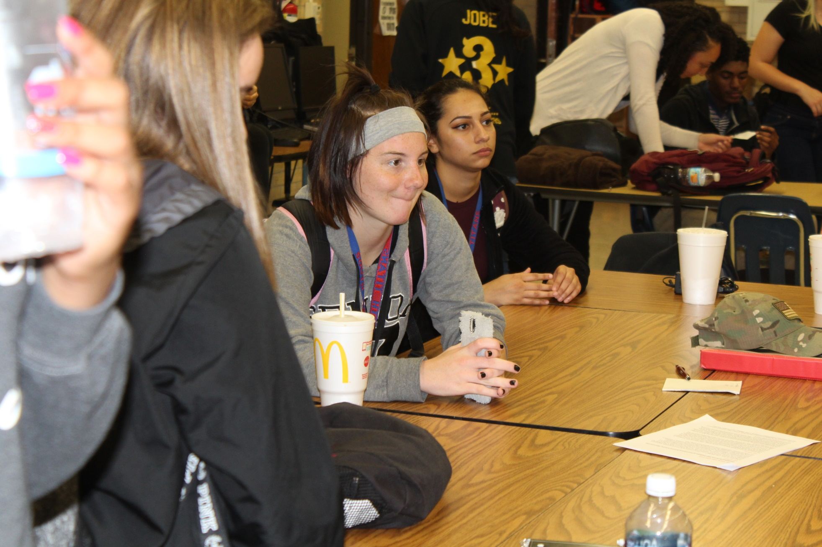
Witness Statements
Notes:
Since students were briefed about the incident in their classes, they rose to the occasion and gave their witness statements as they were called upon from the watching crowd. Teachers were blown away by their performance!

Slide 36
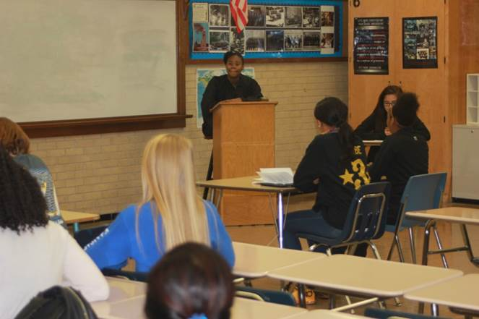
Preliminary Hearing
Notes:
Everything was done as it would be in a real life scenario!

Slide 37
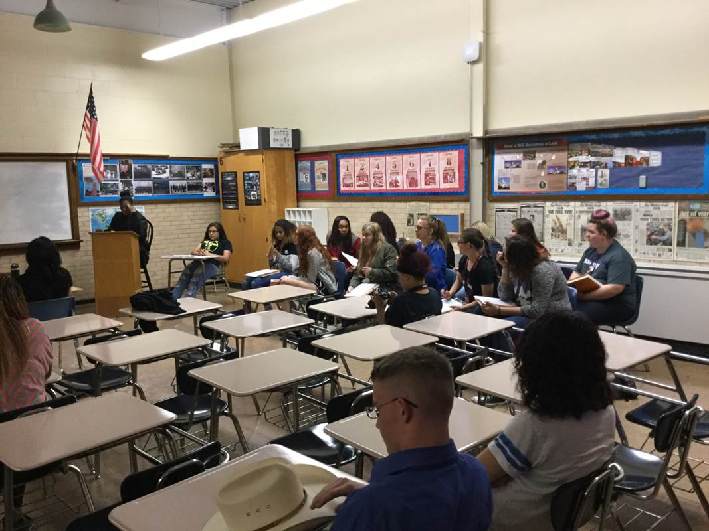
Grand Jury Trial
Notes:
Students took their roles seriously. The jury took notes, the attorneys represented their case, arguments were heated and interesting!

Slide 38
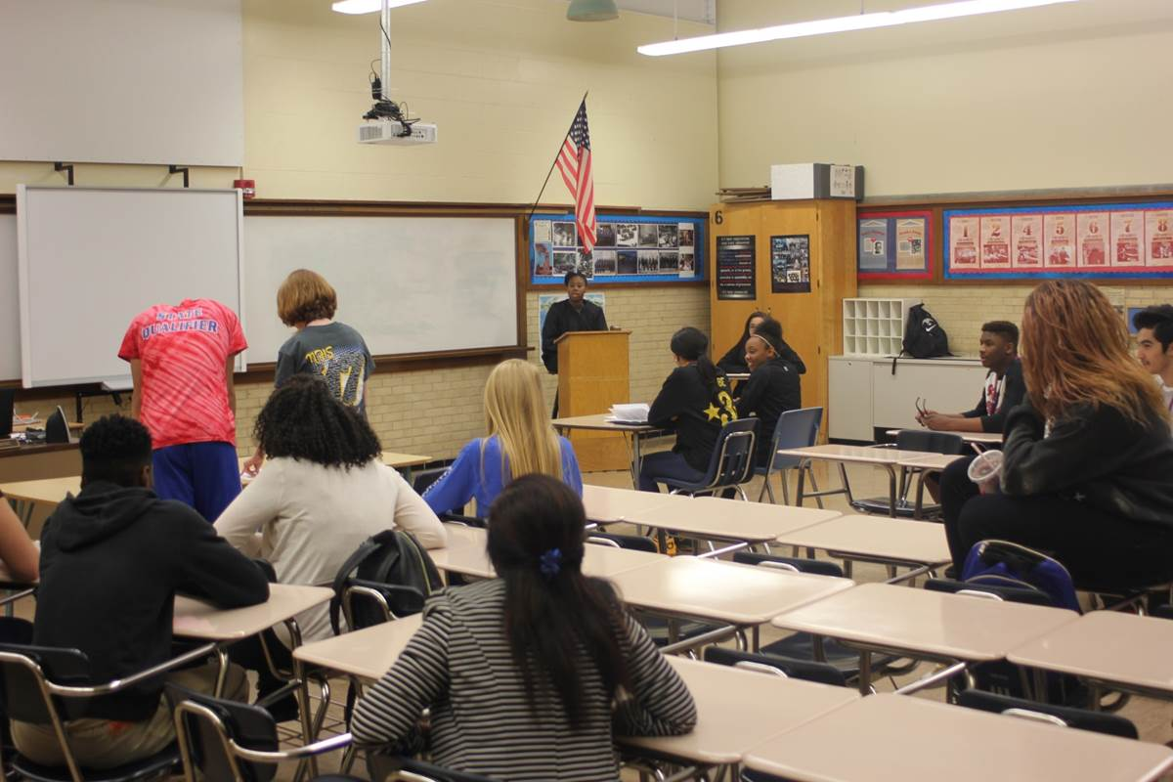
Convicted!
Notes:
The results of the trial, the decision of the Jury is read, the suspect hangs his head down as he is convicted on three counts.

Slide 39
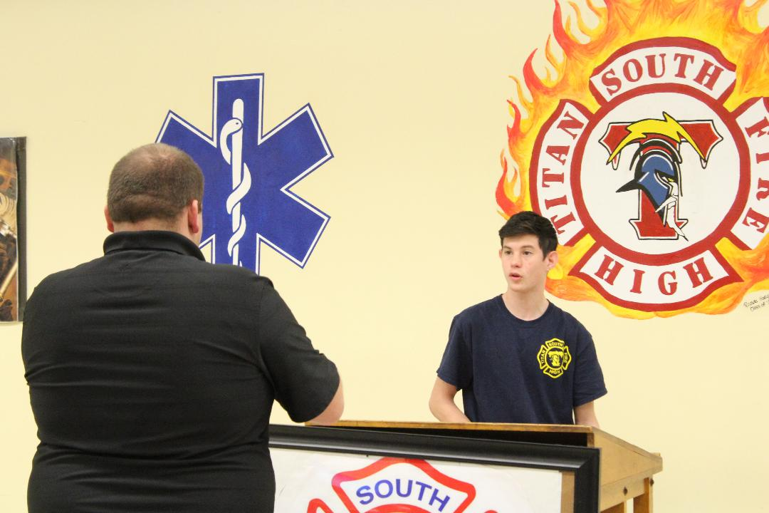
Press Conference
Notes:
The Commander briefs the press on the day’s events.

Slide 40
CSI on FIRE !
Letters of commendation from USD259 Board members
WPS web page / media coverage
Congratulations from Fire chief, Police officers, Principles, and Parents.
Students excited to share their experiences in other classes.
Teachers received the WICOR WIZARD Award!
Time to Celebrate Success
Notes:
Cool things happen at South!! – Principle Cara Ledy
This is crazy amazing cool! Cara, - Communications Director Wendy Johnson
The WICOR WIZARD Award was presented to the teachers in this pathway because this activity made a positive impact on all the students.

Slide 41
In Conclusion
The Pre & Post Survey
The Worksheet for all visiting students
The Props
Questions
New Ideas

