Slide 1
Learning through Internships and Networking with Community Stakeholders (LINCS)

Slide 2
About Us
USD 506 Labette County Schools
5 rural K-8 buildings; 1 central high school
Approximately 500 students in grades 9-12
21 CTE pathways

Slide 3
I3 Project: Inform, Inspire, Ignite
I3 Project: Inform, Inspire, and Ignite
Academic preparation which surpasses the expectations within career and college settings.
Business and Industry partnerships engaging students in skills necessary to thrive in the work environment. Together, LCHS will provide opportunities that inform students about opportunities in business, inspire students to do great things, and ignite students through expert witness.

Slide 4
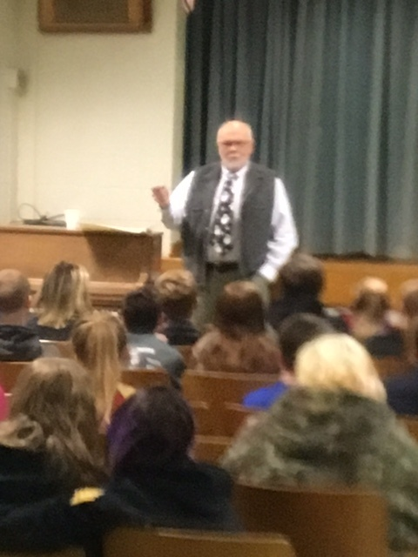
Inform
Job shadowing
Mentoring
Classroom
Facility Tours
Internships

Slide 5
Inspire
Welding Certificate
OSHA 10 Certificate
CNA Certificate
ProStart Certificate
Microsoft Office Specialist Certificate

Slide 6
Ignite
Ignite the spark in individuals to find a meaningful career
Exposure in and outside the classroom in order to focus on career exploration
Understand where student passions exist

Slide 7
2017-18 Program Goals
Hired dedicated Career Advocate position part-time
Build relationships with area businesses
Meet with CTE teachers to establish buy-in for expansion of project
Create accountability and standards for program
Generate student interest and buy-in to program
Increase placement of student interns throughout the community

Slide 8
Lessons Learned
Dedicated staff position not allocated to specific
class schedule can reach more students
Communication between administration, counselors, CTE teachers and businesses
Career Advocate should be facilitator and central point of contact
Internship placement flexibility
not all students or businesses can do 5 days a week or whole semesters
Should not be only a work placement but extension of classroom

Slide 9
Lessons Learned
Accountability for students and process
builds the success of the program
Timesheets, employment skills
Address any potential issues quickly
Dedicated staff position can spot check throughout the year
Student selection by interview with Career Advocate
Reduces loopholes and confusion for placement
Builds relationship between Advocate and students for monitoring purposes

Slide 10
2017-2018 Progress
Second Semester (Jan-May)
32 student placements
CTE tour day planned to visit 6 area businesses
5 speakers organized for spring
Work with counseling staff for placements/
scheduling next year
First Semester (Sept-Dec)
12 student placements
Finance speaker
5 new business partners
30 student interviews
16 placements organized for 2nd semester
Interviews with CTE teachers

