Slide 1
Agricultural Career Pathways
Kansas Foundation for Ag in the Classroom

Slide 2

Journey 2050 Intro
Notes:
Click the PLAY BUTTON to access the video.
https://www.youtube.com/embed/42JEkYvi4cc?rel=0&showinfo=0&autoplay=1

Slide 3
Agricultural Career Pathways
Animal Systems
Biotechnology
Systems
Agribusiness Systems
Environmental
Service Systems
Power, Structure
&
Technical Systems
Food Processing &
Production Systems
Agricultural
Education
Natural Resources
Systems
Plant
Systems

Slide 4

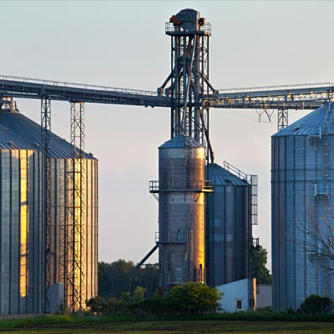
Agricultural Career Pathways
Possible Careers:
  Grain buyer
  Loan officer
  Agricultural journalist
  Equipment sales
  Farm business manager
Agribusiness Systems
https://www.ffanewhorizons.org/2016/03/06/career-overview-agribusiness-systems-jobs/
https://www.agexplorer.com/focus/agribusiness-systems

Slide 5
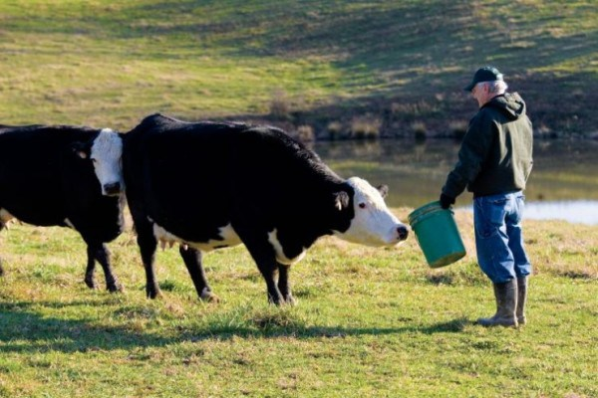
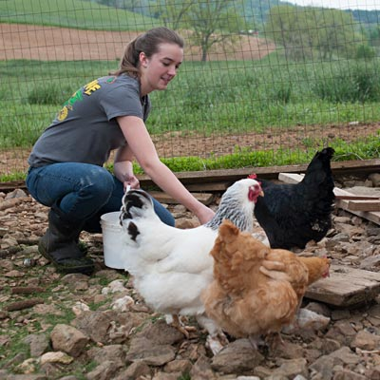
Agricultural Career Pathways
Possible Careers:
  Livestock producer
  Poultry Farm Manager
  Livestock inspector
  Veterinarian
  Zoo animal Specialist
  Equine Rehabilitator
Animal Systems
https://www.ffanewhorizons.org/2016/03/06/career-overview-animal-systems-jobs/
https://www.agexplorer.com/focus/animal-systems

Slide 6


Agricultural Career Pathways
Possible Careers:
  Research Specialist
  Plant biologist
  Military science officer
  Biochemist
  Renewable energy researcher
Biotechnology
Systems
https://www.agexplorer.com/focus/biotechnology-systems

Slide 7


Agricultural Career Pathways
Possible Careers:
  Environmental Engineer
  Landscape architect
  Water quality manager
  Toxicologist
  Recycling coordinator
  Urban Planner
Environmental
Service Systems
https://www.ffanewhorizons.org/2016/03/06/career-overview-environmental-service-systems-jobs/
https://www.agexplorer.com/focus/environmental-service-systems

Slide 8


Agricultural Career Pathways
Possible Careers:
  Food and drug inspector
  Meat scientist
  Dietician
  Development chef
  Quality control specialist
Food Processing &
Production Systems
https://www.ffanewhorizons.org/2016/03/06/career-overview-food-products-and-processing/
https://www.agexplorer.com/focus/food-products-processing-systems

Slide 9

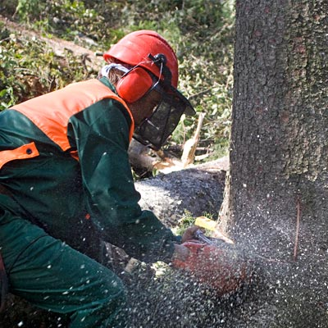
Agricultural Career Pathways
Possible Careers:
  Fish and game officer
  Wildlife biologist
  Geologist
  Forester
  Log grader
  Park manager
  Forester
Natural Resources
Systems
https://www.ffanewhorizons.org/2016/03/06/career-overview-natural-resource-systems/
https://www.agexplorer.com/focus/natural-resources-systems

Slide 10
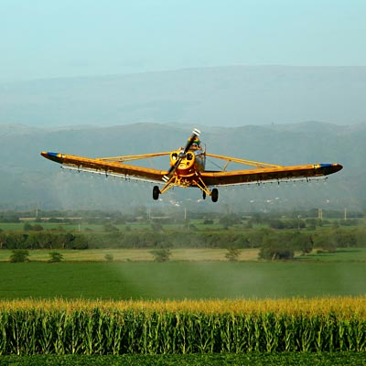
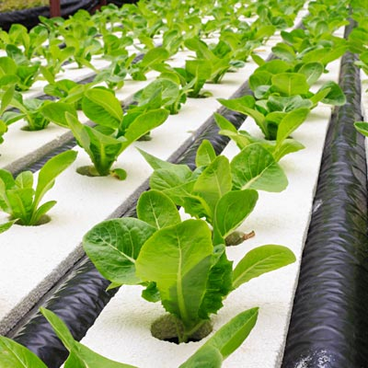
Agricultural Career Pathways
Possible Careers:
  Agronomist
  Farmer
  Plant geneticist
  Seed analyst
  Golf Course manager
  Fruit and vegetable grower
Plant
Systems
https://www.ffanewhorizons.org/2016/03/06/career-overview-plant-systems/
https://www.agexplorer.com/focus/plant-systems

Slide 11
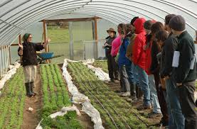
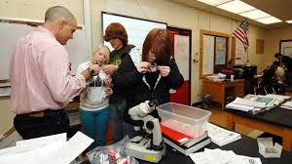
Agricultural Career Pathways
Possible Careers:
  Agriculture Science Teacher
  Extension Faculty
  Bank Loan Officer
  College Recruiter
Agricultural
Education
http://dsiweb.cse.msu.edu/who-we-are/research/education-and-workforce/agricultural-education-and-training-aet-system/
https://www.ffanewhorizons.org/tag/career-pathways/
http://www.uidaho.edu/degree-finder/agricultural-education/ms-ag-ed

Slide 12


Agricultural Career Pathways
Possible Careers:
  Agricultural engineer
  Diesel technician
  Land surveyor
  Contractor/builder
  Welder
Power, Structure
&
Technical Systems
https://www.ffanewhorizons.org/2016/03/06/career-overview-power-structural-and-technical-systems/
https://www.agexplorer.com/focus/power-structural-technical-systems

Slide 13
Online Career Resources

Slide 14
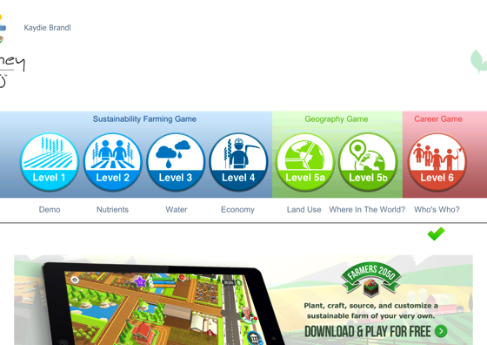
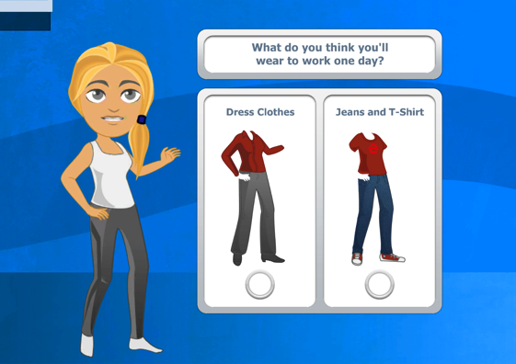
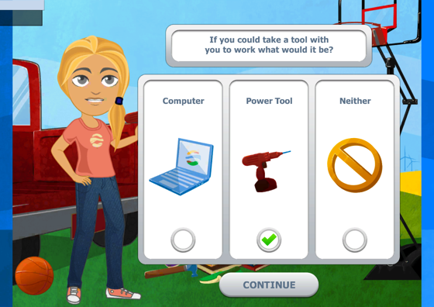
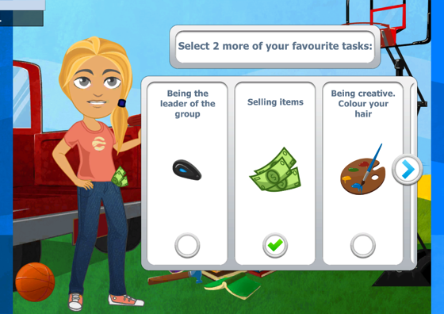
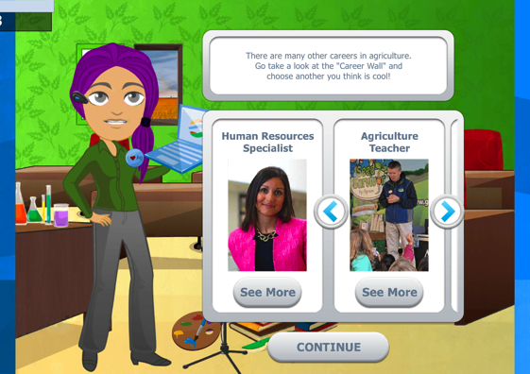
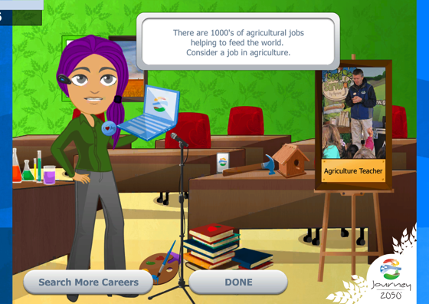
Journey 2050
Journey 2050 is a game developed to teach users about the importance of food security and the role agriculture plays in sustaining growing population. The sixth level allows users to create a character and choose an agricultural related career.

Slide 15
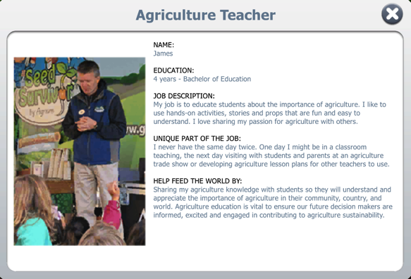
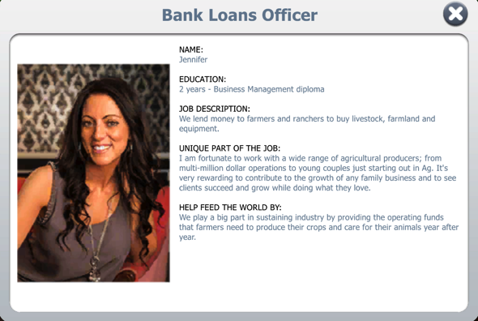
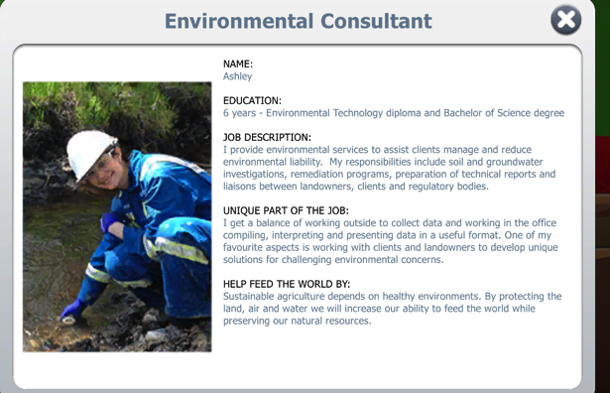
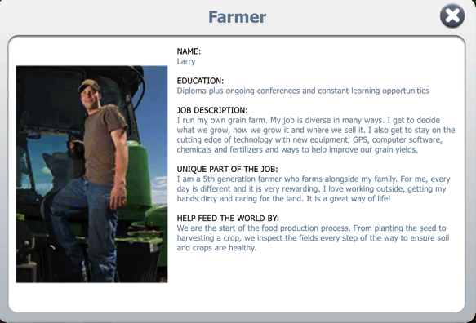
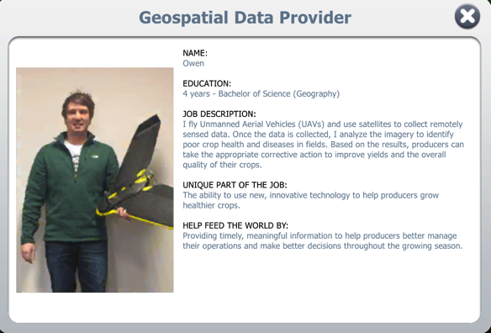
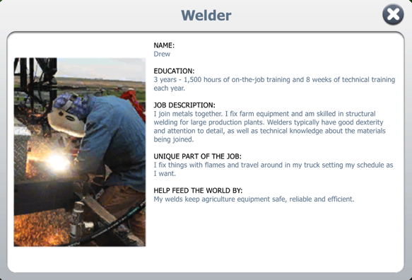
Journey 2050 Careers
After playing level six, users are assigned an agricultural career based on their choices. Users learn about the different aspects of the career, such as education required, unique aspects, and how that career helps feed the world. The game can be found here.
Notes:
Click HERE to access website with game.
http://www.journey2050.com/play-the-game/

Slide 16
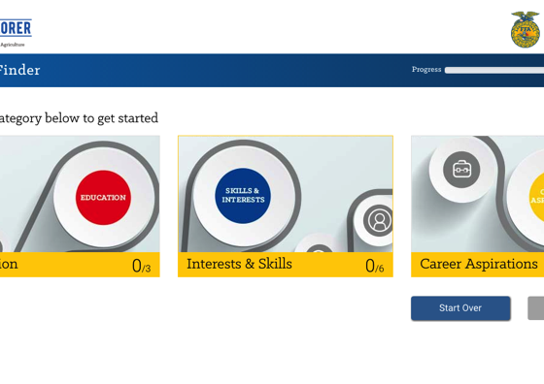
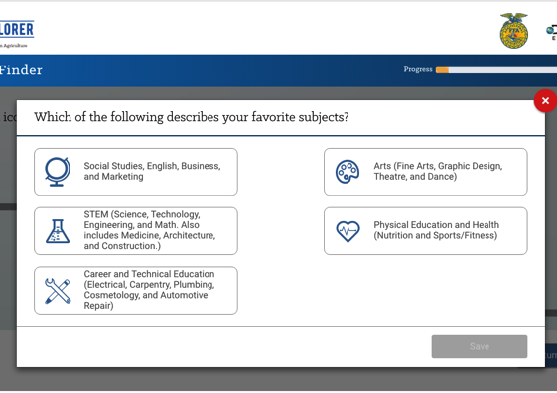
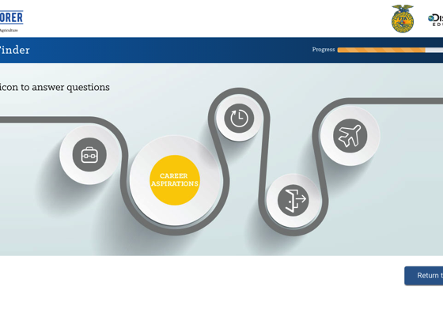
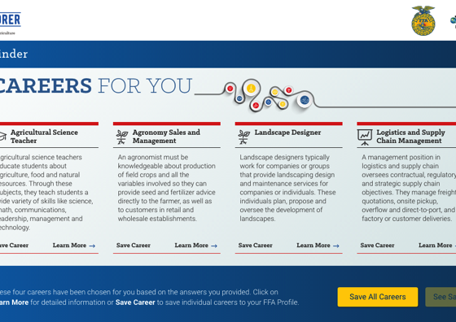
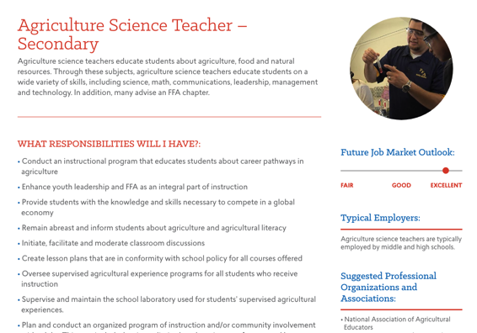
Ag Explorer
Ag Explorer is an interactive personality quiz that allows users to enter information and matches them with agricultural careers. The website can be accessed at https://www.agexplorer.com/
Notes:
NOTE: the link on the powerpoint does not work. Must copy and paste
https://www.agexplorer.com/

Slide 17
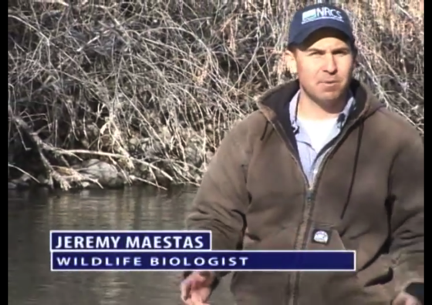
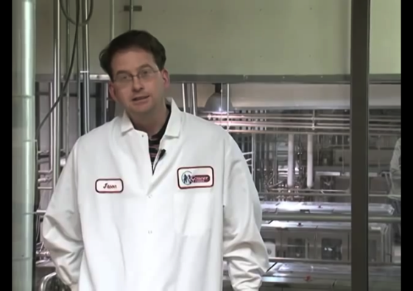
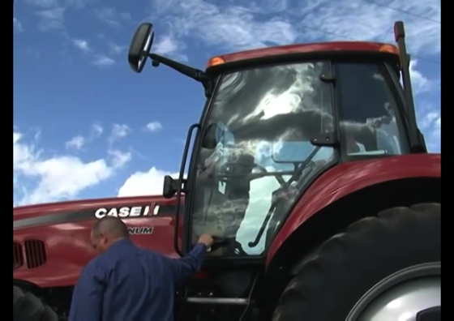
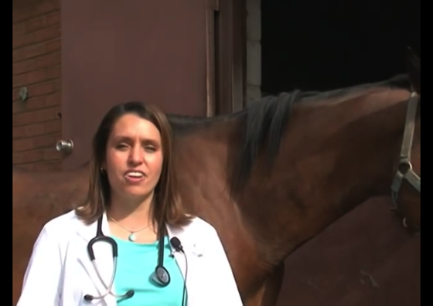
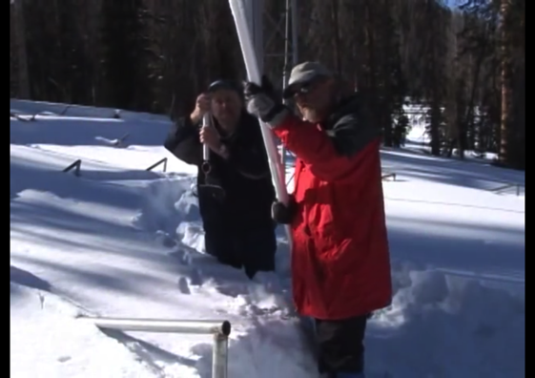
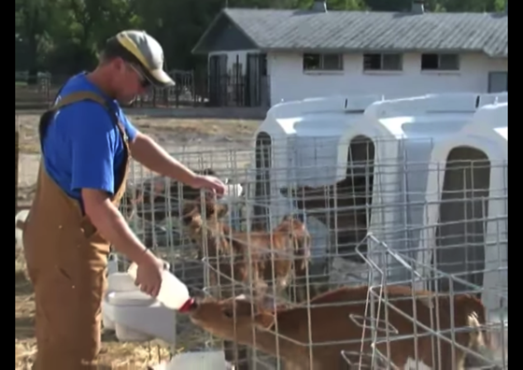
Career Videos
Utah Ag in the Classroom put together this playlist that has over 40 short videos about agricultural related careers. Utah AITC put together a companion presentation that can be found here.
Notes:
Click PLAYLIST to get to the YouTube playlist. https://www.youtube.com/playlist?list=PL7B61381EE0438243
Click HERE to get to the companion presentation. https://prezi.com/ig-vmusw2rrc/agricultural-careers/

Slide 18

Sources:
https://www.agexplorer.com/
https://www.agexplorer.com/focus/agribusiness-systems
https://www.agexplorer.com/focus/animal-systems
https://www.agexplorer.com/focus/biotechnology-systems
https://www.agexplorer.com/focus/environmental-service-systems
https://www.agexplorer.com/focus/food-products-processing-systems
https://www.agexplorer.com/focus/natural-resources-systems
https://www.agexplorer.com/focus/plant-systems
http://dsiweb.cse.msu.edu/who-we-are/research/education-and-workforce/agricultural-education-and-training-aet-system/
https://www.ffanewhorizons.org/tag/career-pathways/
http://www.uidaho.edu/degree-finder/agricultural-education/ms-ag-ed
https://www.agexplorer.com/focus/power-structural-technical-systems
http://www.journey2050.com/play-the-game
https://prezi.com/ig-vmusw2rrc/agricultural-careers/
https://www.youtube.com/playlist?list=PL7B61381EE0438243
https://www.ffanewhorizons.org/2016/03/06/career-overview-agribusiness-systems-jobs/
https://www.ffanewhorizons.org/2016/03/06/career-overview-animal-systems-jobs/
https://www.ffanewhorizons.org/2016/03/06/career-overview-environmental-service-systems-jobs/
https://www.ffanewhorizons.org/2016/03/06/career-overview-food-products-and-processing/
https://www.ffanewhorizons.org/2016/03/06/career-overview-natural-resource-systems/
https://www.ffanewhorizons.org/2016/03/06/career-overview-plant-systems/
https://www.ffanewhorizons.org/2016/03/06/career-overview-power-structural-and-technical-systems/

