Slide 1

Multimedia
We want it, but we are not sure what “it” actually is.
John Decker – Flint Hills Technical College
Notes:
Multimedia image retrieved on February 5, 2018 from https://www.youth.gov.hk/en/career-and-study/it/multimedia-content.htm

Slide 2

Examples of
Rich-Media Experiences
Notes:
Rich media image retrieved on February 5, 2018 from https://eclick.vn/eblog/advertising/what-is-rich-media-really-54.html

Slide 3

This is not your grandfathers Newspaper
Kansas City Star
Use of video and animation
Emporia Gazette
Page devoted to “multimedia”
Notes:
Newspapers image retrieved February 5, 2018 from htthttp://www.chicagonow.com/candid-candace/2016/02/chicago-tribune-sun-times-and-crains-leaders-on-the-future-of-print-media/

Slide 4
Radio, it’s not just on the radio
KVOE – Emporia
Video section on home page
Live broadcast more than just audio
V-100 - Topeka
Photos scrolling at top
Video at bottom of home page
How do you listen to music?
Is multimedia involved?

Slide 5


Traditional book vs E-Book
Better Homes & Gardens
Look and Cook
Notes:
Better Homes and Gardens New Cook Book image retrieved February 5, 2018 from https://www.amazon.com/Better-Homes-Gardens-Cook-Book/dp/0544307070/ref=sr_1_12?ie=UTF8&qid=1517847668&sr=8-12&keywords=Cookbook
Look and Cook image retrieved February 5, 2018 from https://www.youtube.com/watch?v=OICcMiO3_S0
Better Homes and Gardens New Cook Book
1000 color photos
Look and Cook
Interactivity
Video/Audio Instructions
Runs on Mobile devices

Slide 6
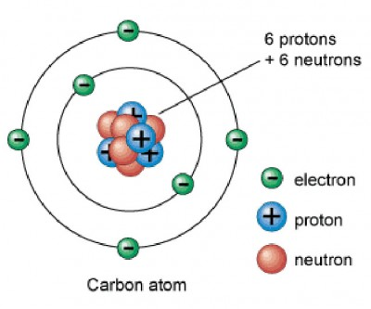
Instructional
Animations
Wealth and
Inequality in America
Adds visual interest
Impactful
Does not matter if you agree
with information or not
Oxygen Atom
Better representation of how electrons move than a normal textbook illustration
Thrust Bearing
Online delivery with a piece of equipment that could not be shared otherwise
Notes:
Oxygen Atom image retrieved February 5, 2018 from https://socratic.org/questions/what-makes-an-oxygen-atom-different-from-a-carbon-atom-a-a-the-number-of-neutron

Slide 7


Interaction
IMD 180O M4
Lesson 6 Part 1 Review
  Adobe Captivate
  Interaction
  Non-linear
  Force completion
  Quiz reporting
  HTML5 vs SWF
Camtasia
Has anyone used this?
Limitations?
Notes:
IMD180O M4 Lesson 6 Part 1 Review is only available with access to the Moodle course taught at FHTC.
Adobe Captivate icon retrieved on February 5, 2018 from https://www.brandeps.com/logo/A/Adobe-Captivate-01
Camtasia icon retrieved February 5, 2018 from https://blogs.library.ucsf.edu/convergence/2017/10/26/goodbye-articulate-studio-hello-camtasia/

Slide 8


Instructional Videos
Install Prefinished Hardwood Floors
Canon C100 Overview / lynda.com
Notes:
YouTube icon retrieved on February 5, 2018 from https://www.iconfinder.com/icons/317714/video_youtube_icon#size=256
Lynda.com logo retrieved on February 5, 2018 from http://www.westlakelibrary.org/?q=node/4434
YouTube is an excellent resource, but must sort through good and bad
How many bad or incorrect instructional videos have you watched?
Fix my car, install hardwood floor, plumbing, anything DIY
How to install a prefinished hardwood floor
Individual: https://www.youtube.com/watch?v=lbiP7rts1Sk
Lowes: https://www.youtube.com/watch?v=ikx7I8mlVxI
Teachers can create their own:
I have created over 300 instructional videos on a variety of topics.
IMD 131 Rendering – ART Renderer Settings
https://www.youtube.com/watch?v=Mbr-u8vzTOI
Buy:
Infinite Skills example: https://www.amazon.com/Learning-Autodesk-3ds-Max-2015/dp/B00LXDUUSU/ref=sr_1_1?ie=UTF8&qid=1517596559&sr=8-1&keywords=infinite+skills+Learning+Autodesk+3ds+Max
Lynda.com example: https://www.youtube.com/watch?v=HPxPQxJLGHc

Slide 9

Podcasts/vodcasts
NPR Podcast directory
Apple Podcast Resources
Notes:
Podcast/Vodcast logo retrieved on February 5, 2018 from https://itunes.apple.com/us/app/podcasts/id525463029?mt=8
NPR Podcast Directory retrieved on February 5, 2018 from https://www.npr.org/podcasts/
Apple Podcast Resources retrieved on February 5, 2018 from https://www.apple.com/itunes/podcasts/
Pod/Vod casts
Who listens to podcasts?
Almost any topic you can think of

Slide 10



Marketing
Touching the Sun
John Shocklee
A Fairy Tale
24 Hours in LA
Notes:
Redington logo retrieved on February 5, 2018 from http://www.sugarcreekflyshop.com/brands/redington-fly-fishing.html
Salsa logo retrieved on February 5, 2018 from http://www.krakatoabikes.net/index.php?cPath=63
Yeti logo retrieved on February 5, 2018 from https://www.mastgeneralstore.com/brand/yeti
Redington
24 Hours in LA
https://www.redington.com/experience/videos
Expanding market
Salsa
Touching the Sun
https://vimeo.com/243666925
How our product will change your life
Storytelling
Bikepacking.com
Explore > Inspiration > Videos
http://www.bikepacking.com/plog/video/
Helps promote a new, expanding market
Storytelling
Yeti
Yeti Presents: John Shocklee / A Fairy Tale
https://www.youtube.com/watch?v=6Wn9umlQMbU&index=12&list=PLT6IyUkzp1o2G2YHBFRsUDP_NLg_jh3QV
Doesn’t show product very much (Less than 10-15 seconds in 7 minute video.
Storytelling
Tree Service
Wellnitz Tree Roots Expose
https://www.youtube.com/watch?v=OPl39l9bxtM
Help explain process to customer
Use in middle of commercial

Slide 11
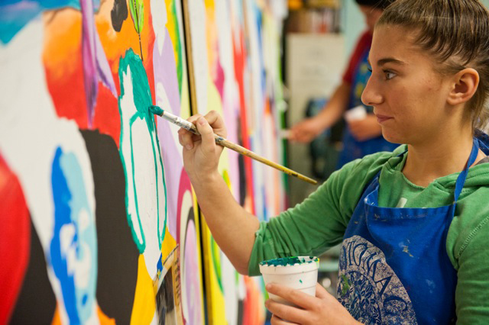
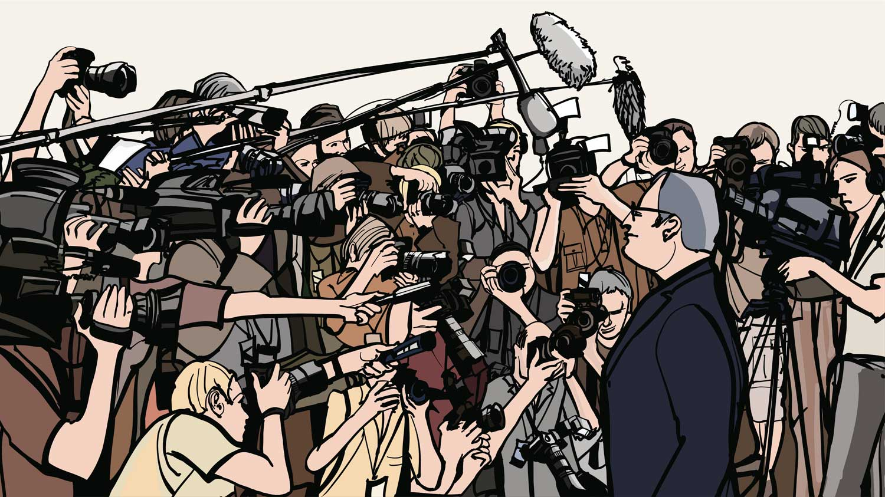

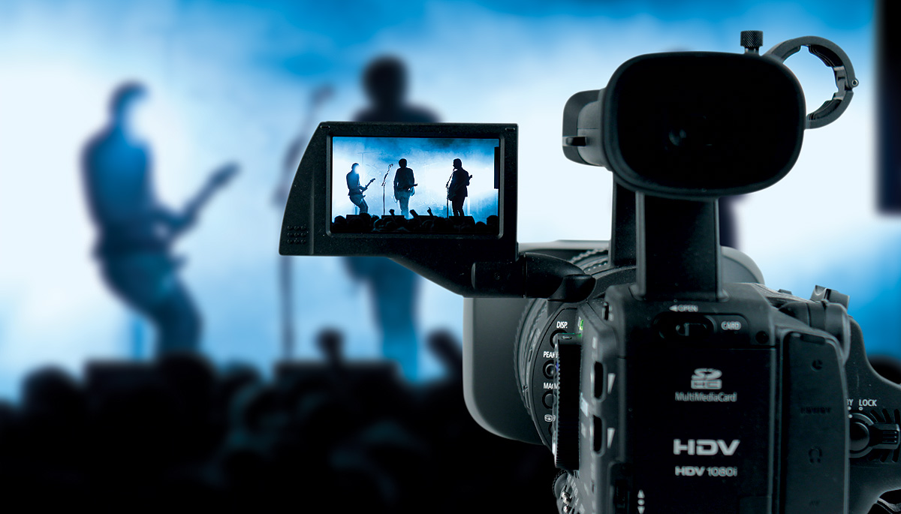




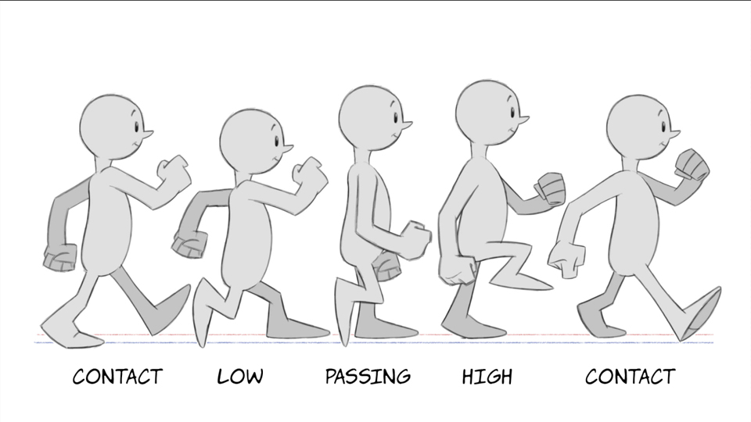

What type of student may be interested in Multimedia?
Notes:
Student painting image retrieved on February 5, 2018 from http://www.tundevisualart.com/classes.php
Graphic Design image retrieved on February 5, 2018 from http://www.stl-horizon.com/graphic-designer/
Video image retrieved on February 5, 2018 from http://www.viralblog.com/viral-social-videos/10-examples-how-to-create-winning-pitches-using-video/
Animation image retrieved on February 5, 2018 from https://www.lynda.com/Animation-tutorials/2D-Animation-Walk-Cycles-Basics/434462-2.html
Creative image retrieved on February 5, 2018 from http://www.coolbusinessideas.com/archives/5-cool-ways-creative-talent-can-help-you-market-your-business/
Teaching image retrieved on February 5, 2018 from https://www.marcodegroen.com/impact-of-multimedia-in-education-for-children-with-special-needs/
Creative writing image retrieved on February 5, 2018 from https://www.udemy.com/get-writing-keep-writing/
Journalism image retrieved on February 5, 2018 from http://campusdrift.com/du-journalism-courses-admission/
Storytelling image retrieved on February 5, 2018 from http://clifonline.org/7-uniquely-fun-storytelling-activities-to-do-with-kids/
Problem solving image retrieved on February 5, 2018 from https://innovateuk.blog.gov.uk/2017/07/10/cross-sector-collaboration-is-essential-to-solving-innovation-problems/

Slide 12
Authoring Tools
Notes:
Rich media image retrieved on February 5, 2018 from https://eclick.vn/eblog/advertising/what-is-rich-media-really-54.html

Slide 13
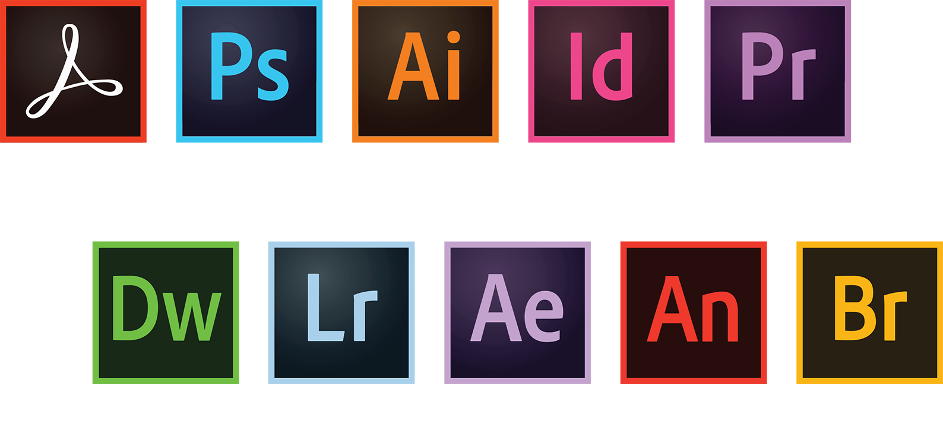
Adobe CC
What is Creative Cloud?
Notes:
Adobe CC icons retrieved on February 5, 2018 from https://www.it.miami.edu/a-z-listing/adobe-creative-cloud/index.html
What is Creative Cloud? https://www.adobe.com/creativecloud.html?promoid=NGWGRLB2&mv=other

Slide 14



Animation
55 Best Animation Software (2017)
Notes:
3D:
Autodesk 3ds Max
Autodesk Maya
Cinema 4D
Blender
2D Animation:
Adobe Animate
Adobe After Effects
55 Best Animation Software: The Ultimate List 2017 retrieved on February 5, 2018 from https://www.renderforest.com/blog/best-animation-software
Adobe Animate icon retrieved on February 5, 2018 from https://www.renderforest.com/blog/best-animation-software
Adobe After Effects icon retrieved on February 5, 2018 from https://commons.wikimedia.org/wiki/File:Adobe_After_Effects_CS6_Icon.png
3ds Max icon retrieved on February 5, 2018 from https://www.gfxmag.com/3ds-max-icon-vector-logo/

Slide 15



Video
The Best Video Editing Software of 2018
Notes:
Adobe Premiere icon retrieved on February 5, 2018 from https://commons.wikimedia.org/wiki/File:Adobe_Premiere_Pro_CS6_Icon.png
Sony Vegas icon retrieved on February 5, 2018 from http://logos.wikia.com/wiki/File:Sony_Vegas_Pro_12_Icon.png
Final Cut Pro icon retrieved on February 5, 2018 from https://www.uplabs.com/posts/final-cut-pro-mac-icon
The Best Video Editing Software of 2018 retrieved February 5, 2018 from https://www.pcmag.com/article2/0,2817,2397215,00.asp

Slide 16

Instructional Design
Notes:
Adobe Captivate icon retrieved on February 5, 2018 from https://www.brandeps.com/logo/A/Adobe-Captivate-01
Articulate Storyline icon retrieved on February 5, 2018 from http://elearningbrothers.com/event/5-must-know-features-articulate-storyline-2/
Camtasia icon retrieved February 5, 2018 from https://blogs.library.ucsf.edu/convergence/2017/10/26/goodbye-articulate-studio-hello-camtasia/

Slide 17
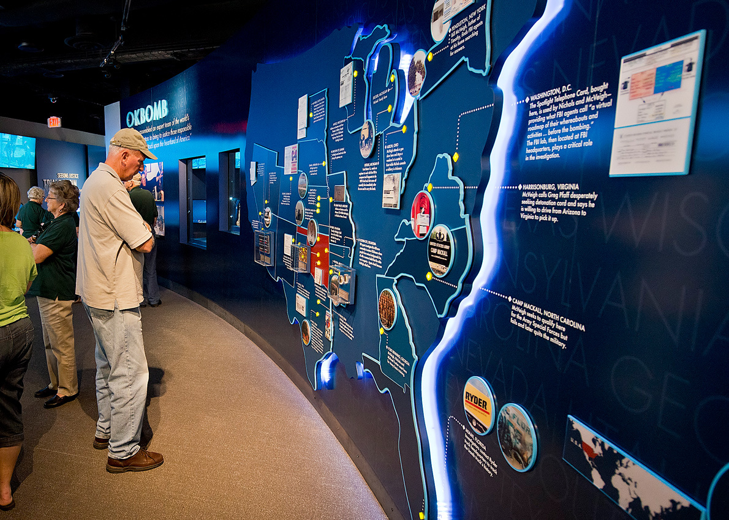


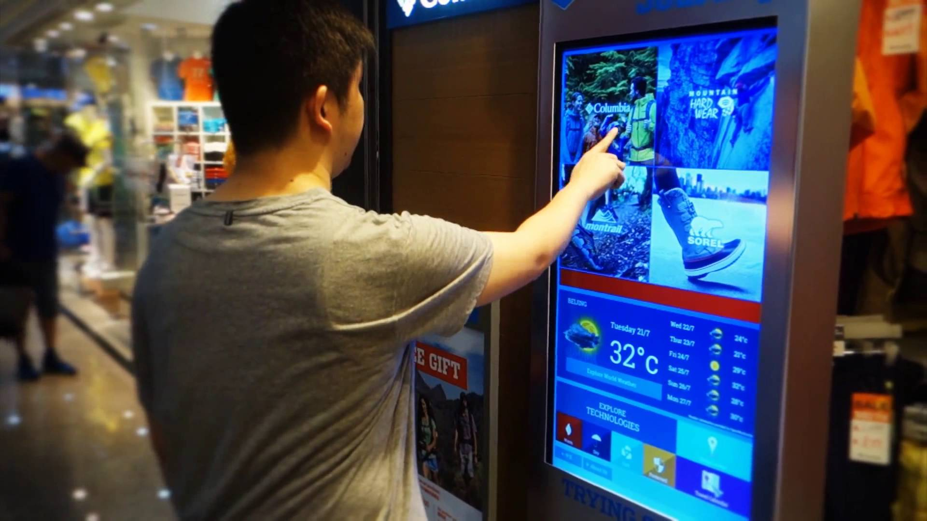
Delivery Methods
Fixed vs Mobile Devices
Notes:
Internet image retrieved on February 5, 2018 from https://www.missoulacurrent.com/government/2017/1
Digital Kiosk image retrieved on February 5, 2018 from https://www.youtube.com/watch?v=eYJYX2qlWpo
Oklahoma City Memorial image retrieved on February 5, 2018 from http://www.benham.com/portfolio/oklahoma-city-memorial-museum
Virtual Reality image retrieved on February 5, 2018 from https://wonderopolis.org/wonder/what-is-virtual-reality
Internet/website (speed increases)
Fixed vs Mobile Devices:
Mobile Marketing Statistics compilation
https://www.smartinsights.com/mobile-marketing/mobile-marketing-analytics/mobile-marketing-statistics/
Digital kiosks
Have you been to a museum in a large city recently?
MOMA
9/11 Museum
Oklahoma City Memorial
Boardroom example
Digital billboards
Virtual Reality
DVD
New ways being developed all of the time.

Slide 18
Educational Opportunities

Slide 19


For more information
Notes:
FHTC Interactive Multimedia Design
F2F and Online
Start as a Junior in HS
Working on 2+2 programs with ESU’s Graphic Design program and Wichita State’s Media Arts program.

Slide 20
Employment Opportunities
Marketing
Education
Entertainment
Journalism
Notes:
Marketing
Educational
Entertainment
Journalism
Bigger towns = more opportunities/money
In Emporia (24,000): ESU Marketing, ESU IT, ESU Athletics, IM Design Group, Hopkins Manufacturing, Glendo, USD 253, Radio Station, Emporia Gazette
Many opportunities for small business/non-profit (i.e. Emporia Main Street, Dirty Kanza Promotions, Emporia Farmer’s Market, United Way, Lyon County Historical Society, Crosswinds, FHTC, and many more)

Slide 21
Questions?
Notes:
Rich media image retrieved on February 5, 2018 from https://eclick.vn/eblog/advertising/what-is-rich-media-really-54.html

