Slide 1
Implementing Authentic Accountability Systems within the Classroom
Anthony Meals - Agricultural Educator at
Blue Valley
Dr. Sally Olson - Kansas State University Comparative Medicine Group

Slide 2
Authentic Accountability??
Key Questions:
How do we prepare students for the real world of work?
How do we instill a sense of work ethic and responsibility in a way that is measurable and trackable?
How do we help students become self-aware of the importance of their personal responsibility and help hold them accountable to that responsibility?
Not easy questions to answer!!
Notes:
Anthony sets context...

Slide 3
Animal Science Audit System
A system used in Animal Science class to create student accountability for the care of animals in our agricultural education program.
Developed in conjunction with Dr. Olson as our community partner, who also served on our Advisory Committee.
Modeled to a similar system used at K-State University.
Notes:
Anthony gives an explanation on how the project came to be...

Slide 4
Work Session #1 - Identify Program Aspect
We each work in a CTE environment that would be conducive to this type of approach with students.
Take 5-10 minutes to brainstorm on your workshop guide about what aspects of your program would you use with an accountability system? Also identify a possible community partner you could work with.
We will allow for share time at the conclusion of the brainstorm.
Notes:
Anthony facilitates the 1st work session...

Slide 5
Structure of the Animal Science Audit System
A system built on Standard Operating Procedures (SOPs).
Why SOPs and how we use them.
Students take the first unit to identify basic SOPs in regards to the care of animals.
Notes:
Sally will explain the concept and importance of SOP and why it should used in the regular language of a CTE program.

Slide 6
Components of Audit System
Daily Records and Care Logs
Self-Audits
Peer Audits
Unannounced Visitation Audit
Notes:
Sally goes further in-depth in how we have the audit system structured...Anthony will add the timing pieces to when we conduct each form of audit.

Slide 7
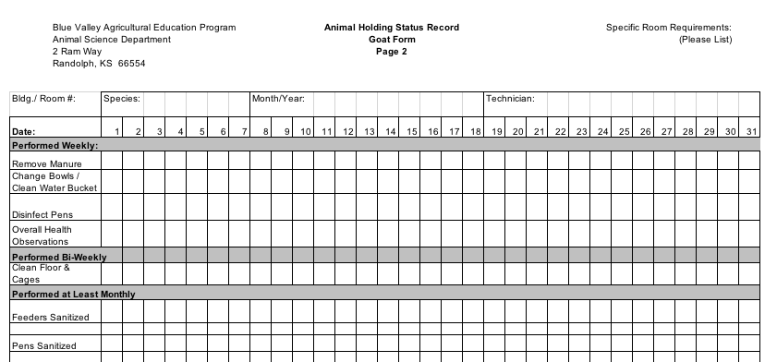
Sample Care Log
Notes:
Sally will explain how she helped facilitate the selection of SOPs and how the care log works...

Slide 8
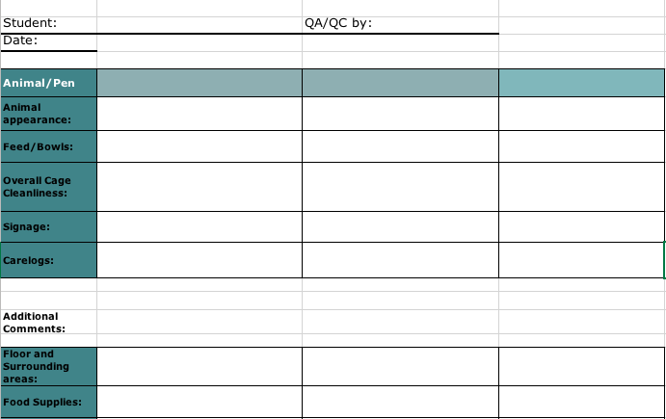
Sample Quality Control Form
Notes:
Sally can explain the utilization of the Quality control form...

Slide 9
Work Session #2 - Creating System Structure
Using our case study as a guide take some time to brainstorm about how you might be able to structure an audit system in your classroom? Let’s take 15 minutes to brainstorm and share our thoughts.
Questions to consider:
How will students determine what SOPs to audit?
How often will you use each form of audit?
How will this become reflected in their grades?
How will you gain buy-in to the system from students, parents, and admins?
Notes:
Sally will facilitate this work session...

Slide 10
Our Results ---
1st Semester Trial -- Spring 2017
Student Push-back
Work Ethic is a crock pot not a microwave…
Partial audit system used
2nd Semester Trial -- Fall 2017
Change in language
Establishment of routine
Full audit system used
Notes:
Anthony will explain the results thus far and how it compared...

Slide 11
Next Steps for Audit System
Create a rating system that can be posted above student care logs based on peer and unannounced audit scores.
Students who earn consistent high quality ratings throughout the semester will receive a small Animal Science Scholarship at Chapter Banquet.
An Animal Science Manager (especially after construction of new facility).
Notes:
Anthony will explain the next steps in the audit program...

Slide 12
Work Session #3 - Audit System Evaluation
Using our case study as a guide take some time to brainstorm about how you might evaluate your audit program? Let’s take 5 -10 minutes to brainstorm and share our thoughts.
Questions to consider:
What will a successful implementation of my audit system look like in the classroom?
What qualitative and/or quantitative measures could I collect to determine the system’s efficacy?
How will I determine what steps I need to take next?
Notes:
Anthony and Sally will facilitate this work session and participants will be able to share their work with the group.

